Slide 1
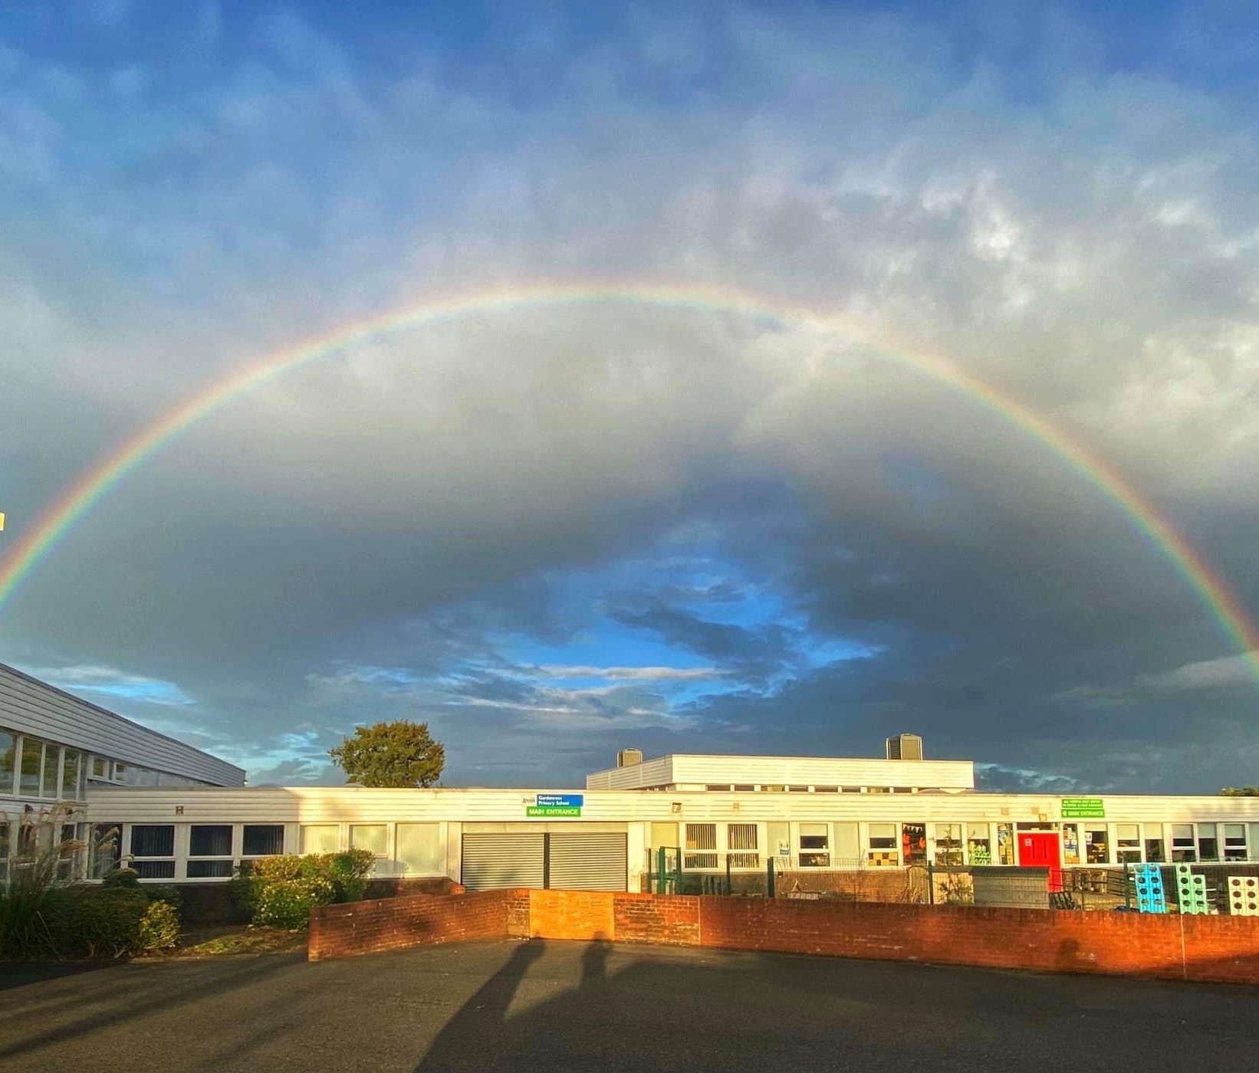
Primary 7
Week beginning
2nd November 2020
Miss Caldwell

Slide 2
Weekly Timetable
Monday | 9:00am – BOYS ONLY address tae lassies 9:30am – GIRLS ONLY Reply tae lads Maths Burns Supper budgeting activity | Lili & Jack – chairperson live Burns reading comprehension | Spelling (GL words in files on teams) | 1pm: Ms Ryding’s group live lesson with Mrs Briggs Work independently on your Robert Burns ‘immortal memory’ project/learn Auld Lang Syne & Caledonia.
Tuesday | 9:00am – Live lesson 9:30am - Maths | 11:00am – Live Lesson 11:30 – T4W | Spelling (GL words in files on teams) | 1pm: Ms Ryding’s group live lesson with Mrs Briggs 1:30pm – make up your own fitness workout to complete.
Wednesday | Miss Caldwell in school so not on teams. 9:30am - Maths | Miss Caldwell in school so not on teams. 11:30 – T4W | Spelling (GL words in files on teams) | 1pm: Ms Ryding’s group live lesson with Mrs Briggs Miss Caldwell in school so not on teams. Robert Burns Immortal Memory & Learn Poems
Thursday | Mrs Briggs | Mrs Briggs |  | 1:00pm – Live Lesson + Video Recording 1:30pm – Reading Task
Friday | STEM challenge – make your own Robert Burns cottage junk model/minecraft/diagram | 11:00am – Live Burns Supper |  | 1:00pm – Live Fun 31 games | PE – complete your fitness workout that you created on Tuesday afternoon

Slide 3
IMPORTANT
Throughout the day on Monday, Miss Caldwell will be going live to hear you say your poems individually.

Slide 4
Number Talks

Slide 5
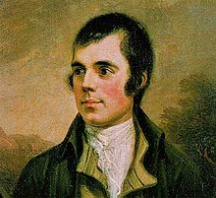
NUMERACY & MATHS –
Money & Budgeting
Task Board
You have been set a challenge to plan your own Burns Supper! You have a budget of £100. You must search online retailers and note down the shop/website, item & price. Things you MUST buy. (You must have enough to serve 50 people) Haggis Potatoes Turnip Dessert Irn Bru Decorations Table cloths Napkins Vegetarian option (for minimum of 10 of your 50 guests) Shortbread Anything else you can think of.
LI: to use budgeting skills.

Slide 6
Literacy - Comprehension
Monday 25th January 2021
LI: to use comprehension strategies to answer questions relating to a text.
Task Board
Read the passage on the following slide. Complete the Blooms comprehension questions. Use full sentences to answer the question. Choose AT LEAST one question per category. To challenge yourself you can complete 2 or 3… I would love to see this! Send me your work ☺

Slide 7
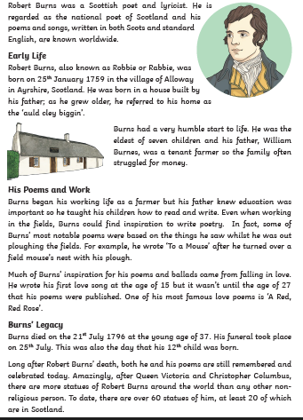
Literacy – Comprehension
Monday 25th January 2021
LI: to use comprehension strategies to answer questions relating to a text.

Slide 8
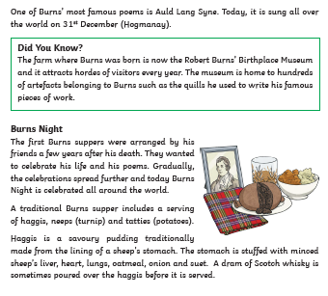
Literacy - Comprehension
Monday 25th January 2021
LI: to use comprehension strategies to answer questions relating to a text.

Slide 9




Literacy - Comprehension
Monday 25th January 2021
LI: to use comprehension strategies to answer questions relating to a text.

Slide 10


Literacy - Comprehension
Monday 25th January 2021
LI: to use comprehension strategies to answer questions relating to a text.

Slide 11
Scotland Topic - Burns
Monday 25th January 2021
LI: to learn the life and works of Robert Burns.
Task Board
1. Complete the literacy task if you have not yet completed all questions. 2. Continue working on your Robert Burns ‘Immortal Memory’ project. See next slide for success criteria. 3. Practice Auld Lang Syne & Caledonia. 4. Create your own tartan name label for our virtual Burns supper on Friday.

Slide 12
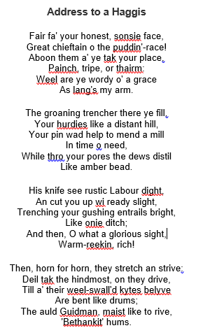
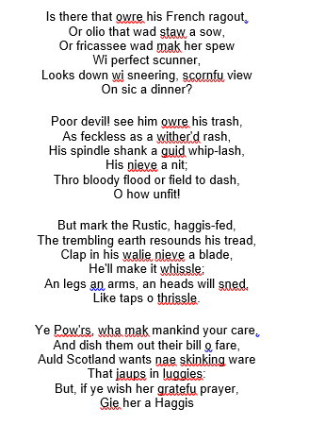
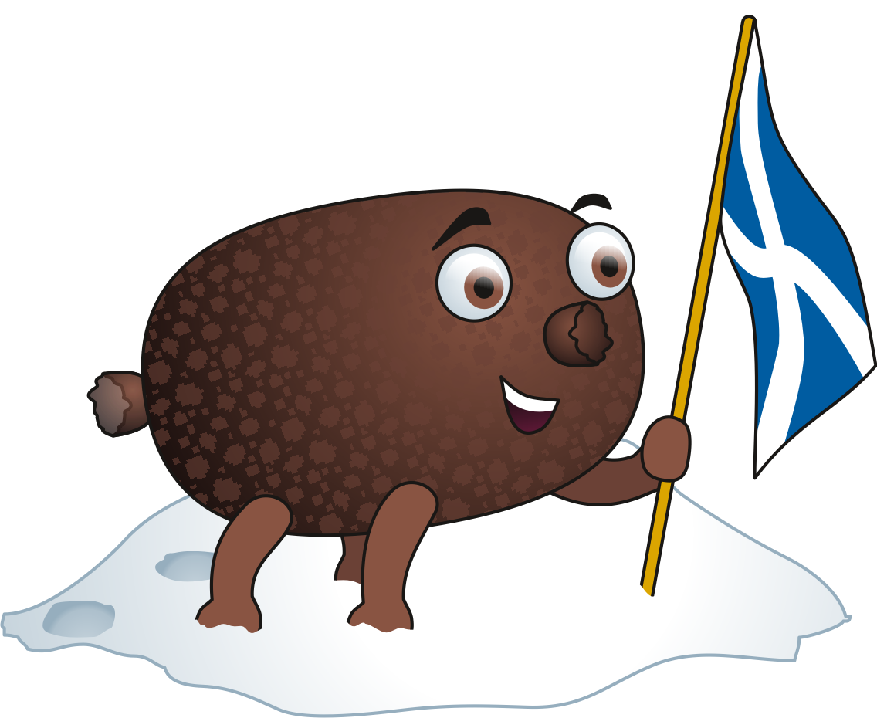
Address Tae A Haggis
Learn these by Monday 25th.

Slide 13
Scotland Topic - Burns
Monday 25th January 2021
LI: to learn the life and works of Robert Burns.
Due Friday 29th January
LI: to research and present information on the life, works and impact of Robert Burns.
SC: You must include –
Information on Robert Burns and his life (facts, age, birthday, death, schooling, job, lives etc).
Information on Robert Burns’ works (poems, songs etc – what was the influence for them, what do they mean?)
Examples of poems/songs.
Impact Robert Burns has on Scottish culture today (how do we remember Burns, celebrate his life and works etc)
Impact Robert Burns has on the rest of the world today (statues/songs sung etc).
Pictures/photos
Include some examples of Scots language.
Appropriately written using writing skills.

Slide 14
Number Talks

Slide 15
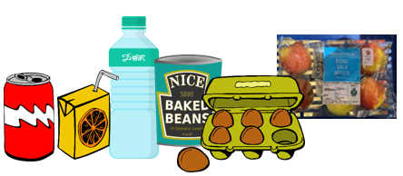
MATHS –
Weight
LI: to use knowledge of familiar objects to estimate weight.
Task Board
Live Lesson – measuring in grams and kilograms. Go into your kitchen and look on the packaging of different foods in your cupboards/fridge/freezer. Note down the item and it’s weight. Find other items in your house that DON’T have their weight written on them. Try to find objects which you ESTIMATE would be around the same weight as the items you found in your kitchen.

Slide 16
Talk 4 Writing
Tuesday 26th January 2021
LI: to plan & write a hot piece Monster text.
Task Board
Live Lesson Read or listen to the model text (see next slide or listen here: https://soundcloud.com/talkforwriting/swamp/s-28ED2KJCK6n Complete the plan on the next slide with as many details as you can. (on the slide after the model text) Write your hot piece! Include everything you have learned – formal language, ambitious technical vocabulary, a diagram of your monster, topic sentences, clear paragraphs.

Slide 17
Part 1
Swamp Monsters
Do you ever wonder what might be lurking in the murky swamps of
our world? Rumour has it that the fabled swamp monster is not
just a creature mentioned in myth and legend but it actually
exists! Now is your chance to find out all that has been discovered
about this unique being.
Swamp monsters are rumoured to inhabit the most remote and
humid swamps of the Amazon rainforest. Living in total solitude, it is
believed that there is, perhaps, only one swamp monster on our
planet, making it a mystery how they reproduce. Dr Patrick Thurston
- world renowned monsterologist from Bristol University - could
perhaps be the only living person ever to see this magnificent
creature: “You cannot believe the pure majesty of the swamp
monster. They seem as if they are ‘one with the swamp’ living in pure
harmony with their habitat.”
.

Slide 18
Part 2
Swamp monsters don’t just live in swamps they resemble them.
Being experts in camouflage, they are indistinguishable from their
environment. Their bodies are made from this environment: limbs
of gnarled branches, incredibly long fingers and glowing, iridescent
hair which changes colour to match their mood. The most
incredible thing about a swamp monster is that they have
translucent breathing tubes meaning they can stay underwater
indefinitely but continue to breathe.
Have you ever wondered what a swamp monster eats? Their diet
consists of herons, rats and even alligators which they hypnotise
with their ever-staring, haunting eyes. Transfixed, any animal is
helpless to the swamp monster who squeezes the life from them
with its lean, powerful limbs. The swamp monster’s tongue has the
ability to taste the air; this allows it to identify when its prey is
close by.
If you are now tempted to try and spot a swamp monster, we advise
extreme caution! This beautiful but deadly creature should be left in
solitude to be studied only by experts trained in monsterology.

Slide 19
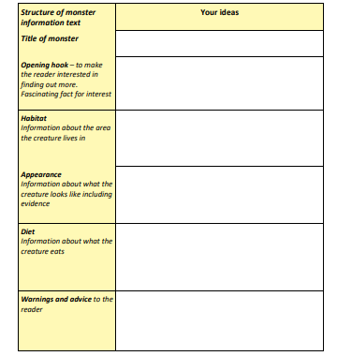

Task

Slide 20
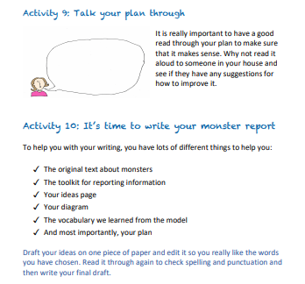
Task

Slide 21
PE Fitness
LI: to research into ‘the Year of the Ox’.
Task Board
Live Lesson – 100 rep challenge. Create your own workout of 100 reps. You will complete this on Friday morning. If you can’t join the live lesson the workout is as follows – calculate your time! 100 high knees 50 lunges 50 squats 50 push ups 50 sit ups 50 shoulder taps 50 star jumps 50 burpees REPEAT x once more ^

Slide 22
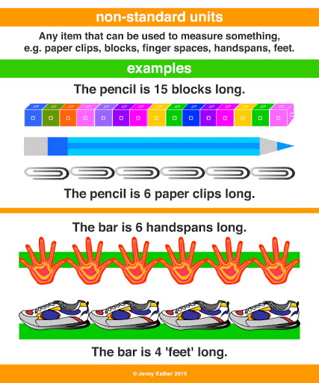
NUMERACY & MATHS –
Measure
LI: to use non-standard units of measurement.
Task Board
Live Lesson – units of measurement. Have a look at different objects, distances etc around your home. Make an estimate and then measure them using non-standard units of measurement. (Eg – how many hands long is your table, how many pencils long is your bed, how many shoes long is the distance between your bedroom and the bathroom). Note your findings down and send them to me ☺

Slide 23
Talk 4 Writing
Wednesday 27th January 2021
LI: to invent a monster’s land using descriptive language.
Task Board
Read or listen to the model text (see next slide or listen here: https://soundcloud.com/talkforwriting/swamp/s-28ED2KJCK6n Create your own map and descriptive paragraph of your monsters land (use your hot piece to help you). See task on next slide.

Slide 24
Part 1
Swamp Monsters
Do you ever wonder what might be lurking in the murky swamps of
our world? Rumour has it that the fabled swamp monster is not
just a creature mentioned in myth and legend but it actually
exists! Now is your chance to find out all that has been discovered
about this unique being.
Swamp monsters are rumoured to inhabit the most remote and
humid swamps of the Amazon rainforest. Living in total solitude, it is
believed that there is, perhaps, only one swamp monster on our
planet, making it a mystery how they reproduce. Dr Patrick Thurston
- world renowned monsterologist from Bristol University - could
perhaps be the only living person ever to see this magnificent
creature: “You cannot believe the pure majesty of the swamp
monster. They seem as if they are ‘one with the swamp’ living in pure
harmony with their habitat.”
.

Slide 25
Part 2
Swamp monsters don’t just live in swamps they resemble them.
Being experts in camouflage, they are indistinguishable from their
environment. Their bodies are made from this environment: limbs
of gnarled branches, incredibly long fingers and glowing, iridescent
hair which changes colour to match their mood. The most
incredible thing about a swamp monster is that they have
translucent breathing tubes meaning they can stay underwater
indefinitely but continue to breathe.
Have you ever wondered what a swamp monster eats? Their diet
consists of herons, rats and even alligators which they hypnotise
with their ever-staring, haunting eyes. Transfixed, any animal is
helpless to the swamp monster who squeezes the life from them
with its lean, powerful limbs. The swamp monster’s tongue has the
ability to taste the air; this allows it to identify when its prey is
close by.
If you are now tempted to try and spot a swamp monster, we advise
extreme caution! This beautiful but deadly creature should be left in
solitude to be studied only by experts trained in monsterology.

Slide 26
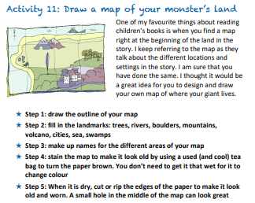
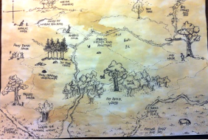
Talk 4 Writing
Wednesday 27th January 2021
LI: to invent a monster’s land using descriptive vocabulary.

Slide 27
Scotland Topic - Burns
Wednesday 20th January 2021
LI: to learn the life and works of Robert Burns.
Task Board
Continue working on your Robert Burns ‘Immortal Memory’ project. See next slide for success criteria. Do some research online to find out what the Scots words mean in ‘Address Tae a Haggis’. Using your research, complete the ‘Address Tae a Haggis’ crossword task.

Slide 28
Address Tae A Haggis
Learn these by Monday 25th.

Slide 29
Scotland Topic - Burns
Wednesday 27th January 2021
LI: to learn the life and works of Robert Burns.
Due Friday 29th January
LI: to research and present information on the life, works and impact of Robert Burns.
SC: You must include –
Information on Robert Burns and his life (facts, age, birthday, death, schooling, job, lives etc).
Information on Robert Burns’ works (poems, songs etc – what was the influence for them, what do they mean?)
Examples of poems/songs.
Impact Robert Burns has on Scottish culture today (how do we remember Burns, celebrate his life and works etc)
Impact Robert Burns has on the rest of the world today (statues/songs sung etc).
Pictures/photos
Include some examples of Scots language.
Appropriately written using writing skills.

Slide 30
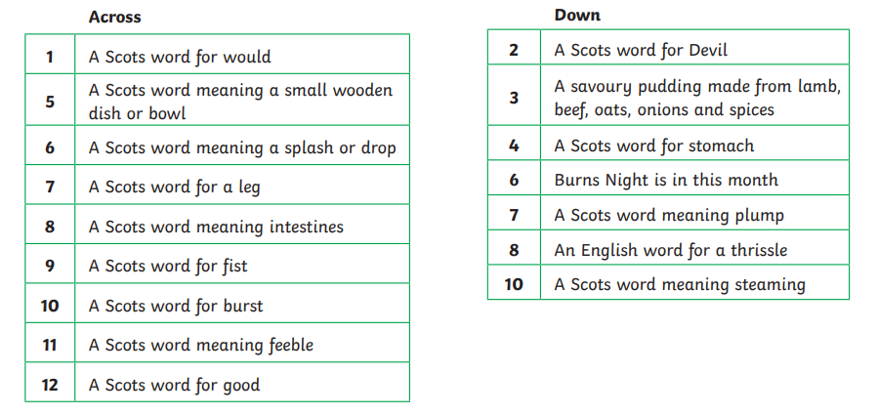
Scotland Topic - Burns
Wednesday 27th January 2021
LI: to learn the life and works of Robert Burns.

Slide 31
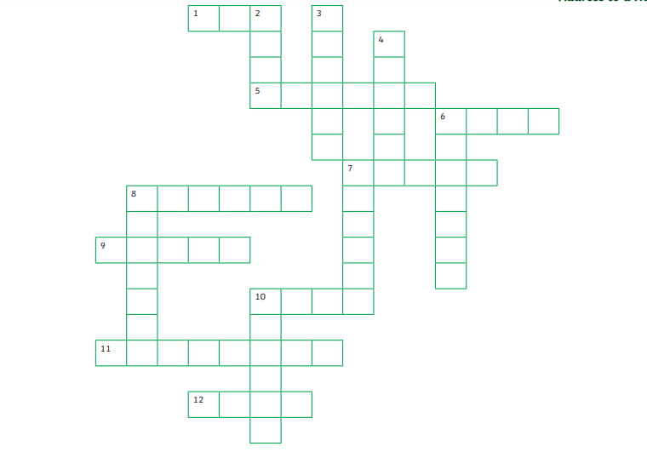
Scotland Topic - Burns
Wednesday 27th January 2021
LI: to learn the life and works of Robert Burns.

Slide 32

Reading –
Auggie & Me
Thursday 28th January 2021
LI: to re-write an aspect of the story from another character’s point of view.
Task Board
Live Lesson Listen to me reading the next part of the ‘Pluto’ chapter. 3. Pretend you are Auggie, write the section about getting the new dog as him rather than as Chris (the way the chapter reads it)

Slide 33
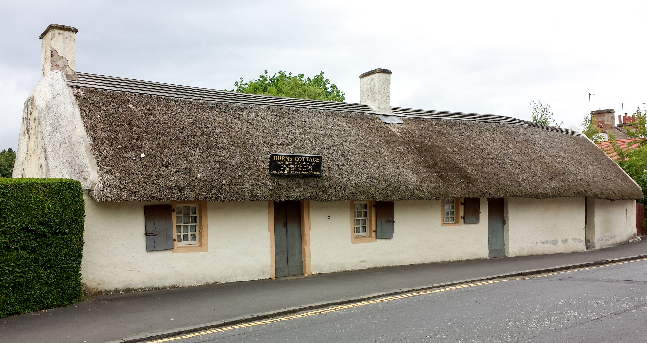
Art/STEM
Task Board
Get creative! I’d love you to make your own version of Burn’s Cottage. You could do this as a diagram, drawing, picture on paint, junk model, use lego or KNEX, minecraft etc. Send me your finished product ☺

Slide 34
Burns Supper
Friday 27th January 2021
LI: to share our Burns learning in a Burns supper.
Follow the link below to join our virtual Burns Supper:
Sophie Caldwell is inviting you to a scheduled Zoom meeting.
Topic: P7 Virtual Burns' Supper
Time: Jan 28, 2021 11:00 AM London
Join Zoom Meeting
https://us02web.zoom.us/j/83549689220?pwd=Y3pqYmk0QmtiMjN6d0dNNUsvd0xFQT09
Meeting ID: 835 4968 9220
Passcode: P7Burns

Slide 35
Fun 31!
Task Board
Live chat with your friends. Games? (bingo, go and get, buzz etc?) Your choice ☺

Slide 36
PE – Workout of your choice.
LI: to complete fitness workouts.
Task Board
This morning I would love you to complete a workout to get those endorphins flowing on a Friday! It is SO important that you continue to keep your mind and body healthy during lockdown and exercising is one of the best ways to do so. Some options for workouts: I’m a Celeb Fitness Camp from last week Joe Wicks (PE with Joe is live at 9am on youtube) https://www.youtube.com/user/thebodycoach1 Complete your fitness workout you made up on Tuesday. Go a jog/run/cycle/scooter I’d like you to let me know what exercise you completed by 11am please ☺

