Slide 1
Wednesday 27th January
27.01.21

Slide 2
Listen to Katie Morag story on SeeSaw
11am live lesson on TEAMS with Miss Lee- IDL
Measuring in Volume video on SeeSaw
Making a Rain Gauge

Slide 3
Log on to TEAMS for our live teaching input with Miss Lee at 11am.
We will be learning about Katie Morag and using adjectives to describe what she looks like!
PPT and recorded audio will be available to watch for those who cannot make that time.
Complete task by:
Drawing Katie Morag in the middle of A3 or A4 paper.
Write Katie Morag at the top of your sheet in large letters. Remember Katie Morag needs a capital as it is her name ☺.
Write describing words around your picture of Katie Morag.
Colour Katie Morag and send it to Miss Lee.

Slide 4
Watch Miss Lee’s volume task on SeeSaw.
Make a rain gauge at home or school following Miss Lee’s video and the instructions provided.
Send me pictures of your different measurements when it rains!
Have Fun! ☺

Slide 5
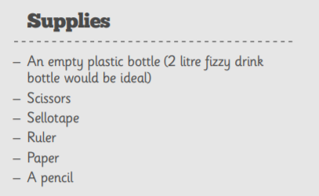
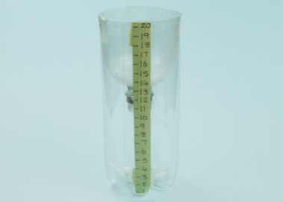
Rain Gauge Instructions

Slide 6
