Slide 1
Primary 7
Week beginning
2nd November 2020
Miss Caldwell

Slide 2
Weekly Timetable
 | 9:00 – 10:15 | 10:45 – 12:45 |  |  | 1:15 – 3:00
Monday | Miss Caldwell in school so will not be on teams. 9:30am - Maths | Miss Caldwell in school so will not be on teams. 11:30 – T4W | Spelling (GL words in files on teams) |  | Robert Burns Immortal Memory & Learn part 2 of poems. Live lesson 1pm (boys only) – toast tae the lassies. Live lesson 2pm (girls only) – toast tae the lads.
Tuesday | 9:00am – Live lesson 9:30am - Maths | 11:00am – Live Lesson 11:30 – T4W | Spelling (GL words in files on teams) |  | 1:00pm – Live Lesson 1:30 – Year of the Ox poster competition
Wednesday | 9:00am – Live lesson 9:30am - Maths | 11:00am – Live Lesson 11:30 – T4W | Spelling (GL words in files on teams) |  | Miss Caldwell in school so will not be on teams. Robert Burns Immortal Memory & Learn Poems
Thursday | Mrs Briggs | Mrs Briggs |  |  | 1:00pm – Live Lesson + Video Recording 1:30pm – Reading Task
Friday | PE with Joe Wicks (youtube) OR I’m a Celeb Fitness camp or workout of your choice | 11:00am – Live Lesson Mental Maths |  | HWB – Internet Safety | 1:00pm – Live Fun 31 games | 1:30pm – Robert Burns art

Slide 3
Number Talks

Slide 4
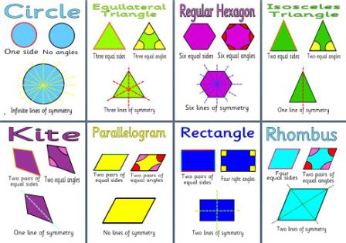
NUMERACY & MATHS – Shape
Task Board
Revision– symmetry https://www.bbc.co.uk/bitesize/topics/zs7mn39/articles/zh7dd6f https://www.mathsisfun.com/geometry/symmetry-line-plane-shapes.html 2. Using paper from your jotter and some scissors, cut out some shapes and fold them on the line of symmetry. (if you don’t have scissors move on to task 3). 3. Draw some shapes of your choice and draw in any lines of symmetry they have. Do the lines of symmetry go up and down (vertical), or side to side (horizontal)? Challenge yourself by drawing irregular shapes!
LI: to identify lines of symmetry.

Slide 5
Literacy - Writing
Monday 18th January 2021
LI: to understand and use formal/informal language appropriately.
Task Board
Read the information on the difference between formal and informal writing. (next slide) Complete the task deciding which sentences are formal an which are informal. (Challenge yourself to re-write them in the opposite way too!) Write 5 formal sentences about a monster and 5 informal sentences about a monster. (tip: informal is how you would speak to friends/family, formal is how you would speak to the Queen/your boss in a job/someone professional)

Slide 6
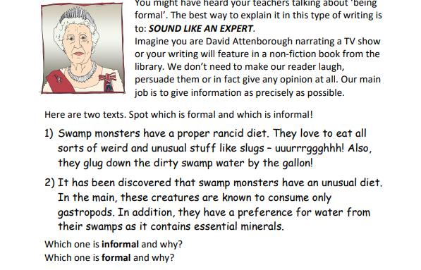
Literacy - Writing
Monday 18th January 2021
LI: to understand and use formal/informal language appropriately.

Slide 7
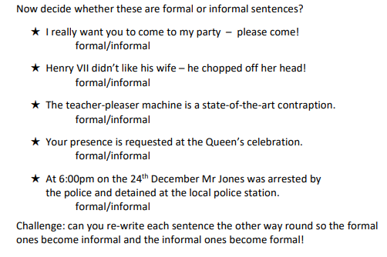
Literacy - Writing
Monday 18th January 2021
LI: to understand and use formal/informal language appropriately.

Slide 8
Scotland Topic - Burns
Monday 18th January 2021
LI: to learn the life and works of Robert Burns.
Task Board
1. Live Lesson 2. Learn the second four verses of ‘Tae a Haggis’ by next Monday – I will ask to hear these on a live lesson or you can send me a video of you saying them privately. 3. Continue working on your Robert Burns ‘Immortal Memory’ project. See next slide for success criteria. PS – it may be helpful to translate your poem from Scots to English – do some research ☺

Slide 9
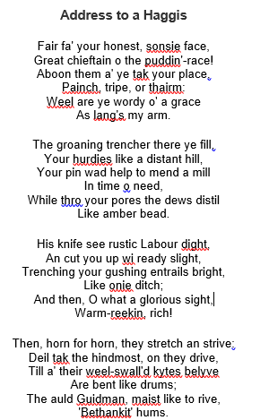
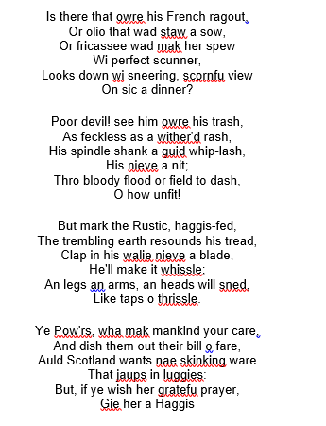
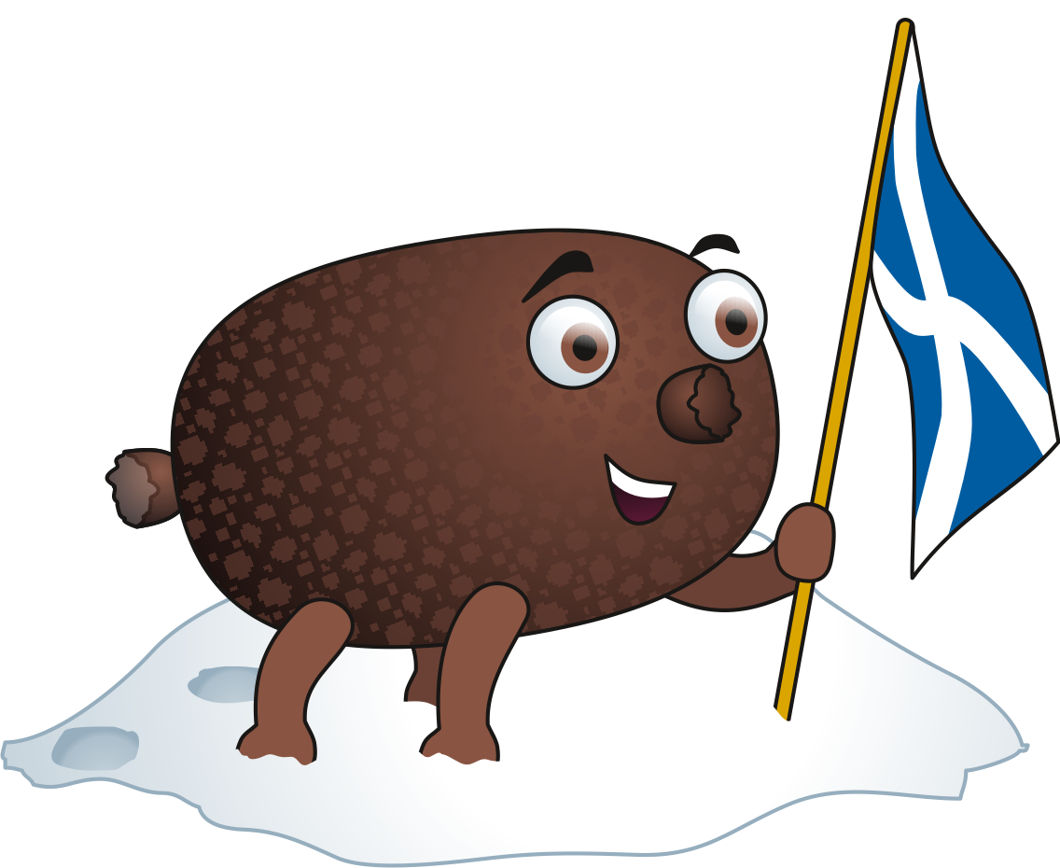
Address Tae A Haggis
Learn these by Monday 25th.

Slide 10
Scotland Topic - Burns
Monday 18th January 2021
LI: to learn the life and works of Robert Burns.
Due Friday 29th January
LI: to research and present information on the life, works and impact of Robert Burns.
SC: You must include –
Information on Robert Burns and his life (facts, age, birthday, death, schooling, job, lives etc).
Information on Robert Burns’ works (poems, songs etc – what was the influence for them, what do they mean?)
Examples of poems/songs.
Impact Robert Burns has on Scottish culture today (how do we remember Burns, celebrate his life and works etc)
Impact Robert Burns has on the rest of the world today (statues/songs sung etc).
Pictures/photos
Include some examples of Scots language.
Appropriately written using writing skills.

Slide 11
Number Talks

Slide 12
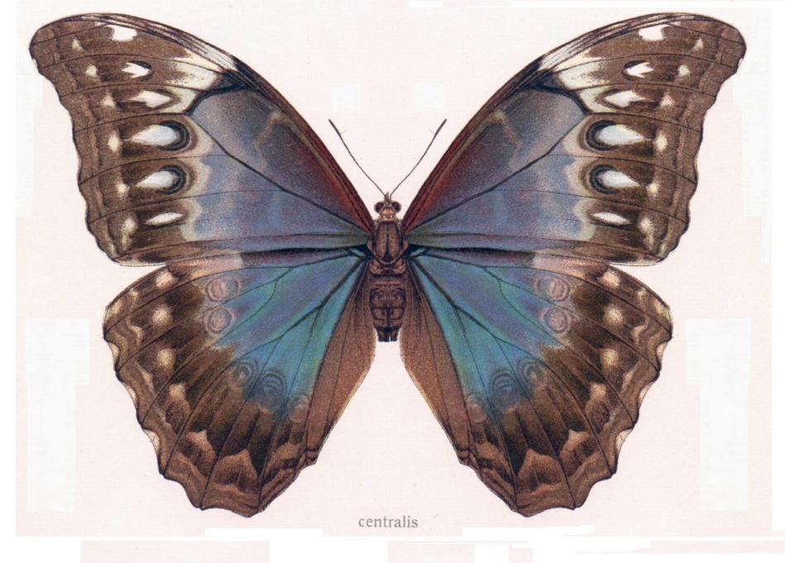
MATHS & ART– Symmetry
LI: to use lines of symmetry effectively.
Task Board
Live Lesson – recap on symmetry, different lines of symmetry, how can we check if things are symmetrical? Create a symmetrical drawing of a butterfly. Fold your paper in half and draw one side first. Use shape & colour. Try to then copy it EXACTLY symmetrical on the other side. Bonus if you can include shading! Symmetry hunt – can you find items in your home/garden/out a daily walk that are completely symmetrical – send me some pictures and tell me if they have a horizontal or vertical line of symmetry, or both!

Slide 13
Talk 4 Writing
Tuesday 19th January 2021
LI: to use topic sentences effectively.
Task Board
Live Lesson Read or listen to the model text (see next slide or listen here: https://soundcloud.com/talkforwriting/swamp/s-28ED2KJCK6n Complete the topic sentences tasks shown on the slide after the model text.

Slide 14
Part 1
Swamp Monsters
Do you ever wonder what might be lurking in the murky swamps of
our world? Rumour has it that the fabled swamp monster is not
just a creature mentioned in myth and legend but it actually
exists! Now is your chance to find out all that has been discovered
about this unique being.
Swamp monsters are rumoured to inhabit the most remote and
humid swamps of the Amazon rainforest. Living in total solitude, it is
believed that there is, perhaps, only one swamp monster on our
planet, making it a mystery how they reproduce. Dr Patrick Thurston
- world renowned monsterologist from Bristol University - could
perhaps be the only living person ever to see this magnificent
creature: “You cannot believe the pure majesty of the swamp
monster. They seem as if they are ‘one with the swamp’ living in pure
harmony with their habitat.”
.

Slide 15
Part 2
Swamp monsters don’t just live in swamps they resemble them.
Being experts in camouflage, they are indistinguishable from their
environment. Their bodies are made from this environment: limbs
of gnarled branches, incredibly long fingers and glowing, iridescent
hair which changes colour to match their mood. The most
incredible thing about a swamp monster is that they have
translucent breathing tubes meaning they can stay underwater
indefinitely but continue to breathe.
Have you ever wondered what a swamp monster eats? Their diet
consists of herons, rats and even alligators which they hypnotise
with their ever-staring, haunting eyes. Transfixed, any animal is
helpless to the swamp monster who squeezes the life from them
with its lean, powerful limbs. The swamp monster’s tongue has the
ability to taste the air; this allows it to identify when its prey is
close by.
If you are now tempted to try and spot a swamp monster, we advise
extreme caution! This beautiful but deadly creature should be left in
solitude to be studied only by experts trained in monsterology.

Slide 16
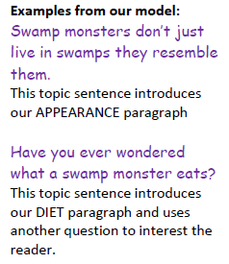
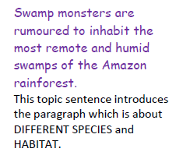
Task
Task Board
Topic sentences are used as little introductions to the paragraph. They allow you to give a little bit more detail than simply using a heading/subheading.

Slide 17
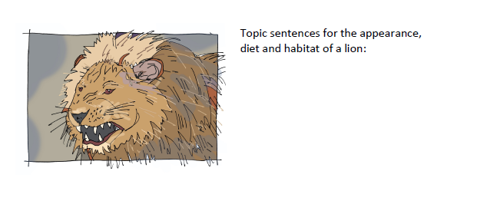
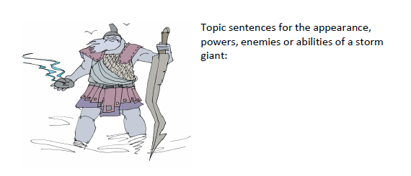
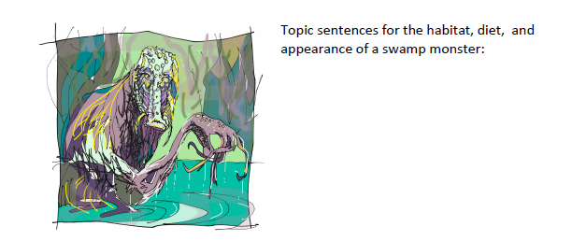
Task
Task Board
Have a go at creating your own topic sentences for the topics below: (you should have at least 3 topic sentences for each picture.)

Slide 18
China – Chinese New Year
LI: to research into ‘the Year of the Ox’.
Task Board
Live Lesson. Complete some research into why Chinese New Year celebrate a ‘year of…’ each year. This year is the year of the ox. What can you find out about that? Using the information on the next slide – create a poster to celebrate the Year of the Ox! Your entries will be sent to the Mandarin hub at Strathclyde university and you may end up winning your design on their Chinese New Year card ☺

Slide 19
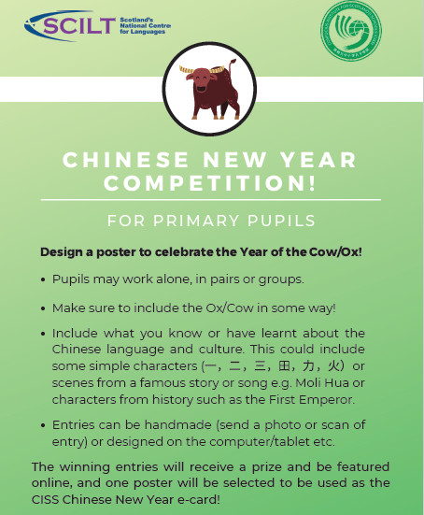
China – Chinese New Year
LI: to research into ‘the Year of the Ox’.

Slide 20
NUMERACY & MATHS – Angles
LI: to identify different lines of symmetry in flags.
Task Board
Live Lesson – lines of symmetry in flags. Have a look at all of the flags of the world https://flagsworld.org/ - can you note down the country then how many lines of symmetry the flag has? (you can draw/print them out and try folding them to see if it is the same on both sides whichever way you fold if you get stuck) Complete the table on the right using tally marks. Which flags were easy to figure out? Why? Which flags were difficult? Why?

Slide 21
Talk 4 Writing
Wednesday 20^{h} January 2021
LI: to innovate a monster.
Task Board
Live Lesson Read or listen to the model text (see next slide or listen here: https://soundcloud.com/talkforwriting/swamp/s-28ED2KJCK6n Think about what you would like your own monster to be like. Complete the tasks on the following slide to detail everything about your monster. (Remember to use descriptive techniques & formal language!)

Slide 22
Part 1
Swamp Monsters
Do you ever wonder what might be lurking in the murky swamps of
our world? Rumour has it that the fabled swamp monster is not
just a creature mentioned in myth and legend but it actually
exists! Now is your chance to find out all that has been discovered
about this unique being.
Swamp monsters are rumoured to inhabit the most remote and
humid swamps of the Amazon rainforest. Living in total solitude, it is
believed that there is, perhaps, only one swamp monster on our
planet, making it a mystery how they reproduce. Dr Patrick Thurston
- world renowned monsterologist from Bristol University - could
perhaps be the only living person ever to see this magnificent
creature: “You cannot believe the pure majesty of the swamp
monster. They seem as if they are ‘one with the swamp’ living in pure
harmony with their habitat.”
.

Slide 23
Part 2
Swamp monsters don’t just live in swamps they resemble them.
Being experts in camouflage, they are indistinguishable from their
environment. Their bodies are made from this environment: limbs
of gnarled branches, incredibly long fingers and glowing, iridescent
hair which changes colour to match their mood. The most
incredible thing about a swamp monster is that they have
translucent breathing tubes meaning they can stay underwater
indefinitely but continue to breathe.
Have you ever wondered what a swamp monster eats? Their diet
consists of herons, rats and even alligators which they hypnotise
with their ever-staring, haunting eyes. Transfixed, any animal is
helpless to the swamp monster who squeezes the life from them
with its lean, powerful limbs. The swamp monster’s tongue has the
ability to taste the air; this allows it to identify when its prey is
close by.
If you are now tempted to try and spot a swamp monster, we advise
extreme caution! This beautiful but deadly creature should be left in
solitude to be studied only by experts trained in monsterology.

Slide 24
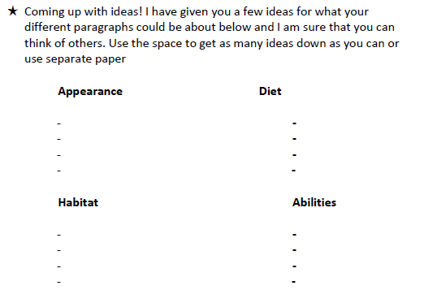
Talk 4 Writing
Wednesday 20^{h} January 2021
LI: to innovate a monster.

Slide 25
Scotland Topic - Burns
Wednesday 20th January 2021
LI: to learn the life and works of Robert Burns.
Task Board
1. Learn the second four verses of ‘Tae a Haggis’ by next Monday – I will ask to hear these on a live lesson or you can send me a video of you saying them privately. 2. Continue working on your Robert Burns ‘Immortal Memory’ project. See next slide for success criteria. 3. Live lesson for THE BOYS ONLY at 1pm to start working on ‘Toast tae the Lassies’. 4. Live lesson for THE GIRLS ONLY at 2pm to start working on ‘Toast tae the Lads’.

Slide 26
Address Tae A Haggis
Learn these by Monday 25th.

Slide 27
Scotland Topic - Burns
Wednesday 13th January 2021
LI: to learn the life and works of Robert Burns.
Due Friday 29th January
LI: to research and present information on the life, works and impact of Robert Burns.
SC: You must include –
Information on Robert Burns and his life (facts, age, birthday, death, schooling, job, lives etc).
Information on Robert Burns’ works (poems, songs etc – what was the influence for them, what do they mean?)
Examples of poems/songs.
Impact Robert Burns has on Scottish culture today (how do we remember Burns, celebrate his life and works etc)
Impact Robert Burns has on the rest of the world today (statues/songs sung etc).
Pictures/photos
Include some examples of Scots language.
Appropriately written using writing skills.

Slide 28
Reading – Auggie & Me
Thursday 21st January 2021
LI: to use character analysis skills based on a text.
Task Board
Live Lesson Listen to me reading the next part of the ‘Pluto’ chapter. 2. Complete the task on the following slide using your character analysis skills.

Slide 29
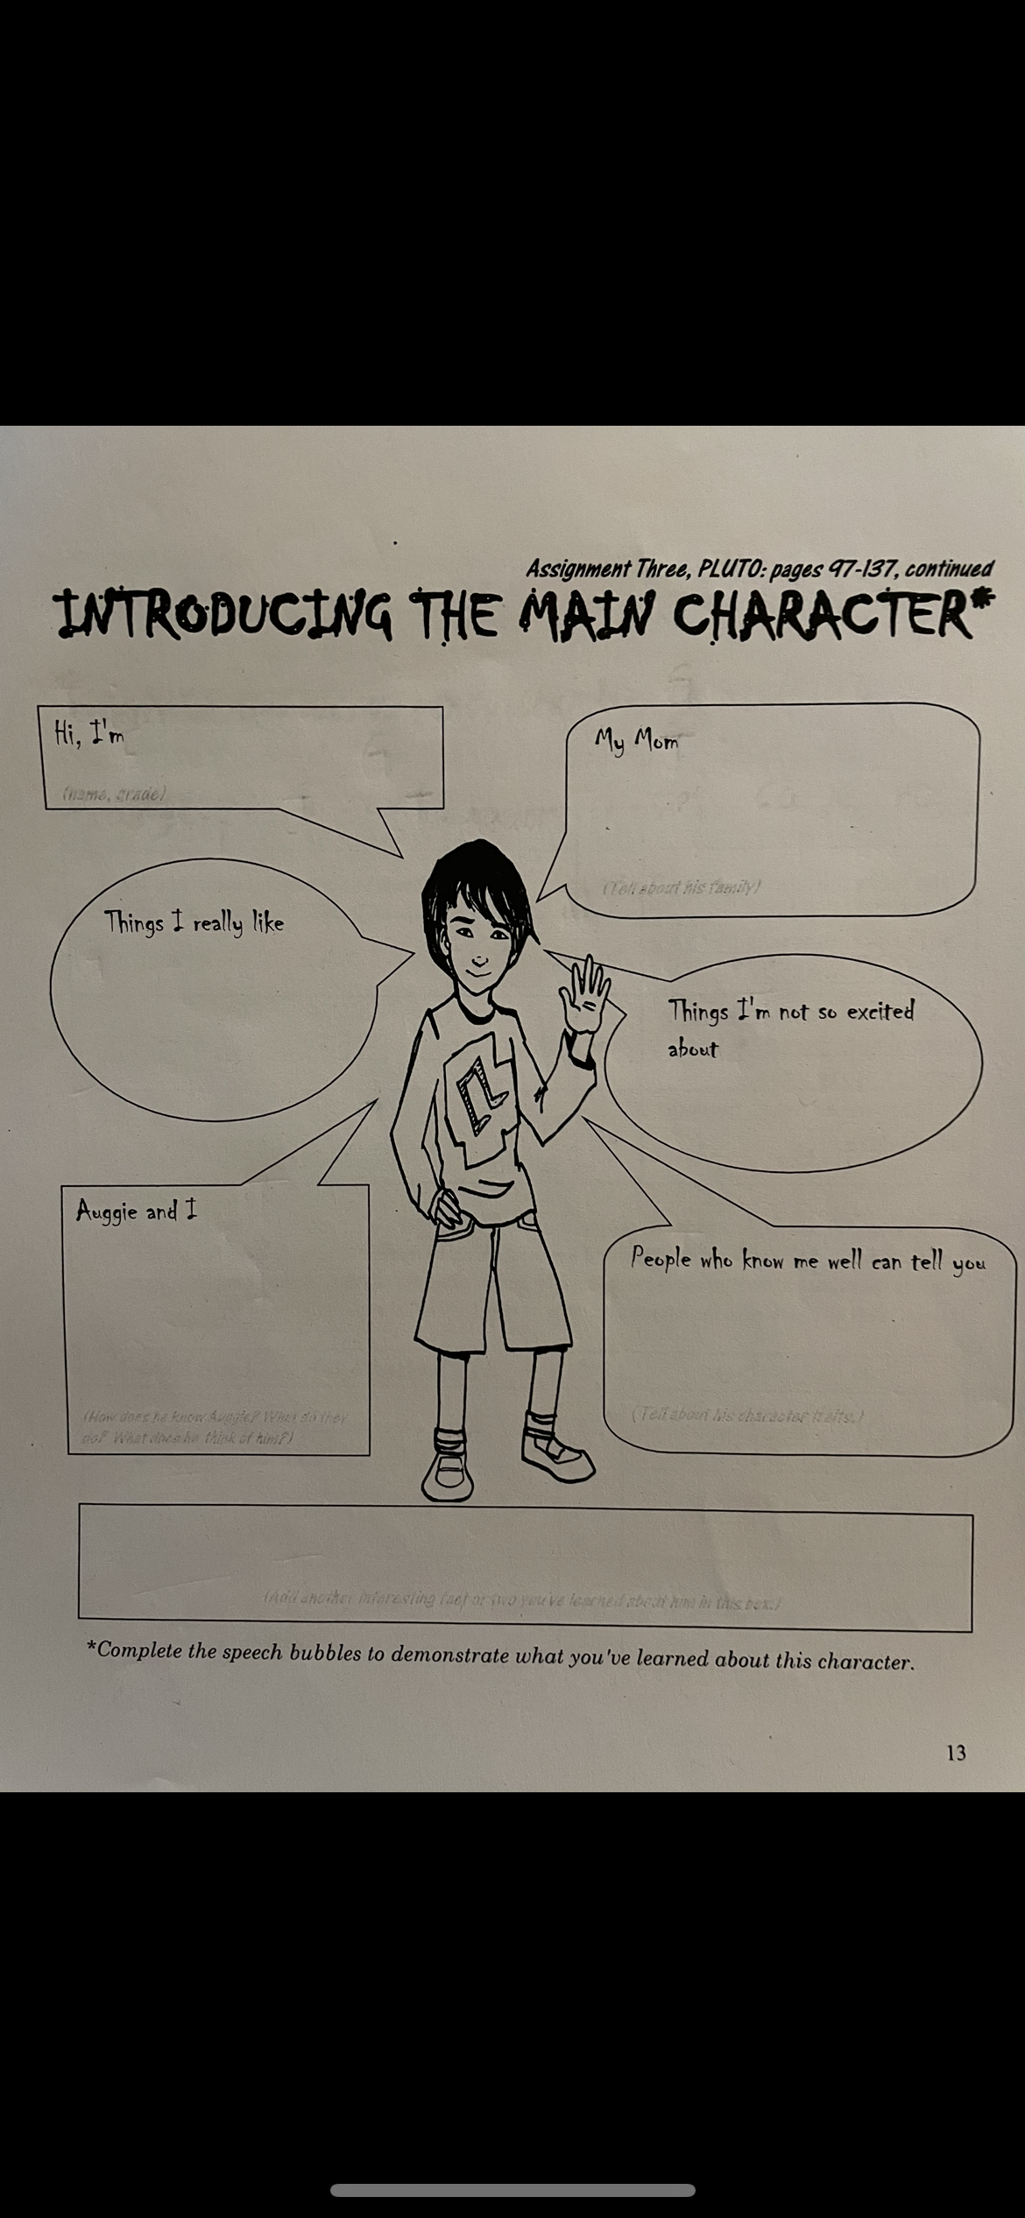
Reading

Slide 30
PE – Workout of your choice.
LI: to complete fitness workouts.
Task Board
This morning I would love you to complete a workout to get those endorphins flowing on a Friday! It is SO important that you continue to keep your mind and body healthy during lockdown and exercising is one of the best ways to do so. Some options for workouts: I’m a Celeb Fitness Camp from last week Joe Wicks (PE with Joe is live at 9am on youtube) https://www.youtube.com/user/thebodycoach1 Make up a workout of your choice! Go a jog/run/cycle/scooter I’d like you to let me know what exercise you completed by 11am please ☺

Slide 31
Number Talks

Slide 32
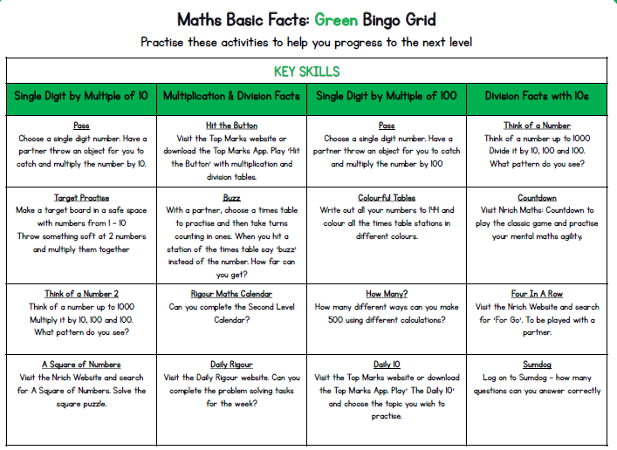

Slide 33
Health & Wellbeing
Friday 22nd January 2021
LI: to identify ways to keep ourselves safe online.
Do some research into how to keep yourselves and others safe online.
Create a poster/powerpoint/sway/leaflet (you choose) to show people, especially children of your age, how to stay safe online.

Slide 34
Fun 31!
Task Board
Live chat with your friends. Games? (bingo, go and get, buzz etc?) Your choice ☺

Slide 35
Art
Task Board
Follow the step by step to create your own Robert Burns picture: https://www.activityvillage.co.uk/learn-to-draw-robert-burns Send a picture to me when you are done!

