Slide 1
3 for Thursday!!
Thursday 13th January 2021
Mrs briggs
Julie.briggs2@south-Ayrshire.gov.uk

Slide 2
Hello p7 ☺
We’re over halfway though the week….. The end is in sight.
Woo hoo!!!
Time for some fun tasks to get you active and creative.
Best of all…….there’s prizes!!!!!!!!!!!!!!!!!!!!!!!!!!!!!!!!!!!!!!!!!
All completed tasks should be posted into the Thursday folder on Teams or e-mailed by 3pm

Slide 3
Task 1…… STEM
Our focus this term is on our bodies, particularly Lungs and Digestion. We will be exploring bodily functions and diseases.
Microbe mania
There are lots of different mi-cro organisms in the world. Lots of them are helpful, some are harmful. You can find out more about microbes here:
https://www.theschoolrun.com/homework-help/micro-organisms
Read, play & learn on the link above.
TASK : Imagine you have just discovered a new bacteria, you will need to think about its type, how it looks, what it does and give it a name. CREATE one Powerpoint slide about your new bacteria, including at least 6 facts about it.

Slide 4
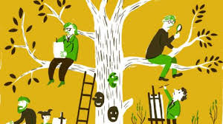
Task 2…… outdoor learning
Its time to get some fresh air, if you can. It’s a great way to de-stress and refresh your mind and body after so much online learning. However, if its not possible to day I have included an indoor option.
TASK :
Outdoor: Have a walk around the streets and see what signs of spring you can see. Look out especially for birds and the buds on the trees. Make a list of all the wildlife you see and do some research on them.
Indoor: Talk about your family’s history. Think about aunts and uncles, grandmas and grandads, great grandmas and great-grandads. Create a family tree. Look through old photographs. Create individual or family portraits.

Slide 5
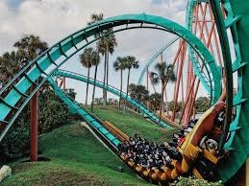
Task 2…… creative challenge
Get your creative brains in gear after all that fresh air to tackle this mini competition for a chance to have a Treat Bag delivered to your doorstep!!!!
TASK : You are hired by an amusement park to create a new and exciting roller coaster!!!!!!
Draw / Construct / Digitally create a model of your new ride.
You can use any materials or media that you have available….. Junk modelling, lego, Minecraft image, 3D drawing etc.
THE MORE CREATIVE THE BETTER!!!!!!!
Entries for this challenge can be submitted (Teams/E-mail) no later than 3pm on FRIDAY
Treats will be delivered by 6pm that evening.

Slide 6
You’re smashing it p7…. Keep it up!!

