Slide 1
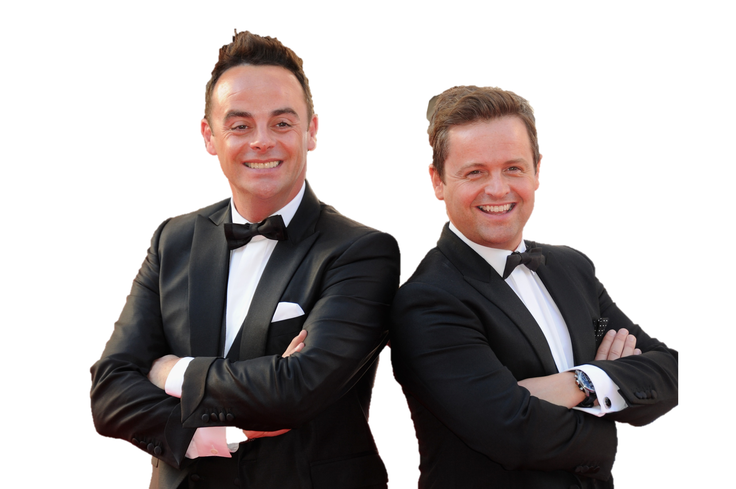
I'm a celeb get me out of here fitness camp

Slide 2
Rules
After each exercise make a note of how many stars you achieved so you can add them up at the end and let your teacher know how you got on. After each exercise you can have a 30 second break
For every 20 seconds you do an activity you will earn yourself a star to take back to your fitness camp. If you stop make note of your starts and wait until the next exercise. Can you beat your teacher?
= 20 seconds
= 40 seconds
= 60 seconds

Slide 3
Warm up-5 minutes
Do some of your own static stretches, make sure you are warming up various body parts and not just your arms.
As well as static stretches can you include some dynamic stretching, this is when you stretch your muscles whilst moving such as lunge walk whilst twisting your upper body.

Slide 4
The exercises
Exercises | Amount of stars achieved
LEECH LUNGES
SNAKEY SQUATS
SCREAMING SIT UPS
PERILOUS PRESS UPS
OUTBACK MOUNTAIN CLIMBERS
ROTTEN RUSSIAN TWISTS
BUSHTUCKER BURPEES
WALLABY WALL SITS
TRICEP DIPS OF DOOM
JOEY JOG ON THE SPOT
LIZARD LEG RAISES
HIGH KNEES
KANGAROO KICKS
CROCODILE CRUNCHES
PLANK OF PERSERVERENCE

Slide 5
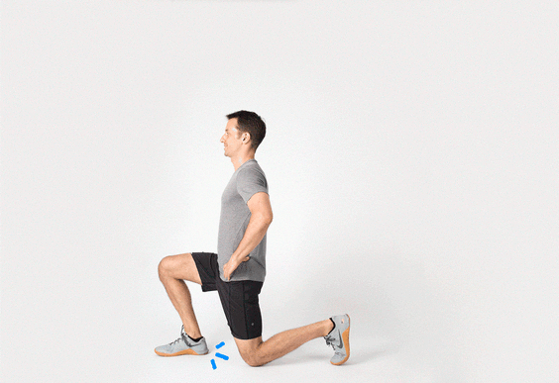
LEECH LUNGES
= 20 seconds
= 40 seconds
= 60 seconds
KEY POINTS:
Stand shoulder width apart
Step forward with one leg
Bend your back leg 90 degrees
Keep your back straight
Keep your shoulders back
Keep your head facing forwards

Slide 6
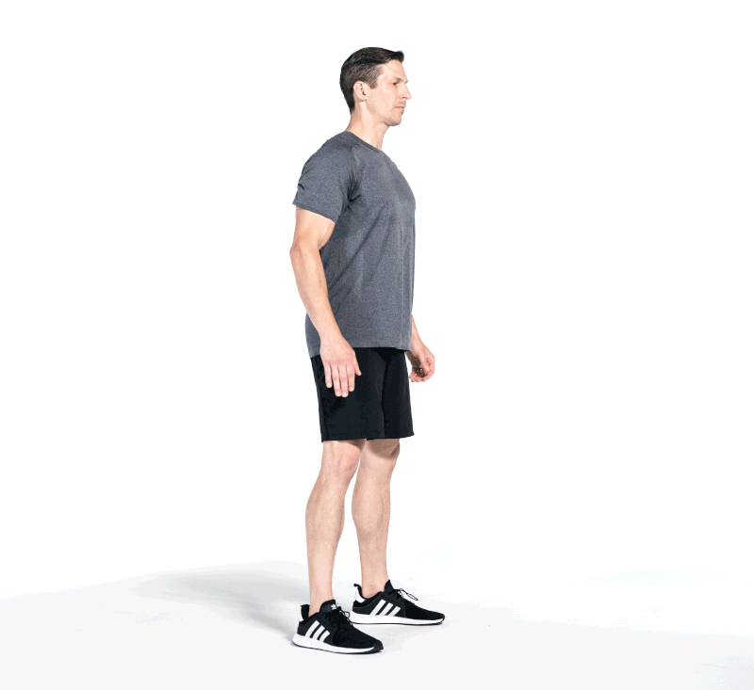
SNAKEY SQUATS
= 20 seconds
= 40 seconds
= 60 seconds
KEY POINTS:
Stand shoulder width apart
Push your hips back
Start to lower yourself as though you are sitting on a chair
Keep your head facing forward and stay upright
Drive through your heels and stand back up and repeat

Slide 7
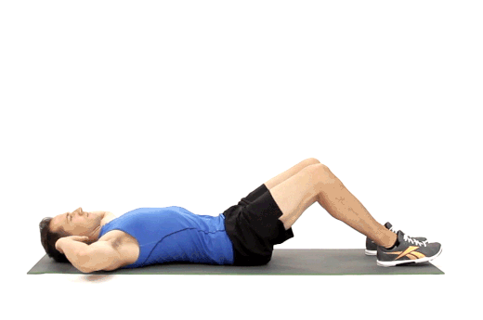
SCREAMING SIT UPS
= 20 seconds
= 40 seconds
= 60 seconds
KEY POINTS:
Lie flat on your back with your knees bent at 90 degrees and feet flat on the floor
Place your hands by your head like the video shows
Engage your core and lift your upper body towards your knees and return to the starting position.

Slide 8
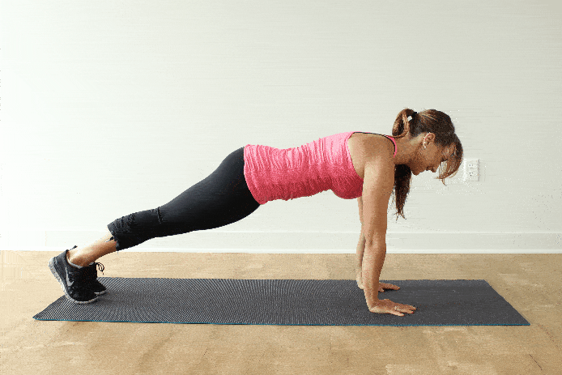
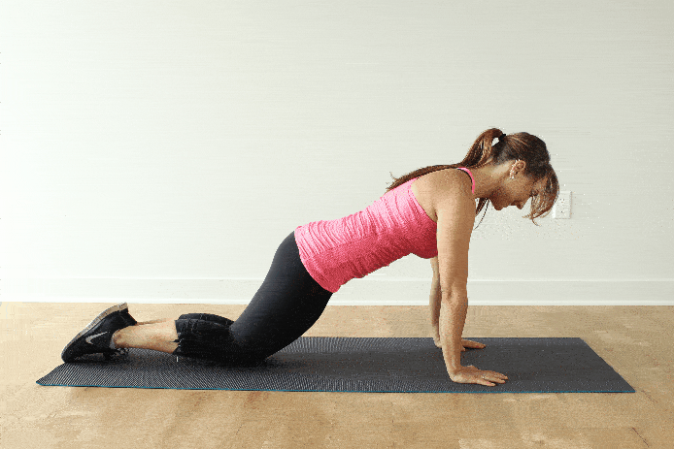
PERILOUS PRESS UPS
= 20 seconds
= 40 seconds
= 60 seconds
KEY POINTS:
Keep your head facing forwards
Keep a straight back
Bend your elbows and lower chest towards the floor
Push back up to the starting position

Slide 9
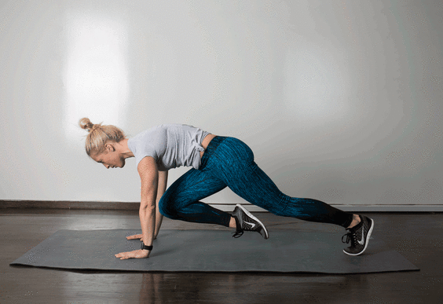
OUTBACK MOUNTAIN CLIMBERS
KEY POINTS:
Begin in a press up position keeping a straight back at all times
Drive your knee to your chest (one leg at a time)
= 20 seconds
= 40 seconds
= 60 seconds

Slide 10
ROTTEN RUSSIAN TWISTS
= 20 seconds
= 40 seconds
= 60 seconds
KEY POINTS:
Sit down on the floor and bend your knees.
Lean back slightly so your body is at a 45 degree angle
Raise your legs slightly up from the floor
Link your hands together in front first, then rotate your arms all the way over to one side and repeat to the other side

Slide 11
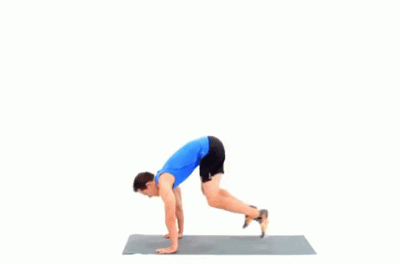
BUSHTUCKER BURPEES
= 20 seconds
= 40 seconds
= 60 seconds
KEY POINTS:
Squat down to the floor and kick your feet back
Bring your chest to the floor
Return to a squat position
Jump vertically up and repeat

Slide 12
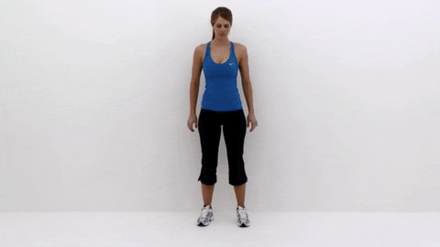
WALLABY WALL SITS
= 20 seconds
= 40 seconds
= 60 seconds
KEY POINTS:
Stand against a wall, place your feet a shoulders width apart
Keep your back straight against the wall
Lower yourself down so your knees are at a 90 degree angle

Slide 13
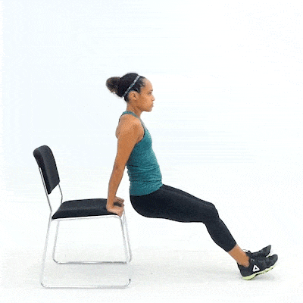
TRICEP DIPS OF DOOM
= 20 seconds
= 40 seconds
= 60 seconds
KEY POINTS:
Place your hands on a chair with your fingers facing forwards
Straighten your legs so only your heels are touching the floor
Bend elbows and your lower body to the floor
Push back up so elbows are straight

Slide 14
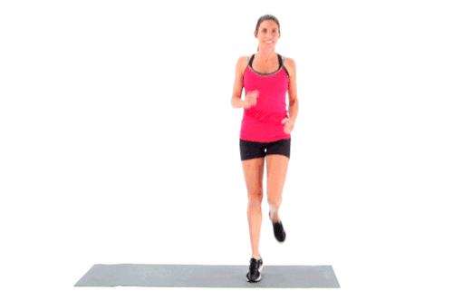
JOEY JOG ON THE SPOT
= 20 seconds
= 40 seconds
= 60 seconds
KEY POINTS:
Engage your arms as you jog on the spot
Make sure swing your opposite arm to leg. Eg if you are bringing your right foot up swing your left arm.

Slide 15
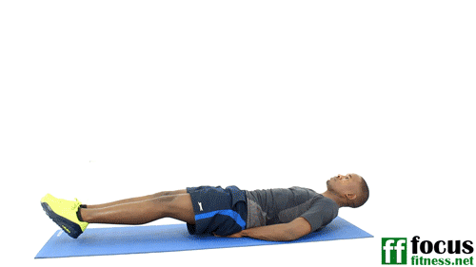
LIZARD LEG RAISES
= 20 seconds
= 40 seconds
= 60 seconds
KEY POINTS:
Lie on your back, keep your legs straight and together.
Keeping your legs straight lift them all the way up towards you until your back starts to lift up.
Slowly lower your legs in a controlled way.

Slide 16
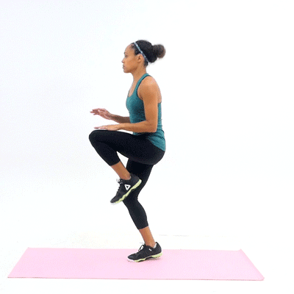
HIGH KNEES
= 20 seconds
= 40 seconds
= 60 seconds
KEY POINTS:
Stand shoulder width apart
Lift one of your knees towards your chest then switch to the next knee.
Continue this movement and alternating your knees.

Slide 17
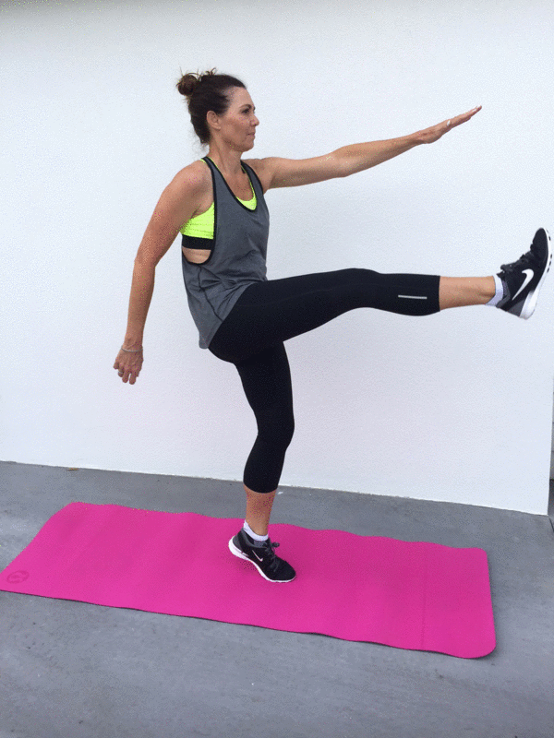
KANGEROO KICKS
= 20 seconds
= 40 seconds
= 60 seconds
KEY POINTS:
Stand shoulder width apart
Kick one of your legs forwards and up towards your opposite hand
Repeat for the other leg
Push through your heel

Slide 18
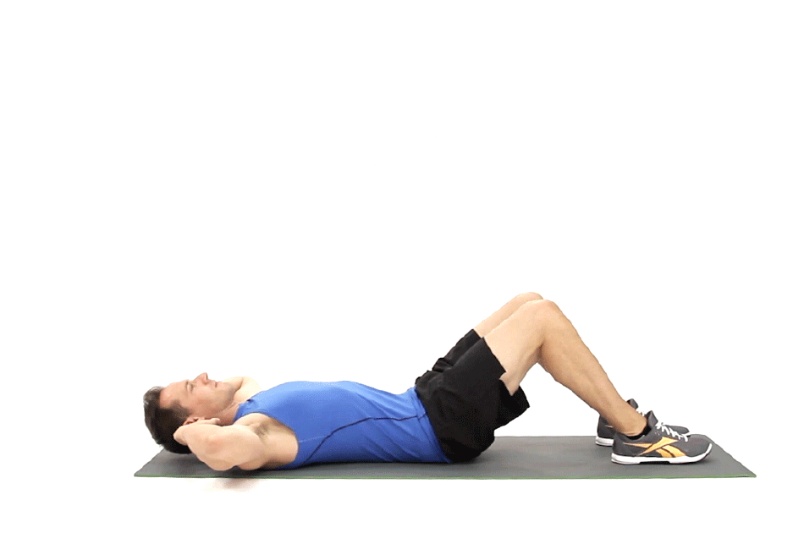
CROCODILE CRUNCHES
= 20 seconds
= 40 seconds
= 60 seconds
KEY POINTS:
Get yourself in the position you did for a sit up
Instead of going all the way up only raise yourself half way and go back down and repeat

Slide 19
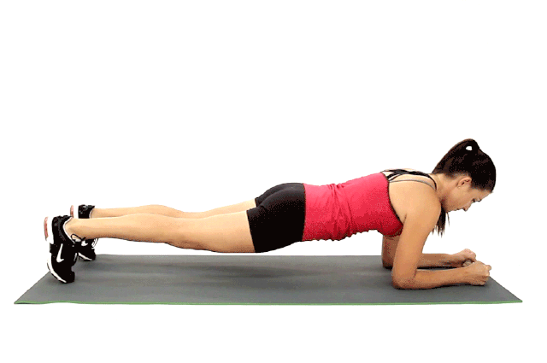
PLANK OF PERSERVERENCE
= 20 seconds
= 40 seconds
= 60 seconds
KEY POINTS:
Lay on your front and place your forearms and palms flat on the floor
Lift your chest, stomach and legs off the floor and maintain your balance on your forearms and toes
Keep a straight, flat back

