Slide 1
Primary 7
Week beginning
2nd November 2020
Miss Caldwell

Slide 2
Weekly Timetable
 | 9:00 – 10:15 | 10:45 – 12:45 |  |  | 1:15 – 3:00
Monday | 9:00am – Numeracy (Miss Caldwell in school so limited access to teams) | 10:45am – Writing | Spelling (GL words in files on teams) |  | 1:00pm – Live Lesson 1:30pm – Robert Burns Immortal Memory & Learn Poems
Tuesday | 9:00am – Live lesson 9:30am - Maths | 11:00am – Live Lesson 11:30 – T4W | Spelling (GL words in files on teams) |  | 1:00pm – Live Lesson 1:30 – I’m A Celeb Fitness Camp
Wednesday | 9:00am – Live lesson 9:30am - Maths | 11:00am – Live Lesson 11:30 – T4W | Spelling (GL words in files on teams) |  | Robert Burns Immortal Memory & Learn Poems
Thursday | Mrs Briggs | Mrs Briggs |  |  | 1:00pm – Video Lesson (Reading) 1:30pm – Reading Task
Friday | I’m A Celeb Fitness Camp | 11:00am – Live Lesson Mental Maths |  | HWB - Safety | 1:00pm – Live Fun 31 games | 1:30pm – Art Hub/Little Art School

Slide 3
Number Talks

Slide 4
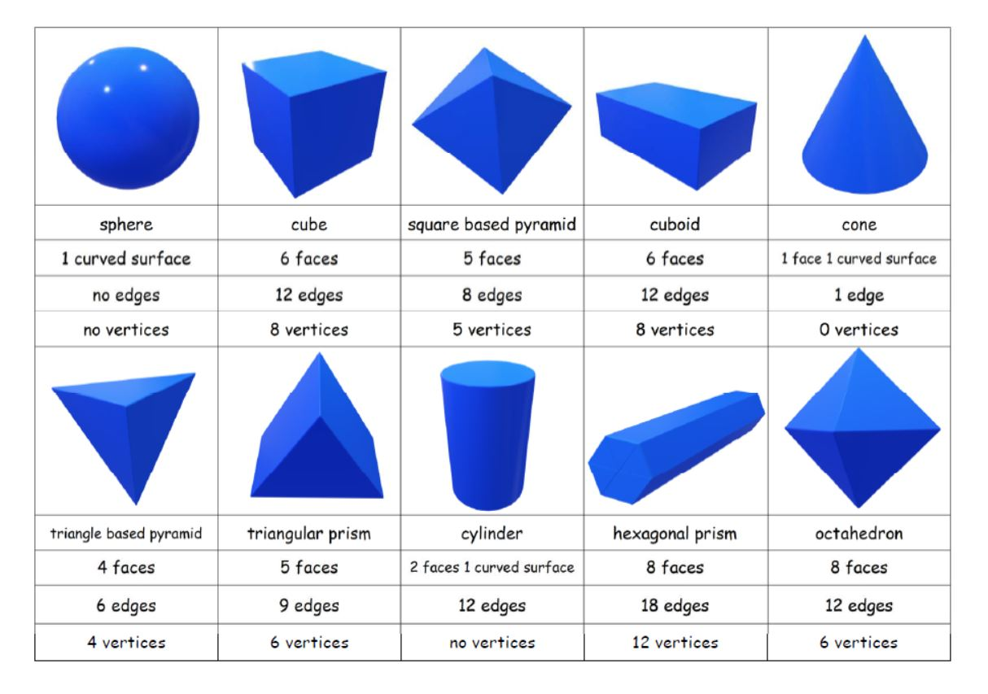
NUMERACY & MATHS – Shape
LI: to shapes and their properties..
Task Board
Revision– shapes and their properties. Watch this if you miss it or need more help https://www.bbc.co.uk/bitesize/topics/zjv39j6/articles/zgqpk2p 2. For the 3D shapes on the right, can you write down items in real life that have these shapes? Can you think of one for each? Can you think of more for some than others? 3. 3D shape hunt – find 3D shapes in objects around your house or outside/during a walk. Note them down and their properties.

Slide 5
Literacy - Writing
Monday 11th January 2021
LI: to write a persuasive piece essay.
Task Board
Remember all of your persuasive techniques: A – alliteration F – facts O – opinions R – rhetorical question R – repetition E – emotions/emotive language S – statistics T – three (rule of) 2. See next slide for your literacy task.

Slide 6
Literacy - Writing
Monday 11th January 2021
LI: to write a persuasive piece essay.
Task Board
Writing Task: Write a persuasive essay using as many techniques as you can to persuade the reader that they should move to Scotland. You may want to do some research to find out some interesting facts or statistics that might make someone want to come to Scotland. Include your opinion too! Check the next slide for all of the things you should include in your essay to be successful. There is also a basic example of structure.

Slide 7
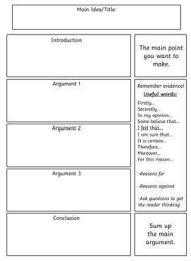
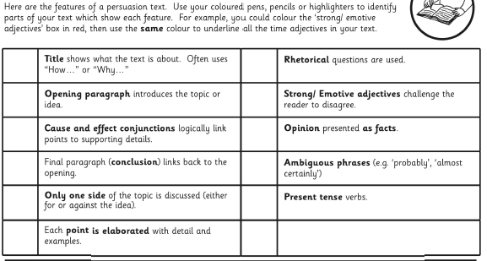
Literacy - Writing
Monday 11th January 2021
LI: to write a persuasive piece essay.

Slide 8
Scotland Topic - Burns
Monday 11th January 2021
LI: to learn the life and works of Robert Burns.
Task Board
1. Live Lesson 2. Learn the first four verses of ‘Tae a Haggis’ by next Monday – I will ask to hear these on a live lesson or you can send me a video of you saying them privately. 3. Begin working on your Robert Burns ‘Immortal Memory’ project. See next slide for success criteria.

Slide 9
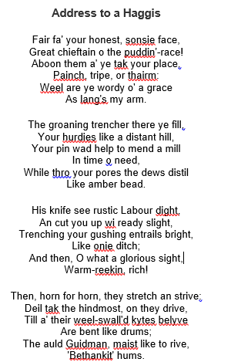
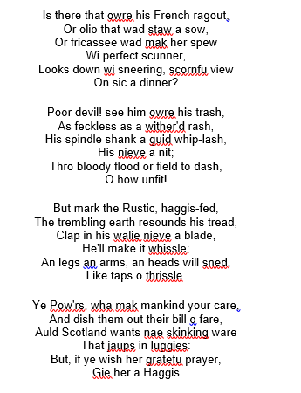
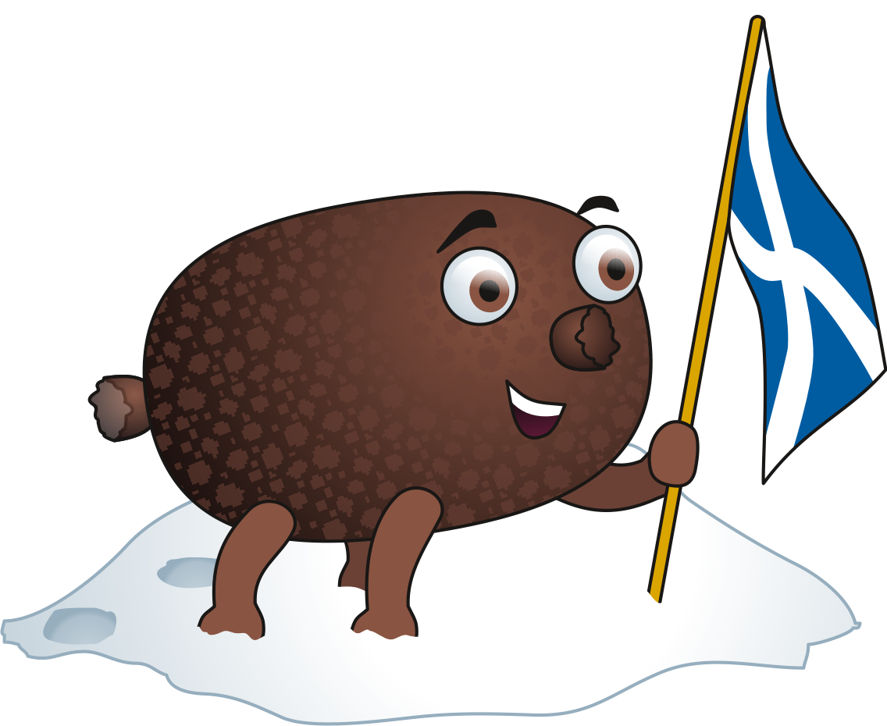
Address Tae A Haggis
Learn these by Monday 25th.

Slide 10
Scotland Topic - Burns
Monday 11th January 2021
LI: to learn the life and works of Robert Burns.
Due Friday 29th January
LI: to research and present information on the life, works and impact of Robert Burns.
SC: You must include –
Information on Robert Burns and his life (facts, age, birthday, death, schooling, job, lives etc).
Information on Robert Burns’ works (poems, songs etc – what was the influence for them, what do they mean?)
Examples of poems/songs.
Impact Robert Burns has on Scottish culture today (how do we remember Burns, celebrate his life and works etc)
Impact Robert Burns has on the rest of the world today (statues/songs sung etc).
Pictures/photos
Include some examples of Scots language.
Appropriately written using writing skills.

Slide 11
Number Talks

Slide 12
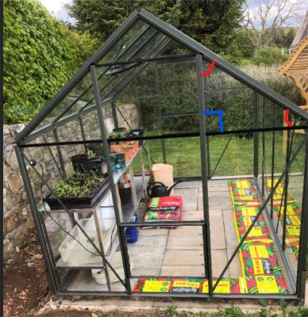
NUMERACY & MATHS – Angles
LI: to identify angles in the environment.
Task Board
Live Lesson – different types of angles. (if you miss this or need extra help check out - https://www.bbc.co.uk/bitesize/topics/zs7mn39/articles/z6q88xs How many different types of angles can you see in the following picture? Create a tally chart. (right, acute, obtuse, reflex, straight line) Do an angles search in a room of your choice. What objects have angles? Name them. (Eg – desk: 4 right angles, 1 obtuse, 1 acute etc)

Slide 13
Talk 4 Writing
Tuesday 12th January 2021
LI: to use vocabulary skills.
Task Board
Live Lesson Read or listen to the model text (see next slide or listen here: https://soundcloud.com/talkforwriting/swamp/s-28ED2KJCK6n Complete the vocabulary task shown on the slide after the model text.

Slide 14
Part 1
Swamp Monsters
Do you ever wonder what might be lurking in the murky swamps of
our world? Rumour has it that the fabled swamp monster is not
just a creature mentioned in myth and legend but it actually
exists! Now is your chance to find out all that has been discovered
about this unique being.
Swamp monsters are rumoured to inhabit the most remote and
humid swamps of the Amazon rainforest. Living in total solitude, it is
believed that there is, perhaps, only one swamp monster on our
planet, making it a mystery how they reproduce. Dr Patrick Thurston
- world renowned monsterologist from Bristol University - could
perhaps be the only living person ever to see this magnificent
creature: “You cannot believe the pure majesty of the swamp
monster. They seem as if they are ‘one with the swamp’ living in pure
harmony with their habitat.”
.

Slide 15
Part 2
Swamp monsters don’t just live in swamps they resemble them.
Being experts in camouflage, they are indistinguishable from their
environment. Their bodies are made from this environment: limbs
of gnarled branches, incredibly long fingers and glowing, iridescent
hair which changes colour to match their mood. The most
incredible thing about a swamp monster is that they have
translucent breathing tubes meaning they can stay underwater
indefinitely but continue to breathe.
Have you ever wondered what a swamp monster eats? Their diet
consists of herons, rats and even alligators which they hypnotise
with their ever-staring, haunting eyes. Transfixed, any animal is
helpless to the swamp monster who squeezes the life from them
with its lean, powerful limbs. The swamp monster’s tongue has the
ability to taste the air; this allows it to identify when its prey is
close by.
If you are now tempted to try and spot a swamp monster, we advise
extreme caution! This beautiful but deadly creature should be left in
solitude to be studied only by experts trained in monsterology.

Slide 16
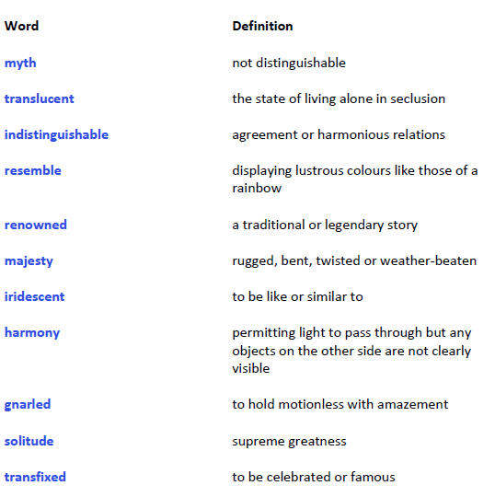
Task
Task Board
Match the word to the definition. Use your own dictionary or an online dictionary to check your answers. Send me your score!

Slide 17
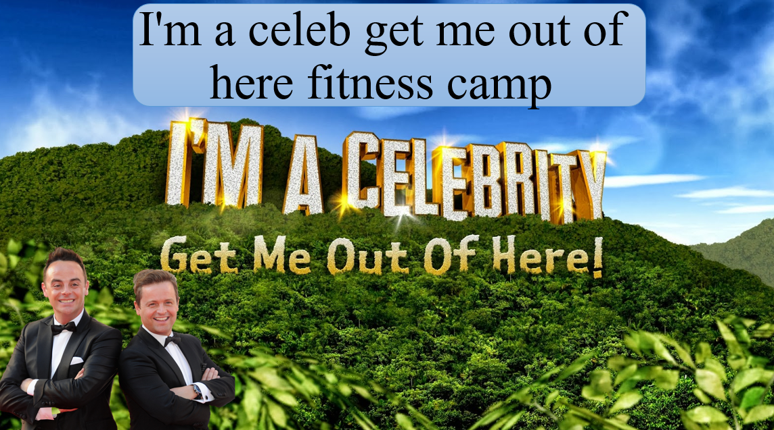
PE – I’m A Celeb Fitness.
LI: to complete fitness workouts.
Task Board
Live Lesson. Access the ‘I’m a Celebrity Fitness camp’ powerpoint from files and complete.

Slide 18
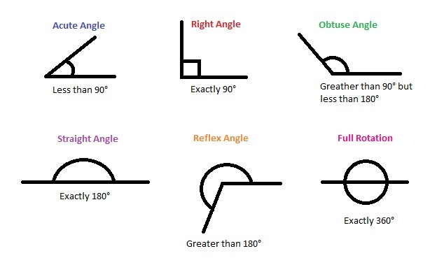
NUMERACY & MATHS – Angles
LI: to identify different types of angles.
Task Board
Live Lesson – different types of angles. (if you miss this or need extra help check out - https://www.bbc.co.uk/bitesize/topics/zs7mn39/articles/z6q88xs Draw your name in spikey/straight line bubble writing – identify all of the angles in your name. Create a poster showing how to identify the different types of angles. What sizes are they between?

Slide 19
Talk 4 Writing
Wednesday 13th January 2021
LI: to structure an information text.
Task Board
Live Lesson Read or listen to the model text (see next slide or listen here: https://soundcloud.com/talkforwriting/swamp/s-28ED2KJCK6n Create your own actions to help you learn the model text. Use the following structure on the next slide to ‘box up’ the model text. Highlight or write out which parts would go where in the structure.

Slide 20
Talk 4 Writing
Wednesday 13th January 2021
LI: to structure an information text.
Structure
Introduction: Which part hooks the reader? Information part 1: What is it giving information on? Information part 2: What is it giving information on? Information part 3: What is it giving information on? Conclusion: How does it sum up the text? (Swamp Monsters model text is on the next slide to remind you)

Slide 21
Part 1
Swamp Monsters
Do you ever wonder what might be lurking in the murky swamps of
our world? Rumour has it that the fabled swamp monster is not
just a creature mentioned in myth and legend but it actually
exists! Now is your chance to find out all that has been discovered
about this unique being.
Swamp monsters are rumoured to inhabit the most remote and
humid swamps of the Amazon rainforest. Living in total solitude, it is
believed that there is, perhaps, only one swamp monster on our
planet, making it a mystery how they reproduce. Dr Patrick Thurston
- world renowned monsterologist from Bristol University - could
perhaps be the only living person ever to see this magnificent
creature: “You cannot believe the pure majesty of the swamp
monster. They seem as if they are ‘one with the swamp’ living in pure
harmony with their habitat.”
.

Slide 22
Part 2
Swamp monsters don’t just live in swamps they resemble them.
Being experts in camouflage, they are indistinguishable from their
environment. Their bodies are made from this environment: limbs
of gnarled branches, incredibly long fingers and glowing, iridescent
hair which changes colour to match their mood. The most
incredible thing about a swamp monster is that they have
translucent breathing tubes meaning they can stay underwater
indefinitely but continue to breathe.
Have you ever wondered what a swamp monster eats? Their diet
consists of herons, rats and even alligators which they hypnotise
with their ever-staring, haunting eyes. Transfixed, any animal is
helpless to the swamp monster who squeezes the life from them
with its lean, powerful limbs. The swamp monster’s tongue has the
ability to taste the air; this allows it to identify when its prey is
close by.
If you are now tempted to try and spot a swamp monster, we advise
extreme caution! This beautiful but deadly creature should be left in
solitude to be studied only by experts trained in monsterology.

Slide 23
Scotland Topic - Burns
Wednesday 13th January 2021
LI: to learn the life and works of Robert Burns.
Task Board
1. Learn the first four verses of ‘Tae a Haggis’ by next Monday – I will ask to hear these on a live lesson or you can send me a video of you saying them privately. 2. Begin working on your Robert Burns ‘Immortal Memory’ project. See next slide for success criteria.

Slide 24
Address Tae A Haggis
Learn these by Monday 25th.

Slide 25
Scotland Topic - Burns
Wednesday 13th January 2021
LI: to learn the life and works of Robert Burns.
Due Friday 29th January
LI: to research and present information on the life, works and impact of Robert Burns.
SC: You must include –
Information on Robert Burns and his life (facts, age, birthday, death, schooling, job, lives etc).
Information on Robert Burns’ works (poems, songs etc – what was the influence for them, what do they mean?)
Examples of poems/songs.
Impact Robert Burns has on Scottish culture today (how do we remember Burns, celebrate his life and works etc)
Impact Robert Burns has on the rest of the world today (statues/songs sung etc).
Pictures/photos
Include some examples of Scots language.
Appropriately written using writing skills.

Slide 26
Reading – Auggie & Me
Thursday 14th January 2021
LI: to use vocabulary skills based on a text.
Task Board
1. Listen to me reading the first part of the ‘Pluto’ chapter. 2. Complete the task on the following slide using your vocabulary skills.

Slide 27
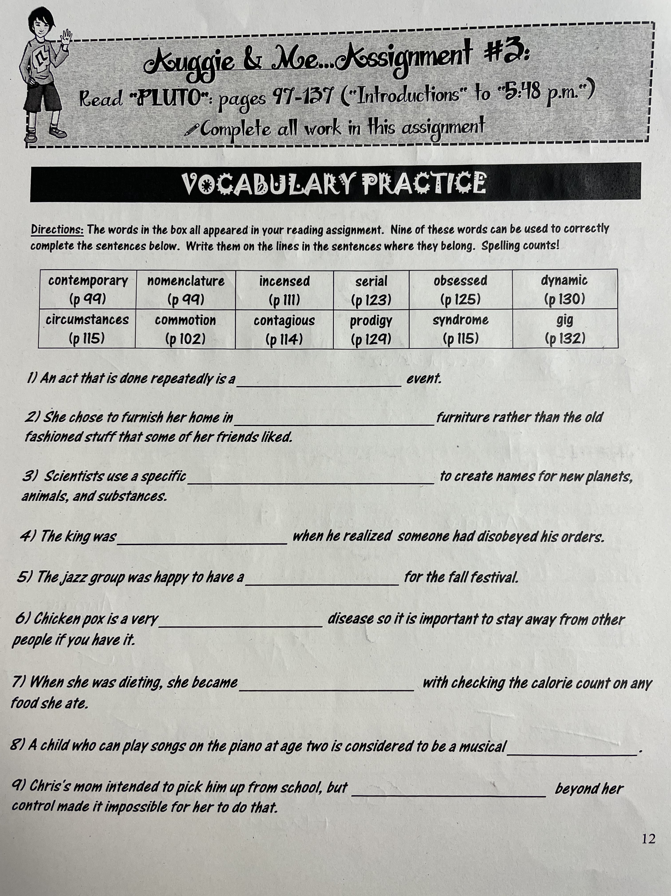
Reading

Slide 28
PE – I’m A Celeb Fitness.
LI: to complete fitness workouts.
Task Board
Access the ‘I’m a Celebrity Fitness camp’ powerpoint from files and complete – try to beat your score from Tuesday!

Slide 29
Number Talks

Slide 30
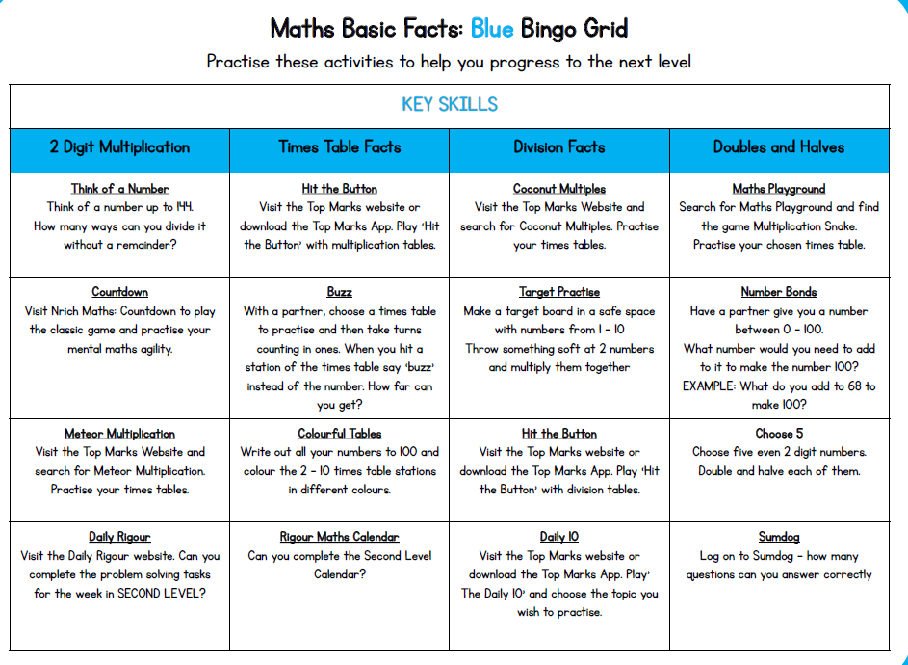

Slide 31
Health & Wellbeing
Friday 15th January 2021
LI: to identify ways to keep ourselves safe.
Keeping Ourselves Safe
Watch the above video and create a leaflet showing how to keep yourselves and others safe. Add any ideas of your own that you have!

Slide 32
Fun 31!
Task Board
Live chat with your friends. Games? (bingo, go and get, buzz etc?) Your choice ☺

Slide 33
Art Hub
Task Board
Choose a ‘little art school’ or ‘art hub’ video from YouTube or the Art Hub website. Send me a picture of your completed masterpiece! https://www.youtube.com/user/ArtforKidsHub - Art Hub https://www.youtube.com/channel/UCjzIXK9CRttcA6i0shxjFng - Little Art School

