Slide 1
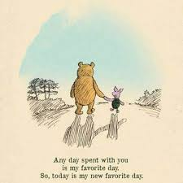
Friday 15th January
15.01.21

Slide 2
Maths
Daily 10
Roll that number board game
Literacy
Reading books
Spelling words
HWB
P.E with Miss Lee

Slide 3
It’s always a good day to be active! Join Miss Lee’s P.E session on the school Facebook page.
This will be live at 9.30, but you can access the video later too!

Slide 4
It’s daily 10 time! Complete your daily 10 in your jotter.
In your pack, there are 2 ‘roll that number’ board games and a dice. There are instructions included also in the pack; enjoy! ☺
To show off your work, it can be sent to Miss Morrison on Seesaw/Teams.

Slide 5
Celebrate – it’s Friday!
Click for a shake break!

Slide 6
Review this week’s library book – using your reading response booklet, tell me what you thought by completing the ‘book review’ page.
To show off your work, it can be sent to Miss Morrison on Seesaw/Teams.

Slide 7
We have worked on a lot of different sounds through the last 2 terms – using the link below, give me your best ‘ff’ word.
https://www.menti.com/9wvi9e3jvy
You can add as many words as you like.

