Slide 1
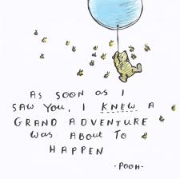
Thursday 14th January
14.01.21

Slide 2
Maths
Daily 10
Education city/topmarks games
Literacy
Reading books
Daily writing prompt
Spelling – tricky words

Slide 3
1. Today’s daily 10 should be completed in your jotter – remember to date the page!
To show off your work, it can be sent to Miss Morrison on Seesaw/Teams.
2. Log in to topmarks and education city – first level numeracy games are relevant to what we have been learning.
Miss Lee can see all of your super work here.

Slide 4
We’ve almost made it! Reward yourself for all your hard work with a shake break.
Click for a shake break!

Slide 5
We should know our library books well by now! Today’s task using your reading response booklet is to complete the ‘interesting words’ page. Look through your book and pick out some words you find interesting – these could be words you would like to use in your own writing, or words you didn’t know before and have learned! Pick 6 words and write these on the sheet.
To show off your work, it can be sent to Miss Morrison on Seesaw/Teams.

Slide 6
In your blue homework jotters, I would like you use the words you picked from your library books to write some sentences.
You should have 6 sentences in total – try to create the most interesting sentence you can using the words you chose. Remember your full stops and capital letters!
To show off your work, it can be sent to Miss Morrison on Seesaw.

Slide 7
Keep working on those tricky words! Play a game of SPLAT with a family member. Put all the words in the middle of the table and have someone call out a word – the first person to ‘splat’ the word keeps it; the person with the most words at the end of the game wins! ☺

