Slide 1
August and September learning at Forehill EYC.
2026-2027

Slide 2
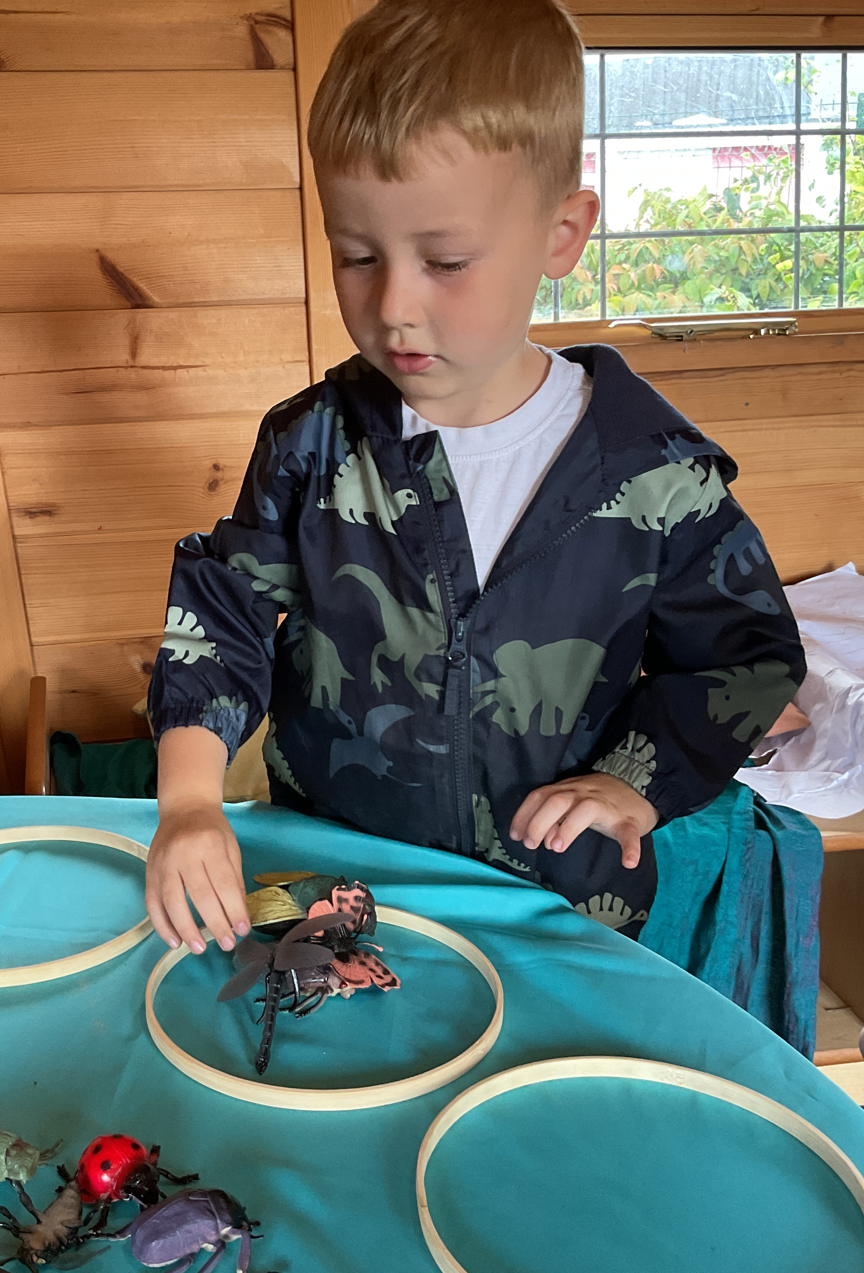
We have been looking at different bugs and sorting them into categories, such as, number of legs and if they can fly

Slide 3
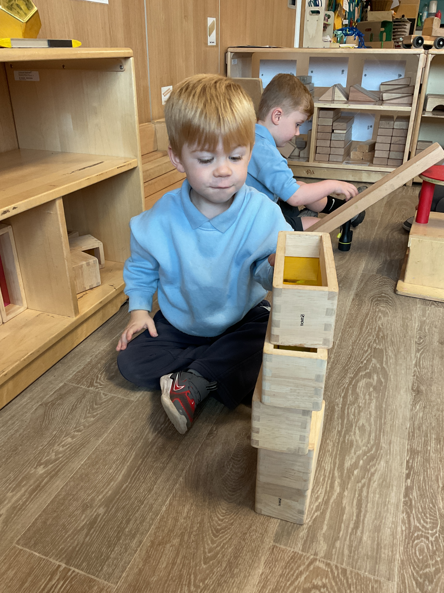
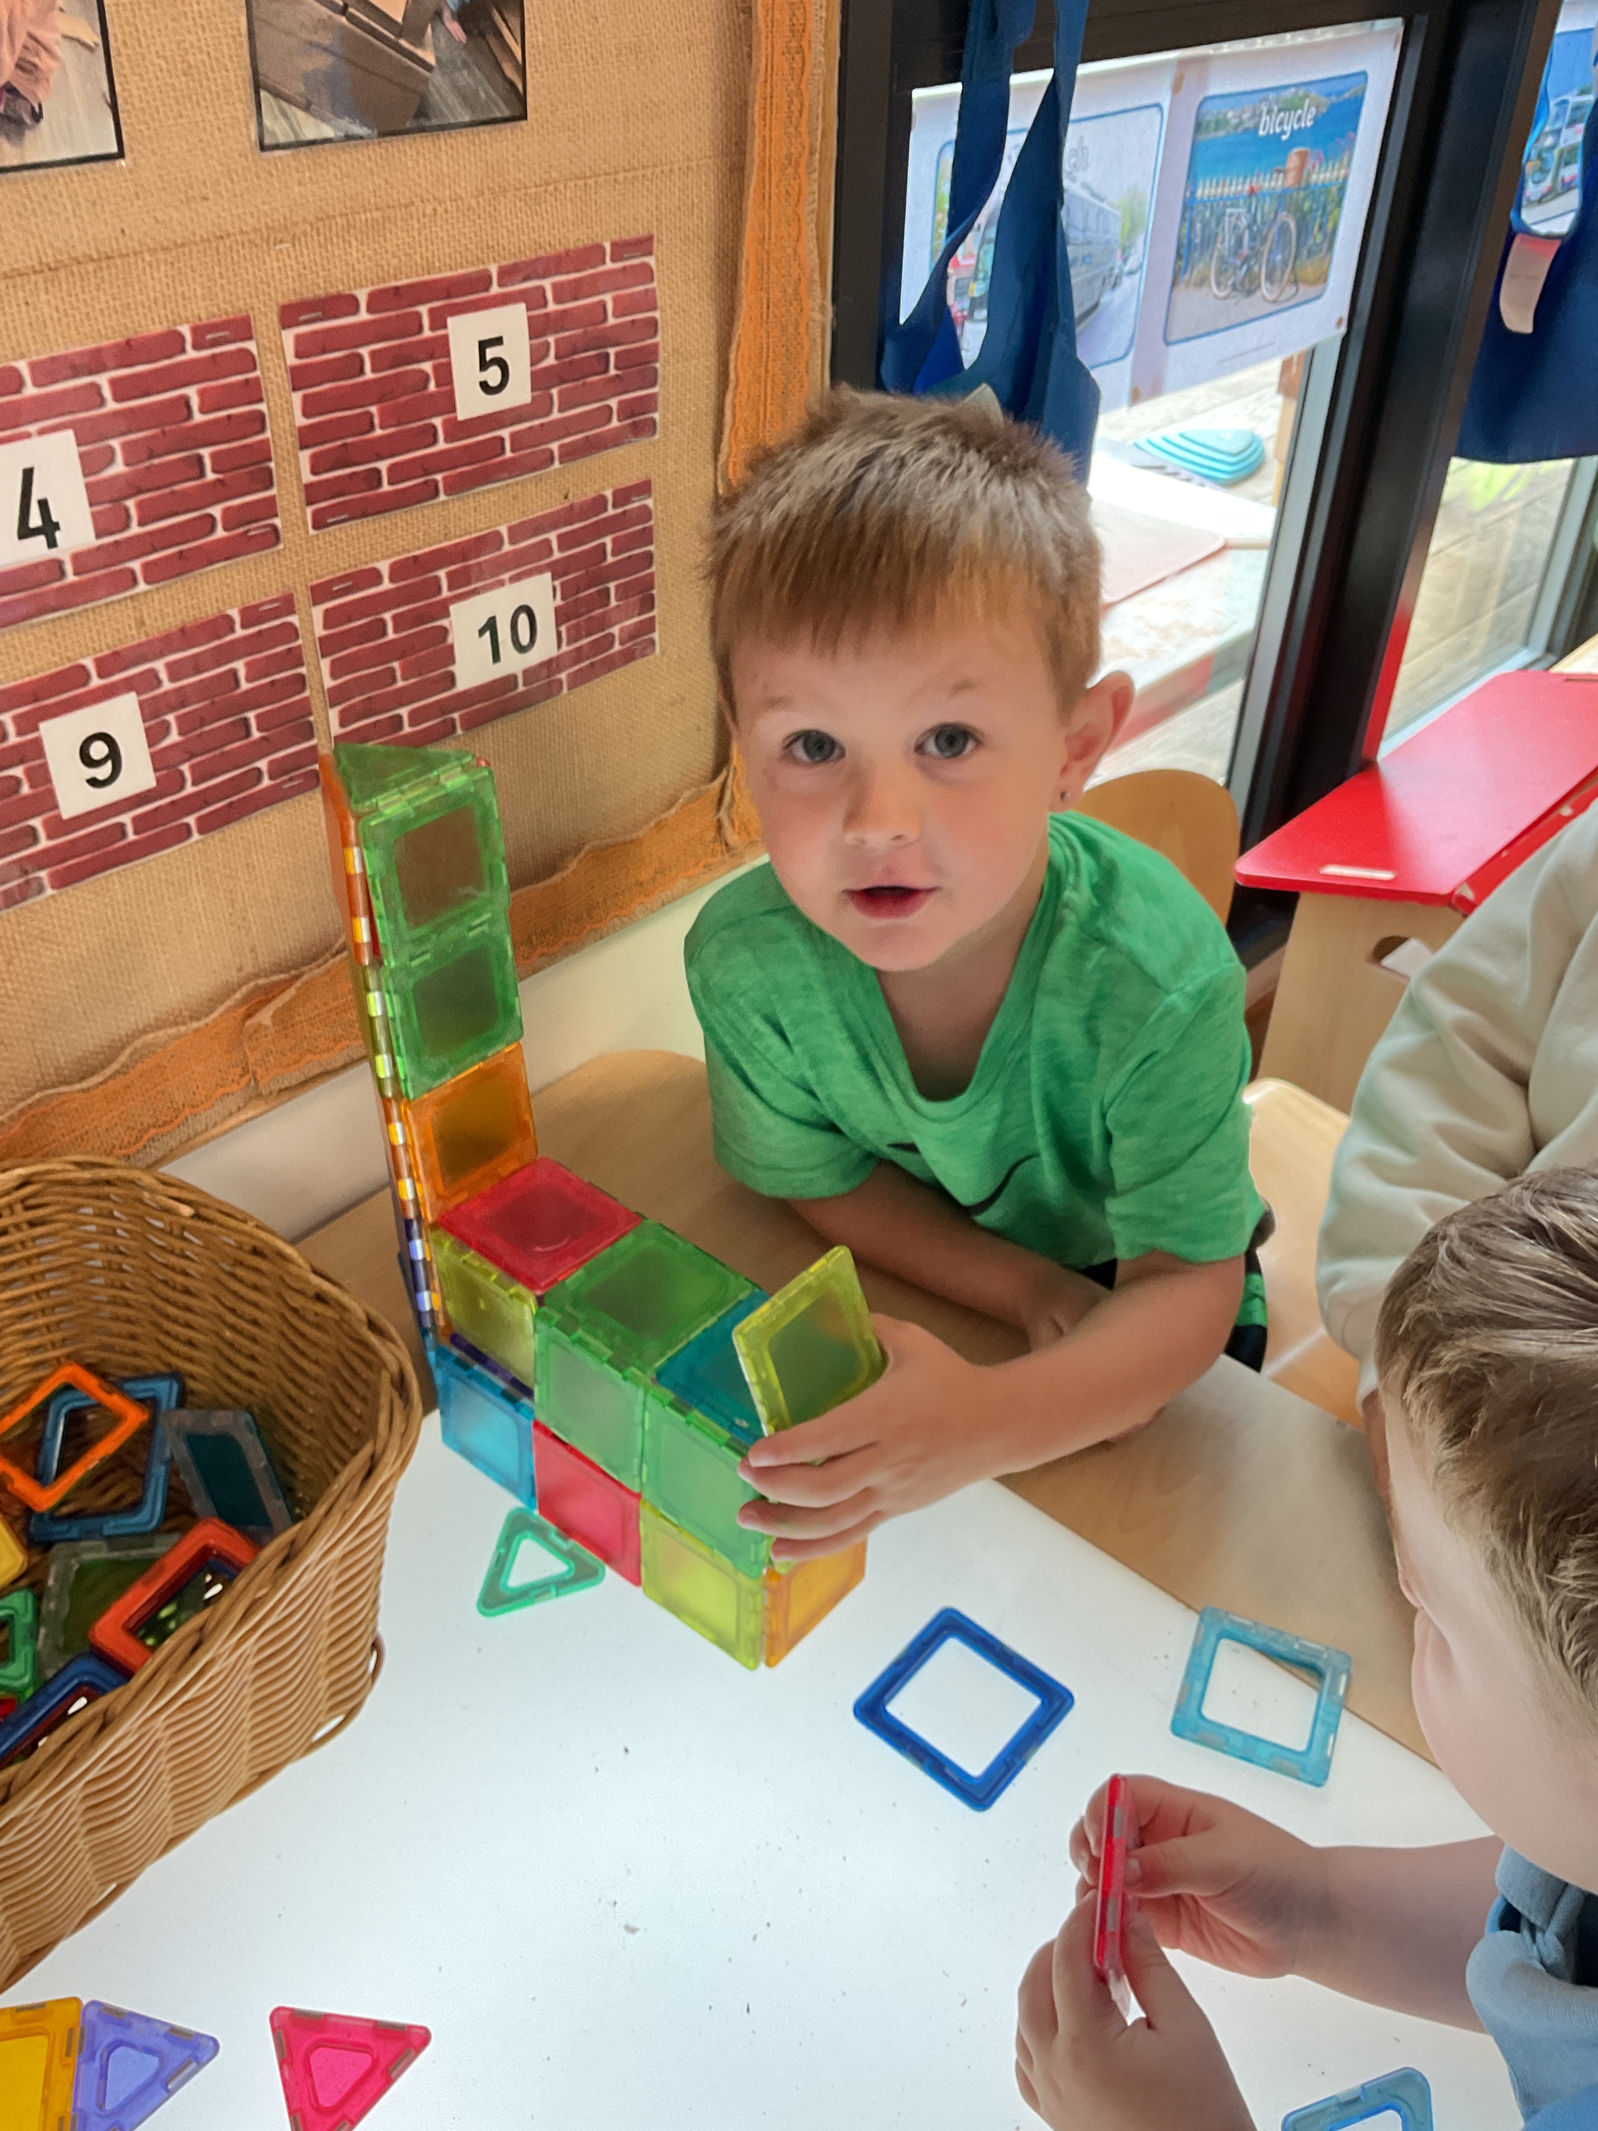
Using the magnetic squares to design a tall building
Building with the large wooden blocks

Slide 4
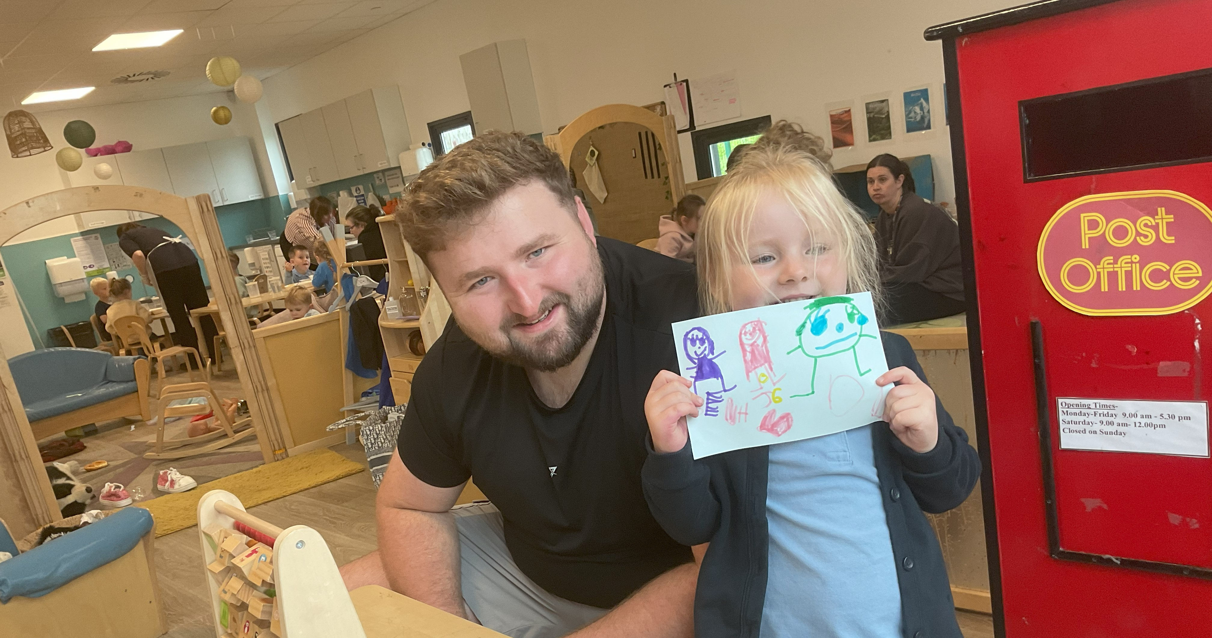
Grace was having lots of fun during our shared learning at the mark making area!

Slide 5
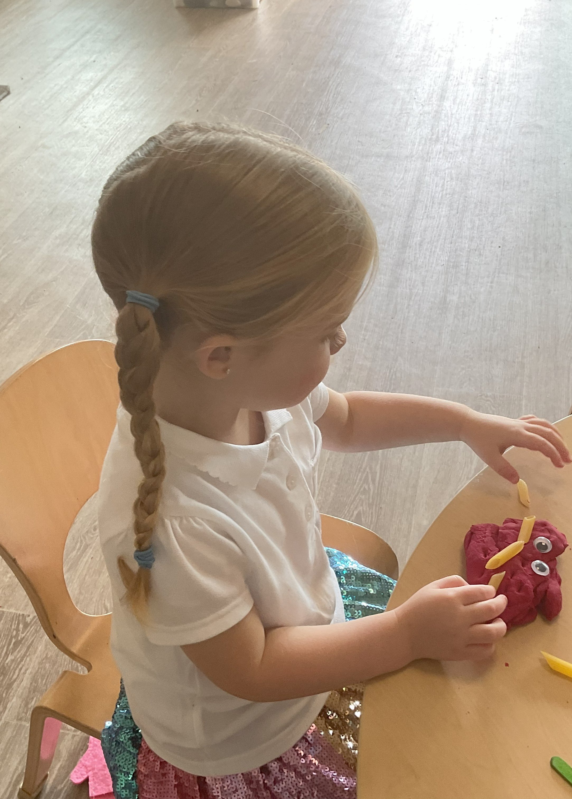
We have been making our own designs and building our fine motor skills with the playdough.

Slide 6
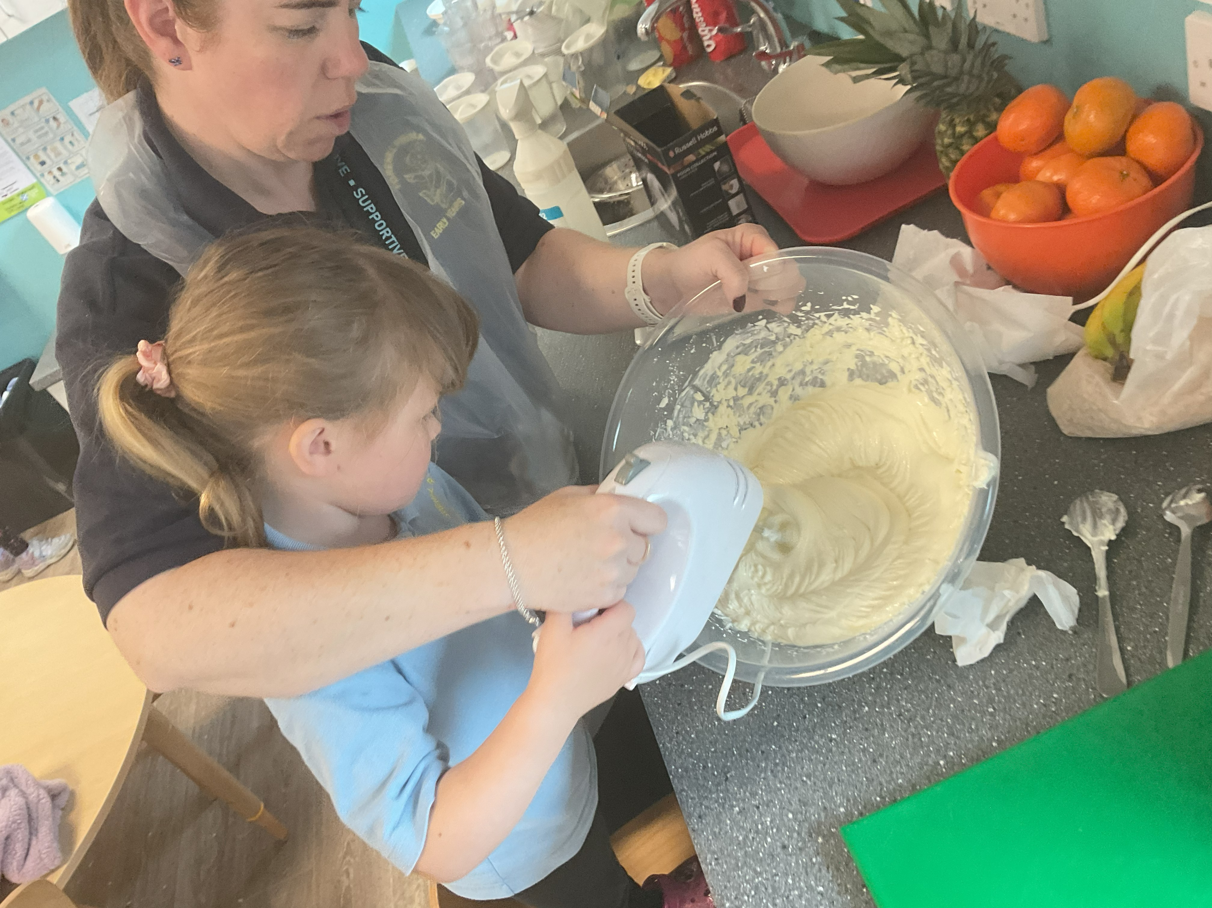
Lynn supported us to use new tools at the snack area!
SR “My mummy uses this at work.”

Slide 7
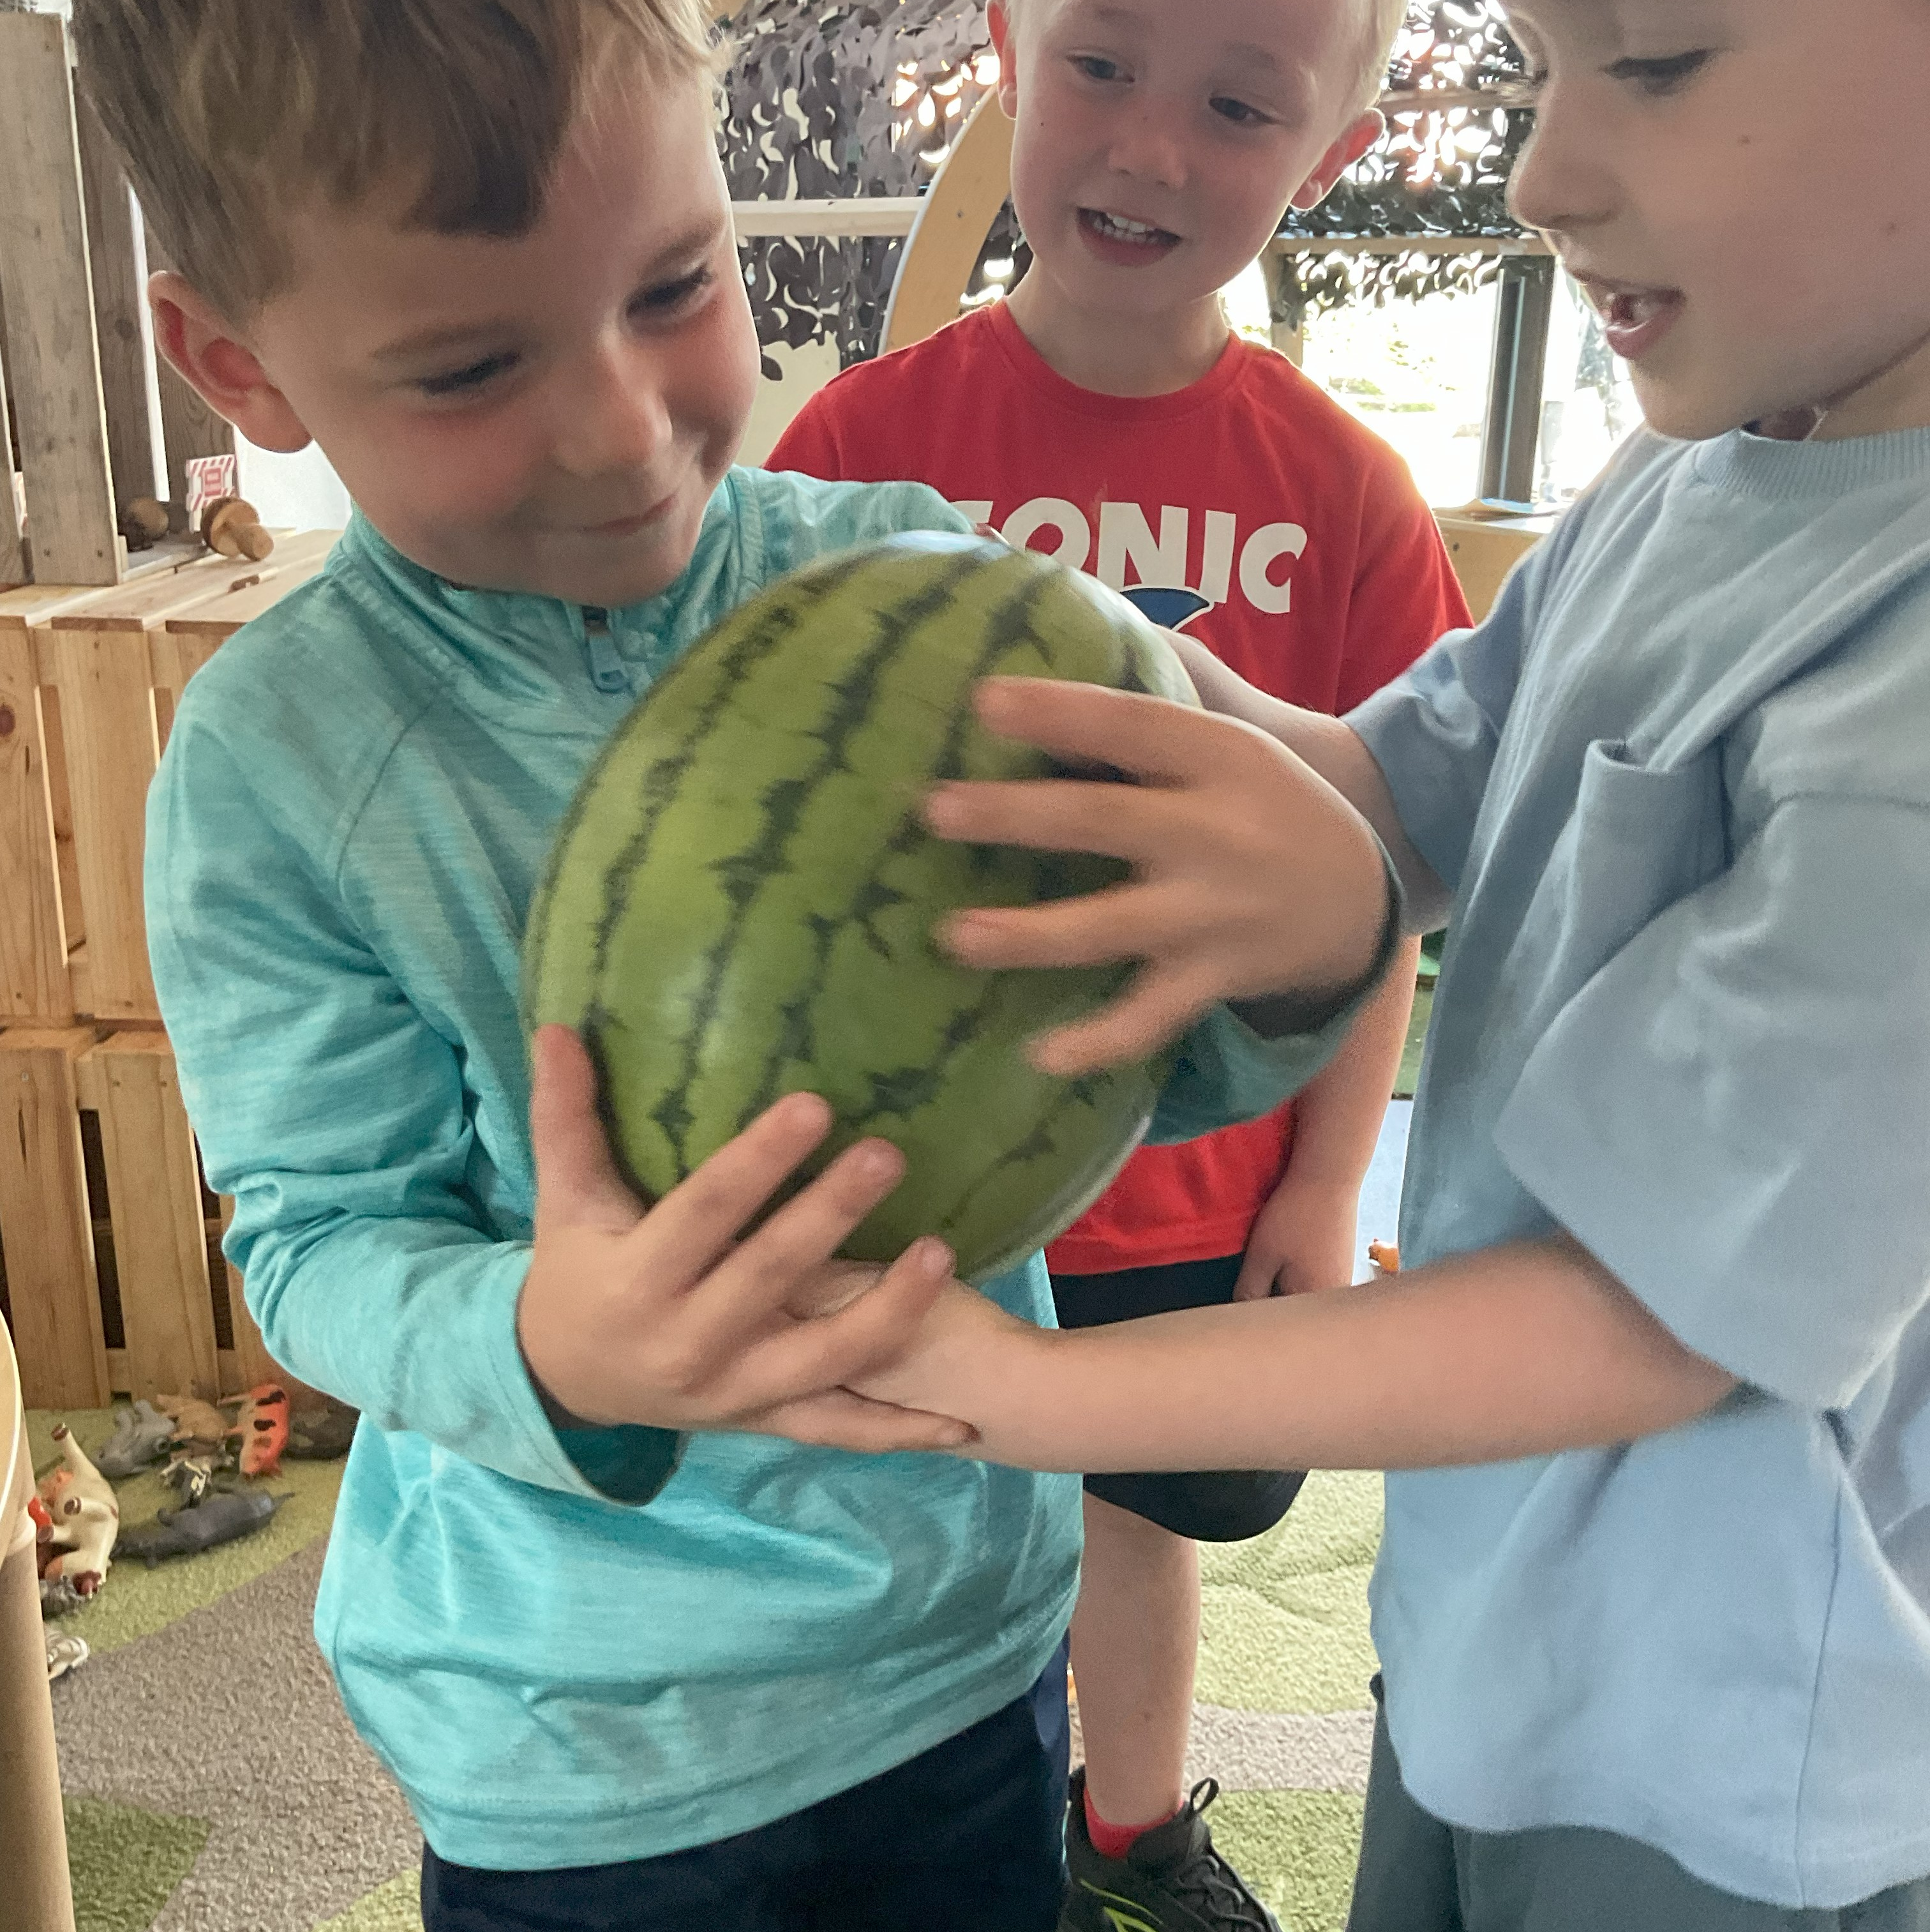
We have been measuring the weight of different items that hippo’s can eat!
“It’s really big and heavy, we tried to smash it like the hippo’s teeth” AMc

