Slide 1
Summer Fun
2026
WEEKS 1 - 3

Slide 2
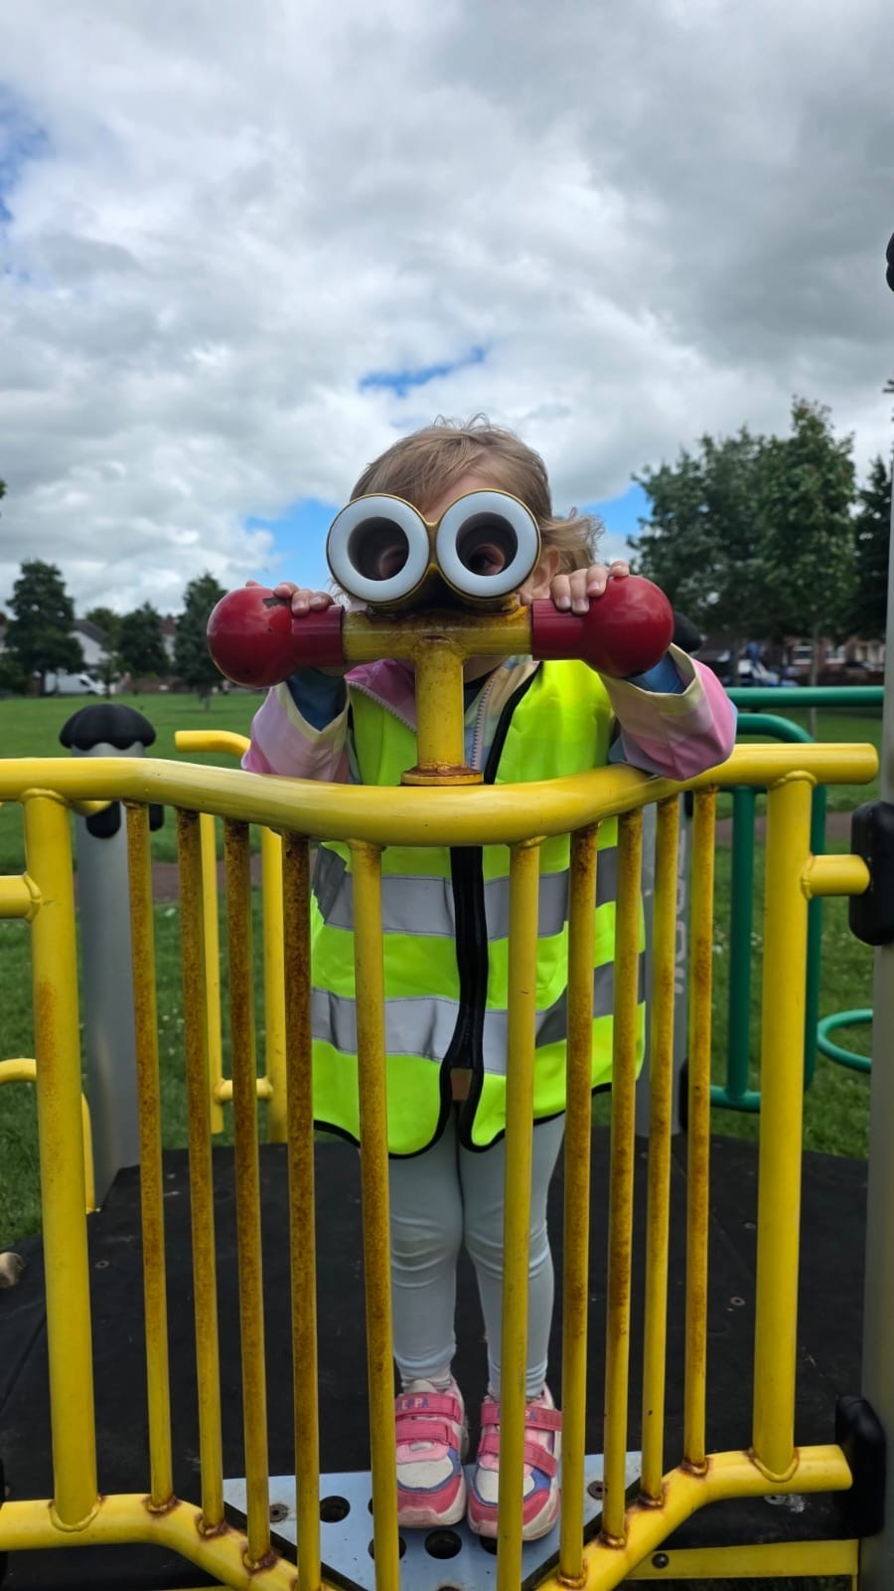
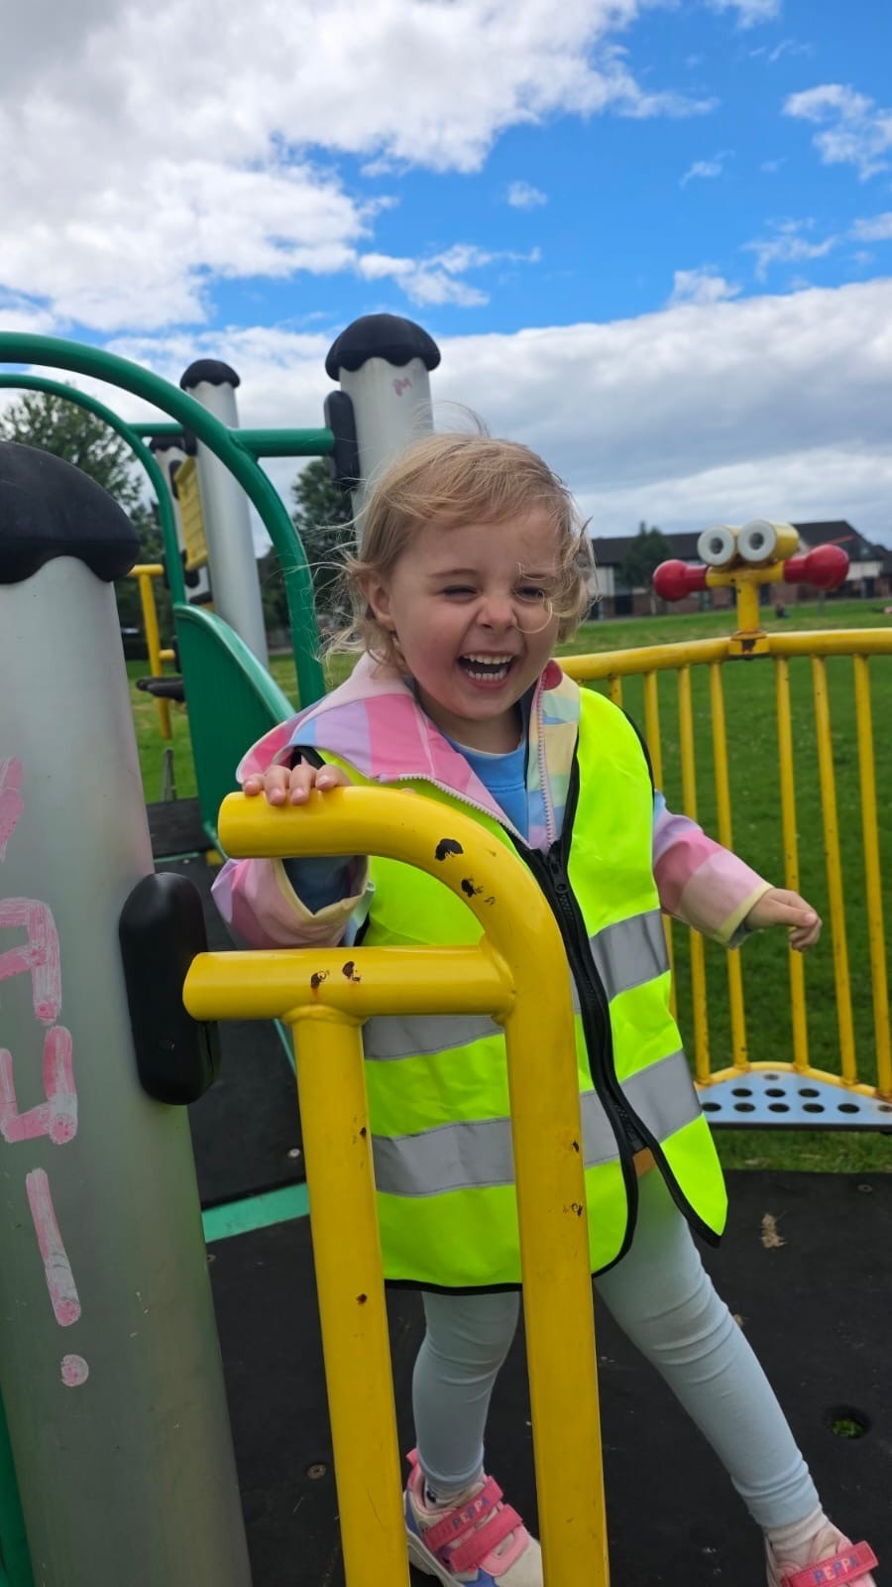
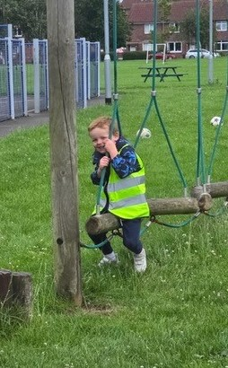
Trip to the park

Slide 3
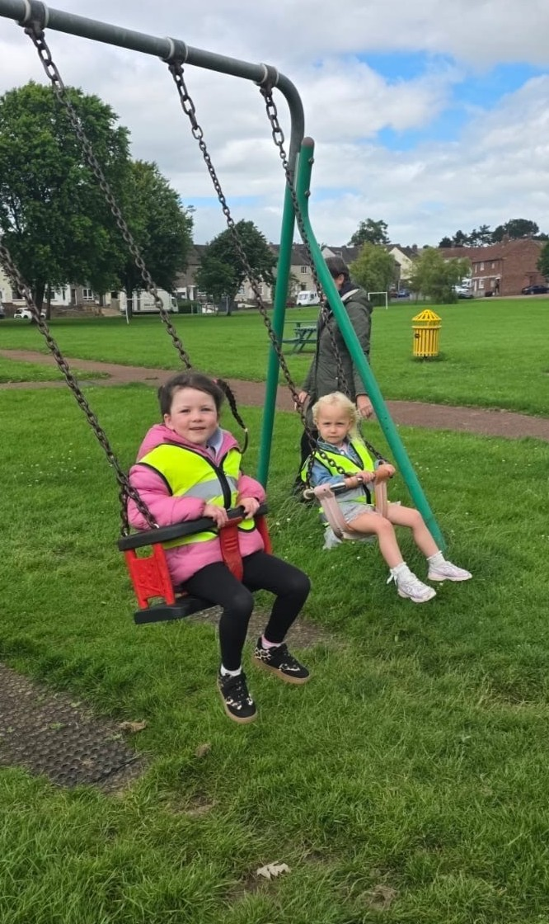
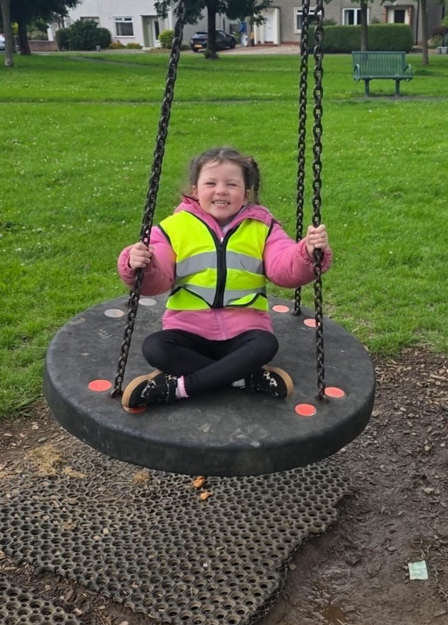
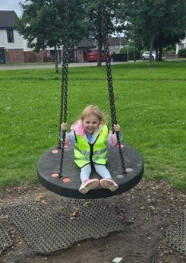

Slide 4
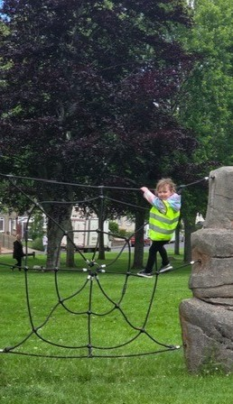
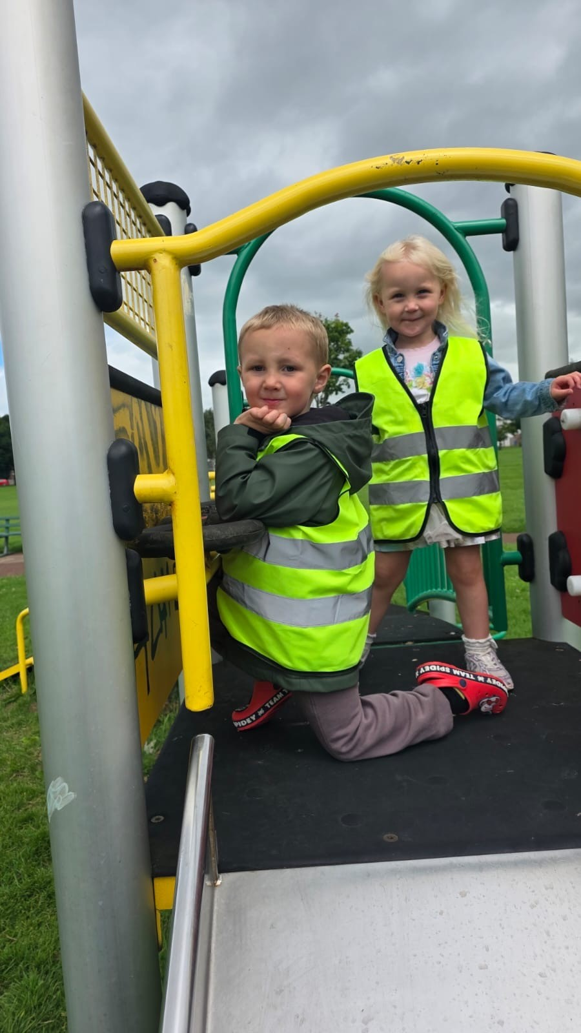
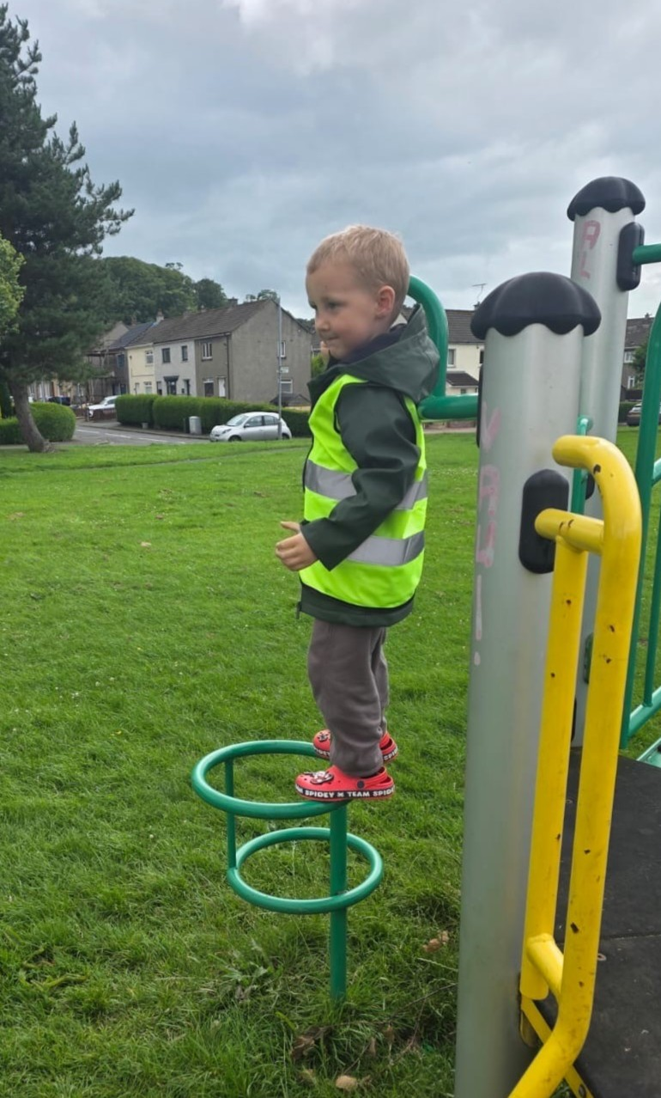

Slide 5
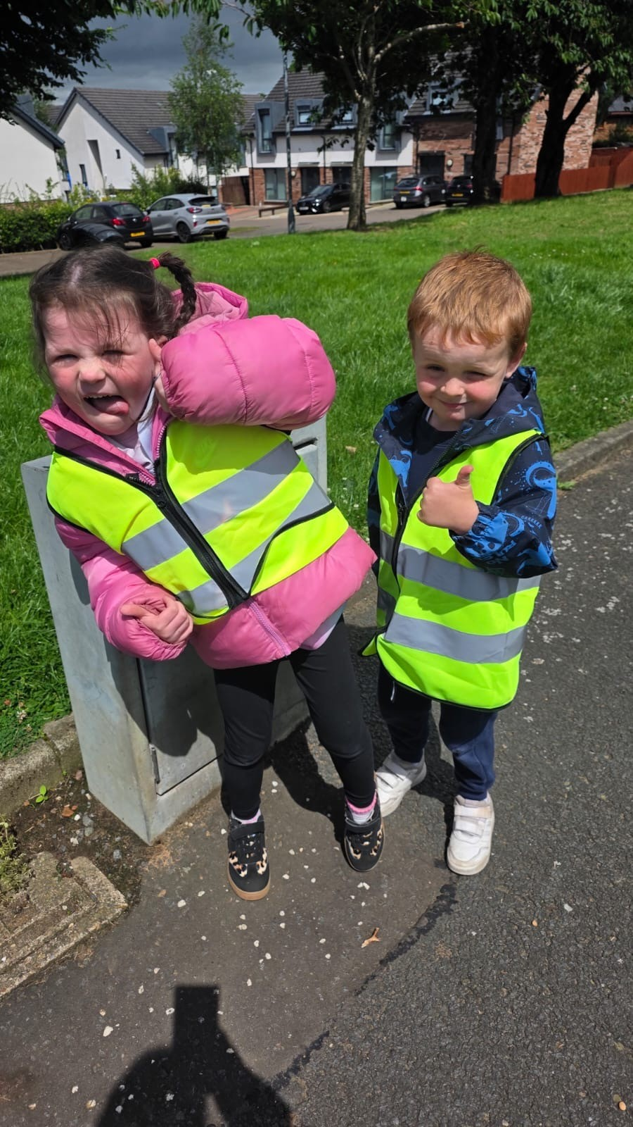
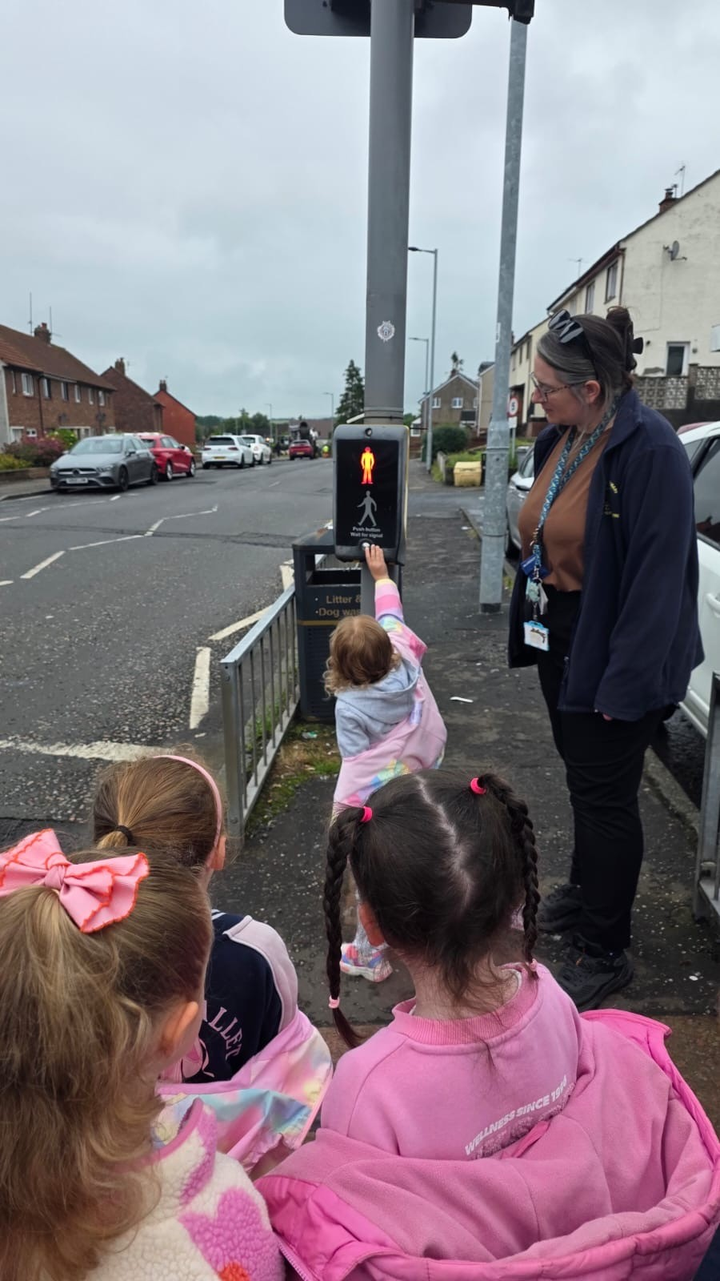
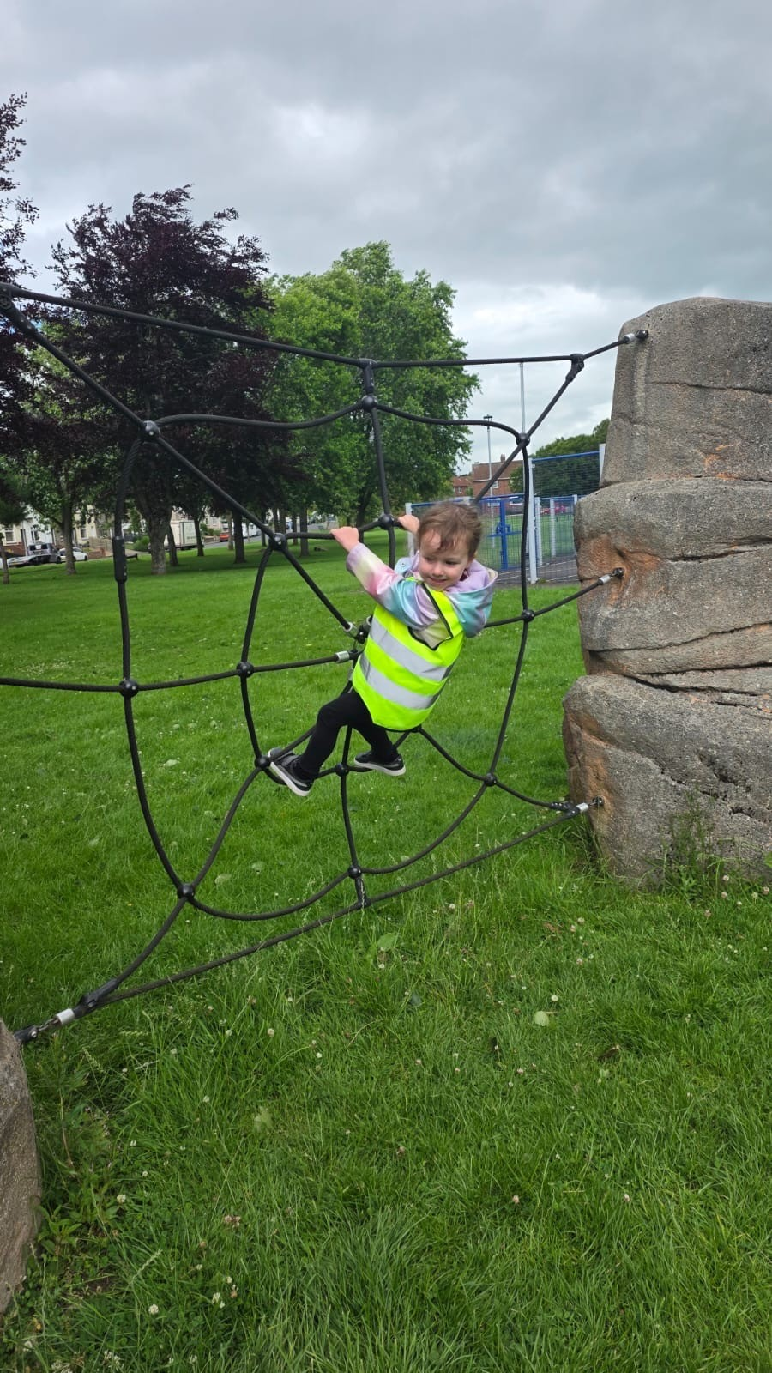

Slide 6
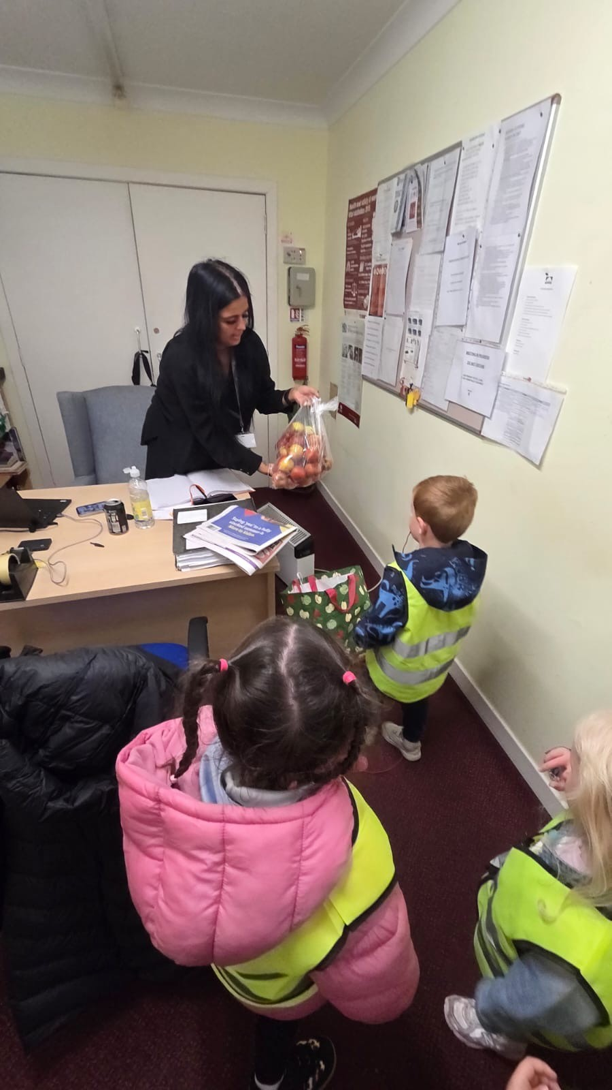
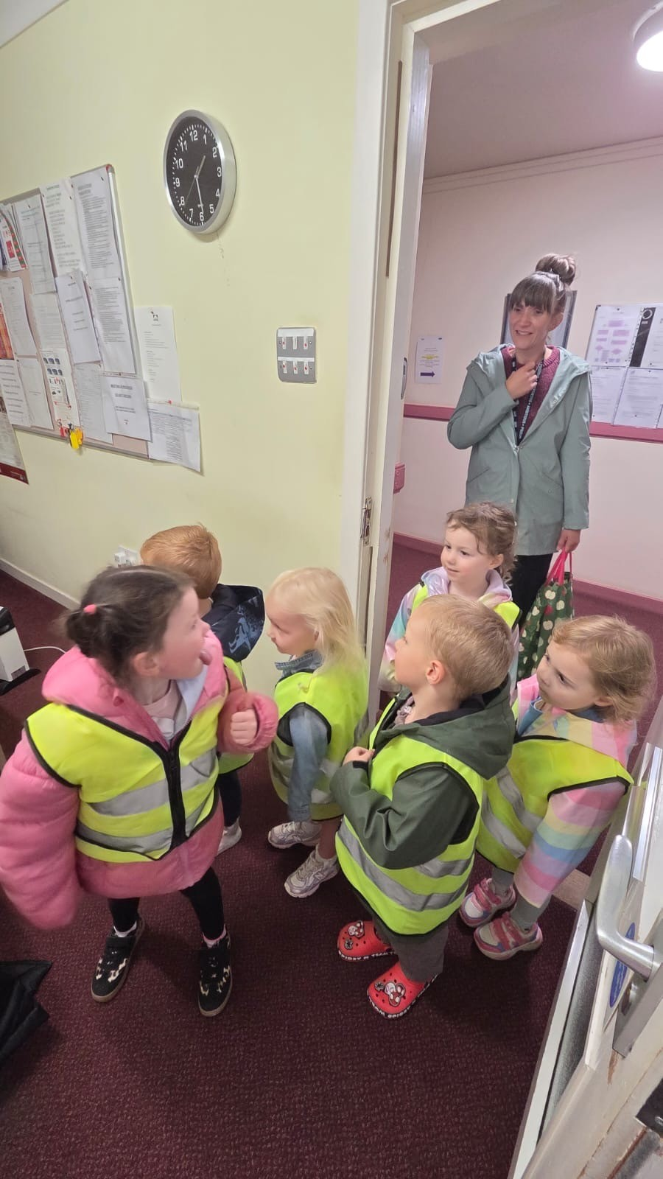
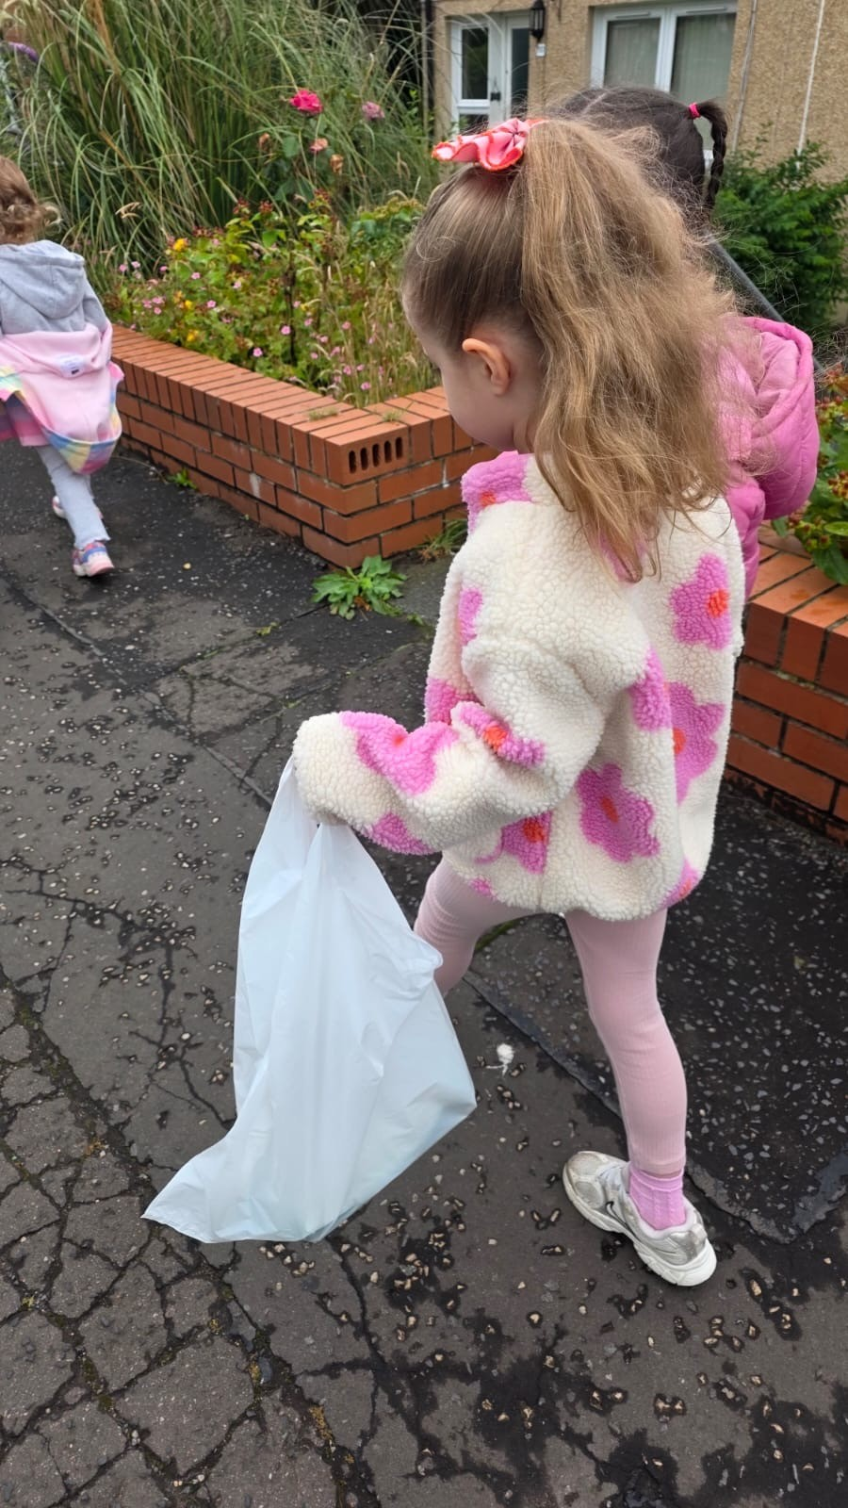
Visit to the sheltered housing

Slide 7
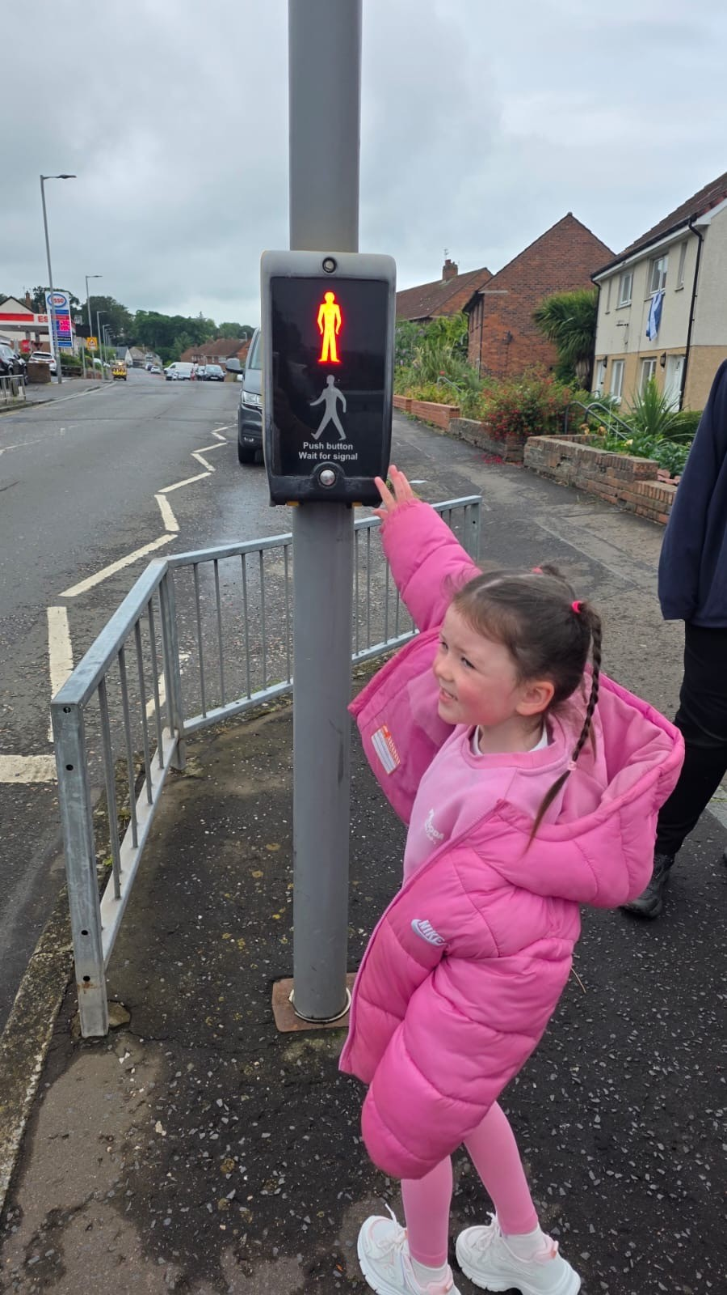
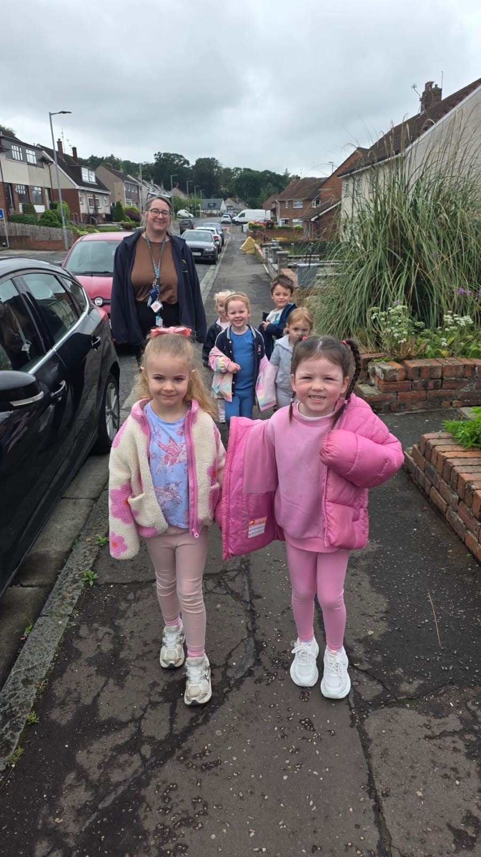
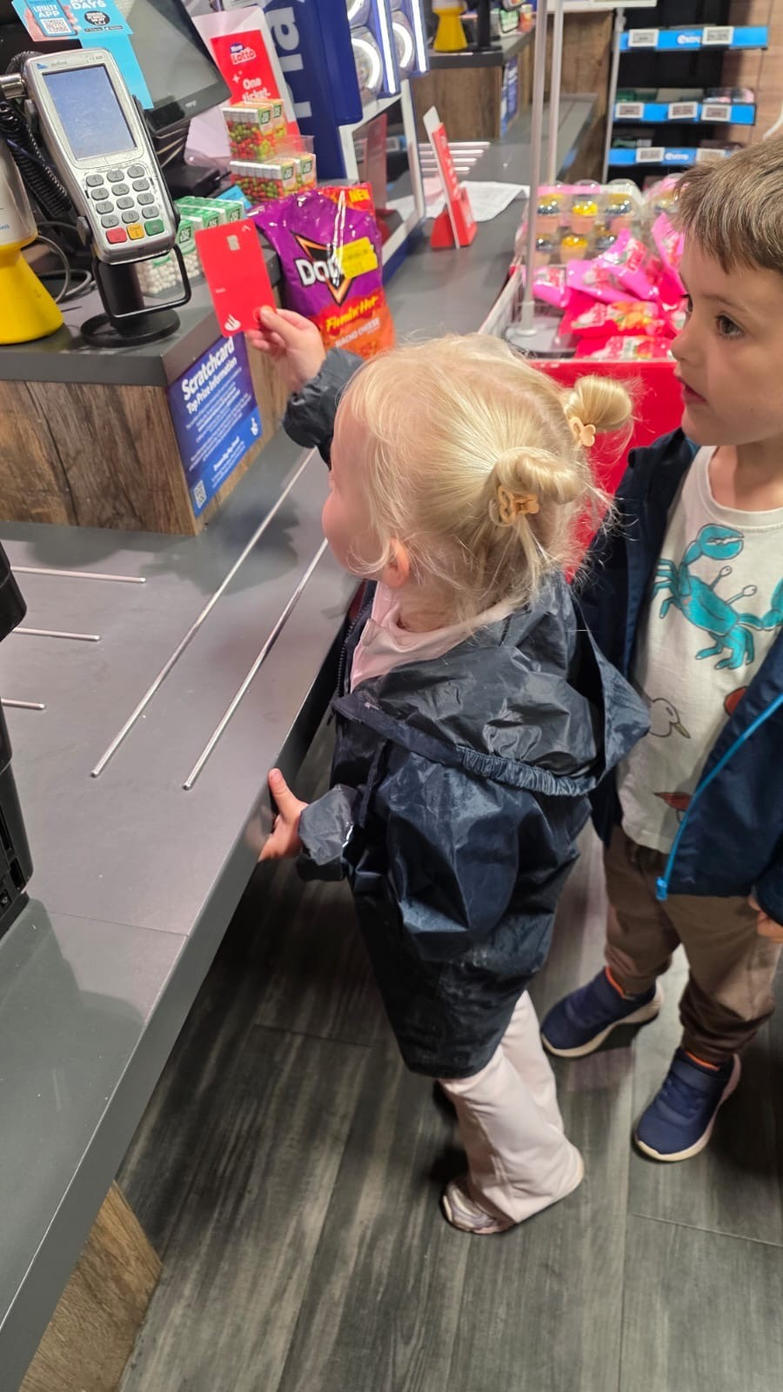
Trip to the shop

Slide 8
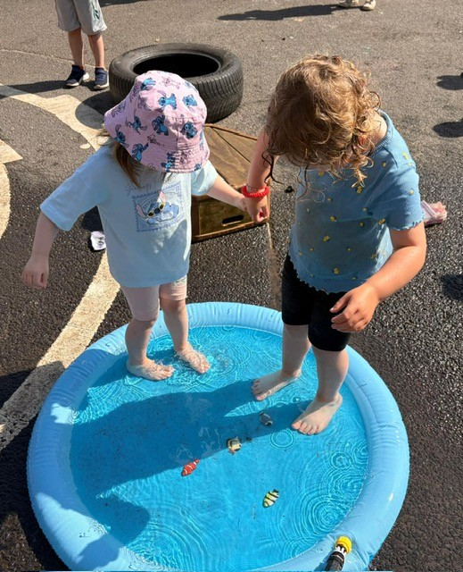
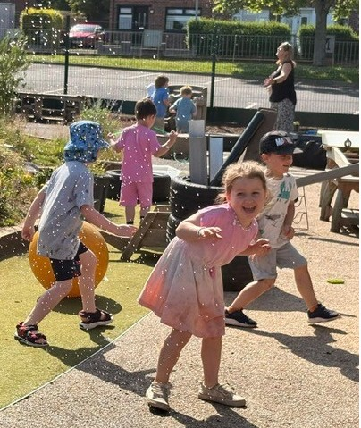
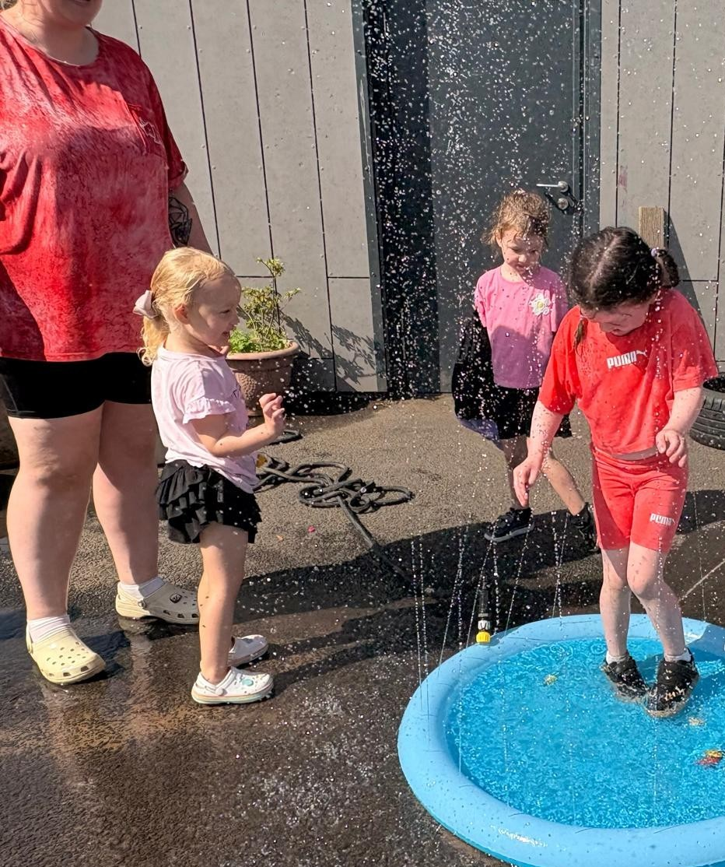
Water Fun

Slide 9
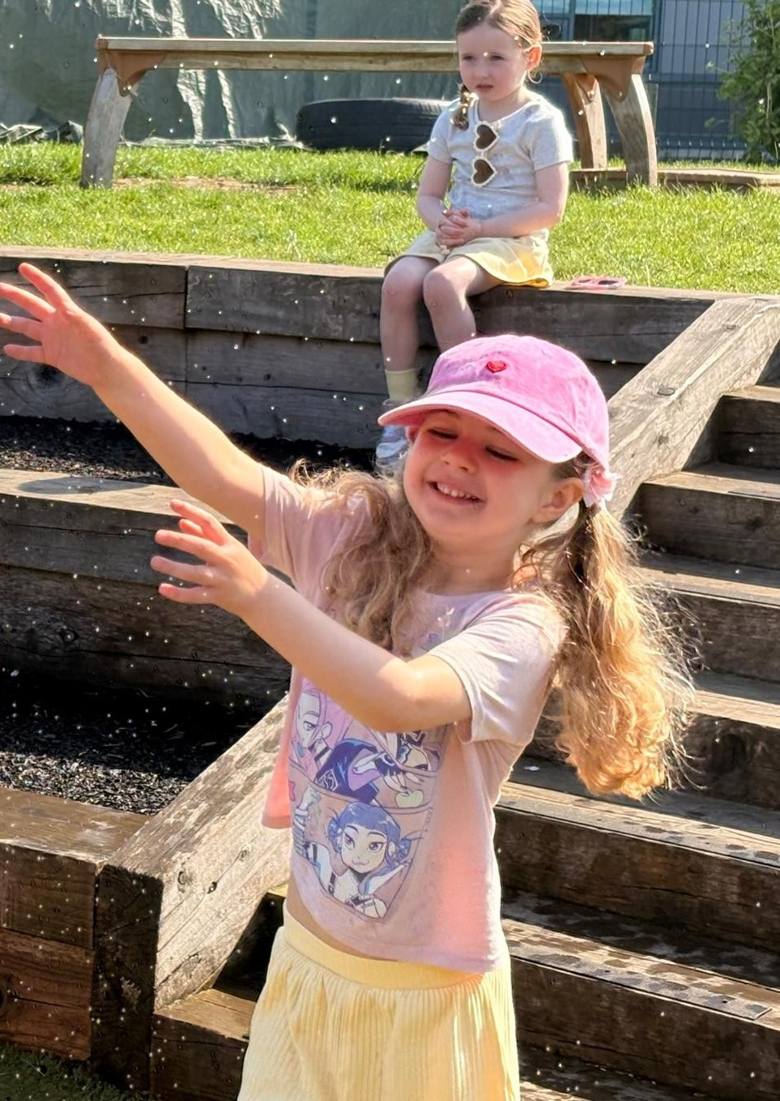
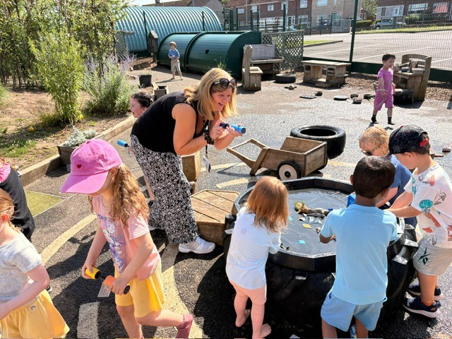

Slide 10
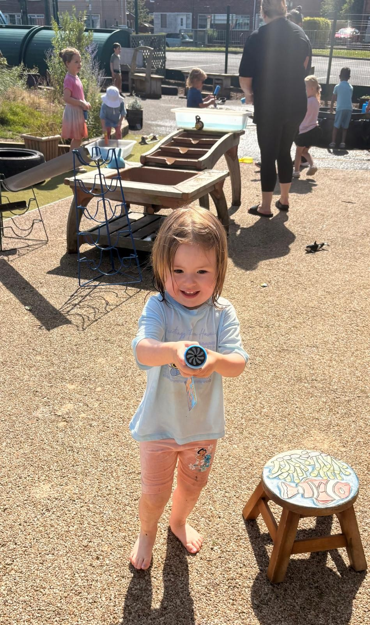
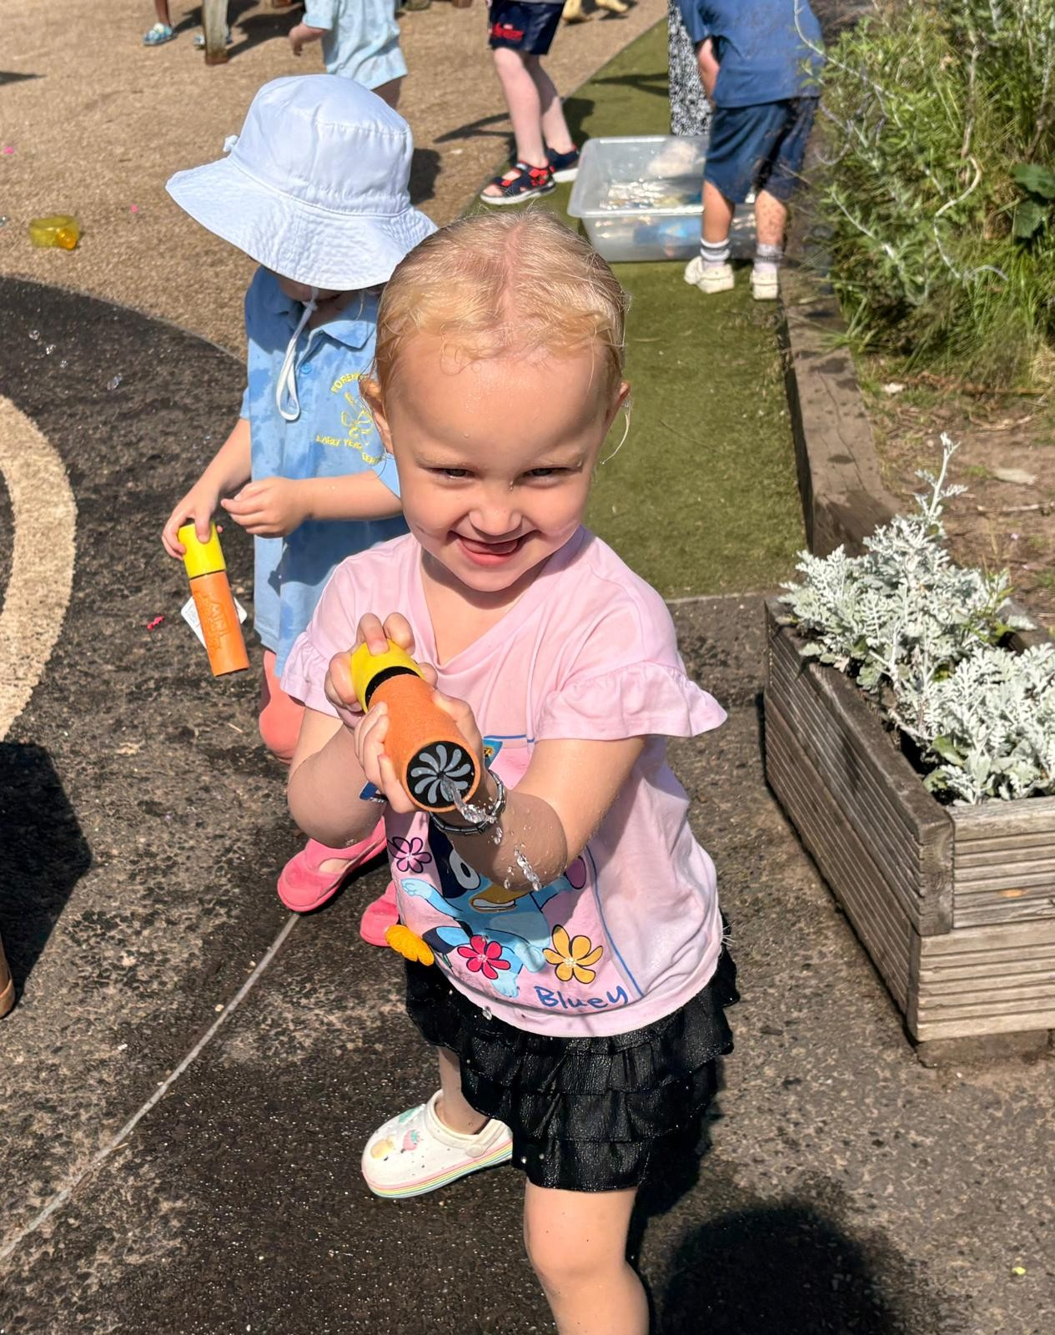

Slide 11
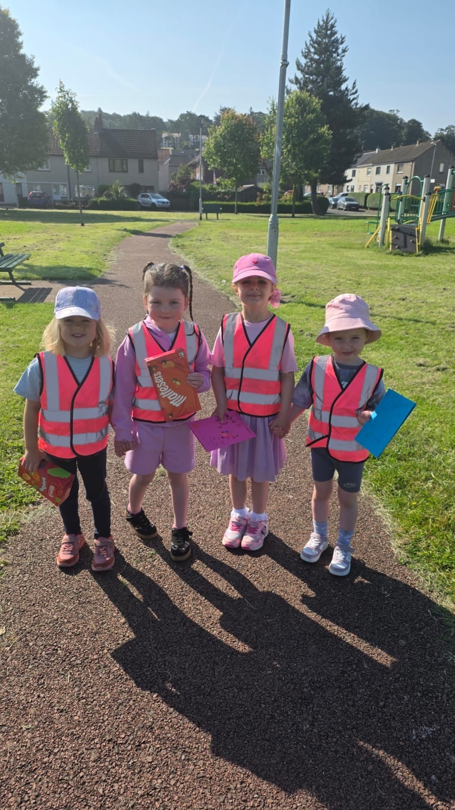
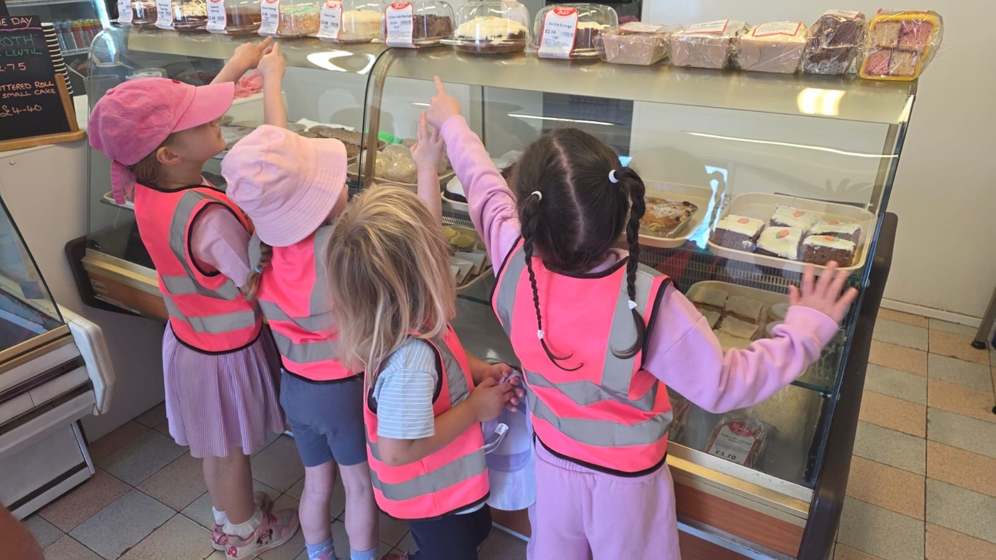
Delivering a thank you gift and a visit to the shop with a quick stop at the park

Slide 12
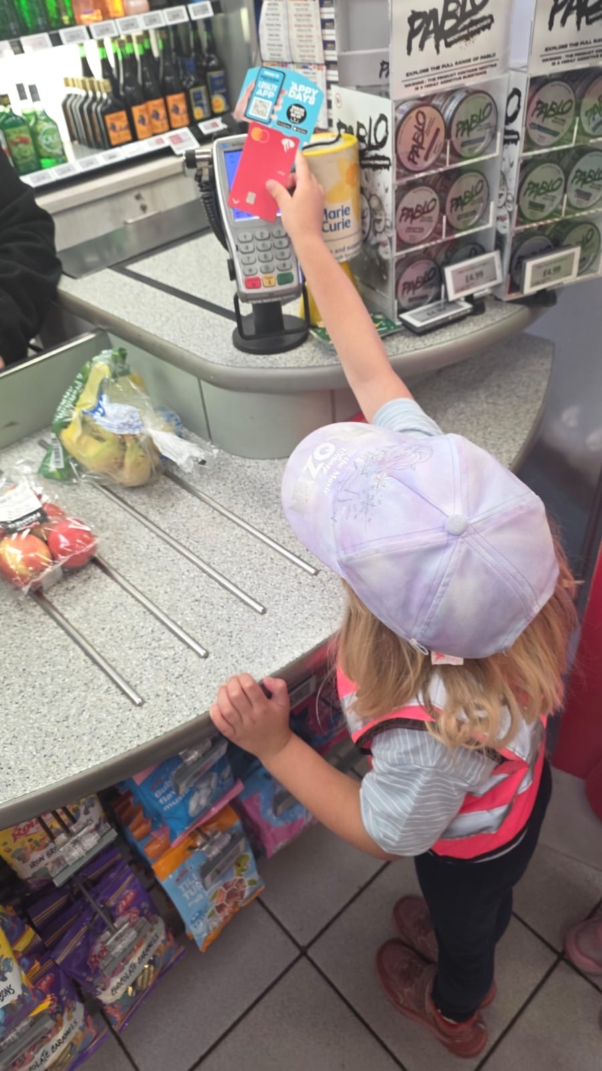
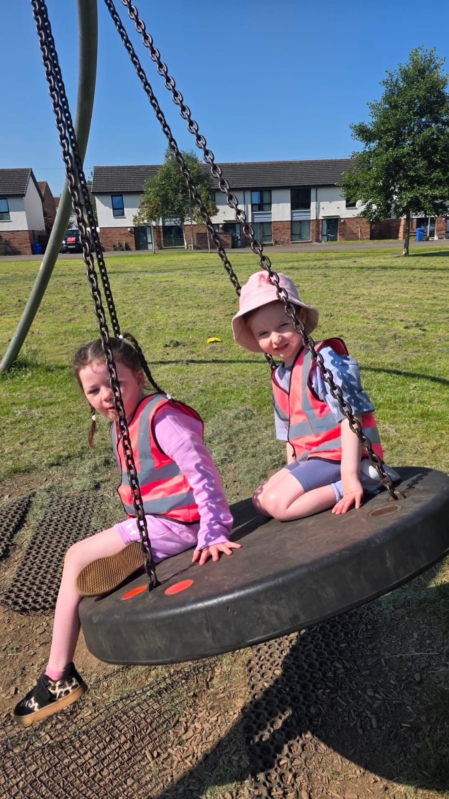
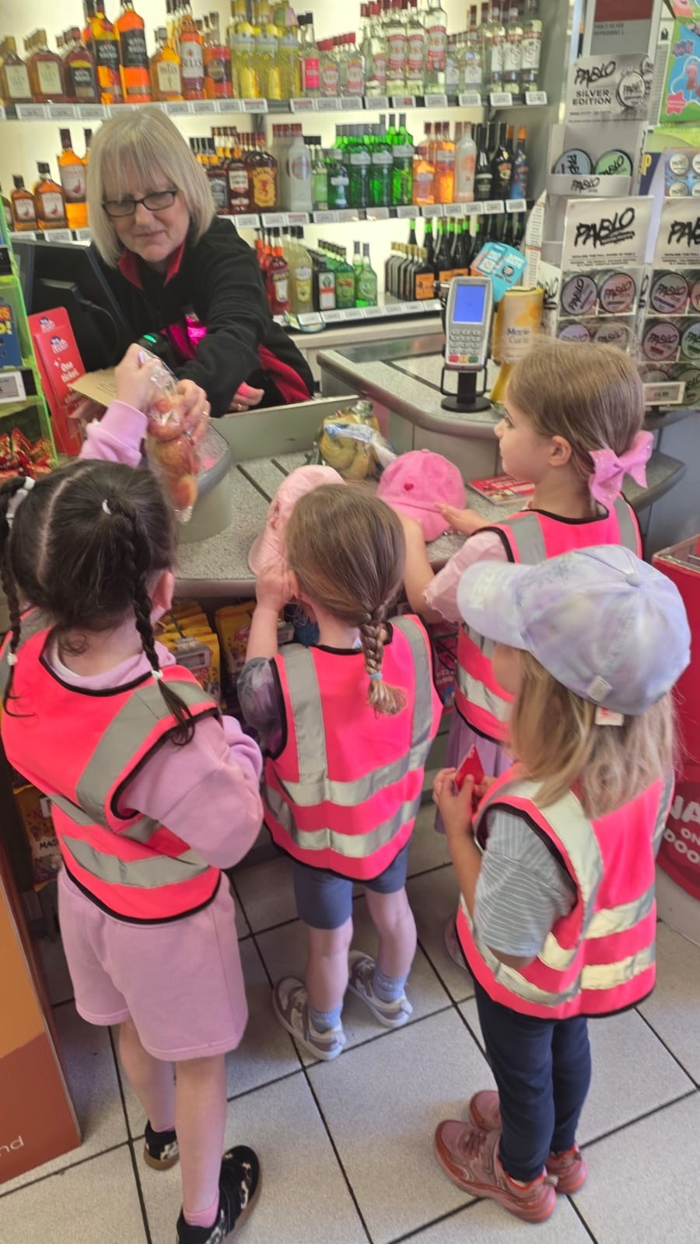

Slide 13
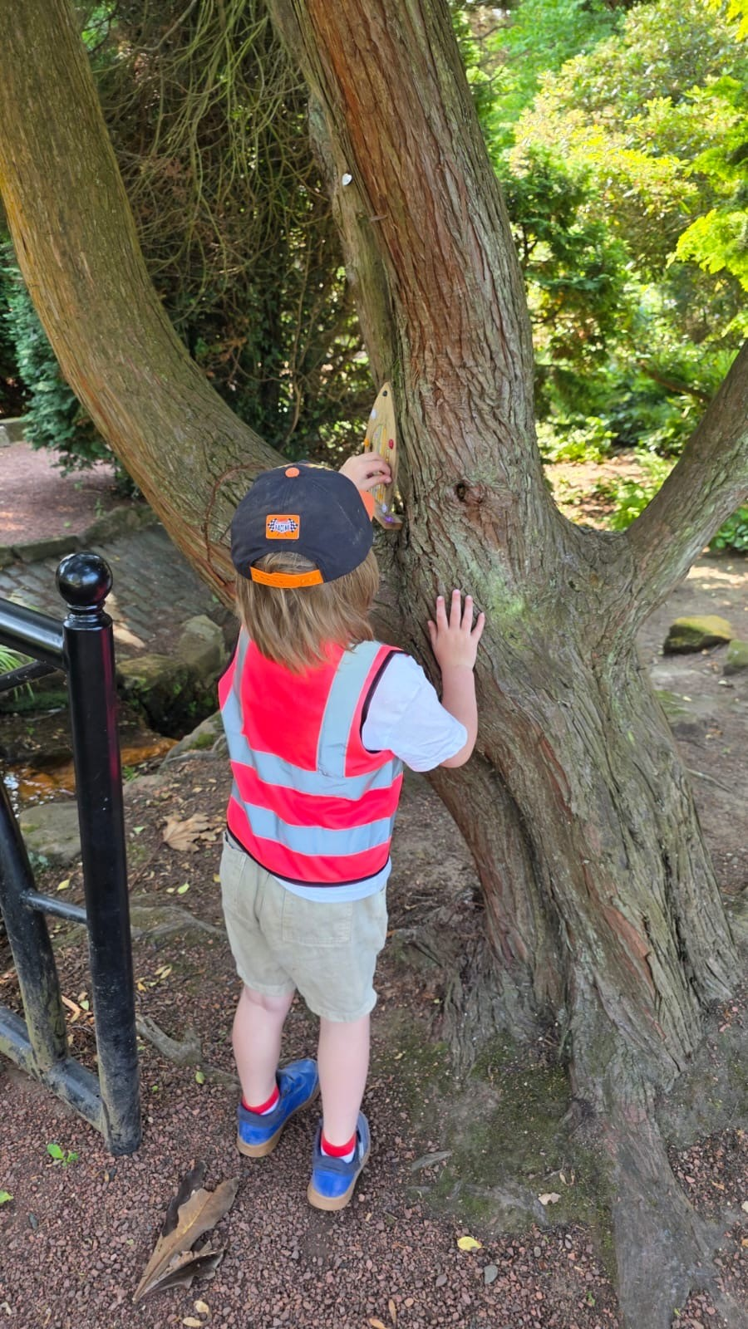
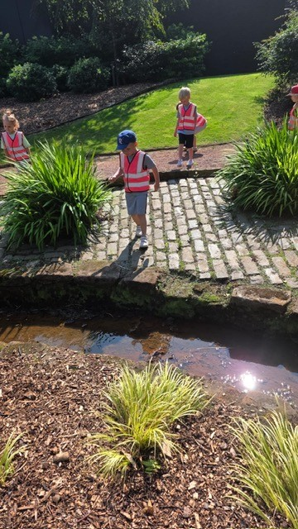
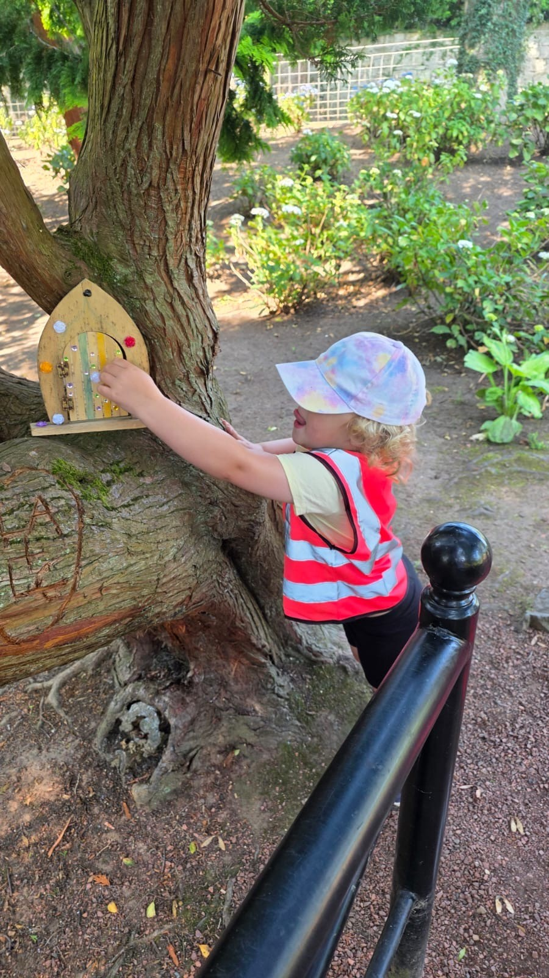
Walk to the river

Slide 14
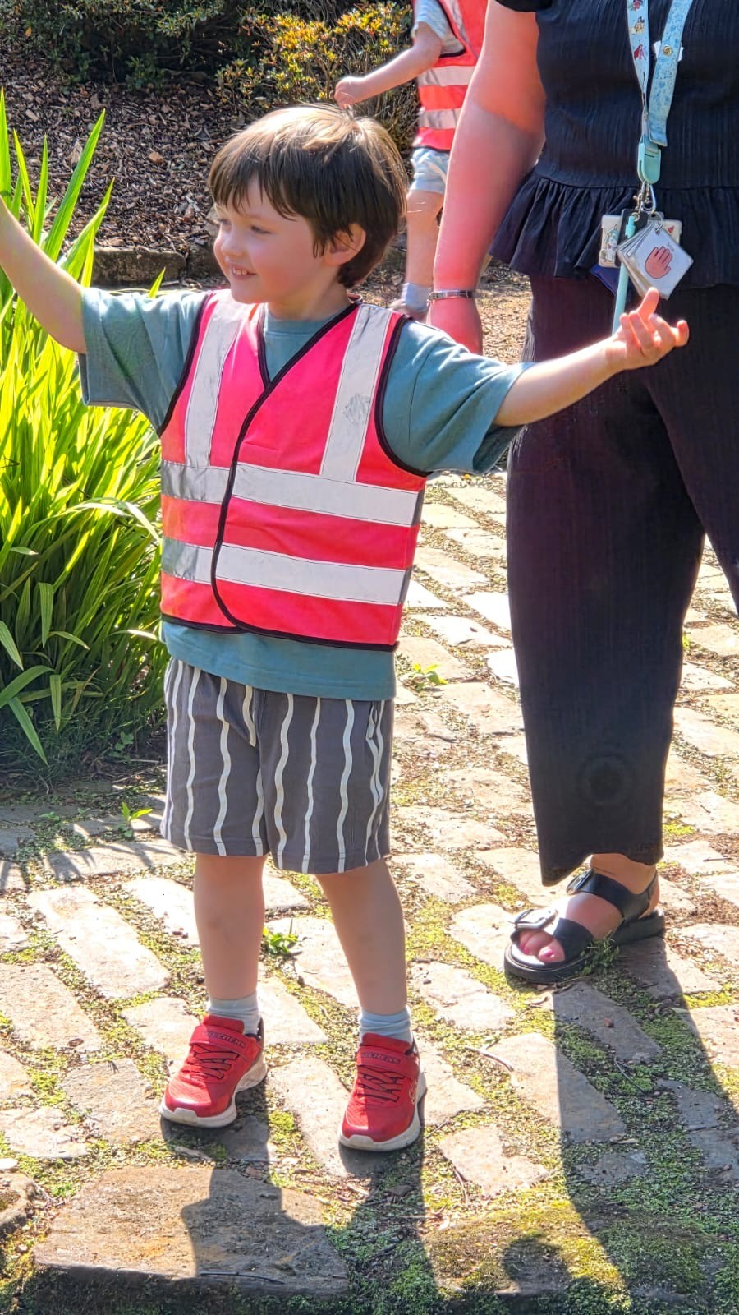
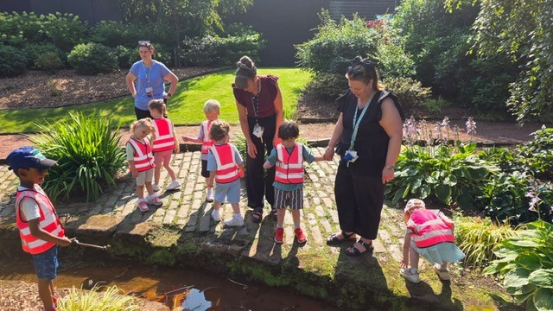

Slide 15
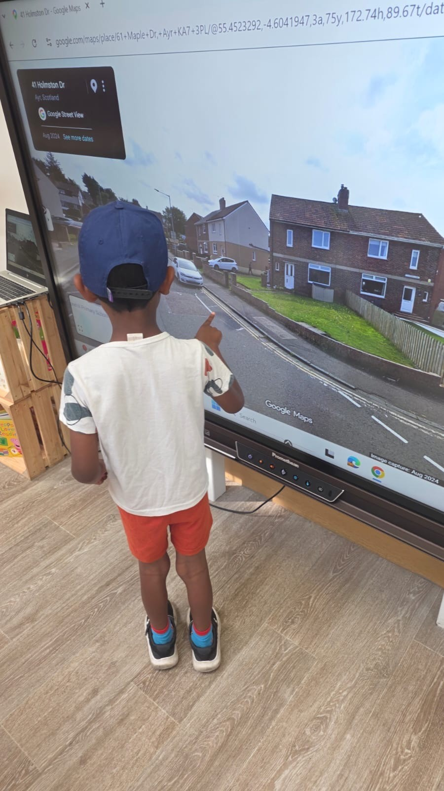
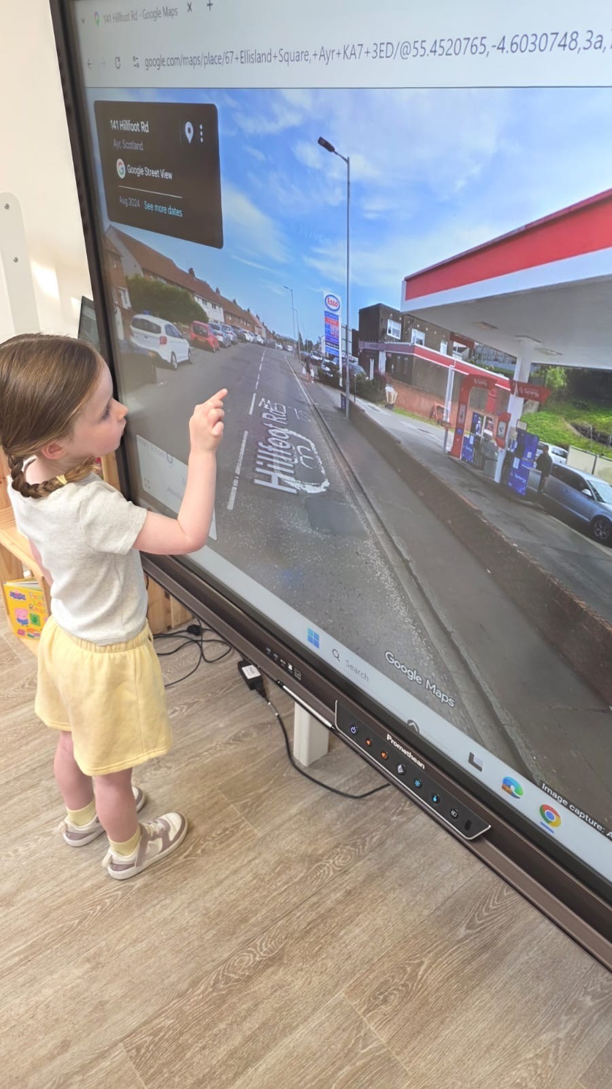
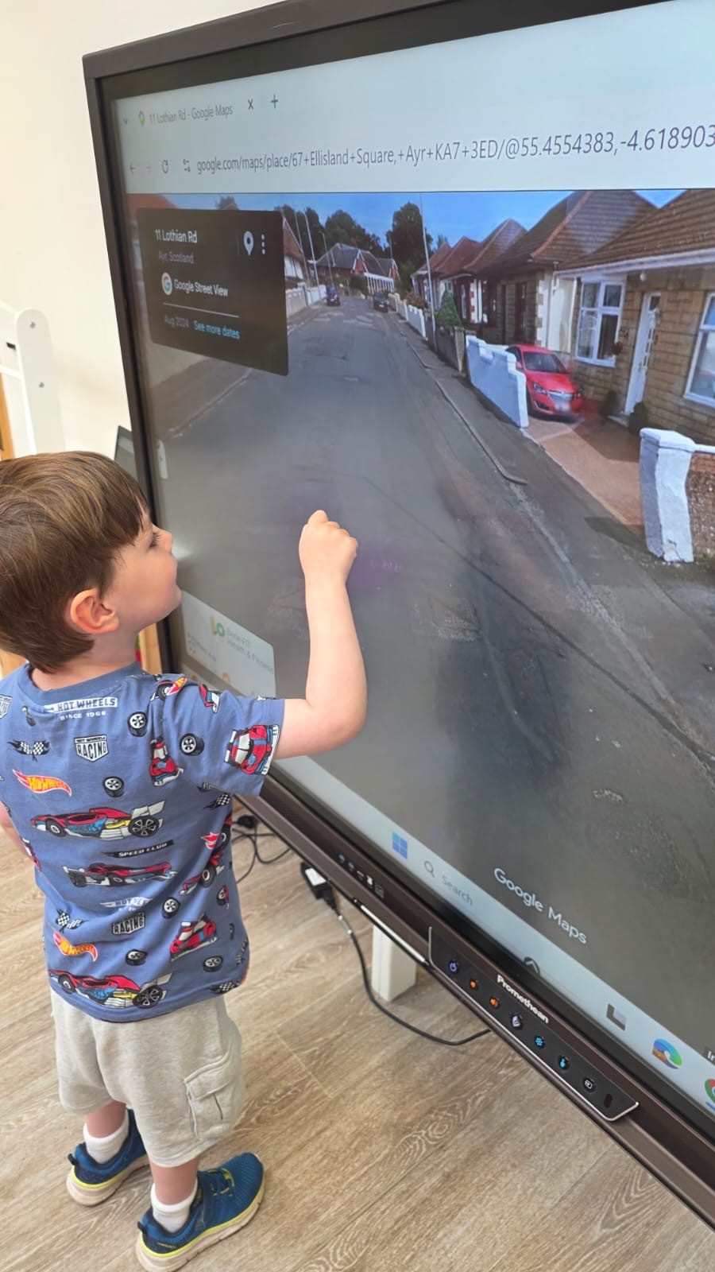
Finding our house and building our own town.

Slide 16
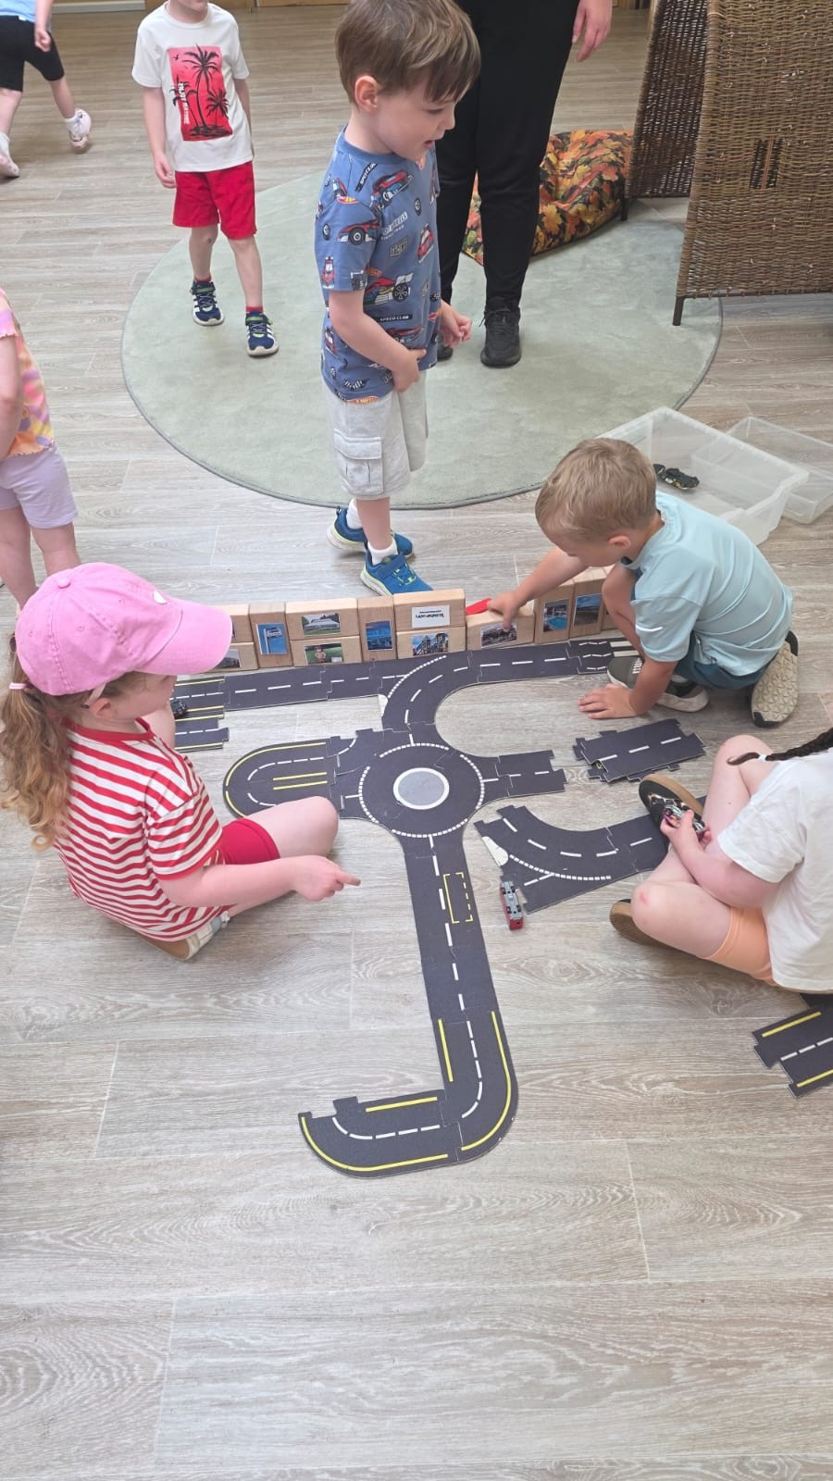
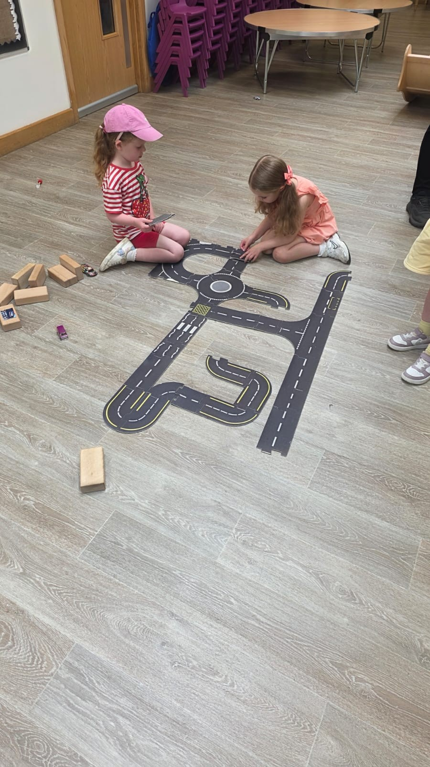
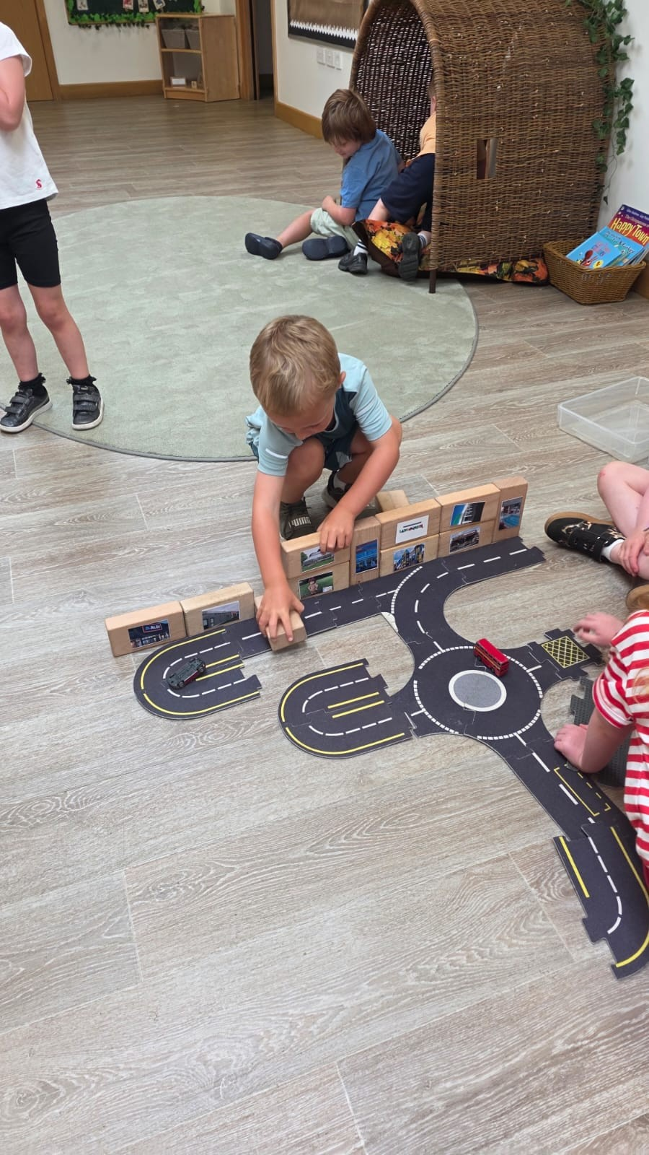

Slide 17
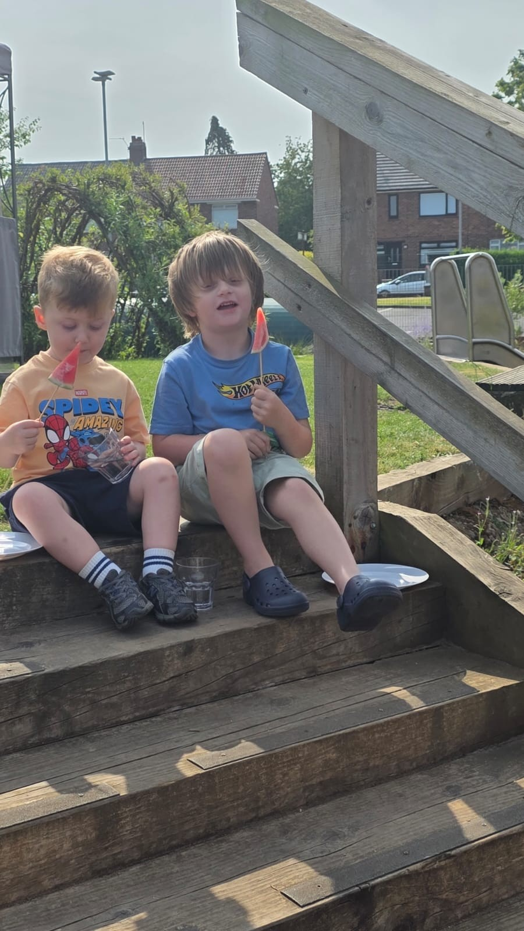
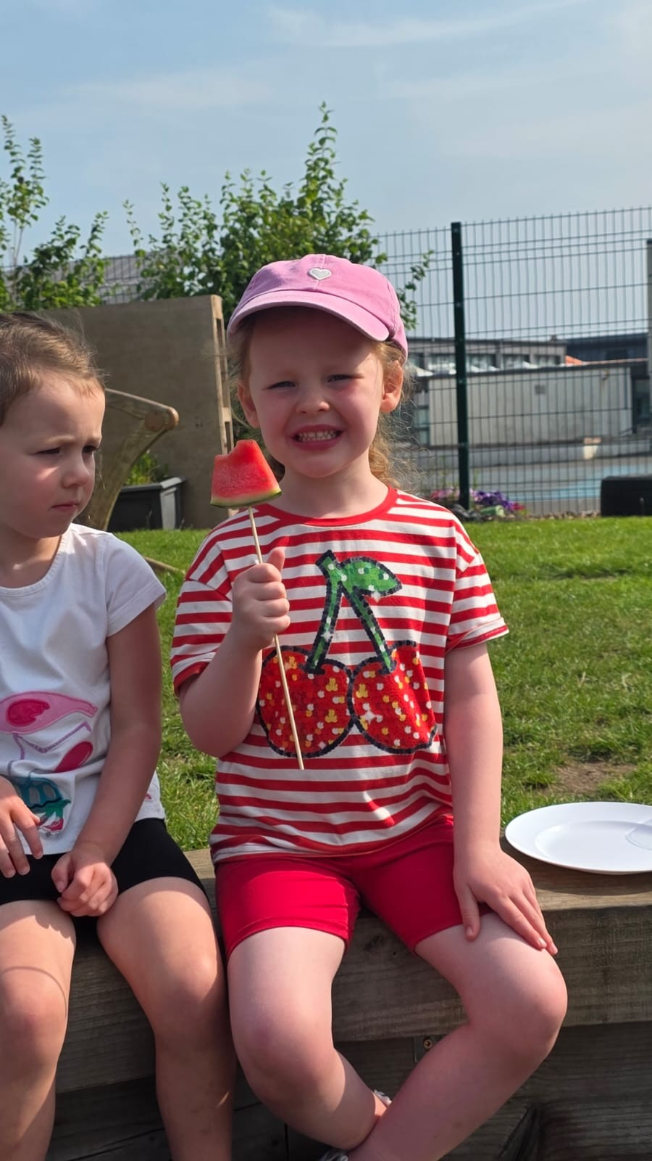
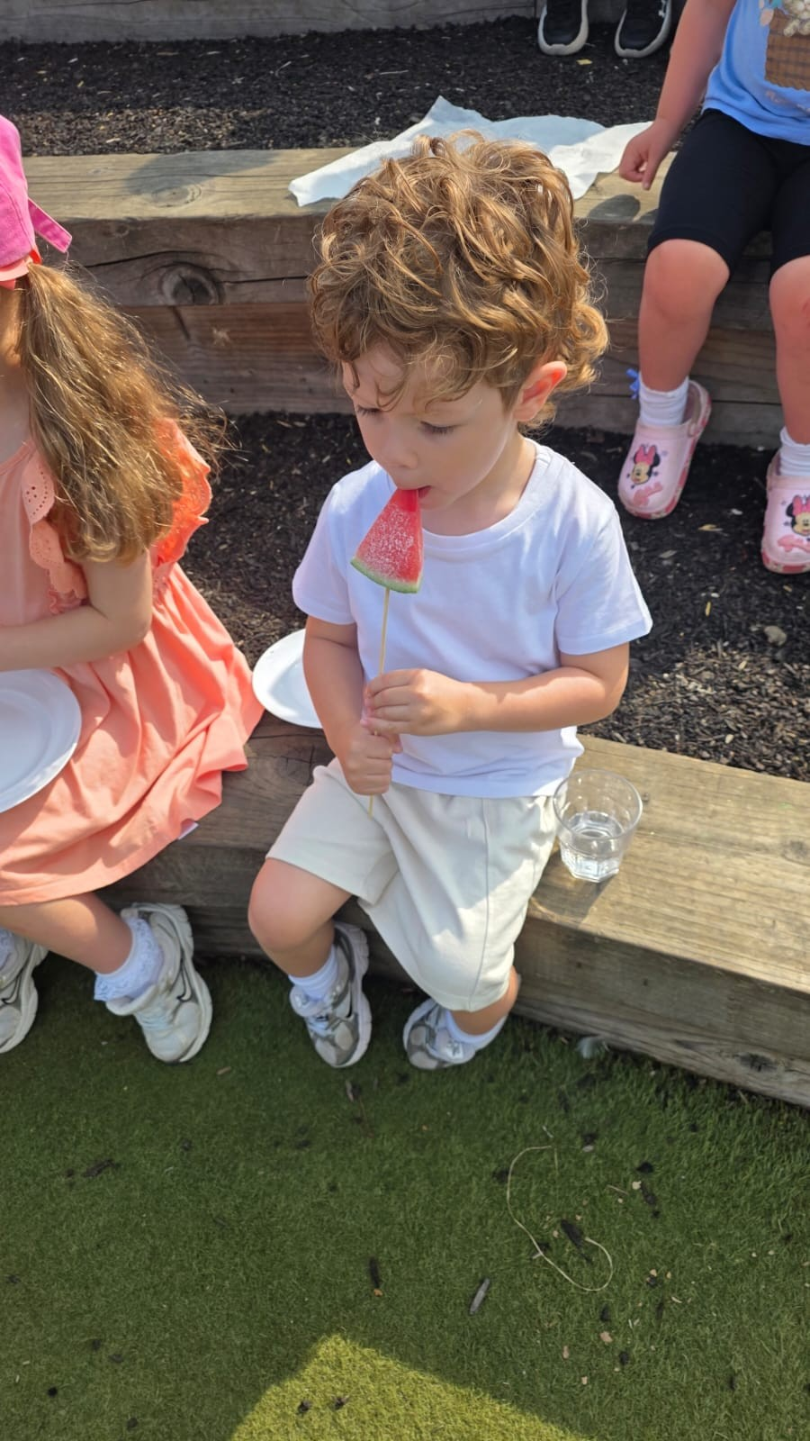
Frozen watermelon lollies

Slide 18
Weeks 1-3 1st - 17th July 2026
Our summer adventures at nursery so far have been full of exciting experiences, learning and fun! We have enjoyed visits to the park, where we explored the swings and roundabout, and trips to the shop to buy items for the nursery. We visited sheltered housing and enjoyed taking apples to the residents, developing connections within our community. We also had great fun with our friends and the ladies at nursery during a water fight using water balloons and water soakers. During a walk to the river, we explored natural materials such as sticks and leaves to see if they would float, had fun playing with helicopter seeds and talked about different trees and flowers. We even enjoyed a snack of fruit including frozen watermelon lollies and water outdoors while discussing how to keep ourselves safe when out on trips. While out in the community, the children began talking about where they lived, which led to us using Google Maps to find our houses from nursery. This inspired us to use wooden blocks and roads to create our own houses, streets and towns, supporting our imagination, creativity and understanding of the world around us.
E&O’S
SCN 0-01a
SCN 0-15a
SOC 0-07a
SOC 0-08a
TCH 0-02a
TCH 0-05a
TCH 0-12a
LIT 0-02a
LIT 0-04a
LIT 0-14a
MNU 0-01a
MNU 0-11a
MTH 0-17a
HWB 0-14a
HWB 0-16a
HWB 0-17a
HWB 0-19a
Safe, Healthy, Achieving, Nurtured, Active, Responsible, Respected, Included

