Slide 1
Dailly Primary School
Welcome to
Primary 1

Slide 2
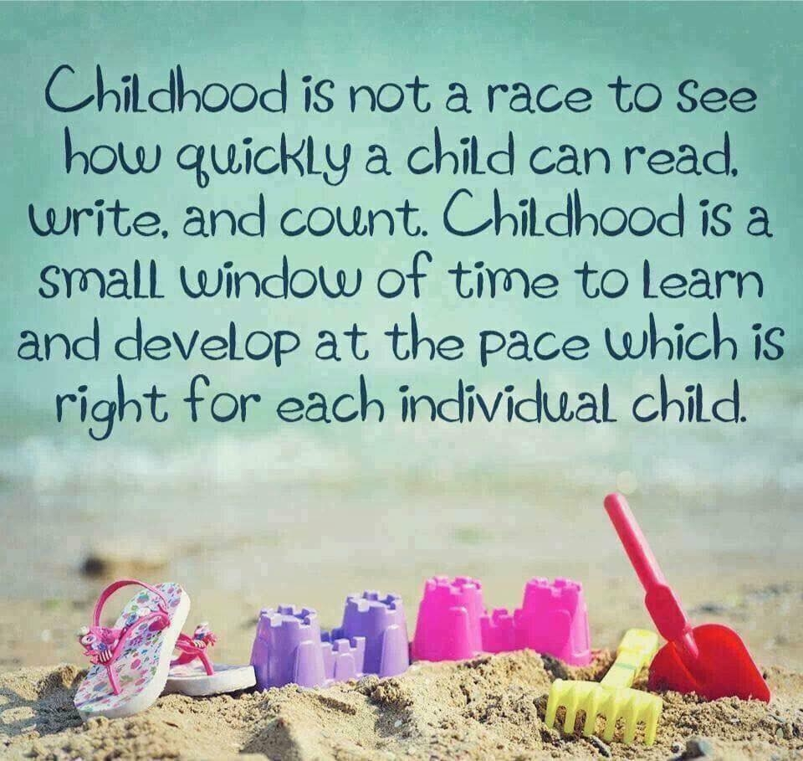
South Ayrshire Council are promoting more Play Based Learning within P1 classrooms
Play Based Learning allows young children to extend and develop skills at their own pace.
Notes:
The promotion of Play Based Learning within P1 classes in SA allows for children to extend and develop skills at their own pace.

Slide 3
Dailly Primary School
Literacy at Early Level . . .
Listening and Talking
Before children can learn to read and write,
they need to develop the building blocks for literacy…
the ability to
* speak
* listen
* understand
Notes:
In modern times, children may be exposed to large periods of screen time as well as many types of stimuli that can be overwhelming.
They also tend to have less free time to play.
This affects their concentration span and their overall performance, especially their ability to read, which involves hearing, distinguishing and blending sounds
https://empoweredparents.co/8-games-to-improve-your-childs-listening-skills/

Slide 4
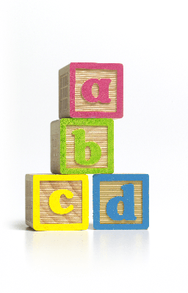
Dailly Primary School
Reading
phonics…
common words…
reading (decoding) strategies…
Notes:
Phonics – hearing the alphabetic sounds, identify the letter shape then blend to create words
Common Words – Tricky words which have to be learned eg because, they, some.
Decoding strategies – picture clues, initial sounds, sounding/blending.

Slide 5
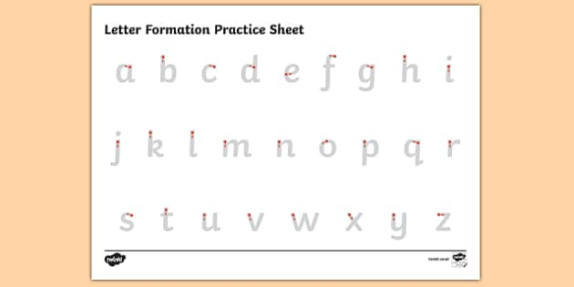
Dailly Primary School
Writing
phonics…
letter formation…
independent writing…
(capital letter, finger space, full stop)
Notes:
Phonics: Active Literacy Programme . . relating formation and sound of alphabet letters
Overwriting follow up activities from reading books or own ideas (diary/journal)

Slide 6
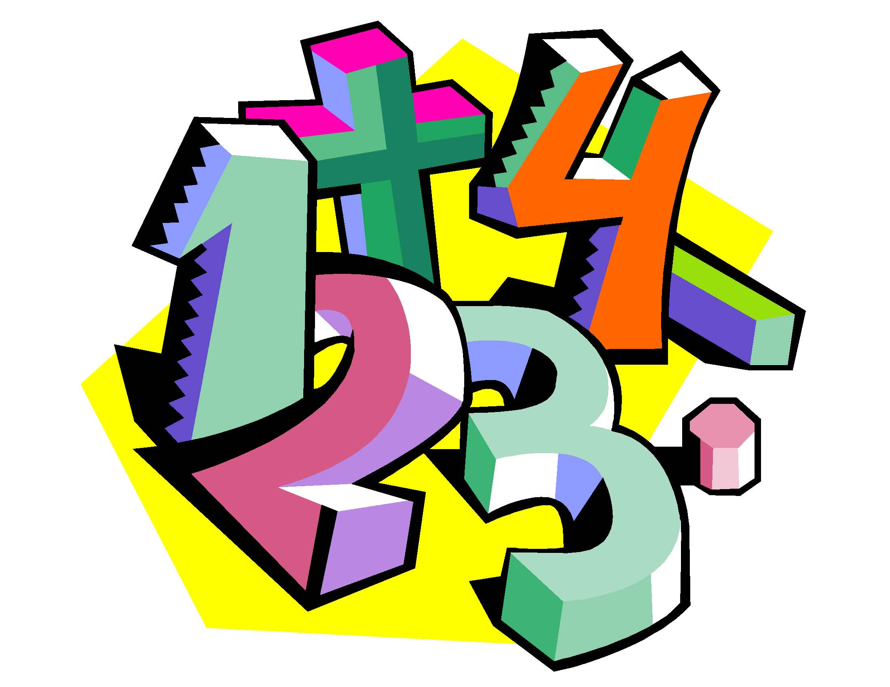
Dailly Primary School
Maths at Early Level . . .
Number
Practical Maths
Notes:
Counting to 20, understanding number before/after. Maths vocabulary of more/less/altogether

Slide 7
Dailly Primary School
Early Level - Number
rote counting… counting 1 - 20
counting objects… 1:1
identifying and writing numbers…
concept of addition and subtraction
Notes:
counting 1:1 and concept of number. Formation of numbers. then recording how many etc

Slide 8
Dailly Primary School
Early Level
Practical Maths
shape…
symmetry…
measure…
time
money
Data Handling
Notes:
All areas which will have been covered in EY will be consolidated in P1.

Slide 9
Dailly Primary School
RME
Science
Technology
HWB
EA
http://valuingchildreninitiative.com.au/a-silent-tragedy/
Notes:
PE - physical exercise
RME – manners, behaviour
Science Music, Painting, Baking and other fun ways to learn!

Slide 10
This is the HOW…
Big Cats ‘LILAC’ No words…..
Magnetic letters – sound games (Snap, Lotto etc)
Common Words - Games
PM Readers – Big Cats
Phonics Hero/ Ed City
Maths – counting games
Mental maths activities - Dot Patterns; conservation of number
Overwiting - number formation
SHM Maths Scheme
Ed City/ Topmarks

