Slide 1
Maybole Community Campus
Progress
At 23 January 2023
Notes:
Introduce yourself
Explain that you are delivering a presentation about the construction industry and in doing so will highlight the range of careers it can offer
Say that you will finish the presentation by telling them about your own career in construction (If applicable)

Slide 2
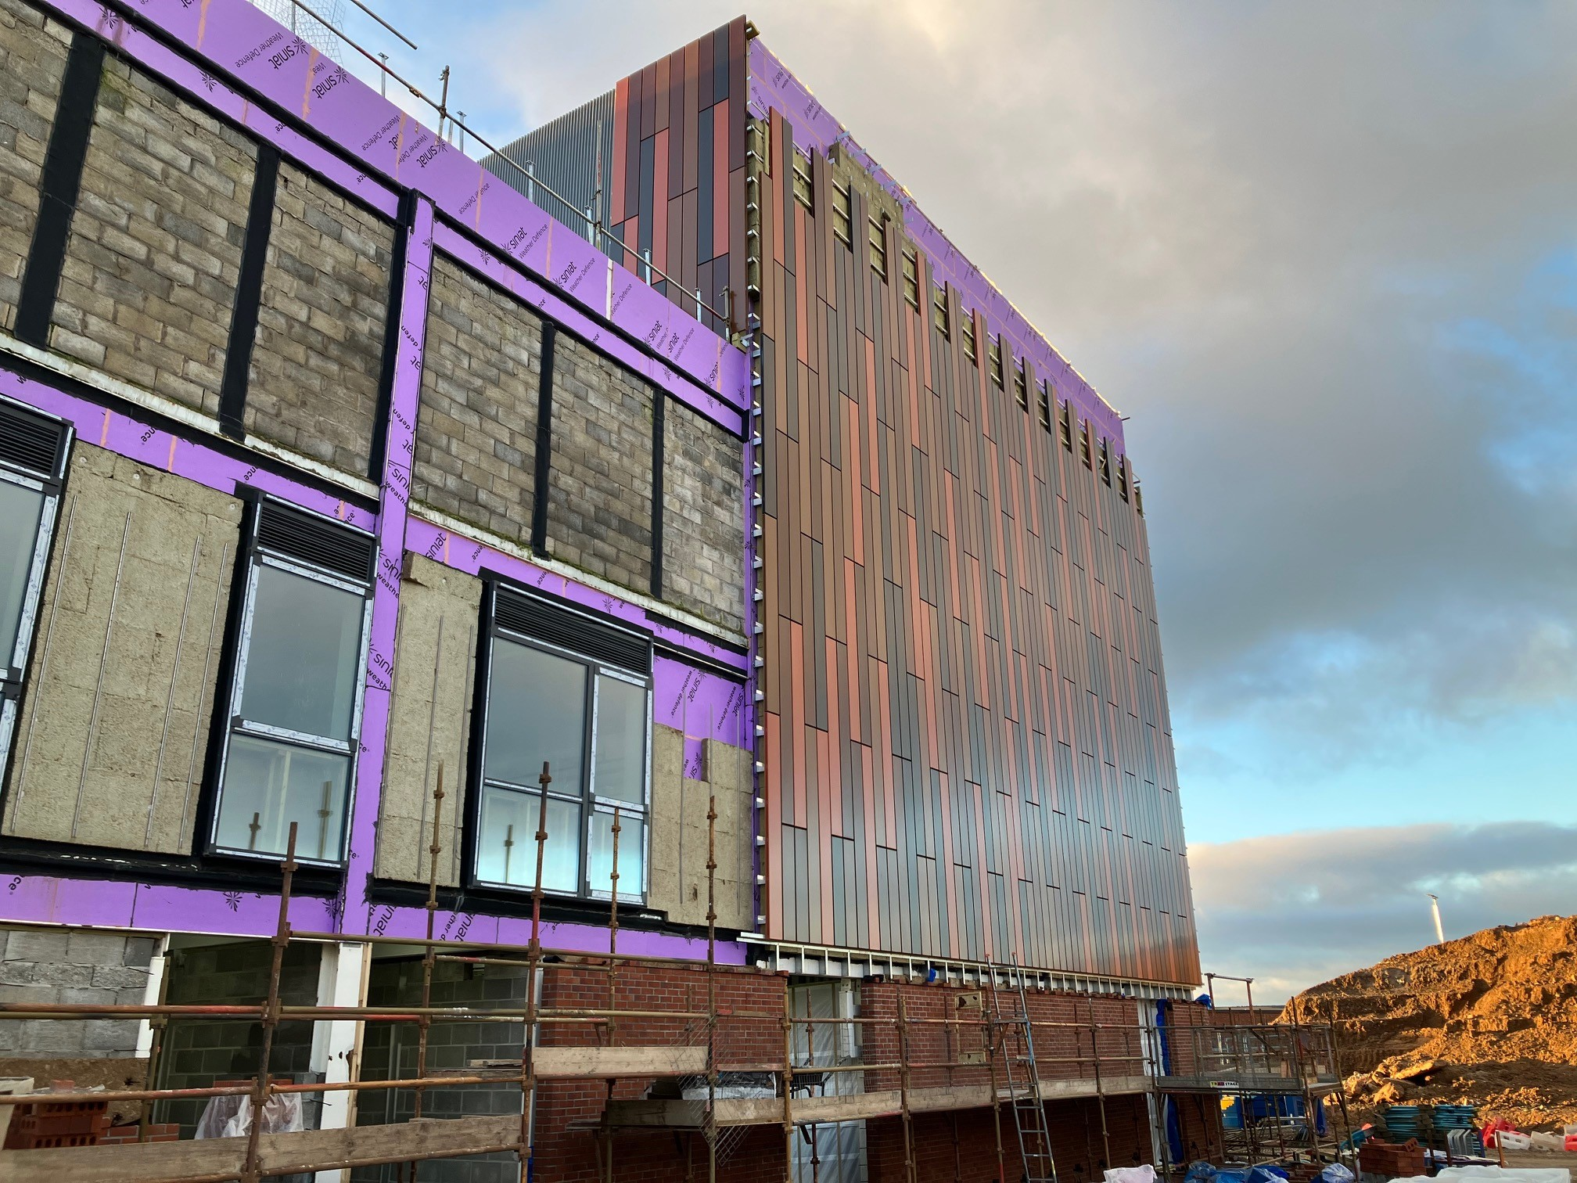
Progress on Site
Sports hall and swimming p0ol cladding works are ongoing. You can see that the cladding design is nearly completed and the facing brick on the north elevation is also progressing.

Slide 3
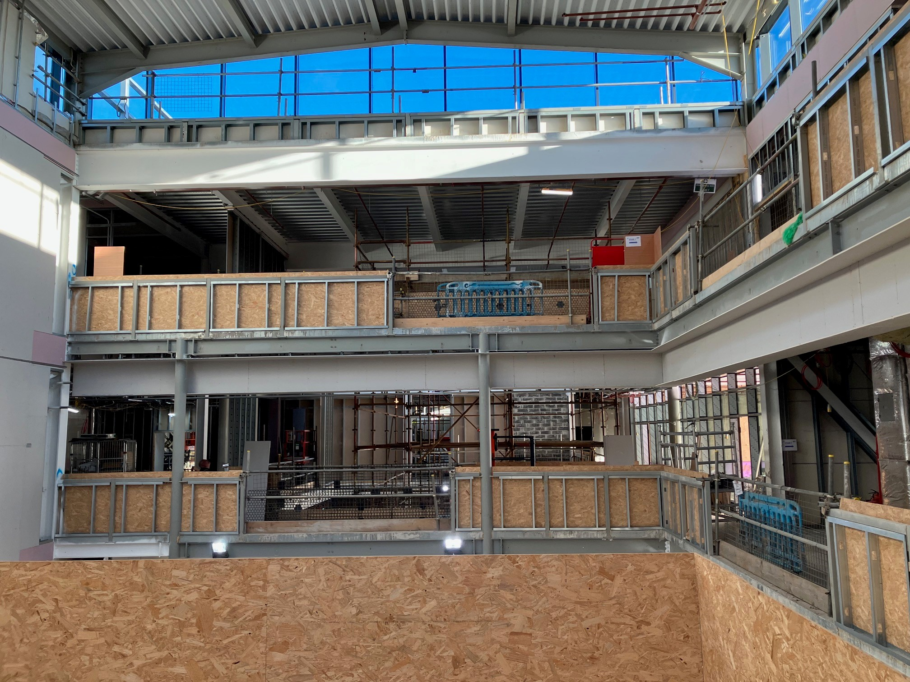
This picture was taken from the secondary school I.T suite. Once this is finished it will be constructed with glass and partition wall. You will be able to look out towards both the primary and secondary atriums.

Slide 4
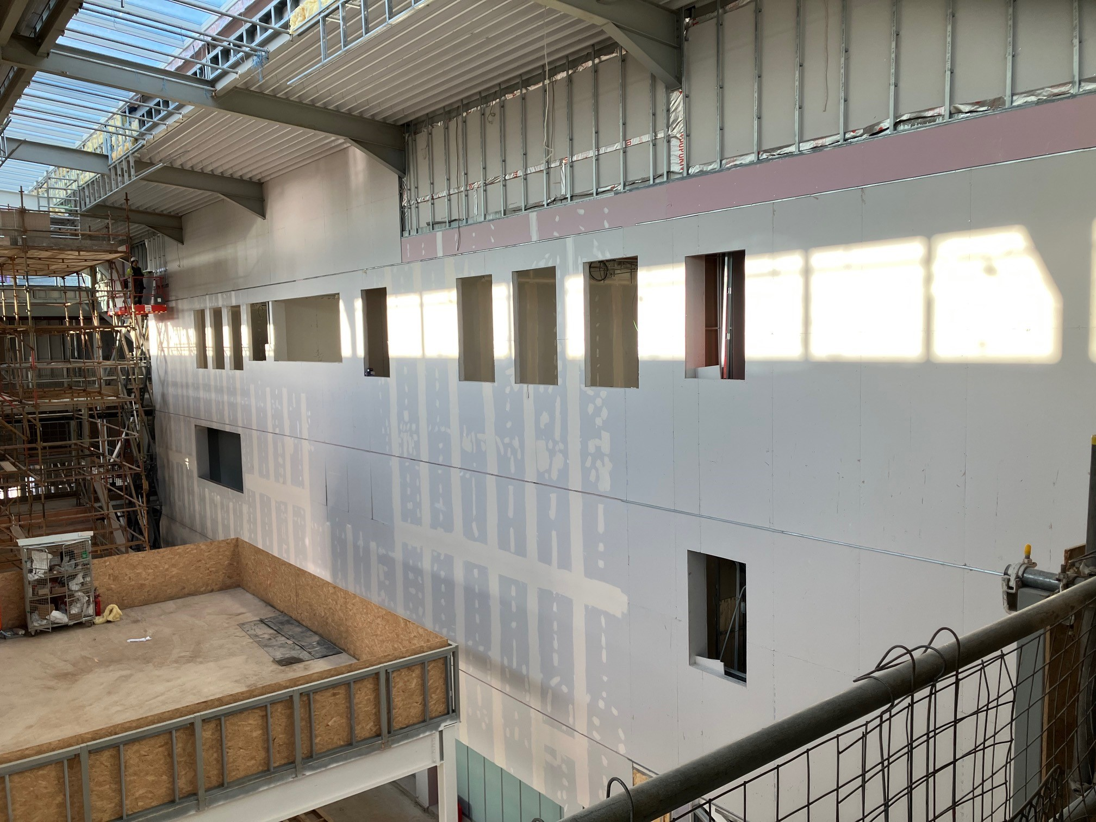
This is another view of the I.T suite which can be seen in the centre of the image.
The partitions you can see to the right of the photo are the outer walls of the secondary school class rooms.

Slide 5
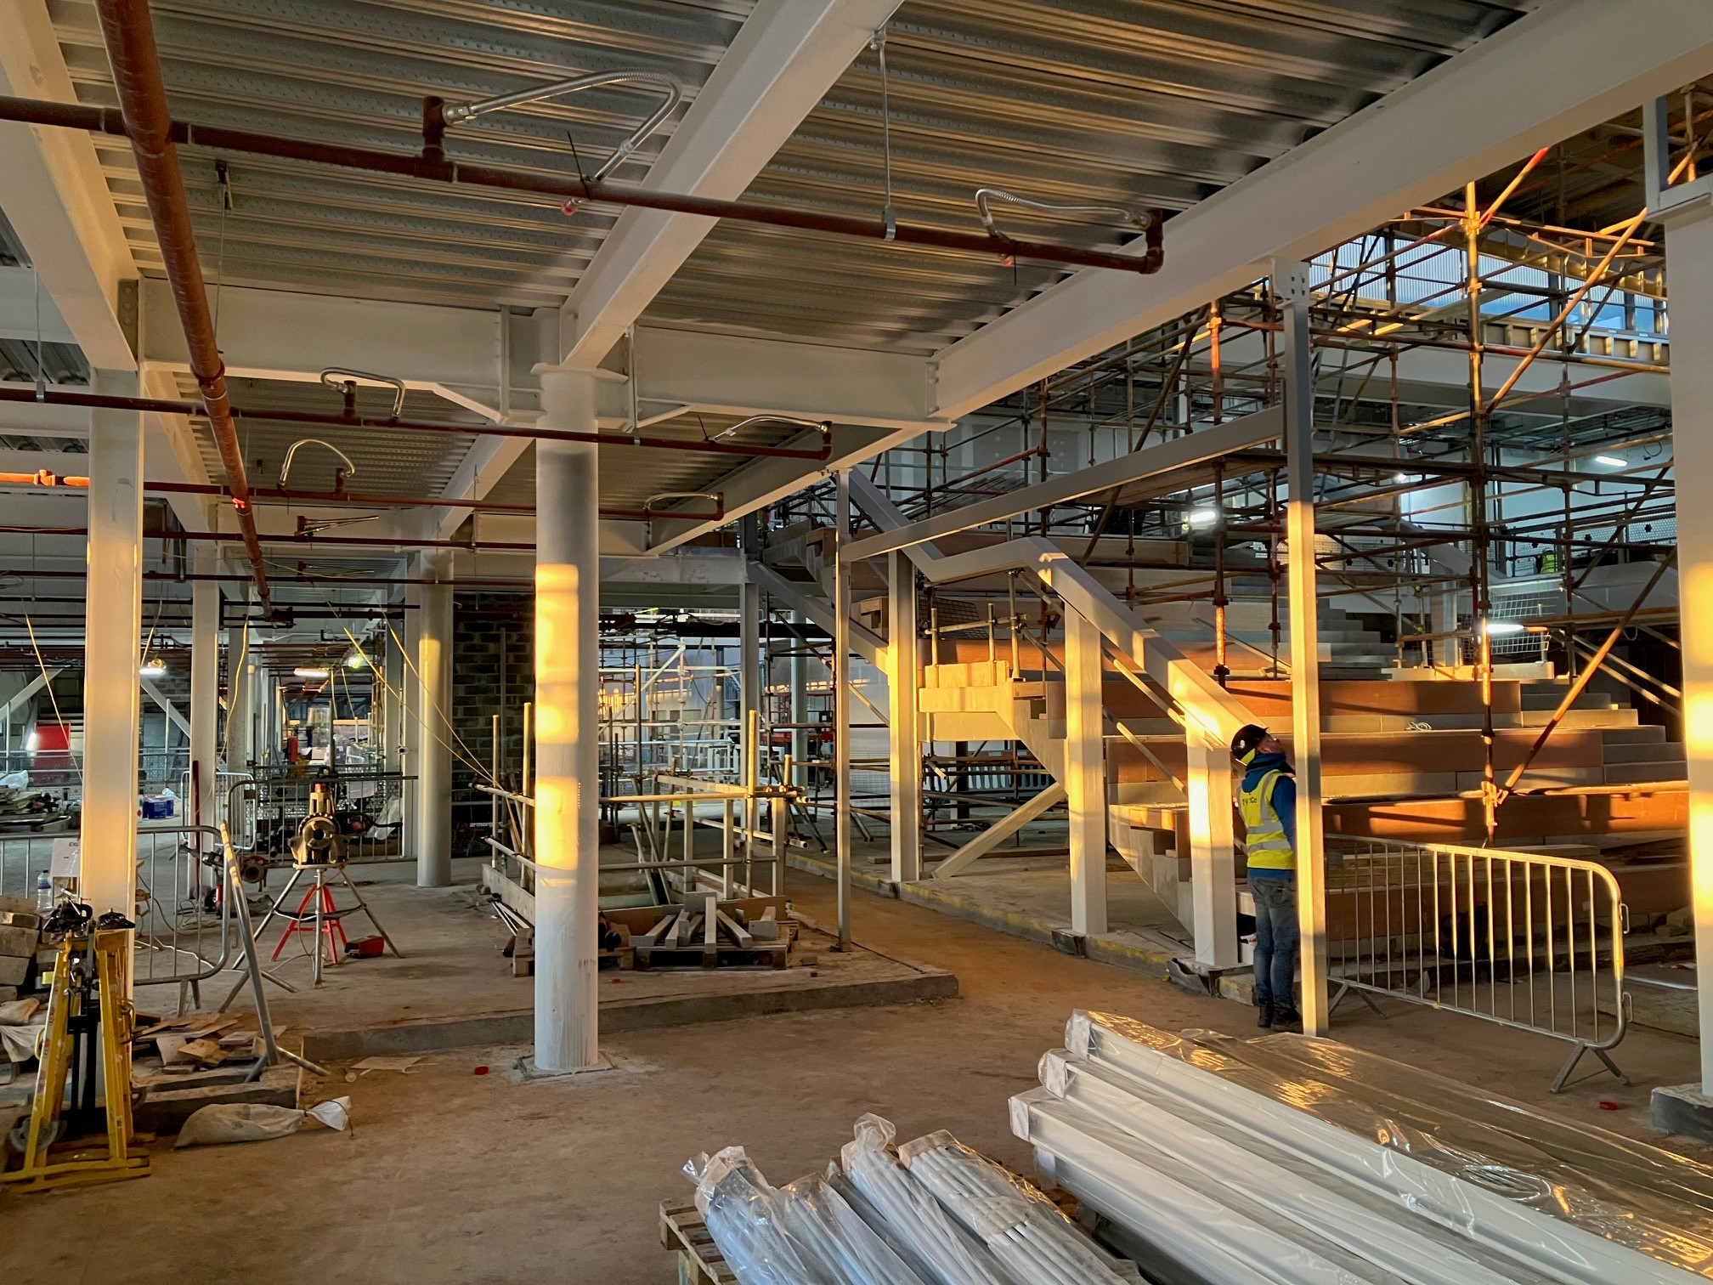
Progress is being made to construct the upper ground floor of the primary school. Services are being installed and classroom partitions are being formed. The hellerup stair is seen on the right hand side of the image. The stair design is becoming a more common design in schools, it is a flexible use space, where the young people can sit and relax or the teachers can deliver lessons.

Slide 6
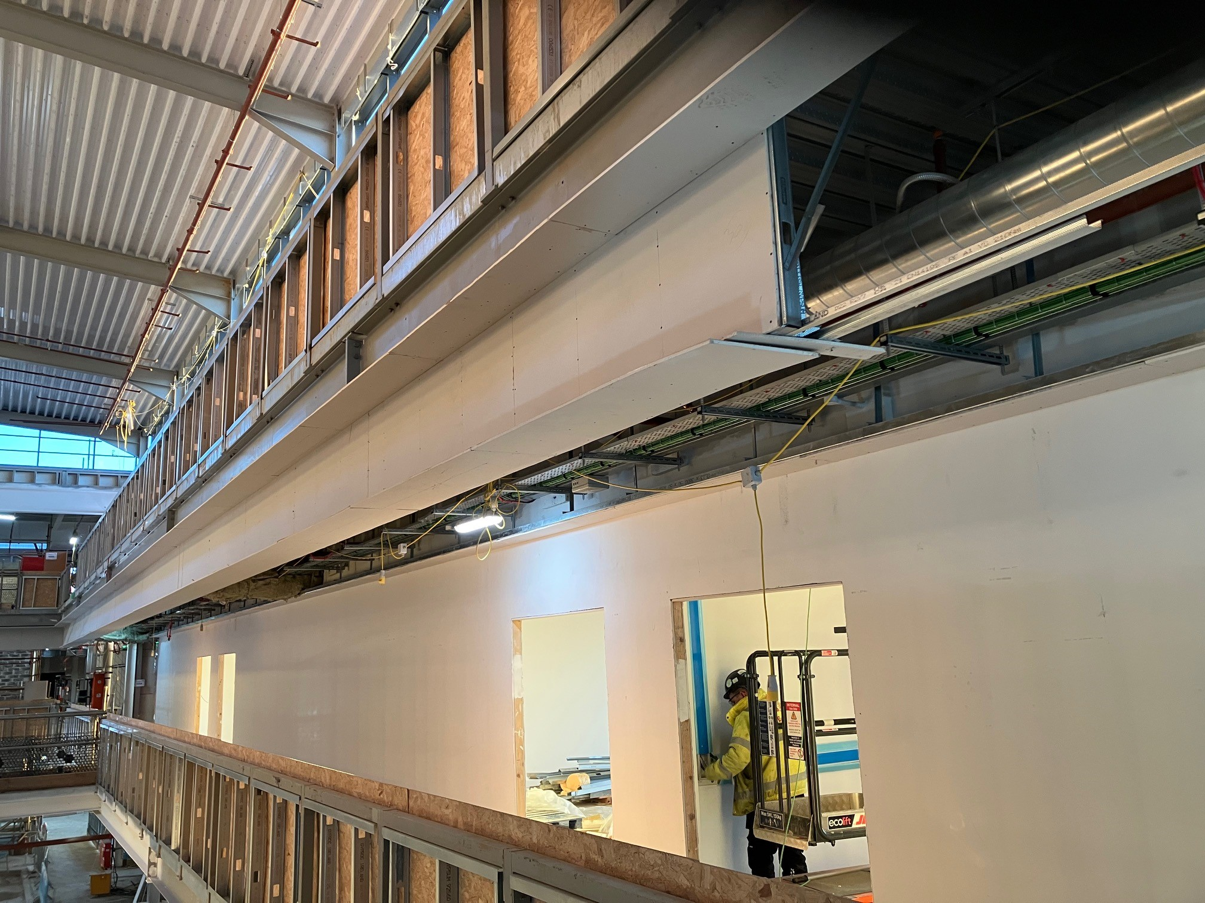
Secondary school balcony edge and ceilings are being formed now that services are nearing completion.

Slide 7
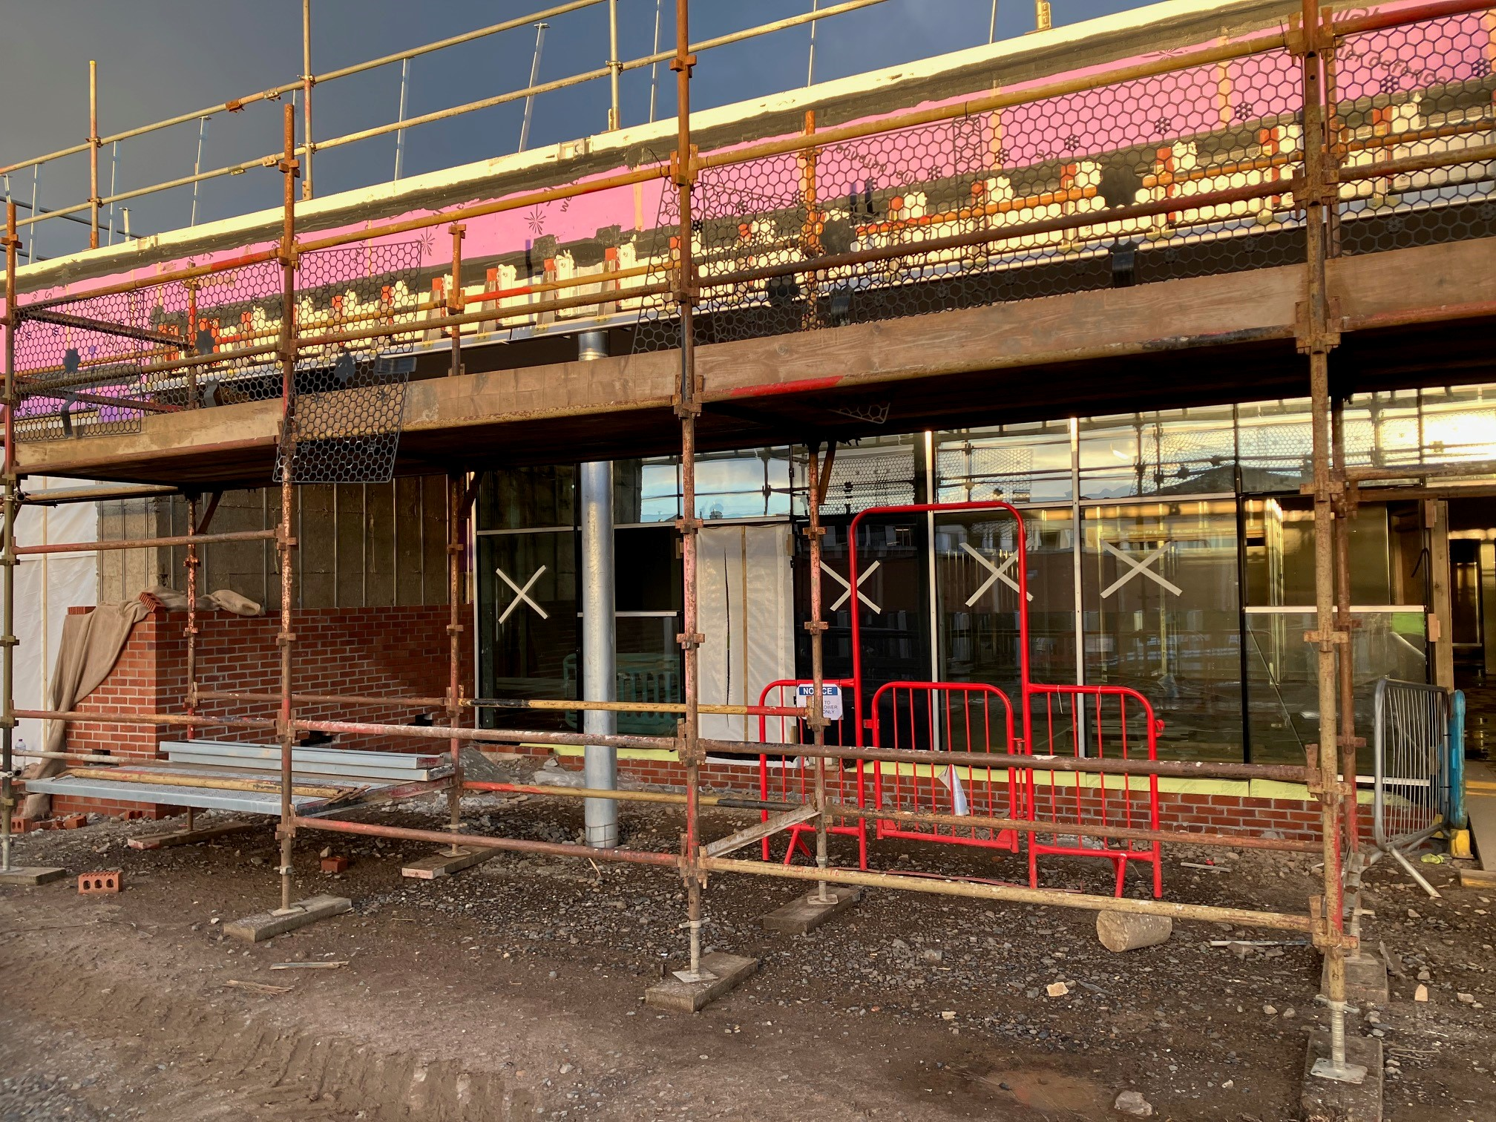
At the nursery, the external brickwork is progressing now that the main glazing has been installed. We are currently working on the nursery roof.

Slide 8
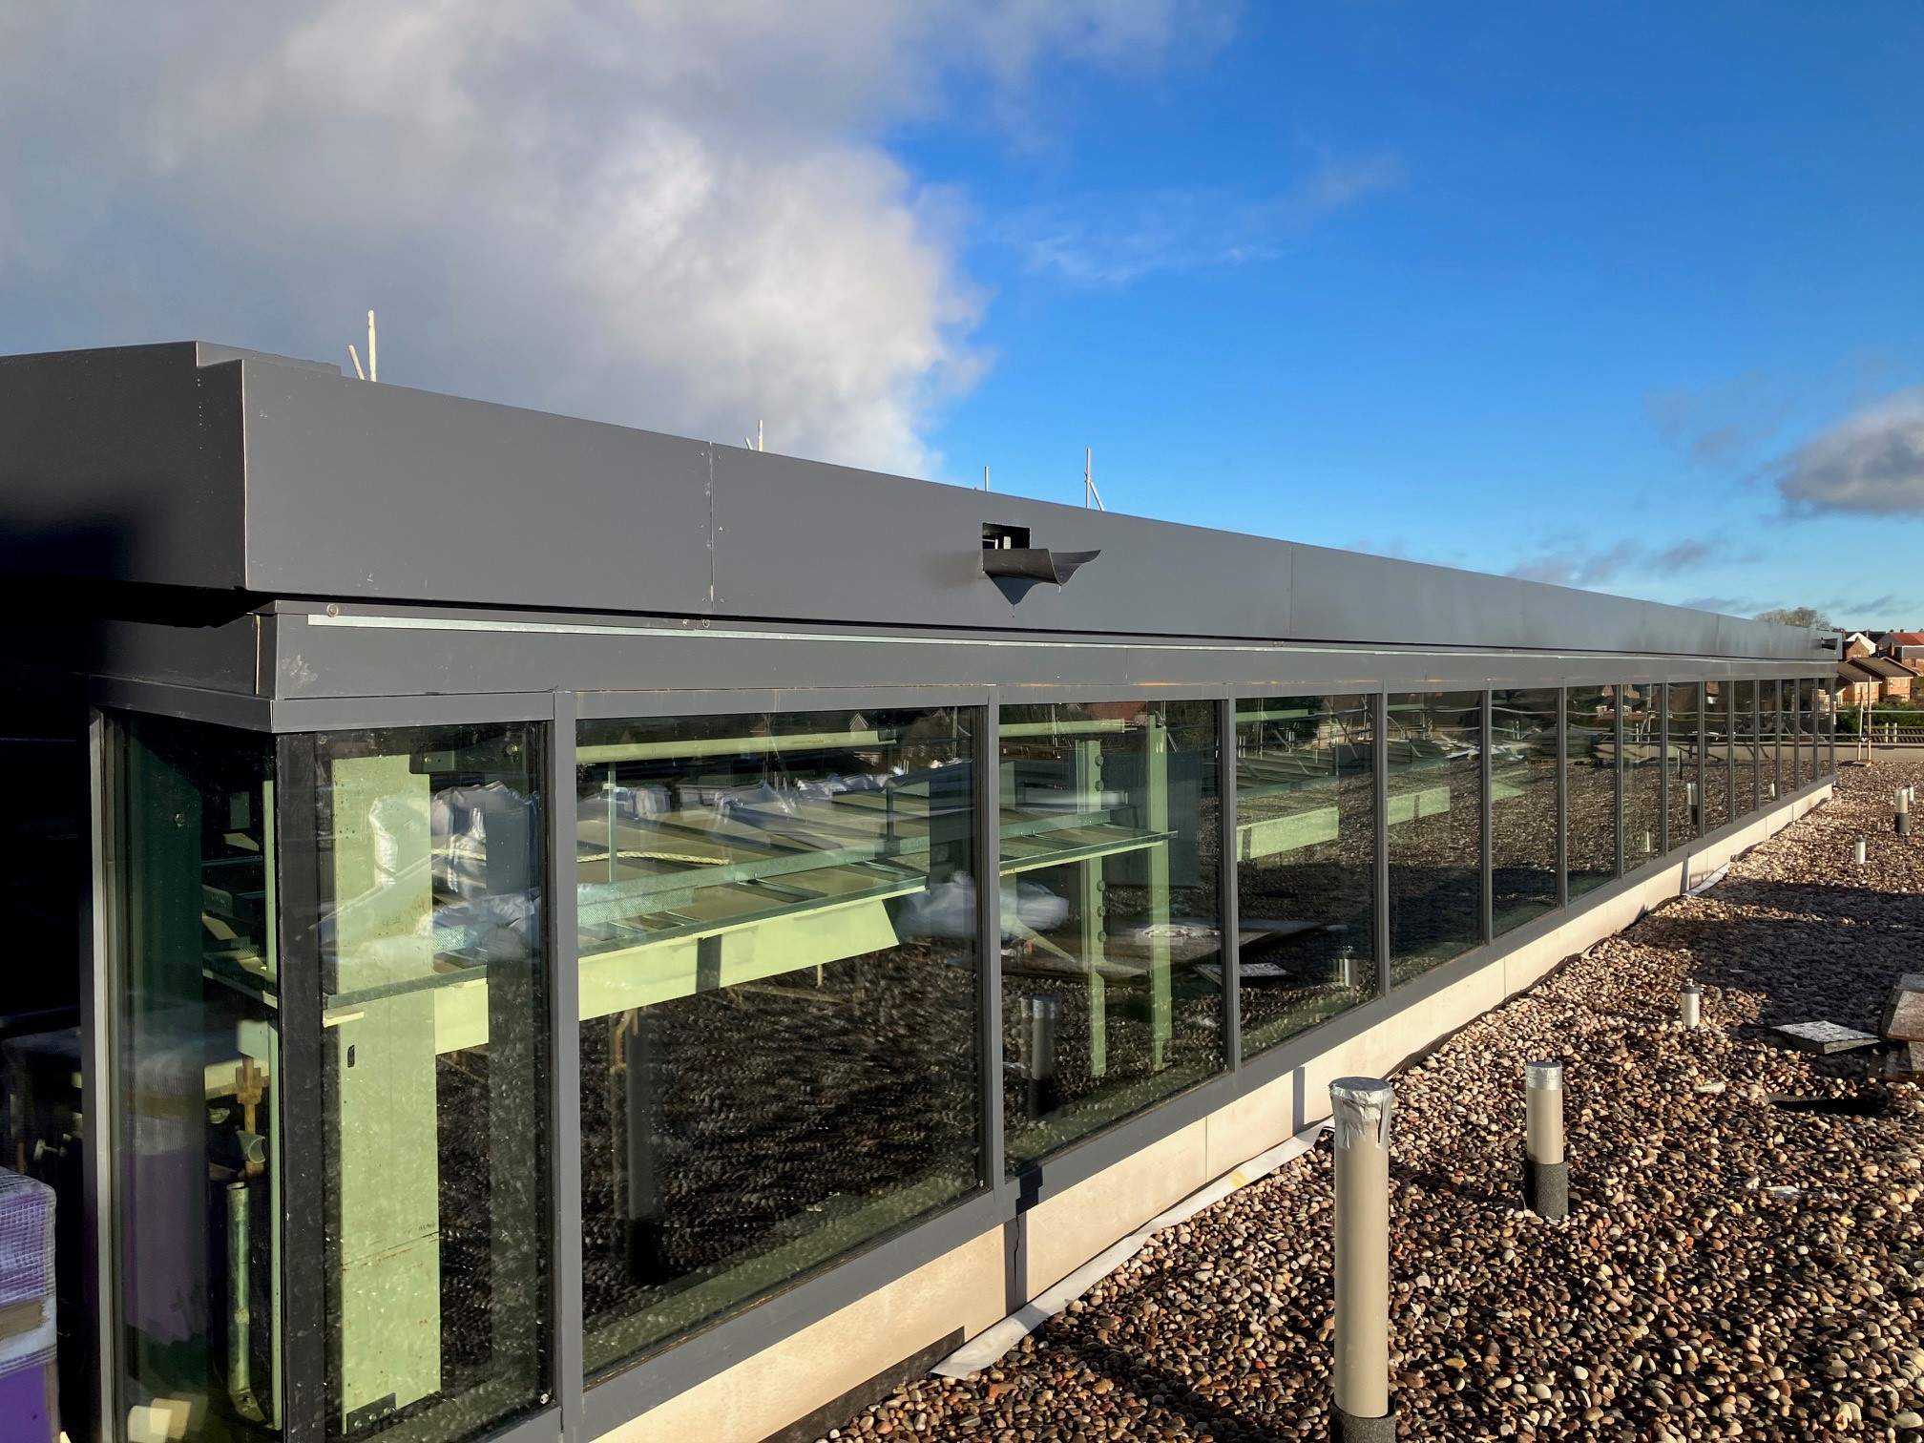
All windows and Skylights on the roof are now fitted. The Velux windows to the roof are now complete. Last week we also have had both prefabricated plant rooms lifted and installed on the roof.

Slide 9
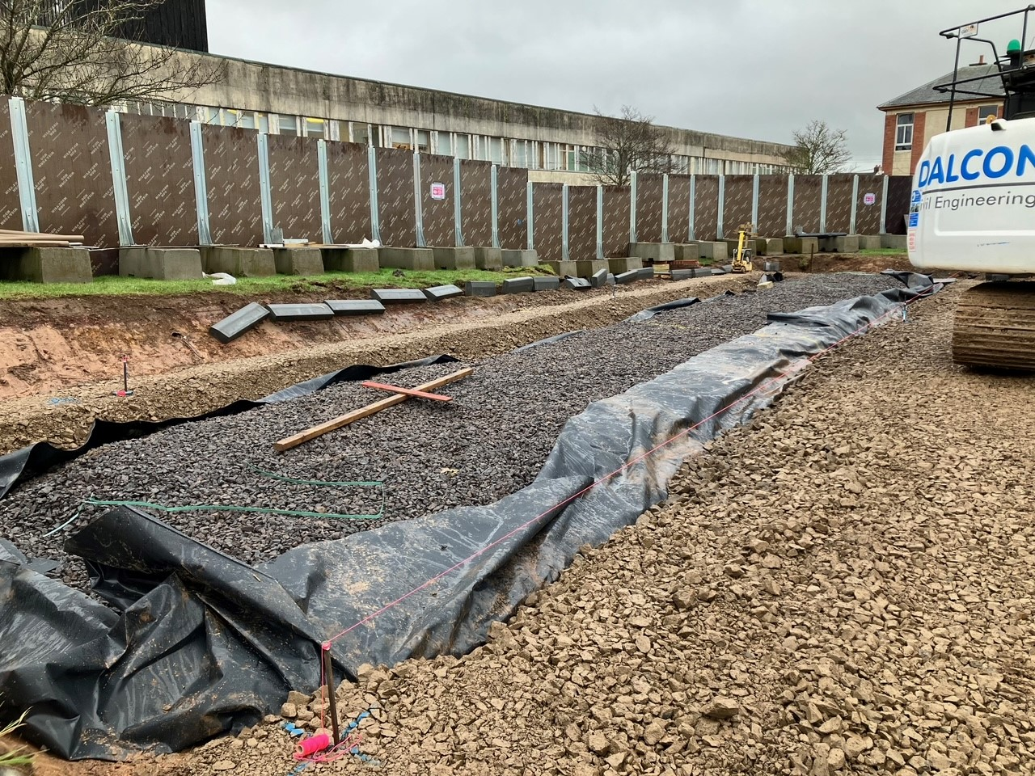
Car parking bays to south car park are now being constructed.

