Slide 1
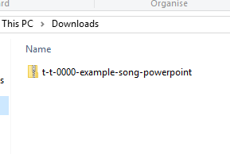
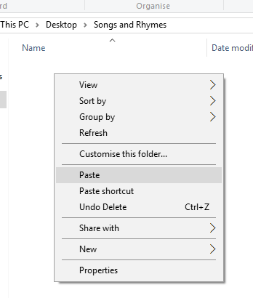


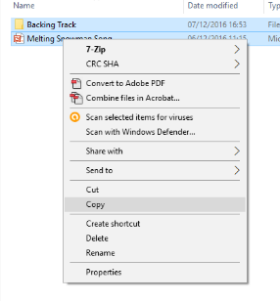
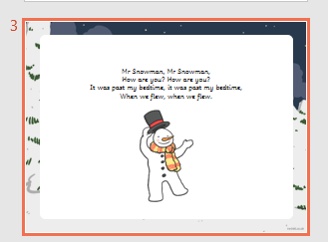
Guidance for Audio PowerPoints
1. Open the folder and copy all the files.
2. Paste the copied files into a new folder.
3. Open the PowerPoint file, enable editing and enter presentation mode (start the slide show). Go to slide 3 and the backing track will start automatically.
The slides will automatically transition in time with the backing track.
You may wish to delete this slide before beginning the presentation.

Slide 3



I’m a little penguin,
Black and white.
Stout and fluffy,
What a sight!
I can't really fly,
But love to swim.
To the water,
And dive right in!

