Slide 1


French
Français
Week beginning 18 May/18 mai
Numbers – Les chiffres

Slide 2
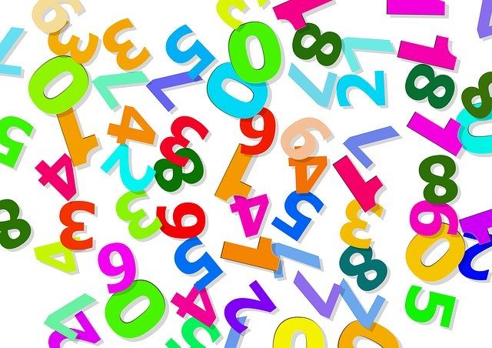
Les
chiffres
Bonjour! Comment ça va?
Last week was national numeracy day which taught us that numbers play a big part in our lives. So, in this week’s French lesson, you will learn how to say numbers in French. For some of you, this is remembering what you have already learnt and for others, it might be the first time you are learning your numbers in French.

Slide 3

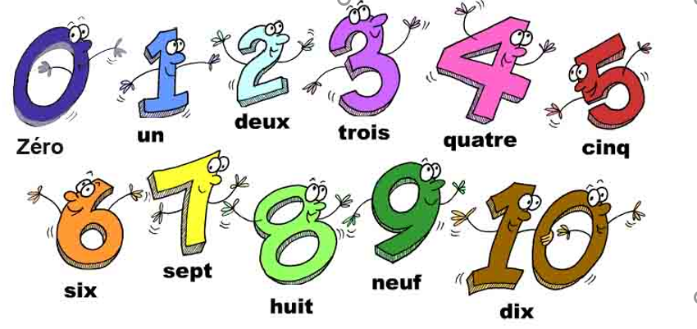
Les chiffres 0-10
1. Listen to the words (click on the speaker icon).
2. Listen to the words again (click on the speaker icon again).
3. Say the words.
For P1/2 (or anyone who wants to practise these numbers)

Slide 4
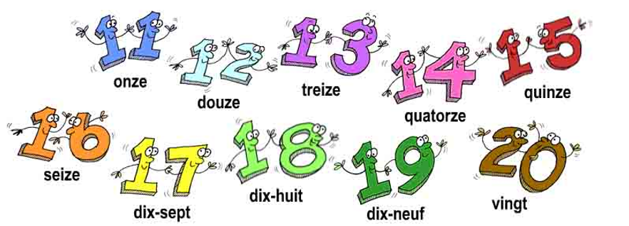
Les chiffres 11-20
1. Listen to the words (click on the speaker icon).
2. Listen to the words again (click on the speaker icon again).
3. Say the words.
For P1/2 (or anyone who wants to practise these numbers)

Slide 5
For P1/2 (or anyone who wants to practise these numbers)
Now that you have learnt or remembered your numbers, test yourself with these tasks. You can choose one or do them all!
Hopscotch/Marelle
Watch these French children play Hopscotch using numbers 1-10. Who wins? What do you think the word “manqué” means? If you have an outside space and some chalk, you could play this game to practise your French numbers.
Number Hunt
There are numbers all around! Hunt around your house and any outside space you have for as many numbers between 0 and 20 as you can. When you find one, say the number out loud in French. How many can you find? (Tip – look at books, your front door, a calendar etc)
Sing along with Alain le Lait Numbers 1-20
If singing a song helps you remember new French words, then this is the song for you! Be warned, it’s an earworm! Click here.
Online Games to practice numbers 0-20
You will find three different games on this page to help you practise your French numbers.
If any of the links do not work, please click refresh (in particular the Hopscotch link)

Slide 6
For P2/3/4 (or anyone who wants to practise these numbers)
Les chiffres 20-60
1. Listen to the words (click on the speaker icon).
2. Listen to the words again (click on the speaker icon again).
3. Say the words.
20 vingt | 30 trente | 40 quarante | 50 cinquante | 60 soixante
21 vingt et un | 31 trente et un | 41 quarante et un | 51 cinquante et un | 61 soixante et un
22 vingt-deux | 32 trente-deux | 42 quarante-deux | 52 cinquante-deux | 62 soixante-deux
23 vingt-trois | 32 trente-trois | 43 quarante-trois | 53 cinquante-trois | 63 soixante-trois
24 vingt-quatre | 34 trente-quatre | 44 quarante-quatre | 54 cinquante-quatre | 64 soixante-quatre
25 vingt-cinq | 35 trente-cinq | 45 quarante-cinq | 55 cinquante-cinq | 65 soixante-cinq
26 vingt-six | 36 trente-six | 46 quarante-six | 56 cinquante-six | 66 soixante-six
27 vingt-sept | 37 trente-sept | 47 quarante-sept | 57 cinquante-sept | 67 soixante-sept
28 vingt-huit | 38 trente-huit | 48 quarante-huit | 58 cinquante-huit | 68 soixante-huit
29 vingt-neuf | 39 trente-neuf | 49 quarante-neuf | 59 cinquante-neuf | 69 soixante-neuf

Slide 7
For P2/3/4 (or anyone who wants to practise these numbers)
Now that you have learnt or remembered your numbers, test yourself with these tasks. You can choose one or do them all!
Education City Game
Log on to Education City and follow this pathway to find a numbers game:Subjects > French > First > First ***> Activities > “Une Quarantaine” . You’ll need to recognise numbers between 20 and 40 to complete a puzzle. Good luck/Bonne chance!
Number Hunt
There are numbers all around! Hunt around your house and any outside space you have for as many numbers between 0 and 60 as you can. When you find one, say the number out loud in French. How many can you find? (Tip – look at books, your front door, a calendar etc)
Sing along with Alain le Lait
Numbers 20-50
Here’s a song from Alain Le Lait to help you remember how to say numbers 20-50.

Slide 8
For P5/6/7 (or anyone who wants to practise these numbers)
Les chiffres 70-90
1. Listen to the words (click on the speaker icon).
2. Listen to the words again (click on the speaker icon again).
3. Say the words.
Tip
Make sure you are confident with numbers 11-20 before learning these numbers (see slide 4 if you need further practise)
70 soixante-dix | 80 quatre-vingt | 90 quatre-vingt-dix
71 soixante-onze | 81 quatre-vingt-un | 91 quatre-vingt-onze
72 soixante-douze | 82 quatre-vingt-deux | 92 quatre-vingt-douze
73 soixante-treize | 83 quatre-vingt-trois | 93 quatre-vingt-treize
74 soixanate-quatorze | 84 quatre-vingt-quatre | 94 quatre-vingt-quatorze
75 soixante-quinze | 85 quatre-vingt-cinq | 95 quatre-vingt-quinze
76 soixante-seize | 86 quatre-vingt-six | 96 quatre-vingt-seize
77 soixante-dix-sept | 87 quatre-vingt-sept | 97 quatre-vingt-dix-sept
78 soixante-dix-huit | 88 quatre-vingt-huit | 98 quatre-vingt-dix-huit
79 soixante-dix-neuf | 89 quatre-vingt-neuf | 99 quatre-vingt-dix-neuf

Slide 9
For P5/6/7 (or anyone who wants to practise these numbers)
Now that you have learnt or remembered your numbers, test yourself with these tasks. You can choose one or do them all!
Education City Game
Log on to Education City and follow this pathway to find a numbers game:Subjects > French > Second > Second*> Activities > “Quatrevingtaine” You’ll need to recognise numbers between 40 and 80 to complete a puzzle. Good luck/Bonne chance!
Number Hunt
There are numbers all around! Hunt around your house and any outside space you have for as many numbers between 0 and 99 as you can. When you find one, say the number out loud in French. How many can you find? (Tip – look at books, your front door, a calendar etc)
Sing along with Alain le Lait
Numbers 70-100
Here’s a song from Alain Le Lait to help you remember how to say numbers 70-100.

