Slide 1
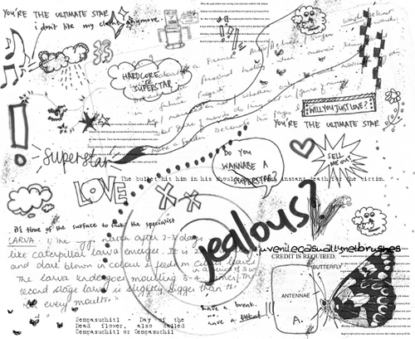
Close Reading
National 5

Slide 2
Linking questions
Link questions often ask you to explain how a sentence creates an effective link between one paragraph and another.
You usually need to answer link questions in two parts:
1. Quote and show how one part links back to previous paragraph
OR
2. Quote and show how the other part refers forward to new paragraph

Slide 3
Linking questions
1.Quote the words that link back to ideas in the previous paragraph.
2.Explain how this connects with the argument or ideas in the previous paragraph.
3.Quote the words which link to the following paragraph or move the argument forward.
4.Explain what the author goes on to write about in the following paragraph.

Slide 4
Linking questions
FORMULA FOR LINK QUESTIONS
The word/expression ‘quote from passage’ links back to ______________ which was discussed in the previous paragraph where it discusses…
OR
The word/expression ‘quote from passage’ introduces the idea of _______________ which is discussed in the next paragraph where it discusses…

Slide 5
Passage: In Madras, as in other garrison towns in India, there were many orphan children of soldiers who had been killed, or died of disease, or had been unaware that they had a child. These children faced an unenviable future. In the Hindu community of their mothers they were unacceptable and in the European community they were equally unacceptable because of their native upbringing.
Question: How does the sentence underlined form a link in the argument? (2 marks.)

Slide 6
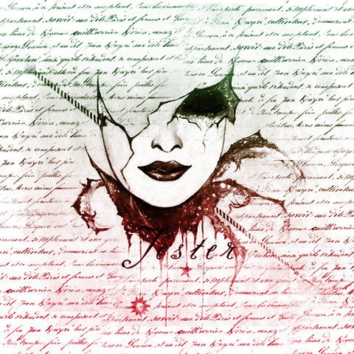
The expression ‘these children’ (1 mark) refers back to the children whose parents don’t know that they exist. (1 mark)
OR
The expression ‘unenviable future’ links forward to the ideas in the rest of passage which tells us why the children are unwanted by their own community and by the wider world also. (1 mark)
Links back to para 1
Refers forward

Slide 7
Passage: When more coal was needed, men dug tunnels into the earth from the quarries. This was dangerous work, because the earth was always falling into the tunnel. Later they dug deeper and this brought greater difficulties and greater danger. Water seeped into the bottom of the pits, poisonous and explosive gases collected, and taking the coal to the surface was hard work. Slowly the dangers were overcome. Miners became more skilful at supporting the roofs of the tunnels, and engineers began to use steam engines to pump water out. They lit fires at the bottom of the pit shafts to drive out foul air; and Sir Humphry Davy invented the lamp which would not set fire to explosive gases.
Question: Using the strategy explained on the previous slide, show how the underlined sentence acts as a link.
(This question is worth 2 marks.)

Slide 8
The expression ‘the dangers’ (1 mark) refers back to the list of problems that miners were faced with in the past such as being barricaded in. (1 mark)
OR
The expression ‘were overcome’ links forward to the ideas in the rest of passage which tells us how miners began to gain control over these problems.
Links back to para 1
Refers forward

Slide 9
There are some language techniques that writers use when they want to describe things vividly.
These are:
* SIMILE
* METAPHOR
* PERSONIFICATION
There are some other techniques in which the sound of the words is important. These are:
* ALLITERATION
* ONOMATOPOEIA
Imagery questions

Slide 10
SIMILE – A comparison that uses the words ‘like’ or ‘as’.
METAPHOR – A comparison that says one thing is another.
PERSONIFICATION – When a non-living object is given human qualities.
ALLITERATION – The repetition of a consonant sound in a sentence.
ONOMATOPOEIA – A word that imitates a
sound.

Slide 11
Identify the techniques in these examples:
* The cowardly kid kicked the can at the cat.
* The brave soldier was a lion in battle.
* The stone fell into the water with a plop.
* The sports car sprinted from the traffic lights.
* The brave soldier was like a lion in battle.

Slide 12
* Alliteration
* Metaphor
* Onomatopoeia
* Personification
* Simile

Slide 13
When tackling an IMAGERY question (simile/metaphor/personification), you need to use the following strategy:
1. Identify the image (what is being compared to what?)
2. Give the literal meaning of the image (Just as…)
3. Explain the connection between the two (so too…)
4. Explain the effect of the image
Remember:
‘Just as… so too…’

Slide 14
FORMULA:
Answer: Just as “__________” has connotations of being _________________, so too is the writer suggesting that _________________.
Remember:
‘Just as… so too…’

Slide 15
Passage: ‘The last days of January were a swine… Everybody slogged grimly by and their hands never left their pockets unless they were wearing gloves. Nobody stopped. Maybe they thought they’d die if they stopped, like explorers at the South Pole.’
Question: Quote a simile from the extract above and show how it is a good piece of imagery to use here.

Slide 16
* ‘Like explorers at the South Pole’.
Just as men/women who explore one of the coldest regions in the world so too are the citizens experiencing the harshness of the cold weather. This simile is effective as it reflects just how cold and snowy the city environment was at that time of year.

Slide 17
Passage: ‘They’ll take suggestions as a cat laps milk.’
Question: What does the imagery in this extract suggest about the way the teachers are taking suggestions?
Answer: Just as “as a cat laps milk” has connotations of being _________________, so too is the writer suggesting that the teachers are _________________.

Slide 18
* The metaphor ‘London is a toilet’ compares the condition of London streets to a filthy toilet.
* Just as a “toilet” is dirty and unsanitary, so too is the writer saying that the streets of London are unclean and unhygienic.

Slide 19
Passage: ‘The food mixer – she was not the sort of woman to use her hands – was an ancient, heavy Kenwood that lived in a deep , secret hole in the kitchen work surface. My father had, in a rare moment of do-it-yourselfery, fitted a heavy industrial spring under the mixer so that when you lifted the lid the mixer slowly rose like a corpse from a coffin.’
Question: Quote an example of personification about the mixer and say what impression it gives of it.

Slide 20
* Personification – ‘Lived in a deep, secret hole’.
* This makes it seem like some sort of monster, something scary or threatening.

Slide 21
* ‘Bubbling’; ‘Rushing’; ‘hissing’; ‘coughing’; ‘puffing’ etc.
* The words imitate the particular noise of either the volcano or the paddle-steamer to which it is compared.
* For example: ‘Hissing’ suggests the noise made by steam being forced from a narrow opening.

Slide 22
In your own words questions
Use your own words
‘Summarise in your own words…’
‘Define in your own words…’
‘List in your own words…’
Keep an eye on the number of marks available to help you decide how many points to make.
Use bullet points if you can.

Slide 23
Passage: ‘Because he was a college professor, first at Columbia, then at Wesleyan and Yale, his vacations generally coincided with ours.’
Question: Explain in your own words why Christopher’s father was able to spend so much time with his children.

Slide 24
Christopher’s father was able to spend time with them because he was a teacher and his holidays were the same as theirs.

Slide 25
Passage: ‘He and my stepmother, Helen, bought a tiny cottage in Ludlow, Vermont, close to several ski areas. All five children were on the slopes by age three and skiing on our own by four or five. Once we were on top of the mountain, we waited together as my father stationed himself a hundred yards below. When he was ready, we skied down to him one at a time until we were all assembled for his review.’
Question: Give three reasons why “all five children” were good skiers when they were children.

Slide 26
The parents bought a house near ski slopes.
They were skiing by the age of three.
Their father was on the slopes encouraging them down.

Slide 27
Passage: ‘Some parts of the world you make a conscious effort to visit and others have to wait until fate delivers you there.’
Question: The writer gives two different explanations for visiting ‘parts of the world’. In your own words, say what they are.

Slide 28
Some places you decide to go to on purpose
Other places you wait and see what happens.

Slide 29
Passage: ‘Qualification for the final, he explained, was a formality provided I agreed to do a twenty-minute comedy set for the audience whilst the judges were out.’
Question: What did he have to do to ensure that they would qualify for the final of the competition?

Slide 30
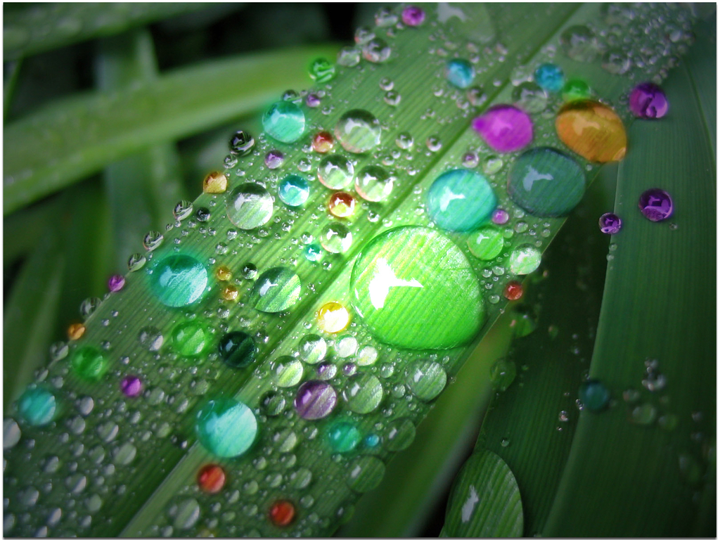
He has to do a stand up show.

Slide 31
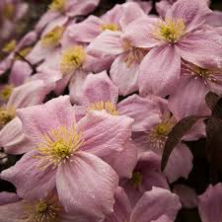
Word Choice
Tone
Questions relating to expression and word choice look at the effect created by the particular choices of the writer. The writer’s tone will depend on these choices.
A good approach is to consider what would be lost if a more neutral word is used instead.

Slide 32
A writer may choose to write informally using a style more typical of speaking rather than writing. This is called colloquial language.
Expressions such as ‘well’, ‘by the way’, ‘of course’ and ‘you know’ are examples, as are slang words such as ‘guy’ for man or ‘kid’ for child.

Slide 33
Writers may also choose to use dialect. Dialect is the name given to the style of language spoken in a particular area of the English speaking world. Scots is an example of a dialect.
You may be asked to compare dialect with Standard English…
DIALECT STANDARDENGLISH
wean child
wee small
Many writers prefer using their own dialect as they feel it is more natural, expressive and lively.

Slide 34
When explaining a writer’s use of word choice, you must make reference to the CONNOTATIONS of the word(s).
CONNOTATIONS are the ideas that we associate with certain words.
You will rarely be asked to comment on the DENOTATION of a word…
Word Denotation Connotation
Rose a type of flower love/romance

Slide 35
Word Choice
Tone
1. Quote a word/ phrase
2. Give the connotations of the word or phrase (what it makes you think of/ what you associate with the word).
3. Explain what this suggests about the writer’s argument or what they are describing.

Slide 36
Passage: (The writer is returning to the trenches at night after a spell on leave during the first world war)
‘Pushing past the gas-blanket, I blundered down the stairs to the company headquarters’ dug-out.’
Question: What does the word ‘blundered’ reveal about the way the speaker descended the stairs?
(2 marks)

Slide 37
The word ‘blundered’ reveals that the speaker moved clumsily/quickly/not placing his feet carefully/heavily.

Slide 38
Passage: ‘A lonely boy was reading near a feeble fire.’
Question: Explain the feelings the word ‘feeble’ arouses in the reader compared with a word like ‘small’.
(2 marks)

Slide 39
* ‘Feeble’ sounds as if the fire is lacking in warmth and strength as well as size.
* It makes the whole image more pathetic and arouses sympathy.

Slide 40
Passage: ‘Tom cringed as Mr Connor leaned towards him.’
Question: What does ‘cringed’ tell us about the relationship between the two characters in the extract?
(2 marks)

Slide 41
‘Cringed’ means to shrink back in fear/shame, so it suggests that Tom is afraid of Mr Connor.

Slide 42
Passage: ‘A street urchin gnawed on the remains of a hamburger he had retrieved from a bin.’
Question: How does the choice of ‘gnawed’ help you to understand how the child ate?
(2 marks)

Slide 43
Gnaw’ means to chew hard, usually on a bone. It suggests the child tore at the hamburger with his teeth as if he was starving.

Slide 44
Emotive language
If a writer is talking about something tragic, such as a disaster, (s)he will use many words which stir up strong emotions.
This is known as emotive language. For example, the words ‘shocking’, ‘horrifying’ and ‘appalling’ express stronger feelings than words such as ‘disturbing’, ‘worrying’ or ‘upsetting’.
A writer would use the former words to play on the emotions of his/her readers.

Slide 45
Tone
You may be asked a specific question on TONE, or tone may be included in the list of choices to discuss in the Evaluation questions.
The tone of a piece of work reflects the attitude of the writer to his/her subject.
The words ‘very nice’ might be said warmly and sincerely to a friend who has just given you a present you wanted.
However, it could also be said cautiously or even sarcastically.

Slide 46
Passage: ‘In the morning I went to Elvis Presley’s birthplace. A path behind the house led to a gift shop where you could buy Elvis memorabilia – albums, badges, plates, posters. There was a visitors’ book by the door. The book had a column for remarks. Reading down the list they said, ‘Nice’, ‘Real nice’, ‘Very nice’, ‘Nice’. Such eloquence.
Question: Identify the tone of the extract and say how it was created.

Slide 47
The tone is IRONIC.
The writer lists some of the remarks written in the book by the visitors which he describes as ‘eloquence’. ‘Eloquence’ means ‘expressed well’ which the comments clearly were not. Therefore the writer’s tone is ironic.

Slide 48
Passage: ‘Star Wars (1977). A technically dazzling and enjoyable science fiction film for children of all ages. The plot is the bad guys (the galactic empire) vs the good guys (the rebels). You’ll root for the good guys and hope the beautiful young princess will be rescued by two young Prince Charmings. You’ll still enjoy the film on TV.’
Question: Identify the tone of the extract and say how it was created.

Slide 49
The tone is COLLOQUIAL/CHATTY.
This is created by the use of informal words such as ‘good guys’, ‘bad guys’ and ‘you’ll…’ This is more like spoken or conversational speech than written language.

Slide 50
Passage: ‘Directly he saw the brontosaurus poking out of the ice, he knew what to do. He had it jointed, salted, packed in barrels, and shipped to the National History Museum in South Kensington. I pictured blood and ice, flesh and salt, gangs of workmen and lines of barrels along a shore – a work of giants and all to no purpose; the brontosaurus went rotten on its voyage through the tropics and arrived in London a putrefied mess; which was why you saw brontosaurus bones in a museum, but no skin.’
Question: Sad Comic Ironic
Which of these words best describes the tone of the extract above. Give reasons for your choice.

Slide 51
Types of sentences
Sentence structure
Statement – narrative/ factual writing
Question – reflective/ emotional writing * rhetorical question
Exclamation – conveys tone of amazement, shock – any strong emotion
Command – used in instructions and in persuasive (e.g. advertisements)

Slide 52
STATEMENTS – tell you something.
They end in a full stop. Most sentences are statements, so it is usually if other types of sentence are used that you will need to comment. Writing which is made up of statements alone may have a calm or impersonal tone.

Slide 53
QUESTIONS – ask something. They always end with a question mark. Using questions may challenge the reader, or show uncertainty in the writer.
Look out for rhetorical questions, which don’t expect an answer, e.g., ‘What kind of an answer is that?’ Such questions aim to stir up strong feelings in the reader, such as anger. They create an emotive tone (one which stirs up feelings or emotions).

Slide 54
COMMANDS – tell you to do something. ‘Think of a number’. They end with either a full stop or an exclamation mark.
They are often used in advertisements or where the writer tries to create the effect of talking directly to the reader.

Slide 55
EXCLAMATIONS – express excitement or surprise. ‘How beautiful it was!’, ‘What a place!’, ‘Goodness gracious!’
Exclamations do not always contain verbs. They often begin with ‘What’ or ‘How’, like the examples above, and end in either an exclamation mark or a full stop.
Exclamations may also create an emotive or dramatic tone.

Slide 56
MINOR SENTENCES – don’t contain a verb. Since they are abbreviations of other types of sentence they may end in a full stop or a question mark: ‘What now?’, ‘Time for a rest.’
Such sentences will be very short and may create a tense or dramatic mood. They are typical of informal language and may be used in direct speech, notes or diary entries.

Slide 57
Identify the following types of sentence:
1. What time does the match start?
2. Give me the money.
3. What an ordeal my interview was!
4. What do people care nowadays?
5. The dance will begin at nine o’clock.
6. Why is she so upset?
7. Come in!

Slide 58
Consider whether sentences are long and complex or short and simple.
‘It is merely to suspect that physicians marry quality with quantity when they judge how far to intervene.’
‘The older generation are a canny bunch.’

Slide 59
Long, complex sentences are typical of written English, and usually, the more complex the sentences, the more formal the language.
Short, simple sentences are typical of speech and types of language which aim to communicate very quickly and directly. Young children, for example, tend to use mainly simple sentences.

Slide 60
Look at the arrangement of words within the sentence, particularly in longer ones. Some of the following features may be worth commenting on:
LIST
REPETITION
CLIMAX

Slide 61
Lists
Listing of items , consequences or ideas
Not “commas make up a list”- items are the list not the punctuation mark
Make clearer
Emphasise volume
Reinforce ideas
Suggest scope

Slide 62
‘I came, I saw, I conquered.’ (Julius Caesar)
The LIST of verbs ‘came’, ‘saw’ and ‘conquered’ creates a sense of action.
The REPETITION of the personal pronoun ‘I’ suggests a speaker who is egotistical and dominating.
The verbs in the list have a sense of progress and end with the most powerful, leading to the effect of a CLIMAX.

Slide 63
Climax/Anti-climax
In climax, a series of ideas are arranged in the order of increasing importance.
What a piece of work is man! How noble in reason, how infinite in faculties! In action, how like an angel! In apprehension, how like a God!
Anticlimax is the opposite of climax - a sudden descent from higher to lower. It is mainly used for the purpose of satire or ridicule.
Here thou, great Anna! Whom three realms obey, Dost sometimes counsel take - and sometimes tea.

Slide 64
Passage: One faction has cried constantly that the countryside is in mortal danger from greedy developers whose only motive is profit; another has kept on roaring that farmers are killing every wild thing in sight and threatening the very soil on which we stand through overuse of machinery and chemicals; still another has been continually heard ululating over a decline in the bird population, or the loss of hedgerows, or the disappearance of marshland, or the appearance of coniferous forest.
Question: Show how the word choice and sentence structure in lines 8–14 emphasise the strong feelings of those who feel the countryside is under threat.

Slide 65
Passage: One faction has cried constantly that the countryside is in mortal danger from greedy developers whose only motive is profit; another has kept on roaring that farmers are killing every wild thing in sight and threatening the very soil on which we stand through overuse of machinery and chemicals; still another has been continually heard ululating over a decline in the bird population, or the loss of hedgerows, or the disappearance of marshland, or the appearance of coniferous forest.
Question: Show how the word choice and sentence structure in lines 8–14 emphasise the strong feelings of those who feel the countryside is under threat.

