Slide 1
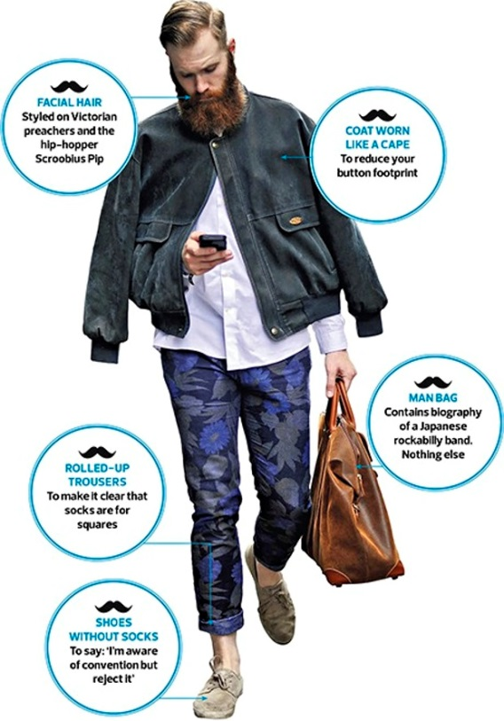
STARTER
Observation Test
Watch the following clip and pay close attention.
Be ready to answer a series of questions.
#beardlove 1
What is the name of the book carried in the first scene?
2. What do the hipsters call their shoes?
3. Name all three hipsters who feature in this sketch.
4. a) How much did the hipsters pay for their leatherette wrist wraps?
b)Where did they buy them from?
5. a) Where do the hipsters keep their IPAs?
b) Name two of the beers they enjoy.
Name three twitter handles used in this sketch.
What colour are Miko’s braces?

Slide 2
What is the name of the book carried in the first scene?
1000 Tattooes
2. What do the hipsters call their shoes?
Shegs
3. Name all three hipsters who feature in this sketch.
Nico
Kiko
Miko
a) How much did the hipsters pay for their leatherette wrist wraps?
b) Where did they buy them from?
£50 a pop
Etsy
a) Where do the hipsters keep their IPAs?
b) Name two of the beers they enjoy.
In the hay-filled mini wheelbarrow
Nuclear Beer Strike & Brutus Thickwhiskers
Name three twitter handles used in this sketch.
@tattooboys
@beardieboys
@sexytatbeards
@beardiehotsters
@tattybeardies
7. What colour are Miko’s braces?
yellow / gold

Slide 3
Why I Hate Hipsters!

Slide 4
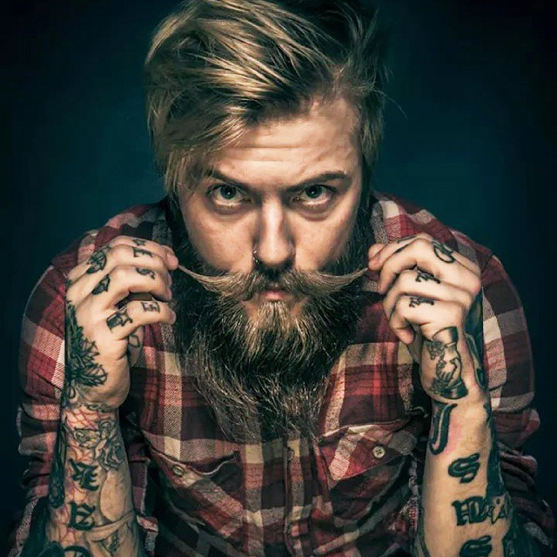
HOMEWORK
Make a list of three things that you hate or that bother you.
Underline the one that bothers you most.
Now make a list / spider-diagram of reasons why you dislike the topic you have chosen with such a passion.

Slide 5
Starter
Read through the list of persuasive language terms on the list below and, with a partner, come up with a definition for each one.

Slide 6
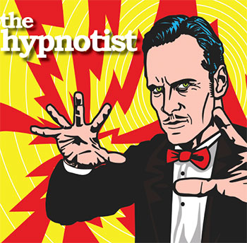
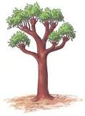
Let’s remember CRAPI FORESTES
PERSUASIVE WRITING
Facts / flattery
Opinions
Rhetorical questions
Emotive language
Superlatives
Triples
Exaggeration
Statistics
Connectives
Repetition
Alliteration
Pronouns
Imperatives
Humour

Slide 7
Their beards are big, bushy and well-maintained.

Slide 8
You and I would never be drawn into such ridiculous flaunting of facial fluff – especially the girls amongst us!

Slide 9
Seemingly, many of us are attracted to the facial fuzz of these prancing prats.

Slide 10
Only 3 of out 10 people surveyed expressed a positive view of the obligatory tattoo sleeve and big beard combo.

Slide 11
When was the last time you hopped on you old penny farthing to pick up a pulled pork sandwich and a coconut water for your brunch/lunch/break-time/ alternative midday meal?

Slide 12
#beardlove #tattooedbeardies #tattooedbeardyhottie

Slide 13
…all competing for the bushiest, most luxurious face foliage…

Slide 14
Let me tell you about beards. Firstly, beards stink. Secondly, beards itch. Thirdly, beards render the wearer moderately more attractive than Mr Twit on a bad day.

Slide 15
So how can we be rid of these ridiculously retro ninnies?

Slide 16
Look past their thick-rimmed specs, see beneath the sleeve of tats, don’t believe in the bowler…

Slide 17
The hipster beard is a visible presence on every high street in the UK and the trend shows no sign of stopping in 2015.

Slide 18
Once I happened upon a hapless hipster basking in the late evening light at the local bus stop. Clearly distressed and fiddling with his phone, hot salty tears poured into his lavishly waxed ‘tashe. Had he lost his bus ticket? No. Did he need a taxi number? No. The source of his suffering? No charge in his mobile to Instagram the sunset!

Slide 19
The rims of his specs were as thick as cables! His beard was so bushy he could barely lift his head!

Slide 20
Rarely am I so offended by the sight of my own species. How I hate to hear hipsters harping on about their “authentic” lives.

Slide 21
Structure for your essay.
Introduction – begin by introducing the topic of your
essay and state the belief that you will go on to prove.
Make your case against your hated topic in the form of a
series of points.
Choose two weak counter arguments to show you
understand the other side of the argument and then
dismiss them.
Conclude by reiterating your viewpoint.

Slide 22
Writing Your Introduction
Begin by introducing the topic of your essay and state the belief that you will go on to prove.

Slide 23
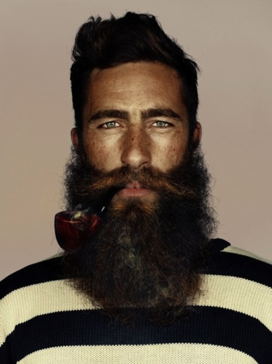
Ban The Beards And Give Hipsters The Heave-Ho!
ALLITERATION
Bushy beards and bowlers are my
bugbear. How I hate to hear hipsters havering about their “authentic” lives. I’m sorry to say it but I’m just not feeling the beardy love and, as far as I am concerned, I believe we must round up all hipsters with their shegs, regs and IPAs in their hay-filled wheelbarrows and tip them off the nearest cliff!
PRONOUN
IMPERATIVE
TRIPLES

Slide 24
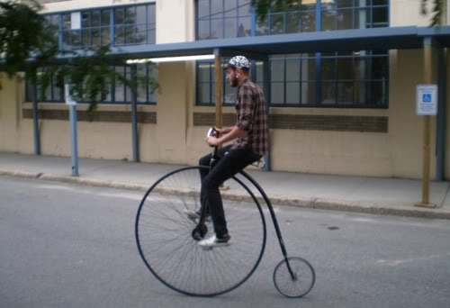
What do you see?
What do you think?
What do you wonder?
You have 5 minutes.

Slide 25
Sample Paragraph
Firstly, I despise the arrogance that hipsters
exude. They have a sheen of smugness that is as
polished as their over-waxed moustaches. They
stride around in tight strides and their egotistical bubbles of smug, continually tilting their chins upwards to flaunt their latest neck tat. Do they realise that in their journey to fulfilment (or self-absorption) they fail to notice the everyday interesting. With faces fixed on phones in their pretentious pose for their latest Instagram selfie they don’t take the time to read the real expressions of those around them. Really? Who has time for their “authentic life” when real life is actually happening and they are genuinely missing it!

