Slide 1
I can select and use the strategies and resources I find most useful before I read, and as I read, to monitor and check my understanding. LIT 3-13a
Through developing my knowledge of context clues, punctuation, grammar and layout, I can read unfamiliar texts with increasing fluency, understanding and expression. ENG 3-12a
To show my understanding across different areas of learning, I can: • identify and consider the purpose, main concerns or concepts and use supporting detail; • make inferences from key statements; and • identify and discuss similarities and differences between different types of text. LIT 3-16a
As appropriate to my purpose and type of text, I can punctuate and structure different types of sentences with sufficient accuracy… 3-22a
Core Course
S1 – 2/3
Sentence structure – phrases, clauses, simple, compound, complex, statements, questions, exclamation, command, parenthesis
Higher order reading strategies – predicting, monitoring, summarising, connecting, visualising, questioning
Punctuation – apostrophes and commas (homework)
Practice exercise 1 – ‘Drummer Boy’
Notes:
Resources adapted from: Highland Literacy, New South Wales Reading Comprehension

Slide 2
Note for teacher
The approach taken in these lessons is for pupils to refamilarise themselves with strategies they will have learned at primary school, and use them independently in their own personal reading.
Pupils will create their own personalised bookmarks with the main strategies associated with higher order reading.
They should then apply these strategies regularly. An approach could be, when updating their reading journal, for pupils to record which strategy they used, how they used it, and how successful they were. This supports metacognition and allows pupils to take responsibility for their own learning.
It is fundamental to regularly reference to pupils how they could use these strategies in other subjects.
Resources designed by Michael Wilkie

Slide 3
Reading Strategies
Learning Intentions
To identify strategies to help me to read independently
To create a resource I can use to help me easily access reading strategies
Success Criteria
To identify all stategies that can be accessed to support reading
To create a bookmark outlining the different stratgeies in an attractive and easy-to-use manner
Starter:
Look at this picture below for thirty seconds. What do you think the image below is a magnified image of?

Slide 4
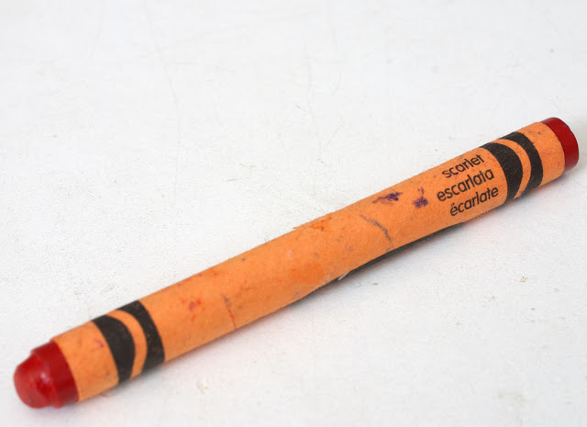
When concentrating on the finer details, were you able to see the bigger picture?
Reading is like this. To understand the whole text, you need to be able to work out the details.

Slide 5
To help you with this, in primary school, you will have probably focused quite a bit of time on Higher Order Reading Skills. By developing these skills, you became:
a quicker reader - a more focused reader
a more confident reader - a curious reader

Slide 6
In high school, we focus on helping you to understand, analyse and evaluate texts.
However, you are also expected, as a
confident and independent learner, to
use these strategies in your own personal
reading.
Therefore, to support your personal
reading, we will design a bookmark
with all the key strategies you will
need to tackle texts.

Slide 7
Before we start:
What is a text?
A text is the way that ideas, experiences opinions and information can be told to you.
This means the books you read, and the any different texts you use in your daily life, including online.
Examples: novels, maps, adverts, emails, films, games, posters, recipes, blogs, vlogs

Slide 8
Strategy 1:
Making Connections
You make a personal connection from the text with:
something in your own life (text to self)
another text (text to text)
something occurring in the world (text to world)

Slide 9
Examples:
This chapter reminds me of a holiday to my grandfather’s farm because…
This character has the same problem that I saw/heard/read in another text, which is…
I saw a program on television that presented things described in this text.
For notes:
Does this remind me of something?
Has something like this ever happened to me?
Do I know something happening in the news or the world that’s similar to this?

Slide 10
Strategy 2:
Predicting
You use evidence from the text, or your own life, to anticipate what will happen next.
As you read you adjust what you predict.
You never just guess.

Slide 11
Examples:
I think this character might be going to jail, because the jury don’t seem to believe anything he is saying in court.
I know that usually people who do risky things like this character end up in serious danger, so this will likely happen.
For notes:
What do I think will happen next?
What words/images do I expect to see in this text?
What might happen next? Why do I think this? What helped me to make this prediction?
Was my prediction accurate? What evidence do I have?
Have I read/seen/heard about this topic anywhere else?

Slide 12
Strategy 3:
Questioning
You ask questions when reading and after reading. You answer them in detail to help understand your text more deeply.
Questions should be asked by yourself, peers, teachers and parents/guardians.

Slide 13
For notes:
What in the text helped me to know that?
How is this text making me feel? Why is that?
When I read/viewed/listened to the text did it remind me anything I know about? Why did it remind me of that?
What did the author of this text mean by…?
Whose point of view is this? What points of view are missing?
Is this a reliable text? How do I know this?
and many, many more.

Slide 14
Strategy 4:
Monitoring
When you get stuck with a text, you stop and think about it.
You know what to do when you don’t understand something – either a word, an idea, or what’s happening in the text.

Slide 15
For notes:
Is this making sense?
What have I learned reading this?
Am I focusing enough? Am I skipping parts?
Should I slow down? Speed up?
Do I need to re-read/view/listen?
What can help me fill in the missing information?
Do I need to ask a peer/teacher/parent for help?
What does this word mean?
Do I need to use a dictionary, thesaurus, and/or Google?

Slide 16
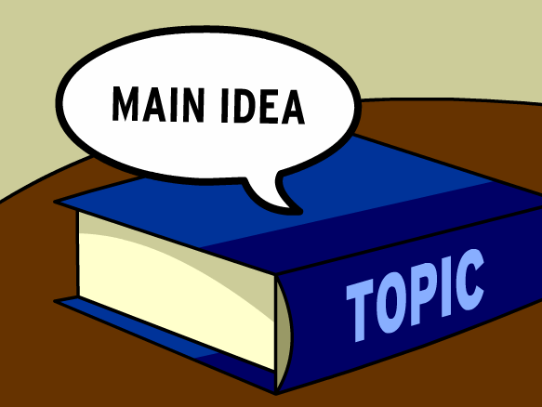
Strategy 5:
Summarising
You identify and accumulate the most important ideas and put them into your own words.
Remember, you can still use common words and proper nouns.

Slide 17
For notes:
What things will help me summarise this text – list, mind map, note-taking, annotations, etc?
What are the main ideas and significant details from the reading/viewing/listening?
If I was to tell someone else about this in a few sentences, what would I tell them?
What is the main theme? How is it connected to the world beyond the text?
In what ways does the text relate to the topic I have been investigating?
Can I create a metaphor for the text I have read?

Slide 18
Strategy 6:
Visualising
You can create a mental image from your text. It’s like having a movie in your mind.
Visualising brings the text to life, engages your imagination and use all of the senses.

Slide 19
For notes:
What are the pictures I have in my head when I read/view/listen to this text?
Can I describe the picture or image I made while I read/heard that part?
How did the picture in my head help me to understand the text?

Slide 20
Strategy 7:
Skimming and scanning
Skim when you want to read something quickly to get the main ideas.
Scan something when you want to read something quickly to find a specific piece of information.

Slide 21
For notes:
Am I trying to find the main idea quickly or attempting to find a piece of information?
Is it appropriate to skim and scan in this task?

Slide 22
Remember, you need to choose the strategies you think you will help you most in different situations.
Some strategies won’t be appropriate to the situation you are in with some texts.
You should try to use as many of the strategies as possible in the rest of S1, using the questions to help you.

Slide 23
Guidance for your bookmark
Focus on information first, decoration second.
Decide what you will need from each strategy.
Summarise the main ideas of the strategy and choose a few questions for each.
You may plan your bookmark beforehand.
The bookmark will be laminated, and cannot be lost.

Slide 24
Reading Strategies
Learning Intentions
To identify strategies to help me to read independently
To create a resource I can use to help me easily access reading strategies
Success Criteria
To identify all stategies that can be accessed to support reading
To create a bookmark outlining the different stratgeies in an attractive and easy-to-use manner

