Slide 1
I can select and use the strategies and resources I find most useful before I read, and as I read, to monitor and check my understanding. LIT 3-13a
Using what I know about the features of different types of texts, I can find, select, sort, summarise, link and use information from different sources. LIT 3-14a
To show my understanding across different areas of learning, I can: • identify and consider the purpose, main concerns or concepts and use supporting detail… LIT 3-16a
To show my understanding, I can comment, with evidence, on the content and form of short and extended texts, and respond to literal, inferential and evaluative questions and other types of close reading tasks. ENG 3-17a
Through developing my knowledge of context clues, punctuation, grammar and layout, I can read unfamiliar texts with increasing fluency, understanding and expression. ENG 3-12a
Core Course
S1 – 1/3
In your own words (describe/explain/identify)
Summarise
Finding and selecting information/evidence (quoting)
Basic Evaluation (justified opinion/quotations)
Skimming and scanning
Highlighting and underlining
Parts of speech (homework)
Resources designed by Jennifer Higgins and Michael Wilkie

Slide 2
Note for teacher
Homework tasks and full lessons exist for:
Intro + Nouns (2 weeks teaching)
Adjectives (1 week)
Verbs (1)
Adverbs (1)
Pronouns (1)
Prepositions and Conjunctions (1)
One lesson and a revision homework task covers articles, determiners and interjections. (1)
If delivered in S1, during library/homework time, where delivered fortnightly, then this course lasts 16 weeks, or August – December.
Resources designed by Jennifer Higgins and Michael Wilkie

Slide 3
Parts of speech
Learning Intentions
- To define different parts of speech
- To create notes to develop thinking and retain information about parts of speech
- To identify parts of speech in different texts
Success Criteria
- To be mostly accurate in parts of speech homework
- To generate notes that are attractive and well organised
- To identify a number of parts of speech in exercises
Starter – in groups/pairs
Which of these are NOT parts of speech?
verb, vowel, consonant, alliteration, adjective, noun, preposition, junction, conjunction

Slide 4
The purpose of grammar
Words are the building blocks of language. Grammar is a set of rules that determines how these building blocks can be put together in different combinations to create well-formed phrases, clauses and sentences.
Without grammar, we couldn’t
understand each other.

Slide 5
Parts of speech
To help us understand each other, we sort our words into different types, according to the role they play in a sentence.
There are ten parts of speech in English. Verbs and nouns are essential to a sentence, but it’s the other parts, including adjectives, adverbs, conjunctions and prepositions, that make a sentence interesting.

Slide 6
Evolving languages
All languages change over time. Different languages have totally different language rules, so sentences can look very different. This is why translations can sometimes be tricky, and why grammar is needed.
I read my sister’s book,
which was good.
I read the book of my sister,
which good was.
I read the book of my sister,
which good was.
Modern English
Old English
German

Slide 7
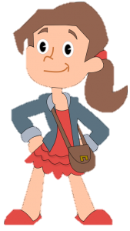
So… why do I need to know this stuff?
Good question. Well, when a child learns a language they absorb the way the language is structured. As you learn to read and write, you refine this knowledge.
However, to be an excellent reader and writer, and to have a confident command of your language, it is important to understand the rules of English well. The best place to start is with grammar.

Slide 8
Seriously though, why are you making me learn this?
Basically, without the rules of grammar, words would be placed in a random order, and understanding would be impeded.
And even more importantly, knowing the rules of grammar means that you can write proper sentences, and know when you have made an error in sentencing. This is one of the most common issues with writing in English.

Slide 9
Before we start…
When you are being taught new knowledge to understand, you have to make choices over how you will record this learning. This is important because you need to be able to retain information and help it become part of your long term memory.
Some people choose to take notes in bullet points, others use subheadings, and some even use illustrations and symbols.
Mind maps are good for creating notes for the first time, but even better for revising what you’ve learned. Remember that underlining and highlighting is something you should do after we’ve finished.

Slide 10
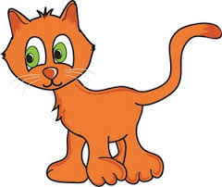
1/10 - Nouns
Every object you see around you, the table, the chair, the window, is called a noun in English grammar.
If it is a common object, without a special name of its own, like a cat, it is called a common noun.

Slide 11
Common nouns
Many nouns are things you can see, e.g. bus, boy, girl, hat, face, hands, pencil, jotter, etc.
Many other nouns will be noticed by your other senses of hearing, touch and smell and are still common nouns, e.g. noise, conversation, fumes, texture.

Slide 12
Task 1 – The name game
Make a list of common nouns, one for each letter of the alphabet. For example a . . . alligator, b. . . banana, c . . . canary, etc.

Slide 13
Task 2 – Identify nouns
Write out the following paragraph, putting a line under each of the common nouns. There are ten to be found.
I was woken by the rain. I looked up and saw the jungle all around me. Then I remembered the plane, the storm, and the crash. But all that remained was my seat from the aircraft. Apart from the sound of frog and insects, I was alone.

Slide 14
Task 3 – Mind the gap
Complete the following sentences with a suitable common noun. For example: The footballer scored a ______ (goal).
The soldier was given a _______.
She sang a lullaby to her _______.
I saw a good film at the ________.
The mouse could smell _______.
The musician played a _______.
The bird picked up the ________.

Slide 15
Proper nouns
A proper noun is the name given to a particular person or place. To show it is a special name, it is written with a capital letter, for example, Tower Bridge is a proper noun because it is the name of a particular bridge.

Slide 16
Proper nouns
Type of proper noun | Examples
Names of people | John, Sally Smith, Queen Elizabeth II
Titles | Mr., Miss, Sir, Dr., Professor, Reverend
Places, buildings and institutions | Africa, Asia, Canada, New York, Red Cross, Sydney Opera House, United Nations
Religious names | Bible, Koran, Christianity, Hinduism, Islam
Historical names | World War 1, Ming Dynasty, Roman Empire
Events and Festivals | Olympic Games, New Year’s Eve
Days of the week, months | Saturday, December

Slide 17
Task 4 – Proper Nouns
Write down the following proper nouns.
Five boys’ names
Five girls’ names
The names of five films or books
The names of five capital cities.

Slide 18
Task 5 – Write out the following, beginning each proper noun with a capital letter.
My favourite uncle, uncle george, took me on a visit to london last saturday. We went on the underground to baker street station, from where it was a short walk to madame tussaud’s museum. I liked the chamber of horrors, but was quite interested in seeing what the kings and queens looked like, particularly richard the lionheart. We went into the planetarium which was next door, and were amazed at the views of the night sky showing mars, venus and mercury. After lunch, we went for a walk by the side of the river thames to have a look at the houses of parliament, and to visit westminster abbey which contains the tomb of the unknown warrior. After tea at the royalty restaurant, we took a taxi to victoria station and went home

Slide 19
My favourite uncle, uncle george, took me on a visit to london last saturday. We went on the underground to baker street station, from where it was a short walk to madame tussaud’s museum. I liked the chamber of horrors, but was quite interested in seeing what the kings and queens looked like, particularly richard the lionheart. We went into the planetarium which was next door, and were amazed at the views of the night sky showing mars, venus and mercury. After lunch, we went for a walk by the side of the river thames to have a look at the houses of parliament, and to visit westminster abbey which contains the tomb of the unknown warrior. After tea at the royalty restaurant, we took a taxi to victoria station and went home

Slide 20
You will notice that some nouns can be either common nouns or proper nouns. They become proper nouns when they become one particular name, spelt with a capital letter, for example: uncle and Uncle George.
Task 6; make a list of all the common nouns in Task 5 which only become proper nouns when they are spelt with a capital letter.

Slide 21
Task 7 – Landmarks
Here is a list of ten common nouns: zoo, castle, tower, loch, pier, bridge, tunnel, caves, cathedral, university.
Here is a list of ten proper nouns: Blackpool, Southend, Strathclyde, Stirling, Cheddar, Clyde, Edinburgh, Coventry, Ness, Erskine.
Make a list, matching each common noun with its correct proper noun, so that both words become proper nouns, e.g.
common noun – wall + proper noun – Hadrian
= Hadrian’s Wall

Slide 22
Collective nouns
A collective noun is a singular noun which groups together plural objects. For example: A flock of sheep are in a pen.
Flock is a singular noun; sheep is being used as a plural word because there are many sheep.

Slide 23
Task 8 – Collective Nouns
An army of ________
A team of ______
A choir of ________
A menagerie of _________
An orchard of ________
A convoy of _________
A library of _________
A swarm of ________
A bouquet of ___________
Here is a list of collective nouns. In the spaces, put in a suitable plural noun.

Slide 24
Abstract nouns
Abstract nouns are the names for all the feelings, thoughts and ideas with you cannot hear, touch or see, but which can exist in your mind.

Slide 25
Abstract nouns
The difference between a common noun and an abstract noun may be seen from the following;
- The sharpness of the knife made him cut his finger.
- You are able to see and touch the knife, but the sharpness is an idea you can think of which doesn’t have an actual shape.

Slide 26
The difference between a common noun and an abstract noun may be seen from the following;
- The sharpness of the knife made him cut his finger.
- You are able to see and touch the knife, but the sharpness is an idea you can think of which doesn’t have an actual shape.

Slide 27
There are several ways in which a word may be changed into an abstract noun, for example,
Putting –ness on the end
clever ⁺ ness = cleverness
happy + ness = happiness
Note that when adding –ness to a word ending with y, you must cross off the y and change it to an i.
Putting –hood on the end
child+hood= childhood
father+hood=fatherhood
Putting -ship on the end
owner+ship=ownership
fellow+ship=fellowship

Slide 28
Task 9 – Changes
Short
Sad
Rough
Sleepy
Crafty
Kind
Smooth
Tidy
Clean
Weary
Change the following words into abstract nouns by adding -ness.

Slide 29
Task 10 – More changes
Change the following words into abstract nouns by adding whichever ending is correct
Champion
Scholar
Parent
Apprentice
Showman
Leader
Knight
Man
Priest
Lively

Slide 30
Task 11 – More changes
Change the following words into abstract nouns by adding whichever ending is correct
Champion
Scholar
Parent
Apprentice
Showman
Leader
Knight
Man
Priest
Lively

Slide 31
Singular and plural
Singular comes from the word single and means one on its own.
Plural means more than just one.
Just one dog = singular noun
= dog
More than one dog = plural noun
= dogs
By looking at this example, what is the usual way of changing a singular into a plural?

Slide 32
Singular and plural
The usual way of changing the singular to the plural is to add the letter s, for example:
school + s = schools
classroom + s = classrooms
There are some exceptions though.

Slide 33
Words ending in s x sh and ch
If you were only to add an s to a word ending with s x sh or ch, you would not hear the sound of the final s. So you must add es to words that end with s x sh or ch.

Slide 34
Task 12 – Write out the plurals of these nouns:
Animal
Watch
Branch
Bush
Nephew
Match
Radish
Couch
Moss
Witch
Glass
Wish
Mattress
Theatre
Sausage
Address

Slide 35
Task 13 – Write out the singular of these nouns:
Artists
Writers
Patches
Pictures
Vases
Shades
Sashes
Churches
Gases
Scratches
Foxes
Stitches
Houses
Taxes
Dresses
Nieces

Slide 36
Task 14 – Sentence work
Write out the following sentences, changing every noun to plural.
The rabbit runs away from the dog.
The girl wears a blue dress.
I keep the bird in a cage.
The priest spoke to the prince.
The reporter spoke to the princess.
The waitress served the tycoon.
The actress carried a bag.
The ship struck the rock.
The glass had a scratch.
The lioness has a cub.

Slide 37
More unusual plurals
The plural of nouns which end with y
If a singular noun ends in y, look at the letter before the y; if it is a consonant, change the y to i and add es to form the plural, for example:
baby
babies
If the letter before the y is a vowel, just add s as usual, for example:
key + s = keys tray + s = trays

Slide 38
Task 15 – Write out the plural of these nouns ending in y:
Fly
Day
Daisy
Alley
Story
Berry
Diary
Dairy
Chimney
Storey
Family
Journey
Abbey
Library
Quay
Melody
Gallery
Lorry
Donkey
Salary
Monastery
Monkey
Quarry
Holiday

Slide 39
The plural of words ending with o
If the singular noun ends in o, look at the letter before the o to make the plural; if it is a consonant, add the two letters es, for example:
echo + es = echoes
hero + es = heroes
There are a few exceptions to this rule, for example: piano > pianos, solo > solos, halo > halos

Slide 40
But…
If the letter before the o is a vowel, just add the letter s, for example:
rodeo + s = rodeos
radio + s = radios

Slide 41
Task 16 – Write out the plural of these nouns ending in o:
Cargo
Stereo
Studio
Patio
Cameo
Buffalo
Piano
Shampoo
Motto
Potato
Tomato
Volcano
Tornado
Mosquito

Slide 42
More unusual plurals
If the singular noun ends in f, change it to v before adding es to form the plural, for example:
wolf > wolves
Also, if the singular noun ends in fe, the plural changes to ves, for example:
wife > wives life > lives knife > knives

Slide 43
Task 17 – Write out the plural of these nouns:
Loaf
Leaf
Calf
Half
Shelf
Thief
Ourself
Yourself
These are the exceptions to the rule!
Chief > chiefs
Belief > beliefs
Dwarf > dwarfs
Roof > roofs

Slide 44
Some more rule breakers!
The names of some animals are the same for both singular and plural, as in the word sheep, for example:
Singular I found one of the sheep.
Plural The dog rounded up all of the sheep.
Task 8: Write out six sentences (one using each word in the singular and one in the plural) for each of the following animals:
trout grouse deer

Slide 45
Some nouns can only ever be plural
Clothes
Trousers
Scissors
Shears
Tongs
Pincers
Pliers
Athletics
Mathematics
Politics
- Can you think why they are only ever plural?
- Can you think of any more?
- Can you think of any words that completely change their spelling in the plural?

Slide 46
Task 18 – Write a sentence for each word but with the noun in the plural.
Foot
Tooth
Goose
Mouse
Woman
Gentleman
Child

Slide 47
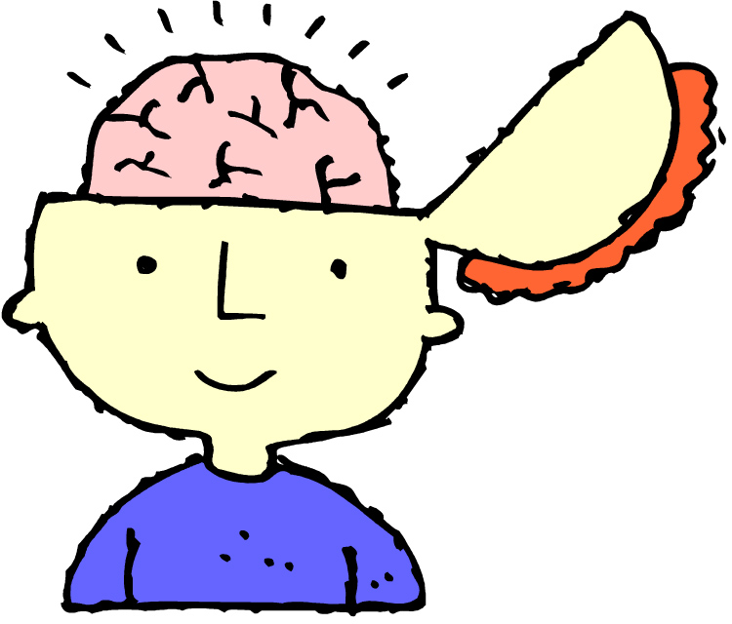
2/10 - Adjectives
Adjectives are describing words which give nouns a fuller or more exact meaning.

Slide 48
2/10 - Adjectives
For example:
The aging film-star waved his crippled hand to the pretty reporter.
Without adjectives, this sentence would read:
The film-star waved his hand to the reporter.
We might then imagine quite a different scene. Adjectives tell your audience more about he nouns you use.

Slide 49
2/10 - Adjectives
There is a well-known poem which tried to stop animal cruelty; here are four lines of the poem without the adjectives:
. . . For tigers,
And for dogs and bears,
And ponies,
And hares.

Slide 50
2/10 - Adjectives
It doesn’t really say much, does it? Here it is with adjectives:
. . . For tamed and shabby tigers
And dancing dogs and bears,
And wretched, blind, pit ponies,
And little, hunted hares.

Slide 51
Task 1 – Identifying Adjectives
Write out the following verse, putting a line under the ten adjectives.
Augustus was a chubby lad;
Fat ruddy cheeks Augustus had;
And everybody saw with joy
The plum and hearty, healthy boy.
He ate and drank as he was told,
And never let his soup het cold.
But one day, one cold day,
He screamed out in a horrid way,
‘I’ll have no nasty soup today!’

Slide 52
Where to place adjectives
Adjectives usually go in front of the nouns they describe, but to add variety and make phrases more interesting, they sometimes go after the noun, for example;
And did those feet in ancient time
Walk upon England’s mountains green?
The adjective ancient goes before the noun time, but green follows the noun mountains.
This is done more often in poetry. Why do you think that is the case?

Slide 53
Task 2 – Identifying Adjectives
Write out the following piece from ‘The House that Jack Built’, putting a line under the five adjectives that follow the nouns..
That waked the priest all shaven and shorn,
That married the man all tattered and torn,
That kissed the maiden all forlorn,
That milked the cow with the crumpled horn . . .

Slide 54
Task 3 – A menagerie
Write some lines about these animals using a few suitable descriptive adjectives.
Magpie
Whale
Mouse
Elephant
Eagle

Slide 55
Task 4 – Powerful Adjectives
Find 15 powerful adjectives which help describe the scene:
The sky glows with a light, strange and dull, that of the beginning of the world. In space is a ball, the Earth, lit by an enormous oval sun, its light an intense electric blue. On Earth, lightning flashes and spurting flames light up the vivid scene; waterspouts swirl, and we can see a struggle, fierce and gigantic, between the fires and waters of our young planet. Earth is swept and covered by scalding, seething seas, on which the storms whip up tremendous waves.

Slide 56
Task 5 – Listing
Make your own list of ten adjectives (that we have not used already!) that you think are strong enough to help to form a strong picture in the mind.

Slide 57
Comparative adjectives
The comparative adjective compares one thing with another, for example: larger, greener
To for the comparative with short adjectives, add er, for example:
long -> longer
short -> shorter
For long words, use the word more in front of the adjective, for example:
beautiful -> more beautiful
intelligent -> more intelligent

Slide 58
Task 6 - Write out the following adjectives in the comparative form by adding er or putting the word more in front.
hard
small
loud
cool
kind
impressive
different
educational
interesting
popular

Slide 59
Superlative adjectives
The superlative adjective compares one thing with all the others, for example: largest, greenest
For short adjectives, add est to the end of the words, for example:
long -> longest
short -> shortest
For long words use the word most in front of the adjective, for example:
beautiful -> most beautiful
intelligent -> most intelligent

Slide 60
Task 7 - Write out the following adjectives in the superlative form by adding est or putting most in front.
smooth
few
fresh
strict
relaxed
effective
obliging
evil
helpful
important

Slide 61
Spelling comparatives and superlatives
Short vowels have a ‘squeezed in’ sound, for example: fat, hot, thin.
If you wished to add to comparative er or the superlative est to an adjective which has a short vowel, you must double the last letter to make sure that the vowel keeps the short sound, for example:
hot + er -> hot + extra t + er = hotter
hot + est -> hot + extra t + er = hottest

Slide 62
However…
Adjectives with a short vowel followed by two consonants do not need an extra letter because they already have one, for example: soft -> softer -> softest
Only double the last letter if there is only one consonant after a short vowel.

Slide 63
Long vowels
Long vowels have a ‘stretched out’ sound, for example: pale, nice, slow, clean
To add er or est to an adjective with a long vowel (or two vowels making a long sound) no extra letter is wanted, for example:
slow + er or est = slower slowest
clean + er or est = cleaner cleanest
If the long vowel is formed by an e on the end of the word, you just add r or st (no extra letter wanted), for example:
pale + r = paler pale + st = palest
nice + r = nicer nice + st = nicest

Slide 64
Task 8 – Correct Adjectives
Write out the following sentences giving the correct form of the adjective in brackets.
He is the (sad) person I know.
The man became (thin) as he grew older.
It was the (long) journey I had made.
The weather this summer was (cool) than it was last year.
Ann is definitely the (tall) of the two girls.

Slide 65
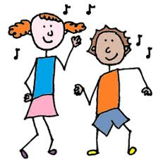
3/10 - Verbs
A verb is an action word.
For example: the teacher holds the pen. The swimmer dives into the pool.

Slide 66
Task 1 – Identifying Verbs
Write out the following sentences underlining the verbs:
The hockey player strikes the ball.
The footballer kicks the ball toward the goal.
The archer shoots an arrow at the distant target.
The golfer swings her golf-club at the ball.
The basketball player leaps up at the net.

Slide 67
Verbs of Being
Verbs do not always describe an action, e.g. dancing, walking, breathing, etc. There is also the verb to be.
For example: I am hungry. The verb in this sentence is am.
Present tense: am, are, is
Past tense: was, were
Future: will be
Progressive form – being - He is being unusual. Perfect form – been - It has been fun.

Slide 68
Tenses
All of the sentences we looked at so far are written in the present tense, as if they are happening just now.
If we were to use the past tense, we would say: The teacher held the pen. The swimmer dived into the pool.
If we were to use the future tense, we would say: The teacher will hold the pen. The swimmer will dive into the pool. When you are writing, your tenses must agree – that is, if you have been writing in the past tense, you should continue in that tense.

Slide 69
Task 2 – Tenses
Add verbs to these nouns in each of the three tenses.
E.g. birds sing, sang, will sing
Lions
Artists
Rivers
Pianists

Slide 70
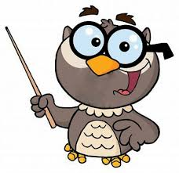
The Helping Verb
Some verbs are made up of more than one word, for example:
was helping
is holding
should be singing
The extra words, in bold, are called helping verbs, or auxiliary verbs, because they help the main verb.

Slide 71
Task 3 – Auxiliary Verbs
Write out the following sentences, putting auxiliary verbs in the blank spaces.
We ______ told to get on with our work and all ______ working at once.
At your age you ______ capable of knowing the work you _______ expected to do by yourself.
If Mary and Jane _______ asked to collect up the books, they ______ stack them away in no time.

Slide 72
The Auxiliary Verb
The auxiliary verb helps verbs to be put in different tenses. For example:
Present
I walk, I am walking
Past
I walked, I was walking, I have walked
Future
I shall walk, I shall be walking

Slide 73
The Auxiliary Verb
Here is a list of the most common auxiliary verbs:
am was do have
is were does has
are did had
shall could must would
will should might may
can

Slide 74
Task 3 – Auxiliary Verbs
Write out the following putting in an auxiliary verb in each blank space.
Now the two dogs ______ barking fiercely at each other.
The children ______ gone out to play on the swings.
What’s the problem? I _______ be able to help you.
You _____ taken my book away and I ______ like it returned.
After each sentence, write whether it is past, present or future.

Slide 75
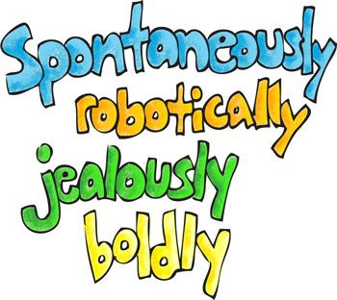
4/10 - Adverbs
Adverbs give more meaning to the verb by saying how, when or where the action happens.

Slide 76
4/10 - Adverbs
There are three main kinds of adverbs:
the adverb of manner which tells you how an action is done. For example: badly, well, quickly, eagerly, slowly.
The athlete ran (verb) quickly (adverb).
The tortoise crawled (verb) slowly (adverb).
The boy hurt (verb) his hand badly (adverb).
The girl eagerly (adverb) attended (verb) the youth club.

Slide 77
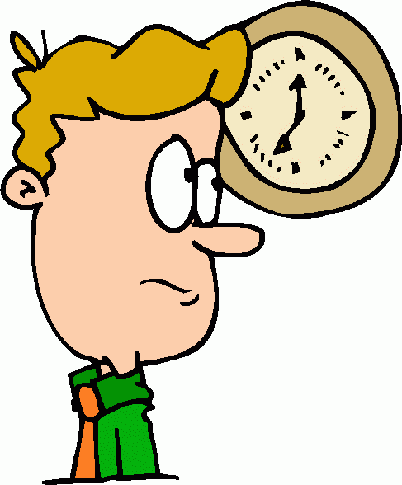
4/10 - Adverbs
b) The adverb of time tells you when an action is done.
For example: now, then, soon, before, since, yesterday
1. Yesterday (adverb) I lost (verb) my pen.
2. She had already finished (verb) her work before (adverb).

Slide 78
4/10 - Adverbs
c) The adverb of place which tells you where an action is done.
For example: here, there
I can’t find (verb) the books anywhere (adverb).
I have looked (verb) for her everywhere (adverb).

Slide 79
Most adverbs are made by adding ly to an adjective, for example: quick -> quickly, wise -> wisely
If the word ends with the letter ‘l’ as in ‘beautiful’, make sure that the letter is kept in the word as well as the new ‘ly’; this will mean that there will be a double ‘l’ as in the following:
hopeful -> hopefully beautiful -> beautifully
If the word ends in a ‘y’ as in pretty, replace the y with an ‘i’ before adding ‘ly’, as in the following:
busy -> bus ->(remove ‘y’ change to ‘i’) -> busi+ly = busily
crazy -> craz ->(remove ‘y’ change to ‘i’) -> crazi+ly = crazily

Slide 80
Task 1 – Changing
Turn the following adjectives into adverbs:
heavy
weary
faithful
thoughtful
cranky
grand
low
happy

Slide 81
Adverbs versus Adjectives
An adverb goes with a verb.
An adjective goes with a noun.
Task Two
Write out the following sentences, identifying the adjectives and adverbs. For example:
She thinks she is very good (adjective), but in fact she plays very badly (adverb).
1. She apologized and said it had been an accidental ( . . . ) mistake. She apologized and said she had done it accidentally. ( . . . )

Slide 82
You may rely on her; she keeps regularly ( . . .) to her time-table. You may rely on her as she keeps a regular ( . . . ) time-table.
I am hopeless at maths and can’t work these out correctly ( . . . ). I am hopeless at maths and can’t provide a correct ( . . . ) answer.
Why do you keep on speaking to me so angrily ( . . . )? Why do you keep on speaking to me in an angry ( . . . ) way?
With a quick ( . . . ) jump, the brown fox was over the lazy dog. The brown fox jumped quickly ( . . . ) over the lazy dog.
Write out the following sentences, identifying the adjectives and adverbs.

Slide 83
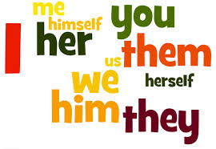
5/10 - Pronouns
A pronoun is a word that takes place of a noun.

Slide 84
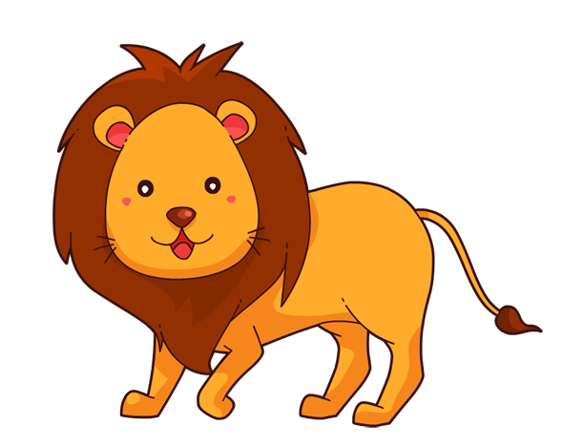
Nouns are an essential building block, but using them all of the time can get repetitive and sound awkward. For example:
Bob was walking down the street when a lion appeared from nowhere. Roaring, the lion chased Bob down the street. The lion’s hot breath was on Bob’s neck. Bob was very scared of the lion. Could Bob outrun the lion or would the lion eat Bob?

Slide 85
Fear not, because if we introduce pronouns…
Bob was walking down the street when a lion appeared from nowhere. Roaring, it chased him down the street. Its hot breath was on Bob’s neck. He was very scared. Could he outrun it or would the lion eat Bob?

Slide 86
Types of pronouns and examples
Personal Pronouns
These represent people, places or things.
I, you, he, she, it, we, you, they (subject), me, you, him, her, it us, you, them (object)
Possessive pronouns
These show ownership.
mine, yours, his, hers, its, ours, yours, theirs
Relative Pronouns
These link one part of a sentence to another.
who, whom, whose, which, that, what
Reflexive pronouns
These refer back to an earlier noun or pronoun.
myself, yourself, himself, herself, ourselves, themselves

Slide 87
Types of pronouns and examples
Demonstrative Pronouns
These function as subjects or objects in a sentence.
this, that, these, those
Interrogative pronouns
These are used to ask questions.
who, whom, what, which, whose
Indefinite pronouns
These do not refer to any specific person or thing, but take the place of nouns in a sentence.
Somebody, someone, something, anybody, anyone, anything, nobody, no one, nothing, all, another, both, each, many, most, other, some few, none, such

Slide 88
Task 1 – Spot the error
Find the wrong pronoun and suggest a replacement.
Zane and Mark gave his report to the class.
I asked Janice to loan me my pencil.
When students get to class, you should be ready to turn in the assignment.
I have two dogs, and it likes to run.
Mrs Garcia called my mother, and he asked for the recipe.
If a horse runs too long, they will overheat.

Slide 89
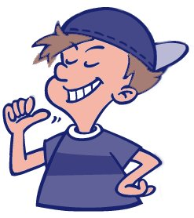
Me or I?
People often make mistakes when deciding whether to use I or me. To work out which to use, split the sentence into two short sentences. It should then become clear which one is right. Remember to put others first in a sentence.
Me and Ben enjoyed the concert.
Me enjoyed the concert.
Ben enjoyed the concert.
Me and Ben enjoyed the concert.
I enjoyed the concert.
Ben and I enjoyed the concert.

Slide 90
Task 2 – Me or I?
Choose either ‘me’ or ‘I’ for each sentence.
Walk with ____, _____ need the company.
You and _______ should go to the park.
Jake asked _____ to help him.
He needs to ask Ken or _____.
This is between you and _______, don’t tell Jake.
Bill told Jake and _____ to go.
If _____ go outside, I’ll get cold.

Slide 91
Task 3 – Tricky Challenge
Complete these sentences using the correct word.
(He, Him) and (I, me) went for a walk.
It was (he, him) (who, whom) we saw in the shop.
No one believes it was (she, her); everyone thinks it was (I, me).
(Us, We) lads were at the cinema at the same time as (they, them)
Notes:
a) He / I b) he / whom c) she / I d) we / them

Slide 92
6/10 - Prepositions
A preposition is a word used to show the position of one thing in relation to another.

Slide 93
6/10 Prepositions
Here are some common prepositions:
in on of for
from with up down
above below before after
over under into until
behind beneath beyond beside
around against along across
among between through near

Slide 94
6/10 Prepositions
Examples of prepositions in use:
The bird is in the nest.
The boy climbed up the steep hill.
The ball rolled under the car.
The girl is studying at college.
It happened very early in the morning.
She dived carefully into the pool.
I have no time for arguing with you.
She emerged from behind the curtains.

Slide 95
Task 1
Choose 4 prepositions and write your own sentences.

Slide 96
Adverb or Preposition?
Some words may be used as adverbs or prepositions depending on the context. Remember, a preposition is used to show the connections between two things.
For example:
He took (verb) the dog inside (adverb).
He took (verb) the dog inside (preposition) the house.

Slide 97
Tip!
In formal writing, sentences should not end with prepositions, but this practice is common in spoken English.
What are you talking about?
I think that is the class he is in.

Slide 98
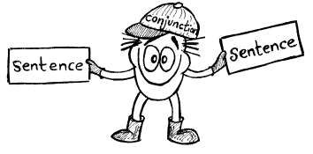
7/10 – Conjunctions (previously known as connectives)
The conjunction (also known as a joining word) joins two or more sentences to make one complete sentence.

Slide 99
7/10 Conjunctions
Sometimes the conjunction joins two parts which could be separate complete sentences, for example:
John walked along the street. He turned round the corner.
John walked along the street and turned round the corner.
↑
The two sentences each have their own verb.
To add variety, you can also use conjunctions that join two parts only one of which is a complete sentence, for example:
John walked along the street. He walked round the corner.
John walked along the street and round the corner.

Slide 100
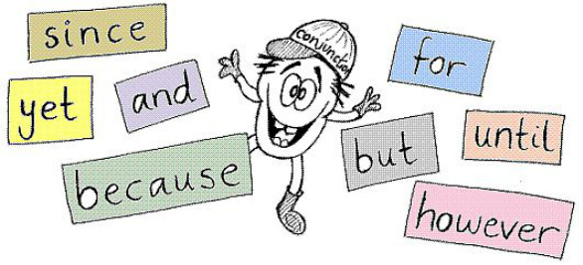
Useful conjunctions
while
when
or
after
as
because
unless
whether
though
how
if
yet
before
nor
since
although
where
until
for
that
but
than

Slide 101
Tip!
In formal writing, sentences should not begin with conjunctions, but this practice is common in spoken English.
Why? Well, starting sentences with because, but or and can sometimes mean that a sentence is incomplete.

Slide 102
Task 2 – Sentences
Write out the following, replacing ‘and’ with a more suitable conjunction:
Mary was chosen for the team and she was a very good player.
He wanted to play centre-forward and he has been put in goal.
We are going out for a long walk and it looks like rain.
This is a good shop and you can buy delicious chocolates.
The actors bowed to the audience and the play ended.

Slide 103
8/10 – Articles
A word used with a noun to refer to a specific person or thing, or someone or something in general.

Slide 104
8/10 Articles
There are two types of article: definite and indefinite.
The definite article – ‘the’
This refers to a specific person or thing. the rhinoceros
2. The indefinite article – ‘a’ or ‘an’
This refers to one person or thing, or can sometimes refer to something or someone belonging to a specific group.

Slide 105
Tip!
‘a’ or ‘an’?
Use ‘a’ before a noun when it starts with a consonant.
Use ‘an’ before a noun when it starts with a vowel or silent ‘h’.

Slide 106
Task 1 – Mind the gap
Insert the definite or indefinite article into the following:
___ boy saw ___ shooting star in ___ sky.
___bird just flew right next to ___ car.
“I want _____ new games console for Christmas,” ____ boy told ___ department store Santa Clause.
I went to ___ market and bought ___ apple, ___ orange and ___ avocado.

Slide 107
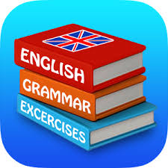
9/10 – Determiners
A word used in front of a noun to tell you something specific or something of a particular type. They are quite similar to adjectives.

Slide 108
9/10 - Determiners
All articles are also determiners – a, an, the.
Other determiners
The distance between the speaker and the thing they are talking about:
this shoe these books that man those houses
Who owns the thing:
my bag your phone his kite their garden
How much and how many:
some sugar much money both girls many adults

Slide 109
9/10 - Determiners
More determiners
The exact number:
one melon two brother fifty roses a thousand years
How something is shared out:
Every child got a prize. Neither side is playing well.

Slide 110
Tip!
‘many’ or ‘much’?
If you can count the plural nouns, then it is ‘many.’
many children many roses
If you can’t count it, then it is ‘much.’
much money much sand

Slide 111
Task 2 – Determined
Write down the determiner in each sentence:
Those earrings are beautiful.
“Whose bone is that?” he thought.
The dog sat patiently in a garden waiting for the postman to arrive.
Many people have pets.
The boy replied, “That book on the shelf.”
Notes:
1 Those 2. Whose 3. The A 4. Many 5. The That The

Slide 112
Task 3 – Gap fill
Fill the gap with the correct determiner:
_____ book do you want to read first?
2. In Spain, _____ towns celebrate the festival of San Jose in March.
3. _____ new classroom didn’t have enough chairs.
4. “_____ dad is really funny,” said Jake to his friend Raj.
Notes:
There are multiple answers for this exercise. Focus on which/what, your as teaching points

Slide 113
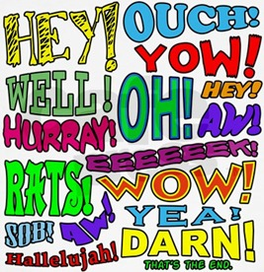
10/10 – Interjections
A word or phrase that occurs alone and expresses emotion.

Slide 114
10/10 - Interjections
Examples of interjections
Ahh Jeez Oh my Oh no
Hmm Ahem Phew Boo
Yahoo Oops Eek Brr
Shh Um Er Eureka
They may be used as:
Greetings (Hello, what are you doing?)
A sentence of their own (Uh oh!)
Part of a sentence (Phew, that was scary.)
Interruptions (I, er, have no idea what happened to, um, the snake charmer.)
Asides – The snake charmer is (cough!) temporarily unavailable.

Slide 115
Task 4 – Additions
Can you improve these sentences with interjections?
“I would like to place an order now, if you are finished playing on your mobile phone?”
When he opened his locker, a red, sticky liquid oozed onto the floor.
He thought it was absolutely freezing in the warehouse.
Notes:
1. Ahem 2. Eek / Eww 3. Brr - or other acceptable answers

Slide 116
Important for teachers
The key to the acquisition of knowledge, particularly grammar rules, and to embed it into long term memory is repetition and consolidation.
Therefore, it is suggested that these lesson are revisited a further three times:
1. Immediately after completion: with highlighters, ask students to pick out the key information for each part of speech
2. 6 weeks after completion: ask students to create a mind map/poster with the key terms and examples of each part of speech
3. 3 – 6 months after completion: Create a quiz covering parts of speech, or ask class to create a quiz for different groups.
It may be beneficial to ask students to parse passages for homework.
Resources designed by Jennifer Higgins and Michael Wilkie

