Slide 1
I can select and use the strategies and resources I find most useful before I read, and as I read, to monitor and check my understanding. LIT 3-13a
Using what I know about the features of different types of texts, I can find, select, sort, summarise, link and use information from different sources. LIT 3-14a
To show my understanding across different areas of learning, I can: • identify and consider the purpose, main concerns or concepts and use supporting detail… LIT 3-16a
To show my understanding, I can comment, with evidence, on the content and form of short and extended texts, and respond to literal, inferential and evaluative questions and other types of close reading tasks. ENG 3-17a
Through developing my knowledge of context clues, punctuation, grammar and layout, I can read unfamiliar texts with increasing fluency, understanding and expression. ENG 3-12a
Core Course
S1 – 1/3
In your own words (describe/explain/identify)
Summarise
Finding and selecting information/evidence (quoting)
Basic Evaluation (justified opinion/quotations)
Skimming and scanning
Highlighting and underlining
Parts of speech (homework)

Slide 2
Key skills in reading
Learning Intentions
To identify strategies that will help you find and select information in a text
To recognise and identify quotations
To evaluate texts and respond with justification
Success Criteria
To skim and scan a text effectively
To use underlining or highlighting to identify appropriate information
To evaluate, giving appropriate justification

Slide 3
Starter: read the passage and answer questions
The Young Citizen‘s Passport – your guide to the law
P1: We hope that you find the passport helpful as it explains, as simply and clearly as possible, those parts of the law that have most relevance to every day life.
P2: Remember! In trying to summarise the law, we had to leave out some details that may be relevant to your own situation. So don‘t rely on this book as proof of your legal rights. Always take further advice before taking any legal action. Often the best place to start is the Citizens Advice Bureau, but there are many other. Remember too that the law is always developing and changing.
1. Look at paragraph 1. In your own words, identify what the writers hope? (1)
2. Look at paragraph 3. In your own words, explain why should you always do before taking legal action? (1)

Slide 4
Finding and selecting information
There are two strategies to help you to find and select information effectively when reading. Strategy one is skimming and scanning.
Skim when you want to read something quickly to get the main ideas
Scan something when you want to read something quickly to find a specific piece of information

Slide 5
Skim when you want to read something quickly to get the main ideas
Scan something when you want to read something quickly to find a specific piece of information
1. In your groups, write a list of times when you would skim and scan.
For example, you would scan a TV guide for a certain show, and you would skim through your feed on Instagram.

Slide 6
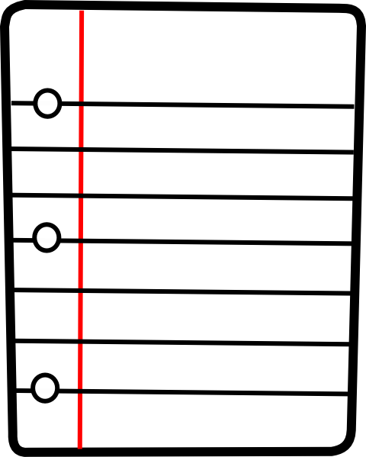
Finding and selecting information
Strategy two is highlighting and underlining.
Scanning and highlighting
When skimming and scanning, using a highlighter or underlining what you find can help you select information.
Blah blah blah blah blah
important blah blah blah
blah blah blah blah blah
blah important blah blah
blah blah blah blah blah

Slide 7
Finding and selecting evidence from a text using quotations
One way you can be asked to show that you understand a text is by writing in your own words.
Another way to show your understanding is to find and select evidence in the form of quotations.
A quotation is a group of exact words taken from a text. If you ever use a writer’s words, that are not your own, then you are quoting. Always use quotation marks – ‘quotation’

Slide 8
Let’s practice
You will be given the ‘Dolphin’ extract. Skim and scan, highlight and underline, to answer these questions.
Select a quotation in the first paragraph that shows that sea fans take a long time to grow. (1)
Find evidence in the first paragraph to prove that Krestovnikoff found the sea fan interesting. (1)
Find the expression in the second paragraph that explains why she could see the dolphin well. (1)
Quote the words in paragraph four that shows the writer had very little time to decide what to do. (1)
Write down a phrase from paragraph four that explains why it is unusual to see a dolphin alone. (1)
Identify two separate words in the fifth paragraph that show that the dolphin was not at all shy. (2)

Slide 9
Dolphin I was filming for The One Show at Falmouth, from a shipwreck called The Volnay. The piece was going to be about life after a shipwreck – which creatures thrive once the boat goes down, and the food chain that is created. I’d got a beautiful pink sea fan as a prop – one of the new ‘shipmates’ on The Volnay. I was chatting away to the camera about the natural history of this species: they grow around a centimetre each year they’re alive. This one was around 15cm, which proved how long species can live with the right underwater environment. I started to hear some noise from the communications team that were giving me my instructions, but I couldn’t immediately make out what they were saying and couldn’t see anything, so carried on with my lines, really fascinated with studying the fan closely. It quickly became apparent that they were shouting, ‘Dolphin! Dolphin!’ really excitedly, and suddenly, right behind me, a bottlenose dolphin appeared. It was quite obvious it wanted to play and wouldn’t leave me alone. I was blown away at how close it was, and with good visibility down deep that day I could see every detail. I have a strict rule of ‘look but don’t touch’ when I’m in nature’s home, but when a dolphin presents you with it’s belly and clearly wants it tickled, I don’t think anyone would be able to resist. I had a split second to decide whether to continue with the piece as planned, or to switch to talking about my sudden encounter. It was a pretty easy decision to be honest. We could revisit the original piece but we might never be this lucky again, not least because seeing a solitary dolphin is quite unusual as they are usually sociable creatures found in their pod. The creature continued to circle me confidently, cheekily tipping e over for a tickle and darting back and forth towards me. I’m sure if it could have spoken it would have said ‘Let’s play!’ It was utterly magical.
Notes:
Print this

Slide 10
Let’s practice - answers
Select a quotation in the first paragraph that shows that sea fans take a long time to grow. (1) – ‘they grow around a centimetre each year’
Find evidence in the first paragraph to prove that Krestovnikoff found the sea fan interesting. (1) – ‘really fascinated with studying the fan closely’
Find the expression in the second paragraph that explains why she could see the dolphin well. (1) – ‘good visibility down deep that day’
Quote the words in paragraph four that shows the writer had very little time to decide what to do. (1) – ‘split second’
Write down a phrase from paragraph four that explains why it is unusual to see a dolphin alone. (1) – ‘usually sociable creatures found in their pod’
Identify two separate words in the fifth paragraph that show that the dolphin was not at all shy. (2) – ‘confidently’, ’cheekily’

Slide 11
Evaluating and justifying with evidence
Evaluating is one of the most important skills you learn in school.
When you evaluate, you come to your own opinion or view of something which you can justify with reasons, and it is based on the evidence you have been presented with.
It shows that you have understood and engaged with a text.
It‘s a bit like being a jury in a court.

Slide 12
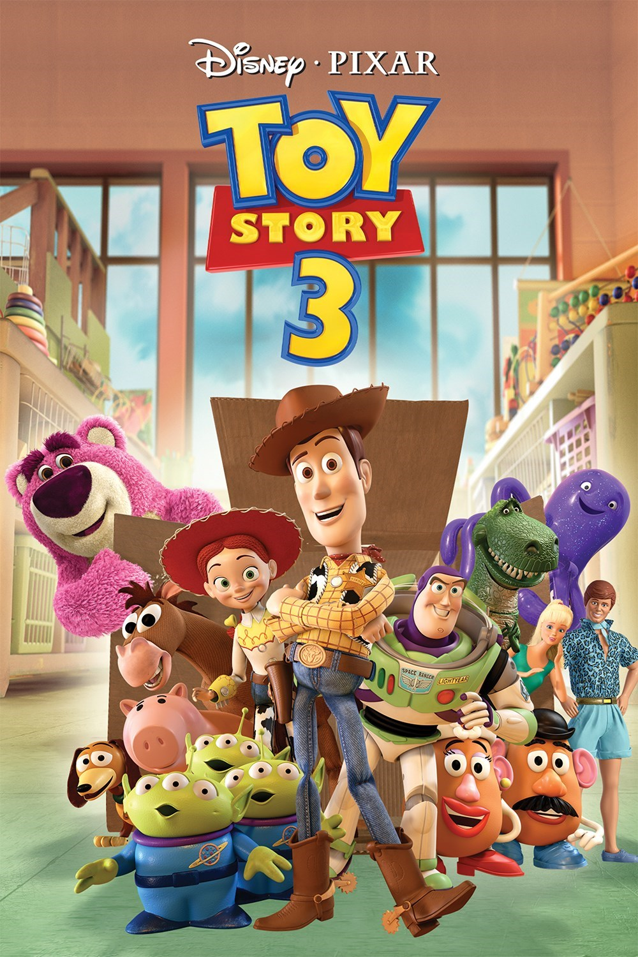
Evaluating and justifying with evidence
For example, if you were to evaluate Toy Story 3 you might say:
I think Toy Story 3 is the most effective film in the trilogy, because it treats the audience as mature and like they are adults. This is evident when Woody and the gang face almost certain death in the furnace. This is quite an unsettling moment, making us question our own fates.

Slide 13
Evaluating practice
Look at the ‘Dolphin’ extract again.
With reference to the text, explain to what extent you agree with the writer’s decision to interact with the dolphin. (3) [Remember – opinion, quote, reason]
2) By using evidence from the text, justify whether you think it was a good idea for the presenter to change the topic of her live piece on The One Show. (3)

Slide 14
Key skills in reading
Learning Intentions
To identify strategies that will help you find and select information in a text
To recognise and identify quotations
To evaluate texts and respond with justification
Success Criteria
To skim and scan a text effectively
To use underlining or highlighting to identify appropriate information
To evaluate, giving appropriate justification
Plenary
Paired Activity
Which of the skills do you now feel most confident with – skimming and scanning, underlining and highlighting, or evaluating? Why?
Which skill do you think you need to work on?

