Slide 1
I can select and use the strategies and resources I find most useful before I read, and as I read, to monitor and check my understanding. LIT 3-13a
Using what I know about the features of different types of texts, I can find, select, sort, summarise, link and use information from different sources. LIT 3-14a
To show my understanding across different areas of learning, I can: • identify and consider the purpose, main concerns or concepts and use supporting detail… LIT 3-16a
To show my understanding, I can comment, with evidence, on the content and form of short and extended texts, and respond to literal, inferential and evaluative questions and other types of close reading tasks. ENG 3-17a
Through developing my knowledge of context clues, punctuation, grammar and layout, I can read unfamiliar texts with increasing fluency, understanding and expression. ENG 3-12a
Core Course
S1 – 1/3
In your own words (describe/explain/identify)
Summarise
Finding and selecting information/evidence (quoting)
Basic Evaluation (justified opinion/quotations)
Skimming and scanning
Highlighting and underlining
Parts of speech (homework)

Slide 2
Summarising
Starter – By yourself
1) Write a paragraph about either the best day of your life or the worst day of your life. [minimum words: 40]
Learning Intentions
To define what summarising means
To explore ways to summarise
To create responses to summarising questions
Success Criteria
To write a definition of what summarising means in English
To identify a strategy to summarise
To attempt to create a number of answers to summarising questions

Slide 3
What is summarising?
Summarising involves taking the main ideas from a piece of text and translating them into your own words.
A summary is significantly shorter than the original text and tends to give an overview/general idea. Basically, it avoids too many details!
‘Why?’– Think, Pair, Share
1. Discuss and write down two reasons why understanding how to summarise is so important in English.
2. Discuss and write down two examples in real life where summarising might be useful.

Slide 4
Why do I have to summarise?
It shows that you have clearly understood what you have read.
It is great for researching and writing pieces of work in every subject.
It helps you find the main point of something.
It stops you from accidentially copying someone’s work.
It is a good point to start from with your own new ideas.
Group discussion
1. Which of the reasons above do you think is the most important? Why?

Slide 5
Successful summarising
Copy into notes:
When you summarise you are looking for the main ideas, not the finer details.
To do this, use your skimming and scanning skills.
Use a highlighter or underline the information you think you need to translate.
You must translate into your own words.
Always answer in bullet points.

Slide 6
Example
Read this advice for young people about banks:
‘There are many reasons why it is a good idea to open a bank account. Firstly, most employers will not pay their staff personally or in cash, but only via a bank account. If you go to college or university and want to take out a student loan, this must also be paid into a bank account. Any money you keep in cash will always stay the same value, but if you put it in a bank you will gain interest on your savings. You will also be able to pay bills simply straight from your bank account. Finally, the younger you are when you open one, the more you build up a credit score showing people you can looking after your money responsibly.’
Summarised in bullet points:
Many companies will send wages to an account
An account is needed to borrow money for further education
The money can earn interest
It provides an easy way to pay for utilities/items
It helps you build up a history of being trusted with money

Slide 7
Summarising
Challenge
Using the paragraph you wrote earlier, summarise either the best day of your life or the worst day of your life.

Slide 8
Let’s try some examples - banking
There are many different banks to choose from. Thinking about the following things will help you decide which bank to open your account with. Is the bank easy to access? Is there a branch near where you live or work, and can you get access to your account outside opening hours by using online banking or a mobile app? Does the bank have a good network of cash machine so that you can easily withdraw money when you need it? Will they pay you a reasonable amount of interest on any money you save in your account? How much will the bank charge you for its services? Do they have any special offers aimed at customers your age?
Work it out yourself
Decide and write down what the title should be for your bullet-pointed list. Write the titles in capitals.
Now, using your own words as much as you possibly can, summarise the important things a young person should consider before opening a bank account.

Slide 9
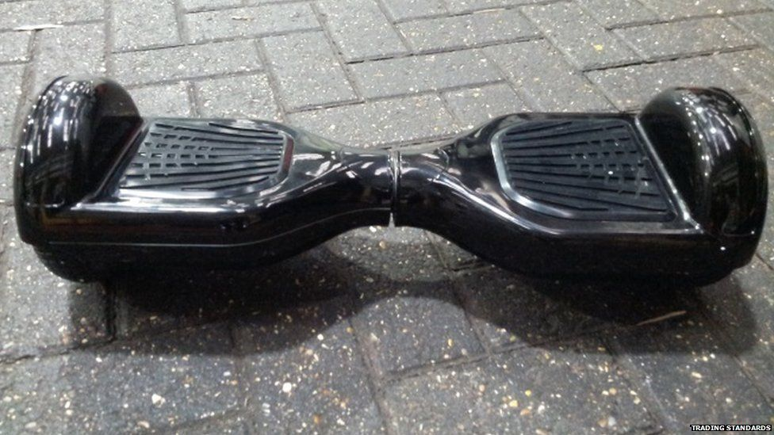
Let’s try some examples
Earlier this week Amazon stopped selling hoverboards - now it's told customers to get rid of them. It reportedly sent emails to anyone who's bought them, suggesting they take them to a recycling centre because of safety concerns. John Lewis and Argos have also now stopped stocking Swegway products. So what's wrong with them and what can you do if you're faced with chucking out the gadget formally known as 2015's must-have gift?
Summarise in groups
1. Summarise Amazon’s actions with regards to hoverboards. (4)

Slide 10
Let’s try some examples
Earlier this week Amazon stopped selling hoverboards - now it's told customers to get rid of them. It reportedly sent emails to anyone who's bought them, suggesting they take them to a recycling centre because of safety concerns. John Lewis and Argos have also now stopped stocking Swegway products. So what's wrong with them and what can you do if you're faced with chucking out the gadget formally known as 2015's must-have gift?
Answer: Amazon have stopped people from buying hoverboards, and it now people have to get rid of them. It also sent emails to customers and have told them to take them to a recycling centre.
What’s up?
2. Write down two reasons why this response would get poor marks. (2)

Slide 11
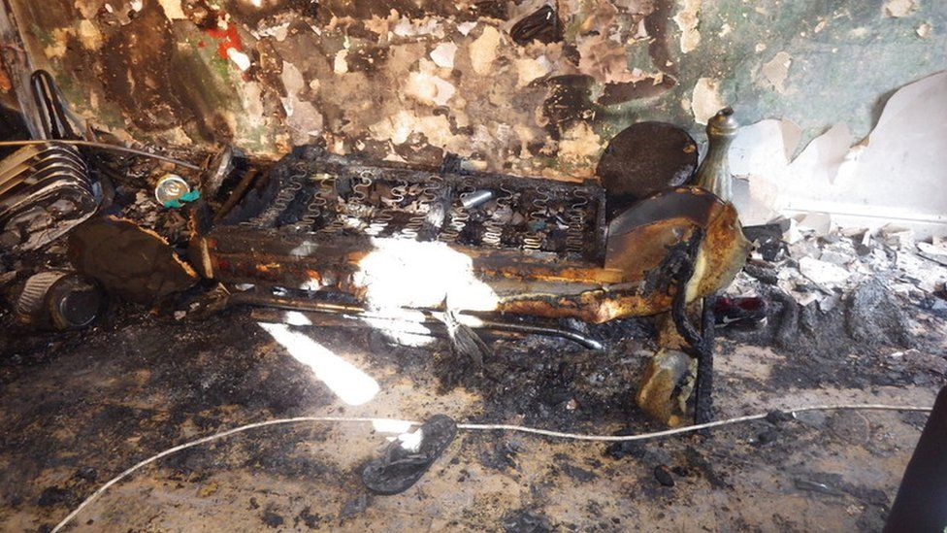
Why they can catch fire
There have been lots of issues raised about faulty wires, rechargeable batteries and chargers. According to Trading Standards, many have plugs without fuses, faulty cables or chargers that can overheat or burst into flames. It said that 88% of the 15,000 hoverboards it's seized around the UK were found to be defective.
Earlier this month, the London Fire Brigade said at least three house fires were caused by such devices over 10 days in October. The government has warned consumers to "think twice" about buying them because of fears over imitation devices being sold at discount prices. If anything does go wrong the shop which sold you a board is responsible for any injuries, which is why lots of places have stopped selling them.
3. Summarise why hoverboards catch fire. (2)
4. Summarise the different responses. (3)

Slide 12
Answers – must be in own words for mark
3. Summarise why hoverboards catch fire. (2)
They have lots of problems with them (1)
They have been badly made (1)
The electrical parts are badly made/problematic/not working properly (1)
They can get too hot and blow up (1)
4. Summarise the different responses. (3)
- Fire service: Dealt with several incidents (1)
Government: Warned against buying hoverboards (1)
Shops: No longer on sale in many (1)

Slide 13
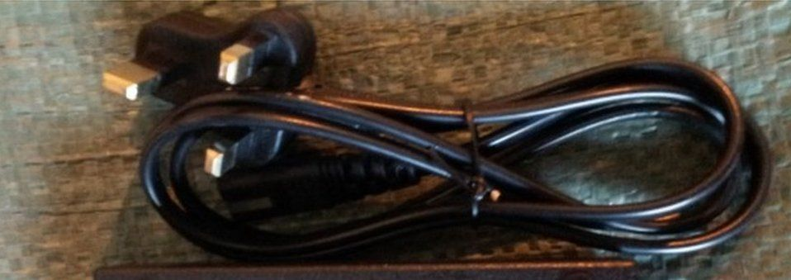
What if I've bought one?
The Retail Ombudsman, whose job it is to sort out disputes between retailers and customers, has urged shops not to sell hoverboards unless they can be sure they're safe. Its boss Dean Dunham added: "Consumers who have already purchased a hoverboard, perhaps as a Christmas present, should contact the retailer and for their written assurance that it's safe.“
If the place where you bought your board can't guarantee that it's safe, you're entitled to a refund under the Consumer Rights Act. You can tell Citizens Advice about any issues, or to let them know about any dodgy boards being sold, by calling 03454 04 05 06. Trading Standards has also said to check for "clover-shaped" plugs and to not be tempted to buy a board if the price seems low.
Argos told Newsbeat: "Should any customer be concerned about their product, they can return it to their nearest Argos store for a full refund. "We apologise to customers for any inconvenience this may cause.“ John Lewis added that it "advises customers to not use the Selfy Stick Air Runner" and that it is "making every effort to contact all customers who have purchased the product".
5. Summarise what you should do if you have bought a hoverboard. (5)

Slide 14
Answers – must be in own words for mark
5. Summarise what you should do if you’ve bought one. (5)
Get in touch with the shop (1)
Get evidence from them that you won’t be in danger (1)
You can get your money back (1)
Contact people who can deal with the problem for you (1)
Look for particular problems with the appearance of hoverboards (1)

Slide 15
Summarising
Learning Intentions
To define what summarising means
To explore ways to summarise
To create responses to summarising questions
Success Criteria
To write a definition of what summarising means in English
To identify a strategy to summarise
To attempt to create a number of answers to summarising questions
Plenary
Paired Activity
Ask a partner about their day so far.
Summarise what has happened to them in bullet points. (3)

Slide 16
Summarising – The Cay
Look at lines 1 – 24. Summarise the incident that took place. (3)
Look at lines 25 – 44. Summarise the problems faced by the island. (3)
Look at lines 52 – 83. Summarise what happens to the SS Empire Tern before and during her sailing. (4)
Summarise the reactions of the people on the island in the final paragraph. (2)
/12

Slide 17
Summarising – A Dog So Small
Look at lines 1 – 14. Summarise the gifts Ben received, and the gift(s) he was expecting. (3)
Summarise the different ways it became clear to Ben that he was not going to get a dog in lines 15 – 29. (3)
Look at lines 35 – 57. Summarise the reaction Ben had to the revelation that he had received only a picture of a dog. (3)
Summarise the reasons given by Ben’s father in lines 66 – 76 that having a dog would be a bad idea. (3)
/12

