Slide 1
To show my understanding, I can comment, with evidence, on the content and form of short and extended texts, and respond to literal, inferential and evaluative questions and other types of close reading tasks. ENG 3-17a
Through developing my knowledge of context clues, punctuation, grammar and layout, I can read unfamiliar texts with increasing fluency, understanding and expression. ENG 3-12a
I can select and use the strategies and resources I find most useful before I read, and as I read, to monitor and check my understanding. LIT 3-13a
I can use a range of strategies and resources and spell most of the words I need to use, including specialist vocabulary, and ensure that my spelling is accurate. LIT 3-21
Core Course
S1 – 3/3
Word Choice – identifying, denotation, connotation
Working with words - synonyms/ antonyms/ prefixes/ suffixes/ root words/ jargon
Spelling strategies homework
Figures of speech homework
Practice exercise 2 – ‘King Tut’s Tomb’
Notes:
Resources adapted from: Levels 3-4 English – Reading for Understanding, Analysis and Evaluation Skills by Jane Cooper

Slide 2
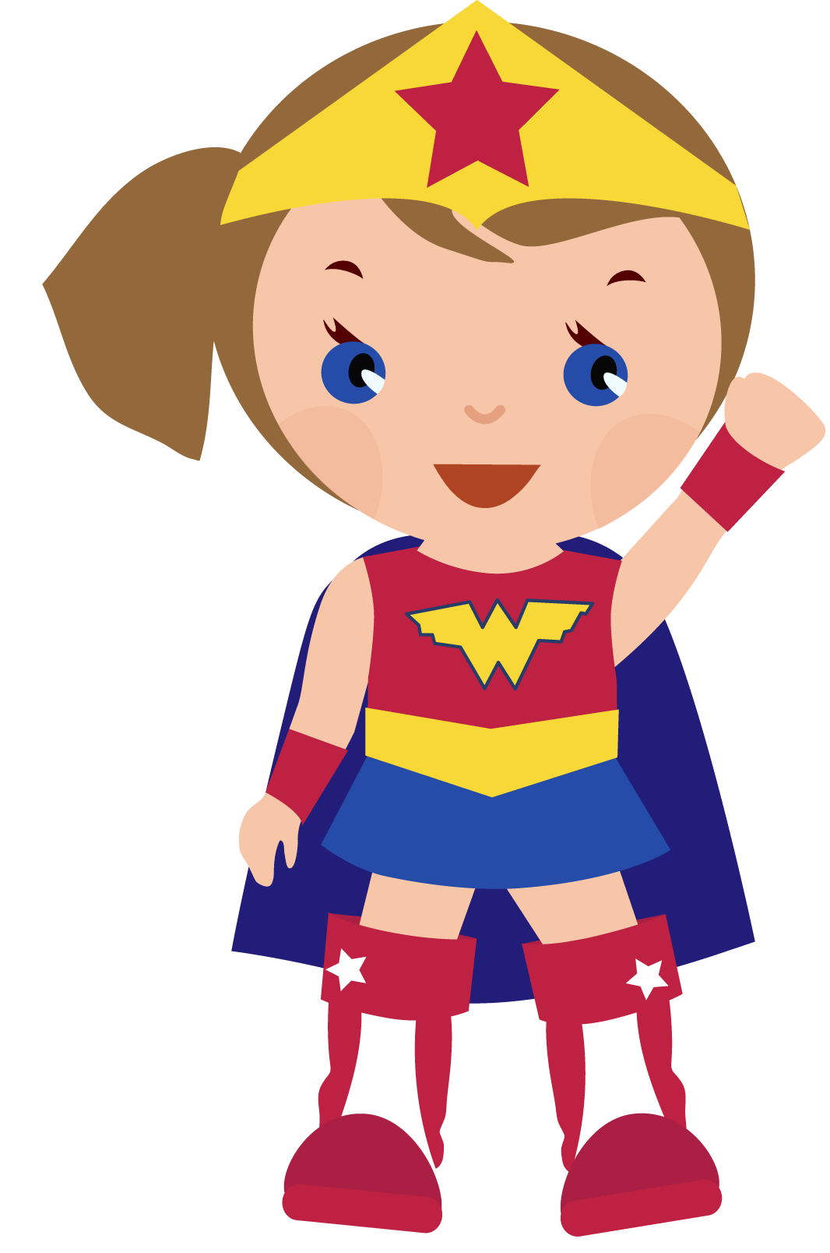
Figures of speech
Learning Intentions
To identify a number of different figures of speech
To examine figures of speech as they are used in language
Success Criteria
- To respond to a number of questions about different examples of figures of speech
Starter
Name as many ways as you can to make your writing more interesting, vivid and memorable.

Slide 3
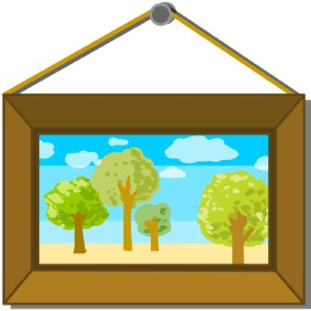
Imagery
‘Image’ is a word that means
the same as ‘picture’.
When a writer is describing a person or a scene, he often compares it to something we are already familiar with so that we can form a clearer picture in our minds.

Slide 4
Task 1 – Groups/pairs
Try to work out what the writer means in each of these examples of imagery.
She was running about like a headless chicken.
You better behave yourself; you’re skating on very thin ice!
I didn’t enjoy the party at all – I felt like a fish out of water.
4. Education is the gateway to adult life.

Slide 5
Similes
The first type of imagery to start with is a simile.
A simile is a way of comparing one thing to another. Similes always use either the word ‘like’ or ‘as’.
Example
The grains of sand sparkled like diamonds.
Clouds, white as feathers, drifted overheard.

Slide 6
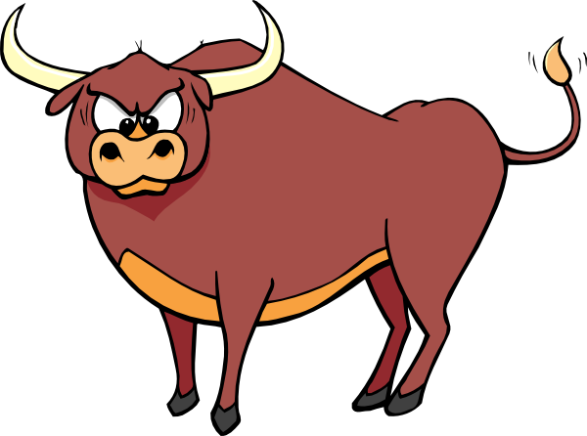
Further example of a simile:
‘He’s as strong as an ox.’
This suggests that the subject is very tough indeed – an ox is a bit like a very large cow, and farmers used oxen to pull heavy machinery before the invention of tractors.

Slide 7
Task 2 – Matching game
Match the object to the simile.
branches like slow trains moving through the grass
ice like arms waving in the sky
worms like sheets of glass
ears like saucers
Match the animal to the quality
as cheeky/brave/tall/blind as a
giraffe/bat/monkey/lion

Slide 8
Task 3 – Description
Work in pairs and complete the sentences, describing yourself in six similes.
I am as wild as a __________
I run like _________
I swim like ________
I talk like _________
I am as good as __________
I am as angry as _________

Slide 9
Task 4 – Explaining and evaluating
Explain what each simile is comparing and evaluate whether you believe this to be a successful comparison.
Sophie’s day was not going well. Her charge had finished off two bottles of Coca Cola, emptied out every toy from his toybox, and the living room was like a bombsite. Worse still, Sophie knew that capturing little Lucas was going to be like putting toothpaste back in its tube.

Slide 10
Metaphors
Metaphors are another kind of comparison, but they are a bit stronger than similes. A simile says one thing is like another; a metaphor makes a very strong comparison by saying one thing is another.
Example
A blizzard of gulls followed the boat.
In this example, a flock of seagulls is compared to snowflakes. They are alike in being white and flying around in the air. Picturing a snowstorm helps us imagine how very many gulls there are and how they swirl around in flight.

Slide 11
Further example of a metaphor:
If your classroom was very cold
you might call it:
a freezer
When we use metaphors, we are usually just comparing one aspect of the thing. If I say my classroom is a freezer, I only meant that it is cold, not that it is full of chunks of frozen meat, a bag of oven chips and some ice cream.

Slide 12
Task 1 – Explaining
Explain what the following metaphors mean:
That girl is a monster.
That boy’s an angel.
I’ve got a mountain of work to do.
She’s been battling with illness.
She been my rock.

Slide 13
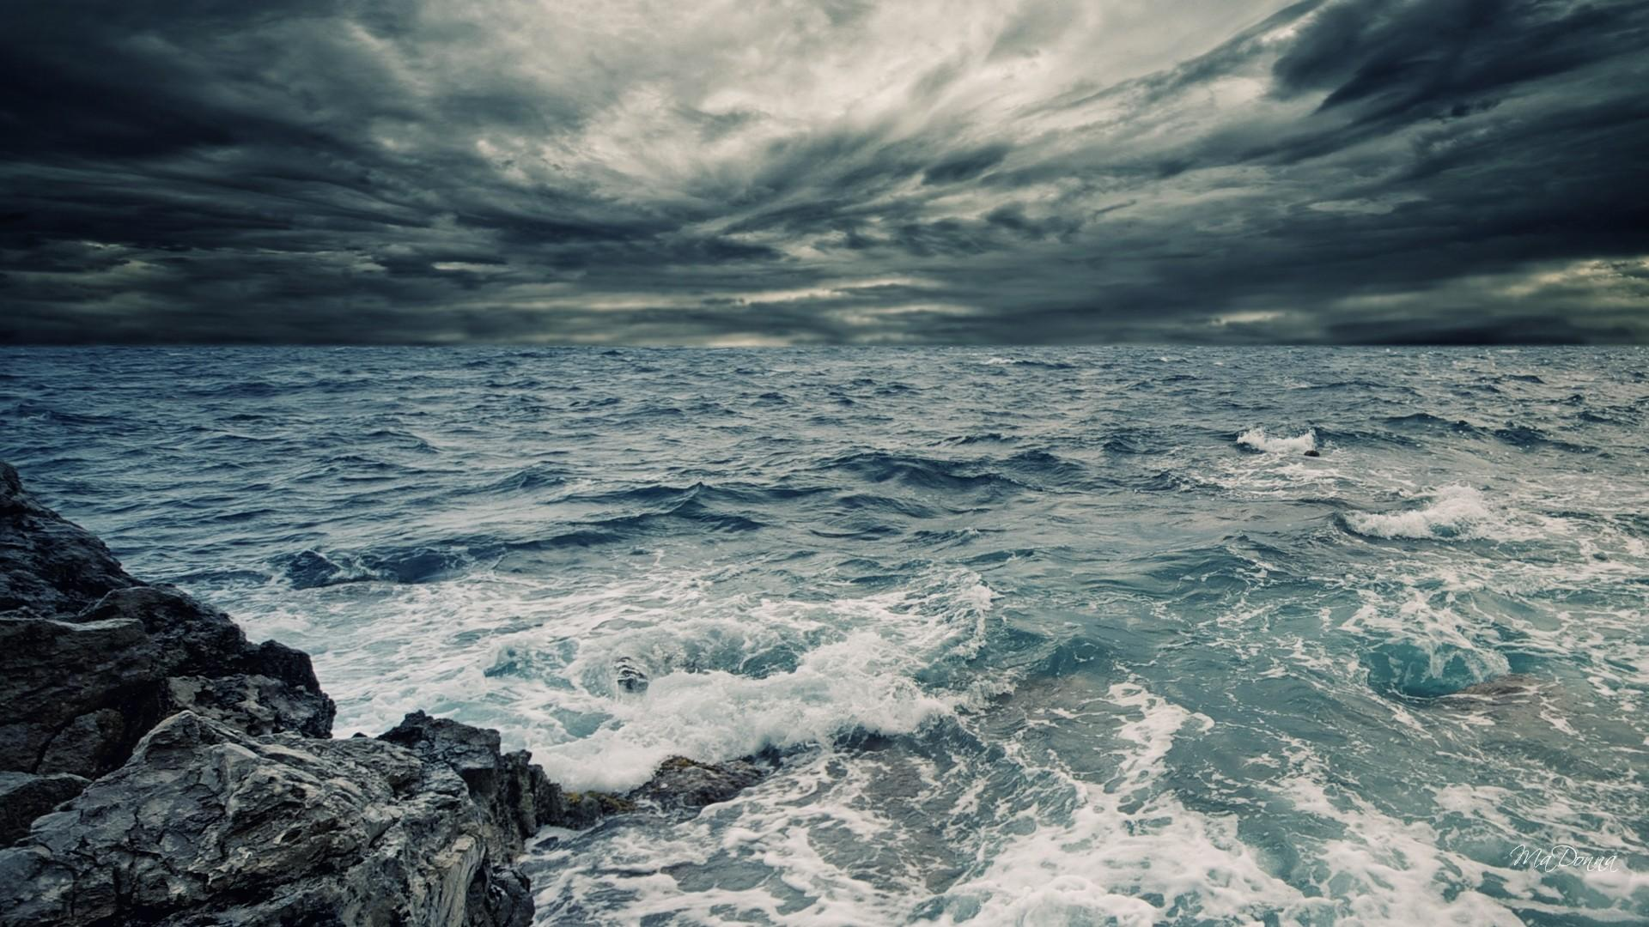
The sea
The sea is a hungry dog,
Giant an grey.
He rolls on the beach all day.
With his clashing teeth and
shaggy jaws
Hour upon hour he gnaws
The rumbling, tumbling stones
And ‘Bones, bones, bones, bones!’
The giant sea-dog moans,
Licking his greasy paws.
Look carefully at the verse by James Reeves.
What is the main metaphor that the writer uses in this poem?
Give two ways, according to the poem, that the sea is like this other thing.
The writer describes the sea gnawing the land ‘with clashing teeth and shaggy jaws’. What is really happening?

Slide 14
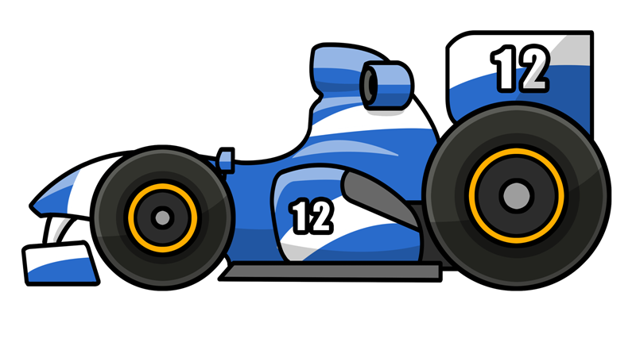
Personification
When we use personification we talk about non-living things as if they were alive, as if they were people (or perhaps animals).
Example – Imagine you were
describing a Formula 1 race:
The cars screamed around the circuit.
Cars cannot really scream as they do not have throats, nor emotions. But, by personifying the cars, we know the noise they made and the excitement and tension they generated.

Slide 15
Further example of personification:
You could describe a storm by saying:
The wind howled.
Wind cannot howl. Wind has no throat, nor does it resemble a wolf. However, by personifying the wind with the word ‘howled’, we know the kind of noise it made. It also helps to set the atmosphere in writing, striking fear that the wind seems to contain a sense of threat.

Slide 16
Task 1 – Explaining
Explain these examples of personification. Say what is the non-living thing in each comparisons, and also what living thing this is being compared to.
The tidal wave swallowed everything in its path.
When the band failed the audition their dream died.
She hadn’t eaten since breakfast and her stomach was grumbling.
We’re not ready to play that team – they’ll chew us up and spit us out.

Slide 17
Onomatopoeia
Onomatopoeia is the language technique used when the sound of a word matches its meaning.
Numerous words for the noises animals make are examples of onomatopoeia. For example:
woof hiss miaow
As too are words that represent noises:
bang clank thump
Words for actions and movements are included:
swish twirl tap

Slide 18
Task 1 – Understanding
Make a mind map titled ‘Onomatopoeia’.
Make separate branches for ‘animal sounds’, ‘noises’ and ‘actions or movements’.
In groups/pairs, try to think of as many examples for each branch.

Slide 19
Task 2 – Evaluating and Editing
Read the paragraph below and re-write it, improving it with onomatopoeia.
The boat moved through the water. The air was heavy. Birds called, and unseen creatures moved into the water. Stinging bugs flew around the boat. Suddenly, Jack heard something traveling in the dense bushes. He stifled a call when the thing came through the leaves onto the river bank. It was just his dog, Buddy!

Slide 20
Task 3 – Analysing and Evaluating
In which texts do you most regularly see onomatopoeia used? Why is it used?
Why you think writers would use onomatopoeia? What do they achieve?
What should a writer be careful of when using onomatopoeia? Why?

Slide 21
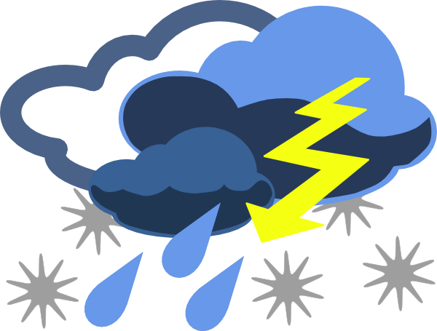
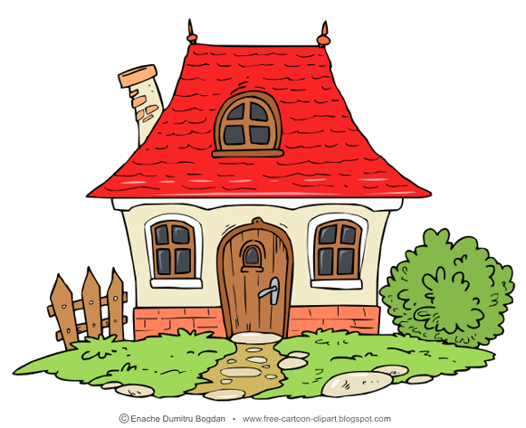
Alliteration
Alliteration is when writers use two or more words, close to each other, which begin with the same sound.
For example:
wild, windy weather
or
cosy cottage

Slide 22
Writers love alliteration because it is very catchy. This sound effect makes writers’ words and ideas stick to our brains more quickly and easily. It also helps to emphasise ideas.
Because it is so memorable, alliteration is often used in headlines, brands and adverts.
Task 4 – Recalling
In groups/pairs, note down as many popular brands or slogans that use alliteration.

