Slide 1
To show my understanding, I can comment, with evidence, on the content and form of short and extended texts, and respond to literal, inferential and evaluative questions and other types of close reading tasks. ENG 3-17a
Through developing my knowledge of context clues, punctuation, grammar and layout, I can read unfamiliar texts with increasing fluency, understanding and expression. ENG 3-12a
I can select and use the strategies and resources I find most useful before I read, and as I read, to monitor and check my understanding. LIT 3-13a
I can use a range of strategies and resources and spell most of the words I need to use, including specialist vocabulary, and ensure that my spelling is accurate. LIT 3-21
Core Course
S1 – 3/3
Word Choice – identifying, denotation, connotation
Working with words - synonyms/ antonyms/ prefixes/ suffixes/ root words/ jargon
Spelling strategies homework
Figures of speech homework
Practice exercise 2 – ‘King Tut’s Tomb’
Notes:
Resources adapted from Handling Spelling, Help your kids with English, http://budden.wikispaces.com/file/view/Spelling+and+HS.pdf,

Slide 2
Spelling strategies
Learning Intentions
To develop strategies to help tackle tough spelling situations
To identify a number of rules to help with particularly tricky spelling issues
Success Criteria
To create a personal spelling dictionary and identify a number of strategies to use in it
To test the strategies against a number of examples
Starter – in groups
What strategies do you use when you write and want to use a word that you do not know how to spell?

Slide 3
I ask somebody. What other pupils have said:
I write the best I can and go back later.
I stop and look it up.
I write the word a few ways and go with the spelling that looks best.
I substitute another word but sometimes I’ll change it back when I revise.
I use a spell checker on Word or I use Google.
I try to break the word into parts and sound them out.
I think about the ways the pieces of the word look.
I look for roots or word parts that I know.
I think about rules to see if anything works.
I associate parts of the word with other smaller words.
I remember a funny rhythm or rhyme I made up to remember the word.
I close my eyes and try to see the word in my head.

Slide 4
Wait, why can’t I just use Google all the time?
I have a spelling checker.
It came with my PC.
It plane lee marks four my revue
Miss steaks aye can knot sea.
Eye ran this poem threw it,
Your sure reel glad two no.
Its vary polished in it’s weigh.
My checker tolled me sew.
- ‘Candidate for a Pullet Surprise’ by Jerrold H Zar

Slide 5
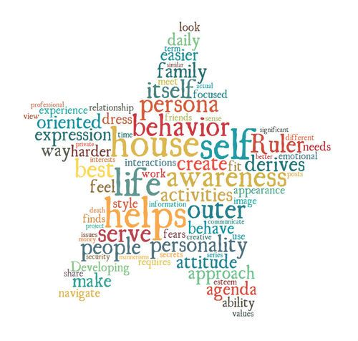
There are so many words to learn!
No, there’s not.
50% of the words we use
in writing come from a list of
the 100 most frequently used
words.
89% come from the 1000
most frequently used
words.
95% come from the 2000
most frequently used words!
Class discussion – What does learning these statistics mean for learning to spell words?

Slide 6
In primary school you learned to spell most of these frequently occurring words.
In secondary school, we work a little differently. It is now up to you to independently identify the words you find tricky and find strategies to support you in getting them right.
How do we do this?
We will design a personal spelling dictionary
We will create a spelling strategies poster

Slide 7
Task 1 – Take a whole new page.
Write ‘Spelling Strategy Dictionary’ as a heading. Then, draw this table.
Word – correct spelling | The strategy I use
accommodate

Slide 8
Whenever you come across a word you find tricky to spell, and more importantly, tricky to remember how to spell, you should add it to the dictionary, building up your own personal record.
However, you also need to have the tools to help you remember the spelling. These are called strategies.
Task 2 – On another new page put the heading ‘Spelling strategies I need’

Slide 9
Strategy 1: See a word within a word
Example:
young = young – there’s a you in young
believe = believe – there’s a lie in believe
Strategy 2: Highlight the hard bit
Example:
separate = separate
Address = address

Slide 10
Strategy 3: Sound out the spelling in your head
Example:
beautiful = “Life is b-e-a-u-tiful”
definitely = “Def-in-i-tely”
Strategy 4: Break it down to syllables
Example:
fascinating = fasc – in – ating
manufacture = man – u – fac – ture

Slide 11
Strategy 5: Use mnemonics/sayings
Example:
Rhythm - Rhythm helps your two hips move
Strategy 6: Look, cover, write, read, repeat

Slide 12
Strategy 7: Notice how words are built with roots, prefixes and suffixes
Example:
uncomfortable = un + comfort + able
Irregularly = ir +regular + ly
Strategy 8: Know the spelling rules for tricky words

Slide 13
Task 3 – What strategy would you use for ‘accommodate’? Write it on the table.
Word – correct spelling | The strategy I use
accommodate

Slide 14
Task 4 – What strategy would you use for the following commonly misspelled words?
interesting
existence
mischievous
recommend
psychology
occurrence

