Slide 1
To show my understanding, I can comment, with evidence, on the content and form of short and extended texts, and respond to literal, inferential and evaluative questions and other types of close reading tasks. ENG 3-17a
Through developing my knowledge of context clues, punctuation, grammar and layout, I can read unfamiliar texts with increasing fluency, understanding and expression. ENG 3-12a
I can select and use the strategies and resources I find most useful before I read, and as I read, to monitor and check my understanding. LIT 3-13a
I can use a range of strategies and resources and spell most of the words I need to use, including specialist vocabulary, and ensure that my spelling is accurate. LIT 3-21
Core Course
S1 – 3/3
Word Choice – identifying, denotation, connotation
Working with words - synonyms/ antonyms/ prefixes/ suffixes/ root words/ jargon
Spelling strategies homework
Figures of speech homework
Practice exercise 2 – ‘King Tut’s Tomb’

Slide 2
Working with words:
prefixes and suffixes
Learning Intentions
- To understand the terms ‘prefix’ and ‘suffix’ and their use
To identify a number of uses of prefixes and suffixes
To find examples of prefixes and suffixes
Success Criteria
To create notes that exemplify a number of prefixes and suffixes
To demonstrate understanding of prefixes and suffixes from questions
Starter – in groups/pairs
Write down three strategies you could use to expand the range of vocabulary in your writing.

Slide 3
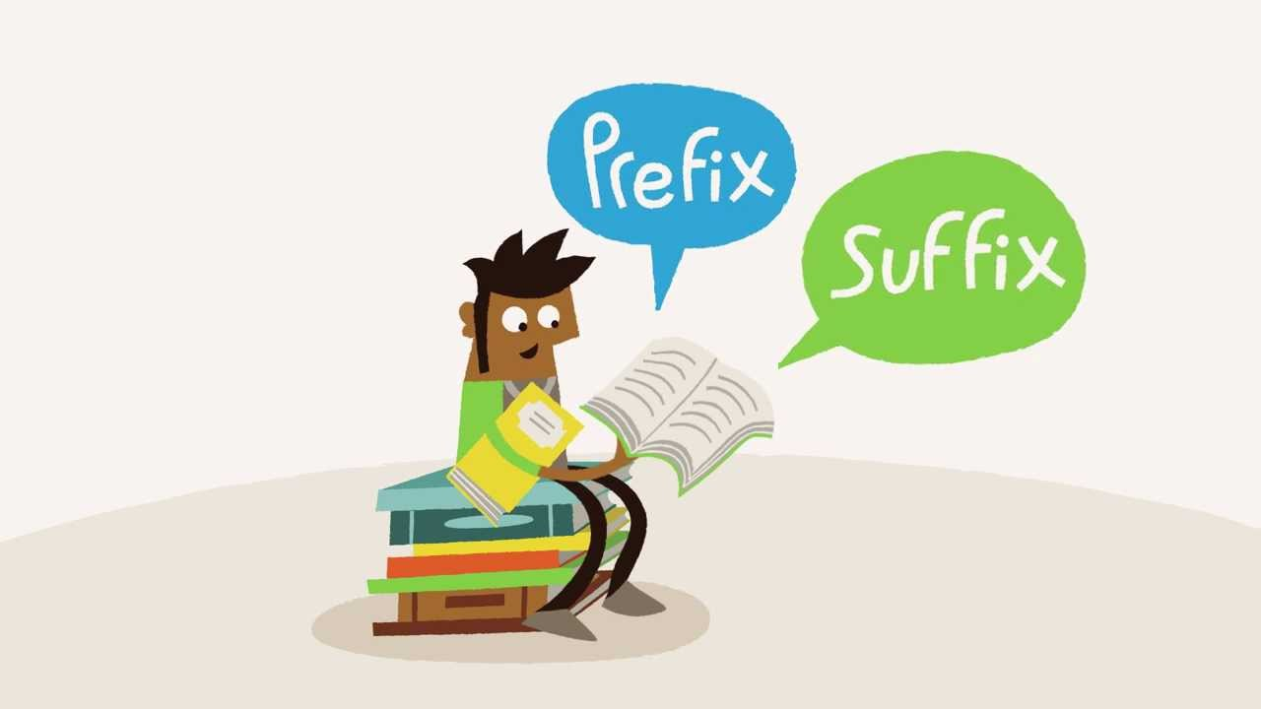
To understand the English language better, to build your vocabulary, to support your spelling, AND to help you work out the meaning of words, it is important to have an understanding of prefixes and suffixes.

Slide 4
Prefixes and suffixes
Prefixes are added to the start of a word and suffixes are added to the end of a word. They can change a word’s meaning, or its part of speech.
dis-
cover
predict
-able
the prefix dis- means ‘not’
To uncover/find
the suffix –able means able to
To know what will happen

Slide 5
Prefix | Meaning | Examples
ab- | away from | abnormal
anti- | against | antisocial
be- | make | befriend, belittle
de- | opposite/down | detach, decline
ex- | former | ex-husband
im-, in-, ir- | not | immature, incredible, irrational
mid- | middle | midway
non- | not | nonsense
post- | after | postwar
pre- | before | premature, pre-empt
re- | again | reapply, reform
sub- | under | submarine, submerse
trans- | across | transmit, transport
un- | not | uncover, uncool
and many more…

Slide 6
Suffix | Meaning | Examples
-able, -ible | able to | sustainable, sensible
-al | act of | denial
-ant, -ent | person who performs an action | accountant, student
-ed | past tense | stopped
-er, -or | person who performs an action | drummer, investigator
-est | the most | shortest
-ette | small | maisonette, cigarette
-ic, -tic, -ical | having characteristic of | historic, poetic, radical
-ing | present | hopping, skipping
-ism | the belief in | modernism
-s, -es | more than one | otters, foxes
-ward | in a direction | backward
and many more…

Slide 7
Task 1 – Prefixes
Write down the prefixes in the following words.
transport b) circumference c) postscript d) submarine e) unknown
Task 2 – Prefixes
Read the passage and insert the correct prefix so that it makes sense.
It was not a pleasant _____duction to the new term with the poltergeist haunting the school. This _____natural activity was ___gregating his classmates, some thought it was _____ordinary, while others saw it as an ___standing prank.

Slide 8
Task 3 – Suffixes
Write down the prefixes in the following words.
explorer b) edible c) decorator d) simplify
Task 4 – Suffixes
Read the passage and insert the correct suffix so that it makes sense.
It was simply not sustain____, nor was it to anyone’s advant___ to put up with this situa____ any longer: the ghost had to go. However, it was use____ and ridicul___ to try and prev___ any more dam___ being done.

Slide 9
Working with words: roots
Learning Intentions
To explain where many of our the words in the English language come from
To define root words
To identify a number of root words and examples
Success Criteria
To summarise an understanding of the origins of the English language
To fill out two tables of root words

Slide 10
Vivid, varied vocabulary
Did you know that there are over
171, 000 words in the English
language? That is more words
than in most other languages.
Experts think this probably happened
because English has borrowed from, and been influenced by, so many other languages. We have taken lots of words from the languages of other countries that have invaded Britain in the past. We have also taken words from countries that we have ruled, or traded with.

Slide 11
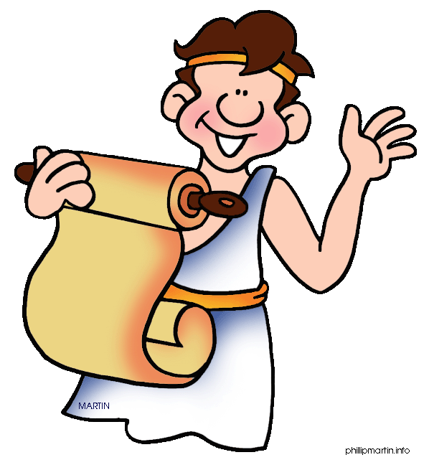
Some of our words come from Greek:
hero epic
colossal
claustrophobic
geography
biology
history
music
school
amnesia
disaster
apology

Slide 12
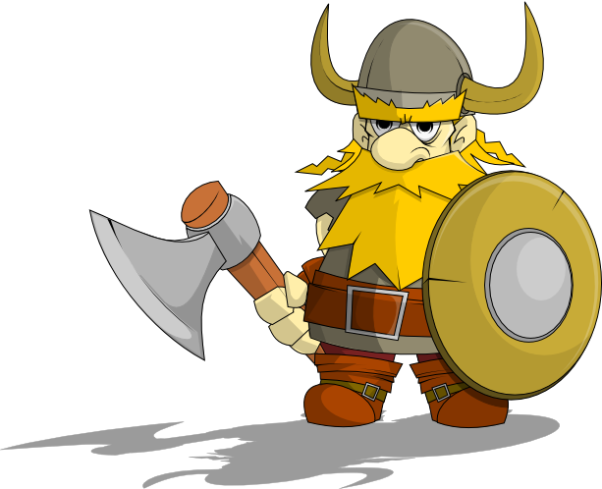
Some of our words come from the Vikings:
scare
anger
cake
mistake
hit
drag
die
give
take

Slide 13
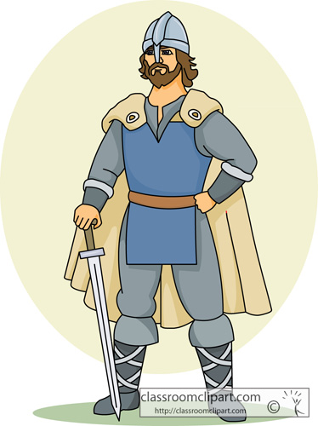
Some of our words come from the Saxons:
flesh
blood
rotten
bruise
wound
house
woman
loaf

Slide 14
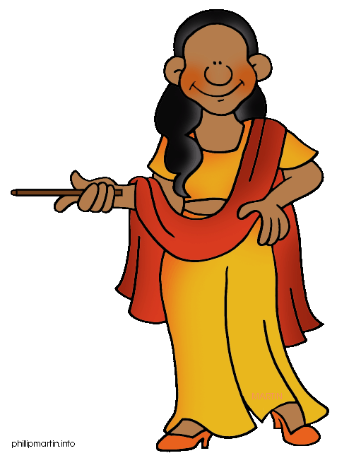
Some of our words come from languages spoken in India:
bagle
loot
jodhpurs
jungle
thug
bungalow
pyjamas
shampoo
yoga

Slide 15
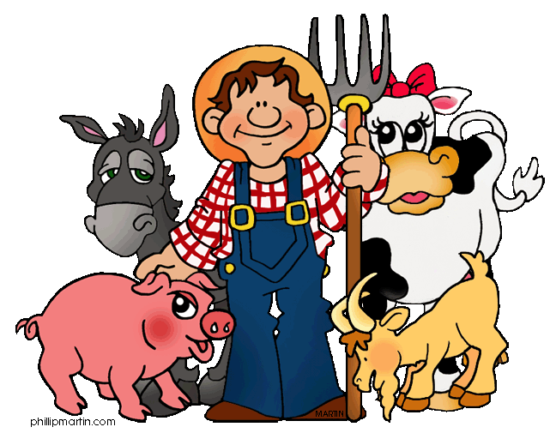
After the Norman invasion of 1066 we got lots of words from French. For example, our words for farm animals come from Old English, but the words for the meat that we get from them is from French.
pig = pork cow = beef sheep = mutton

Slide 16
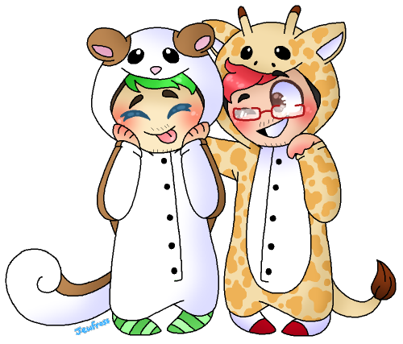
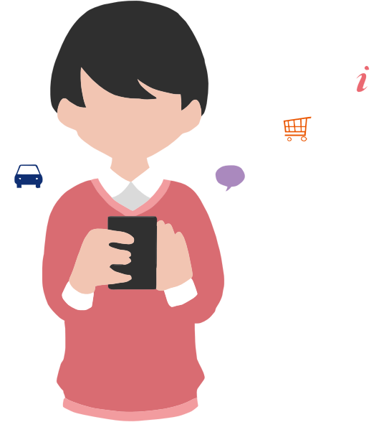
New words are still being added to English all the time, often to let us talk about new ideas and new ways of behaving. In the last few years words like ‘selfie’, ‘cake pop’, ‘e-cigarette’, ‘webisode’, ‘jeggings’, ‘onesie’ and ‘smartphone’ have all become widely use.

Slide 17
Task 1 – Summarising
From the information we have just read, summarise what you have learned. (4)
Remember – focus on the main points and use your own words!

Slide 18
To understand the English language better, to build your vocabulary, to support your spelling, AND to help you work out the meaning of words, it is important to have an understanding of roots.
The root is the part of a word that contains meaning. Roots most commonly come from Latin or Greek.

Slide 19
the Greek root means ‘story’
suffix –ology means ‘the study of’
This new word refers to the study of myths, or a collection of mythic stories.
myth
-ology
mythology
re-
form
reform
add the prefix re-
the Latin root means “shape”
This new word means to make a change or improvement.

Slide 20
When words share the same root – such as employ in the words employee, employer, employment – they are known as a word family.
However, if you do not know whether a word has a Latin or Greek root, the dictionary or Google should tell you.

Slide 21
Task 2 – Common Latin root words
There are around 1,000 Latin root words in English, with many arriving in 1066 from French, which takes much of its own language from Latin. Complete the table, filling the examples. The hint will help you with the final example for each root.
Latin Root | Meaning | Examples
aqua, aque | water | aquar___ , aquat__ , aqued___ (hint: water course)
bi | two | biann___ , bic____ , bi___y (hint: one or the other)
cent | one hundred | centi_____, c______y, p__ ____ (maths)
circum | round | circumfer____, circumsta____, circumna______ (to go round)
form | shape | forma____n, tr____form, c__form (to do the same)
liber, liver | free | liber__, d___liver, libera____n (independence)
mater, matr | mother | mater____y, matric___e (murder)
min | small | minia______, mini_____, min____y (the smallest group)
quad | four | quadb___, quadru____ (four born)
terr | earth | ex___terrest___ , terr_in, terri___y (land owned)

Slide 22
Answers
Latin Root | Meaning | Examples
aqua, aque | water | aquarium , aquatic , aqueduct (hint: water course)
bi | two | biannual , bicycle , binary (hint: one or the other)
cent | one hundred | centipede, centimetre, century, per cent (maths)
circum | round | circumference, circumstance, circumnavigate (to go round)
form | shape | formation, transform, conform (to do the same)
liber, liver | free | liberty, deliver, liberation (independence)
mater, matr | mother | maternity, matricide (murder)
min | small | miniature, minimum, minority (the smallest group)
quad | four | quadbike, quadruplet (four born)
terr | earth | extraterrestrial , terrain, territory (land owned)

Slide 23
Task 2 – Common Greek root words
There are hundreds of Greek root words in English, especially relating to science. Complete the table, coming up with 2 examples for each.
Greek Root | Meaning | Examples
aero | air
bibl, biblio | book
bio | life
dec | ten
dem, demo | people
phobia | fearing
psych | spirit
tele | far off
therm | heat

Slide 24
Working with words:
synonyms and antonyms
Learning Intentions
- to explain reasons why synonyms and antonyms are useful to know
- to identify numerous examples of synonyms and antonyms
- to explore unusual synonyms and antonyms
Success Criteria
- to attempt all questions and be mostly accurate
- to create notes that will help reading and writing in the future using synonyms and antonyms
Starter – in groups/pairs
For what purposes do we use a thesaurus?

Slide 25
A synonym is a word that means the same, or nearly the same, as another word.
Having a secure knowledge of the synonyms of some of the most over-used words in English will help you avoid repetition and introduce variety in your writing

Slide 26
Commonly overused words and their synonyms
nice
attractive charming
agreeable delightful pleasant likeable
pleasurable
excellent outstanding
superb
skilful
first-rate
tremendous
great
look
exciting
glance peek gaze
stare watch survey
examine study gape
dramatic thrilling
sensational exhilarating
stimulating electrifying
rousing breath-taking
stirring

Slide 27
Commonly overused words and their synonyms
said
muttered cried
whispered demanded
yelled gasped
exclaimed
remarked
absorbing
arresting
fascinating
captivating
inspiring
appealing
boring
interesting
angry
dull
monotonous
mundane
tiresome
tedious
lacklustre
annoyed livid
furious irate
incensed fuming
infuriated
wrathful enraged

Slide 28
Task One – Matching game
Match the synonyms.
meagre
tranquil
yearly
robust
agile
persuade
insolent
lament
malady
peaceful
disease
rude
nimble
annually
scanty
grieve
coax
strong
Notes:
meagre/scanty tranquil/peaceful yearly/annually robust/strong agile/nimble persuade/coax insolent/rude lament/grieve malady/disease

Slide 29
Task Two – Challenge
Place the words in their proper positions in the sentence. Be careful of their meanings.
(handsome – pretty)
The _____ girl admired the ______ portrait.
(hot – sultry)
On a ______ day don’t drink ______ liquids.
3. (antique – old)
The _______ man was fond of ______ furniture.
4. (loving – tender)
Her _______ hands had prepared a _______ chicken.
5. (sad – dull)
The day was ______ and we felt quite ______.
Notes:
1. pretty/handsome 2. sultry/hot 3. old/antique 4. loving/tender 5. dull/sad

Slide 30
An antonym is a word that means the opposite of another word.

Slide 31
Task Three – antonyms and prefixes
Give the antonym by adding a prefix.
advantage
approve
essential
pleasure
screw
possible
famous
legible
Notes:
1. disadvantage 2. disapprove 3. unessential 4. displeasure 5. unscrew 6. impossible 7. infamous 8. illegible

Slide 32
Task Four – Challenge
Give the antonyms of the following adjectives. Be careful and think hard.
a bright boy
a bright colour
a bright light
a stormy day
a stormy sea
a stormy meeting
a wild boy
a wild horse
a wild flower
Notes:
1. stupid 2. dull 3. dim 4. calm 5. smooth/calm 6. peaceful/friendly 7. quiet 8. tame 9. cultivated

Slide 33
Working with words:
jargon (specialist vocabulary)
Learning Intentions
to define the term jargon
to examine examples of jargon in use in different contexts
Success Criteria
to fully take part in jargon games
to identify as many examples of jargon as possible
Starter – class discussion
What occupation do you aim to work towards when you leave school?
What qualifications do you think you‘ll need?

Slide 34
Jargon is the language that goes with particular subjects. Some jobs had a lot of jargon or specialised language that goes with them. Often the language can be difficult for people who are not experts in the area to understand.

Slide 35
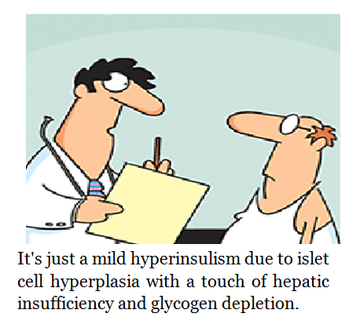
Take doctors and nurses, for example. They use words like ‘stent’ or ‘venflon’. They might hang a sign at the end of your hospital bed saying you are ‘nil by mouth’. They might send for a ‘crash team’ or send a patient to the ICU. Why do they use this language? It helps them to communicate quickly with each other, and makes patients feel more comfortable as they don’t understand what’s being said (some may disagree).

Slide 36
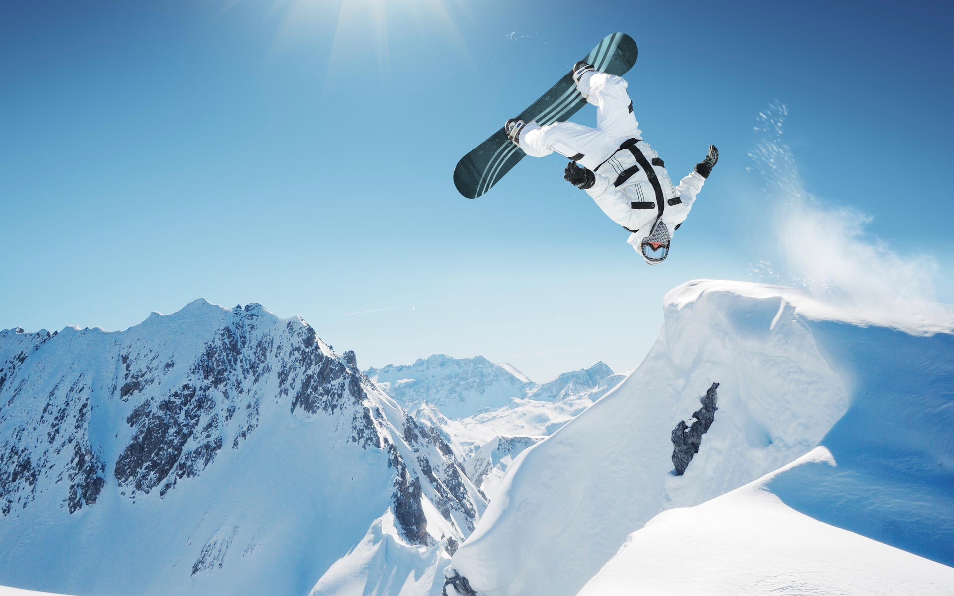
Some sports, hobbies and pastimes have a lot of jargon and specialised language that goes with them. Snowboarders sometimes feel ‘stoked’, perhaps because they have just ‘shredded’ some ‘gnar’. A snowboarder would rather feel ‘crunchy’ than ‘squirrelly’ and would hate to end up in a ‘garage sale’.

Slide 37
Class Task
Divide your class in half, and make sure you have permission to take your phones out.
One half of the class is going to find out the meanings of the six bits of medical jargon:
stent venflon nil by mouth crash team ICU SCBU
The other half of the class is going to find out the meanings of the six bits of snowboarding jargon:
stoked shred gnar crunchy squirrelly garage sale
Each person should stand up when he or she is finished. Which side will finish first?

Slide 38
Answers
Medical jargon
stent: a tiny tube placed inside an artery or vein
venflon: a small plastic tube inserted through the skin (usually the back of the hand) and into a vein
nil by mouth: the patient is not allowed to drink anything
crash team: a group of doctors and other medical staff who resuscitate patients whose heart has stopped
ICU: intensive care unit
SCBU: special care baby unit

Slide 39
Answers
Snowboarding jargon
stoked: hugely excited or enthusiastic
shred: to carve or tear up the snow
gnar: terrain that is dangerous, and therefore also cool and exciting, to go snowboarding on
crunchy: a word used to describe something that is really great
squirrelly: loose, shaky or unbalanced
garage sale: a bad fall that makes loose items such as your helmet, goggles, gloves, etc. land away from your body

Slide 40
Task Two – Read each list and decide which job, hobby or area of life the jargon belongs to.
beat, fold, whip, cream, fry, pass
pass, fail, external, assessment, SQA, moderate
dribble, pass, assist, back, shielding
moderate, heavy, squally, severe, blizzard
defendant, plantiff, prosecution, witness, advocate
chord, angle, mean, media, factor

Slide 41
Task Two – Read each list and decide which job, hobby or area of life the jargon belongs to.
beat, fold, whip, cream, fry, pass- cookery
pass, fail, external, assessment, SQA, moderate - teaching
dribble, pass, assist, back, shielding - football
moderate, heavy, squally, severe, blizzard - weather
defendant, plantiff, prosecution, witness, advocate - law
chord, angle, mean, media, factor - mathematics

Slide 42
The different uses of the same word should help you understand what jargon is more clearly. Jargon is not just about what the word means, it is about what a word means for certain people in a certain situation.

