Slide 1
I can select and use the strategies and resources I find most useful before I read, and as I read, to monitor and check my understanding. LIT 3-13a
Using what I know about the features of different types of texts, I can find, select, sort, summarise, link and use information from different sources. LIT 3-14a
To show my understanding across different areas of learning, I can: • identify and consider the purpose, main concerns or concepts and use supporting detail… LIT 3-16a
To show my understanding, I can comment, with evidence, on the content and form of short and extended texts, and respond to literal, inferential and evaluative questions and other types of close reading tasks. ENG 3-17a
Through developing my knowledge of context clues, punctuation, grammar and layout, I can read unfamiliar texts with increasing fluency, understanding and expression. ENG 3-12a
Core Course
S1 – 1/3
In your own words (describe/explain/identify)
Summarise
Finding and selecting information/evidence (quoting)
Basic Evaluation (justified opinion/quotations)
Skimming and scanning
Highlighting and underlining
Parts of speech (homework)

Slide 2
In your own words
Learning Intentions
- To discuss and understand why answering in your own words is important
- To explore examples and create responses
- To create your own questions
Success Criteria
- To discuss with a partner and answer questions about in your own words
- To try to respond to the example questions
- To create questions which a peer can answer
Starter
In your groups, list as many ways as you can think of to show you understand what you read.

Slide 3
If your teacher asked you to show that you understand what “extremely challenging” meant, how would you do that?
You would translate in to your own words.
Extremely = very
Challenging = difficult
Extremely challenging = very difficult

Slide 4
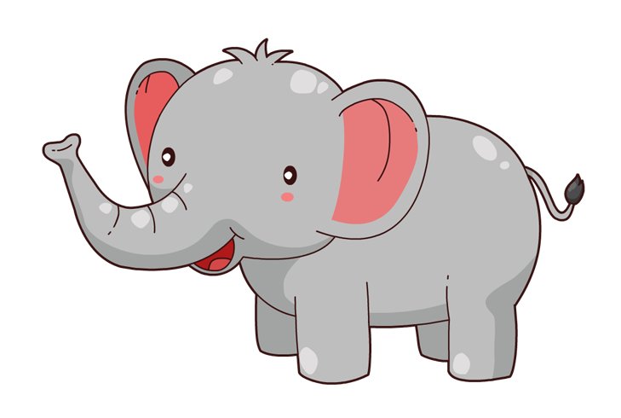
Example
Read this extract from a wildlife magazine:
‘Angus is 8 months old. By the time he’s 10, scientists predict that rhinos, African elephants and leatherback turtles will all be extinct in the wild. By the time he’s 35, they predict up to 50 per cent of all bird species will be extinct.’
Now, read this attempt by a pupil to put it into her own words:
Angus is just a young baby. Experts forecast that, before his first decade, several famous animals will only be able to be viewed in zoos. They think that, when he reaches his mid-thirties, nearly half of all kinds of birds will have died out.

Slide 5
In your own words
Think, Pair, Share… then write down:
Why do you think answering in your own words is an effective skill in English? (2)
Why do you think having this skill in your life outside school will be useful? (2)

Slide 6
Why do I have to write in my own words?
It helps you to write better, and in more unique and original ways.
It shows that you have clearly understood what you have read.
It helps you learn and retain the information.
It shows that you are a mature person who can think carefully.
It stops you from accidentially copying other people’s work.
‘Why?’ Ranking Task – Think, Pair, Share
1. Rank these five reasons from most important (1) to least important (5). Be ready to justify your decision.

Slide 7
Four steps - copy
Four steps to answer in own words:
What is the focus of the question (what information are you being asked to find)?
How many marks is it worth (how many pieces of information do you need to give)?
Find the information in the passage – underline it.
Translate it into your own words and write your version of it down.
Some exceptions to the rule:
You can keep proper nouns and common words.
Proper nouns – Egypt, Kieran, Los Angeles, etc.
Common words – the, and, at, but, etc.

Slide 8
Let’s try some examples
Abigail Sweeney was often seen as a very odd young lady. She would sweep into class late, but try very hard to complete her work. With her teacher she was rude and obstinate, but with her large circle of friends she was the most helpful, kind and effervescent girl you could wish for. She would have their backs in arguments, wipe away their tears, and cheer them up with overdramatic stories.
Class Discussion
1. Which of the words in the example do you think will be difficult to turn into your own words?
By yourself
2. In your own words, describe what Abigail was like with her friends.

Slide 9
Let’s try some examples
Abigail Sweeney was often seen as a very odd young lady. She would sweep into class late, but try very hard to complete her work. With her teacher she was rude and obstinate, but with her large circle of friends she was the most helpful, kind and effervescent girl you could wish for. She would have their backs in arguments, wipe away their tears, and cheer them up with overdramatic stories.
Abigail would help her friends, welcome them, and in arguments she would support them.
Class Discussion
1. Identify what is incorrect in this response.

Slide 10
Let’s try some examples
Back to the wildlife magazine...
‘None of this has happened yet – and there‘s still time to stop it. If everyone who cares about nature takes as much action as they can, Angus might still inherit a world with wilflife, safe from the worst effects of climate change.‘
Complete
the table:
Original writer | My own words
None of this has happened yet
there’s still time to stop it
everyone who cares about nature
takes as much action as they can
Angus might still inherit a world with wildlife
safe from the worst effects of climate change

Slide 11
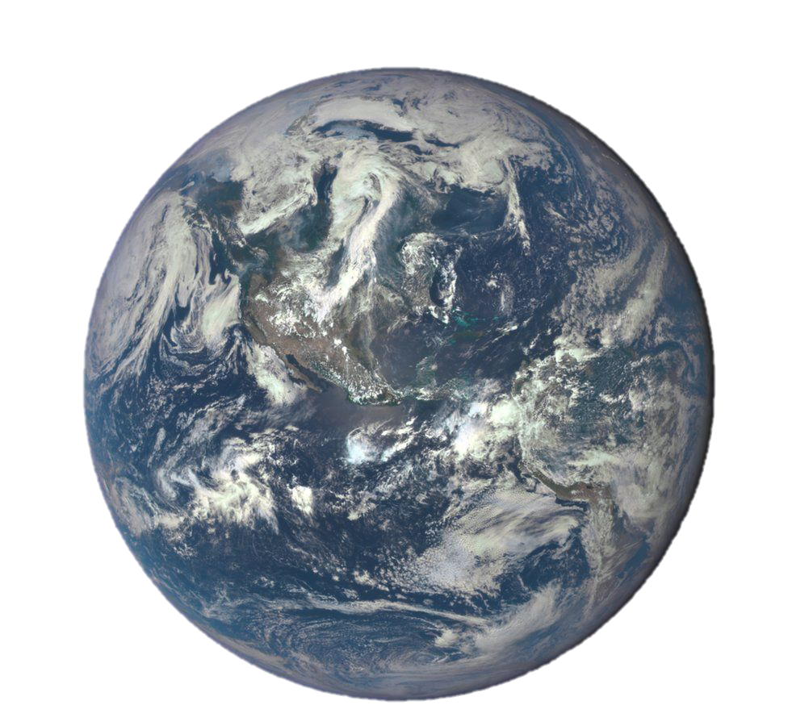
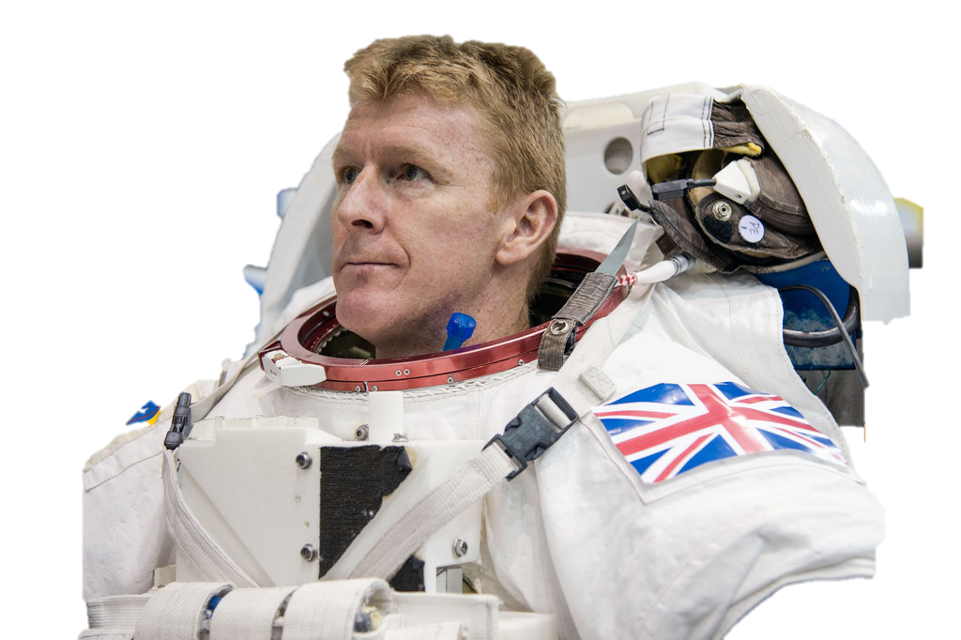
Major Tim Peake has arrived at the International Space Station.
He'll be spending six months there, as the UK's first official astronaut.
The former army pilot will be carrying out experiments and projects designed to attract young people into science.
But what effect does six months in space have on your body - and your mind? We asked Libby Jackson from the UK Space Agency.
"I think the time will fly by but physically it will change him," says Libby, who's worked on Tim's mission. "His bones will get weaker and his muscles will get weaker. He'll be doing two hours of exercise every day to try and combat those things. When he comes back to earth, it'll take about a year for his body to get over all the effects of being in a weightless environment for six months.”
But it's not just what happens to his body. Libby says that all the astronauts say the same thing when they return.
1. In your own words, explain why Major Tim Peake has become well known. (2)
2. In your own words, describe what will happen to Peake in space. (2)

Slide 12
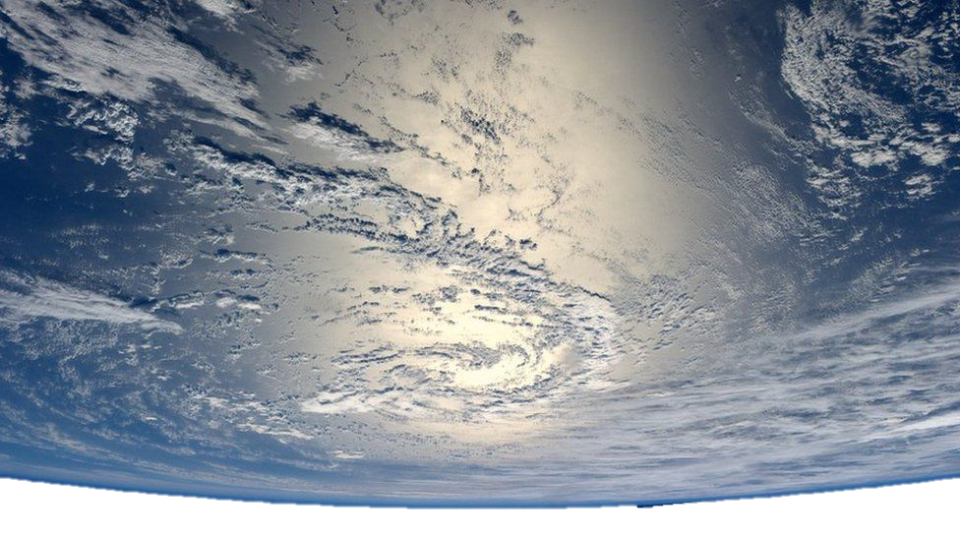
"The one thing that really changes you is seeing the earth from up there. That’s a view, that for all the photos and videos that come back home, unless you’ve seen it in your own eyes you really can’t truly appreciate it. That often will have profound impacts on the crew - we'll have to see what happens to Tim when he comes back."
That impact is known as the "overview effect" - literally what seeing the planet from space does to you. Former astronaut Michael Lopez-Alegria explains that it's a lot to get your headaround.
"It's really very impactful to see the place where the entirety of human history has occurred, below you. Seeing it's actually real.” As well as the size of the planet, Michael says there's one thing that really sticks out. "You see the effects of human presence on the planet. You can see air pollution, contamination. You can see deforestation - a lot of bodies of water that have become smaller.It gives you a greater awareness of the fragility of the planet and the eco system and gives you a better sense of the ecosystem and how important sustainability is."
3. In your own words, explain what ‘really changes you,’ and what happens to ‘the crew.’ (2)
4. Describe, in your own words, what Michael Lopez-Alegria says astronauts see from space. (2)

Slide 13
Answers – must be in own words for mark
1. In your own words, explain why Major Tim Peake has become well known. (2)
(1) for ‘astronaut’
(1) for ‘UK’s first official’ astronaut on the ‘International Space Station’
2. In your own words, describe what will happen to Peake in space. (2)
for ‘physically it will change him’
for ‘His bones will get weaker’
(1) for ‘his muscles will get weaker’
3. In your own words, explain what ‘really changes you,’ and what happens to ‘the crew.’ (2)
for ‘seeing the earth from up there’
(1) for ‘will have profound impacts’
4. Describe, in your own words, what Michael Lopez-Alegria says astronauts see from space. (2)
for ‘entirety of human history has occurred, below you’
for ‘the size of the planet’ and (1) for ‘effects of human presence’
(1) for ‘air pollution, contamination’ and (1) for ‘deforestation’
Other answers may be acceptable.

Slide 14
What are command words?
To help develop your higher order thinking skills, when you are building your reading skills, you will see some words appear in questions quite a lot. These are called command words. You will see them used in all of your subjects.
Identify – Find information and name it
Describe – Give details of the features or characteristics
Explain – Discuss cause and effect, make links between things clear

Slide 15
Using the command words, write your own question
Speaking from the ISS to officials and family members, he said: "It was a beautiful launch. That first sunrise was absolutely spectacular.
"We also got the benefit of a moon rise which was beautiful to see.”
And he gave a thumbs up to his wife, Rebecca, who told him: "It was fantastic to watch that launch today.
"There were quite a few parties down on the ground, so your launch was well celebrated by everybody down here.
"Have a great mission. We love you."
5. In your own words, ________________________________________.

Slide 16
Using the command words, write your own question
In their new home, the crew will work, sleep and exercise in a dozen modules, together about the same volume as two Boeing 747s.
The three crew members join the existing taskforce on board the ISS - Nasa astronaut Scott Kelly and Russian cosmonauts Mikhail Kornienko and Sergey Volkov.
Mr Kelly and Mr Kornienko are approaching the ninth month of their one-year ISS mission.
A maximum of 10 crew members can live on the station.
6. In your own words, ________________________________________.

Slide 17
In your own words – The Kingdom by the Sea
1. ‘He was an old hand at air raids now.’ (line 1)
In your own words, explain what this means. (1)
Look at lines 2 – 13. In your own words, what shows he was well prepared for another raid? (2)
2. In your own words, explain why ‘lights were dangerous.’ (line 13) (2)
3. In your own words, describe the objects that Harry had to gather in lines 20 – 29. (2)
4. In your own words, describe three things Harry did as soon as he reached the air raid shelter. (3)
5. Look at lines 54 – 57. In your own words, explain why Harry found it funny that his Mum was worried about burglers. (2)
/12

Slide 18
In your own words – Thimble Summer
In your own words, describe the weather conditions affecting Garnet in lines 1 – 14. (3)
Look at lines 15 – 25. Using your own words as far as possible, explain what would have happened if ‘the rain didn’t come soon.’ (2)
Look at lines 35 – 42. In your own words, explain why you think it was called ‘the cold room.’ (2)
Look at lines 55 – 59. In your own words, give two reasons why Garnet’s father said ‘What a day!’ when he came home. (2)
Look at lines 64 – 82. In your own words, describe the ‘pool.’ (3)
/12

