Slide 1



Welcome to
Alloway Early Years Centre
Picture please

Slide 2
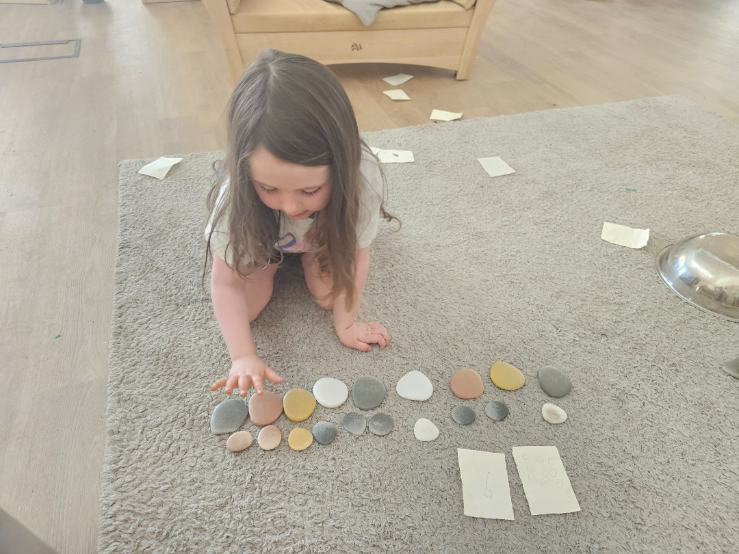
Our School Vision
To provide a safe, happy, purposeful and nurturing learning environment, where children, staff, parents and visitors feel valued and respected.
Everyone in our school is supported to reach their full potential by working together to promote kindness, inclusion and resilience.

Slide 3
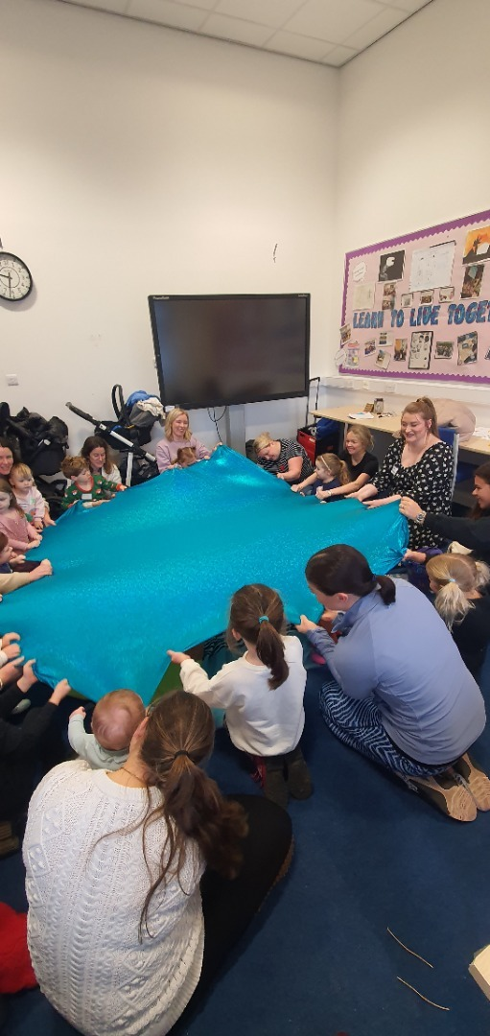
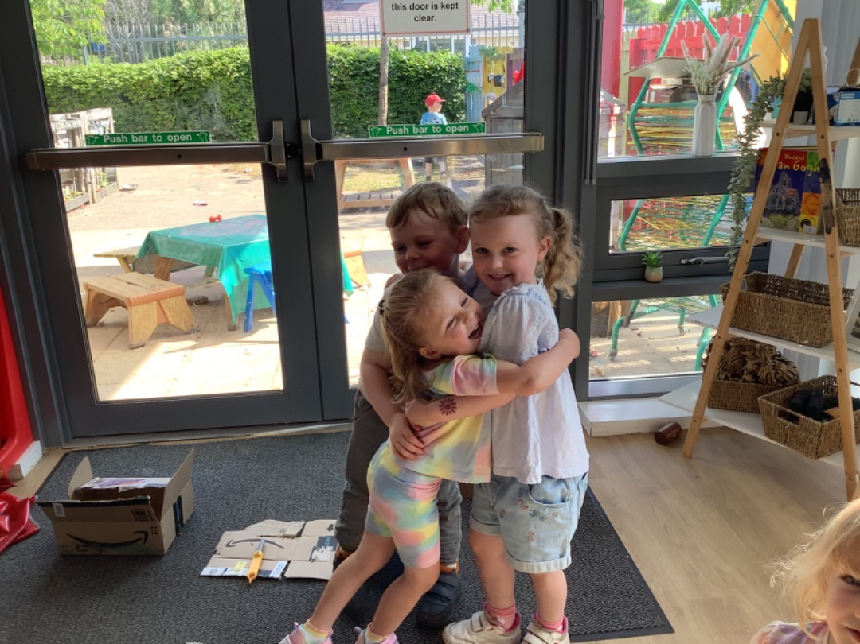
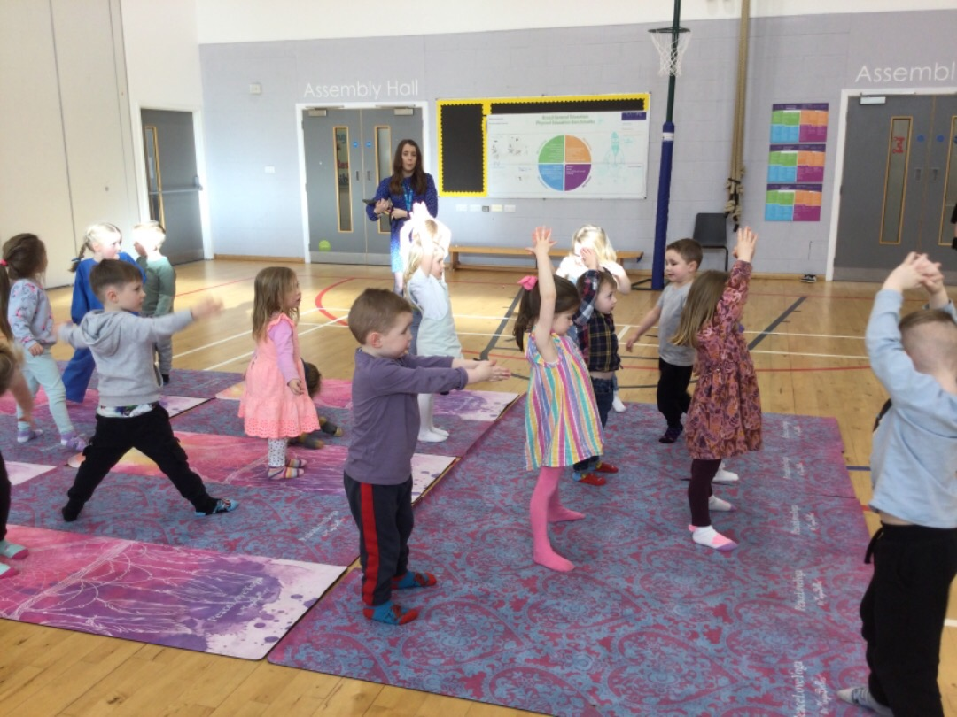
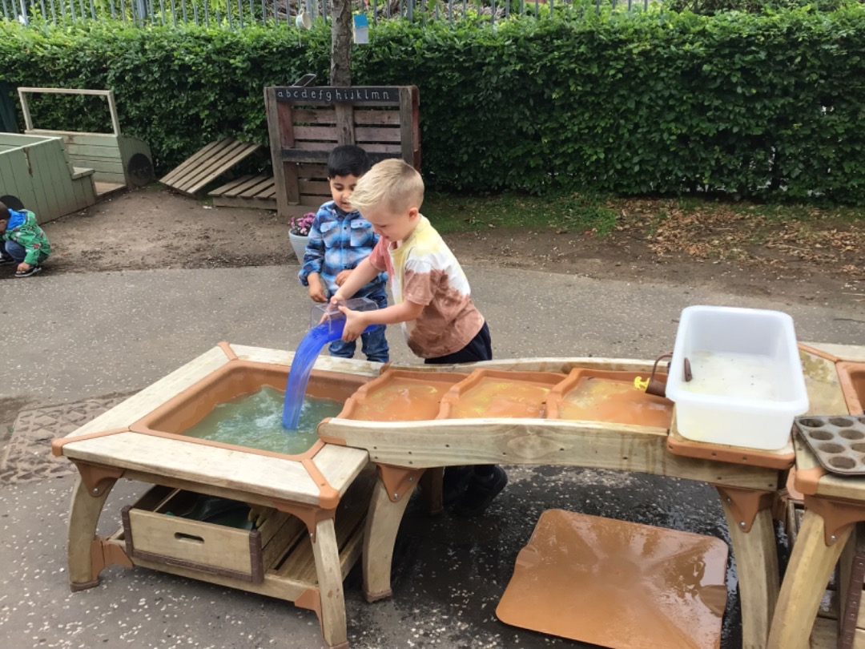
Our School Values
KIND
INCLUSIVE
RESPECTFUL
SAFE

Slide 4

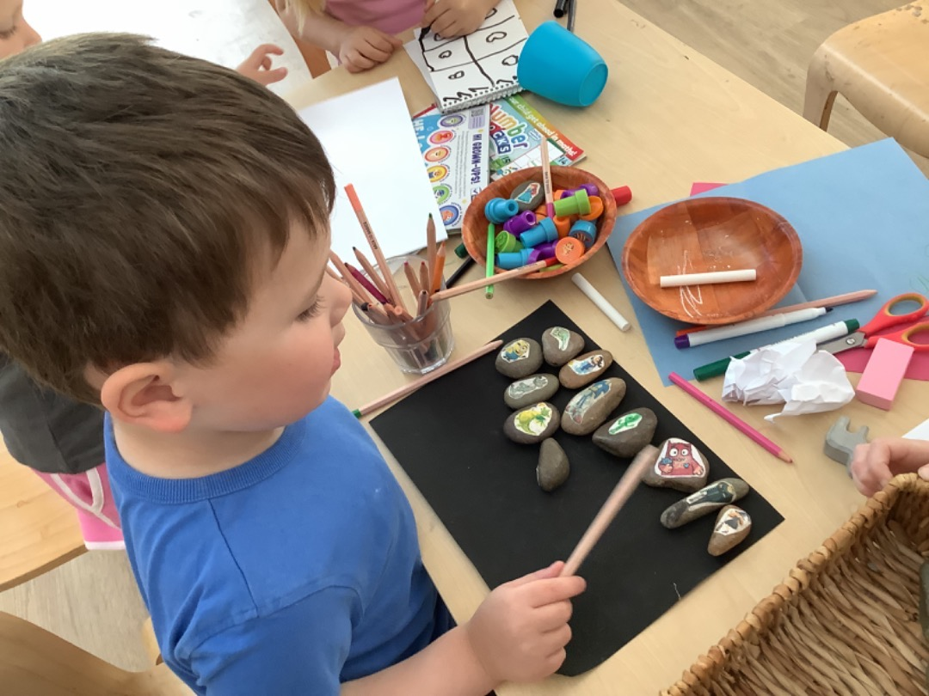
Early Years Centre Aims
In Alloway EYC we aim to provide a service of the highest quality for you and your child by:
  Providing a safe, welcoming environment in which your child will feel happy, secure and valued.
  Providing a stimulating learning environment meeting the developmental needs and interests of your child.
  Offering a range of learning experiences and activities to foster the emotional, social, physical, creative and intellectual development of your child.
  Nurturing, challenging and supporting your child in all aspects of his/her development.
Picture please

Slide 5

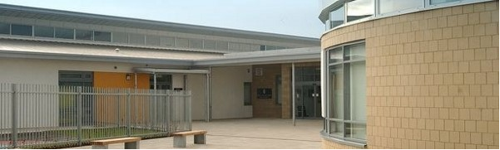
Early Years Centre Session
Full days
9am-3pm
In order to help families with school drop off and pick up the EYC doors will open from 9-9.10am and 2.45-3pm.

Slide 6
Routines
Doors open at 9-9.10am
To accommodate school pick up we will open our doors from 2.45-3pm to facilitate pick up.
Please come to the main EYC door where a staff member will always be present when the door is open.
If you come out with door opening hours please ring the buzzer.
Please phone any absences into school office.

Slide 7
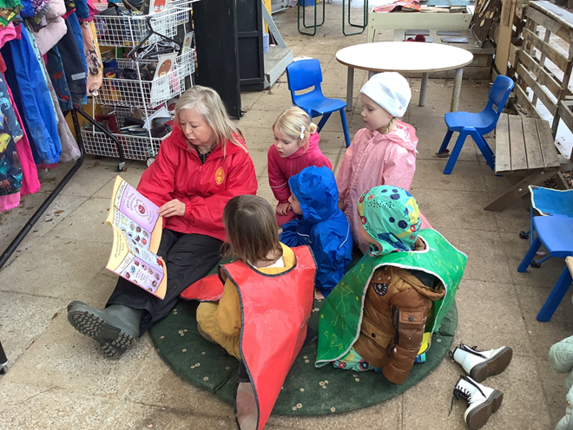
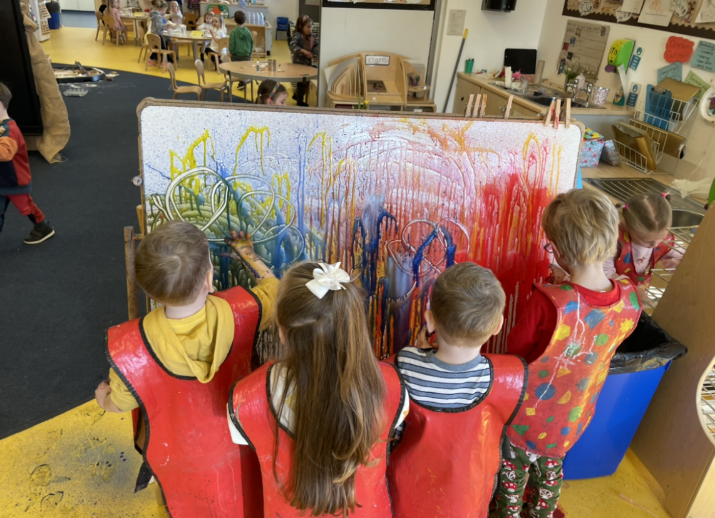
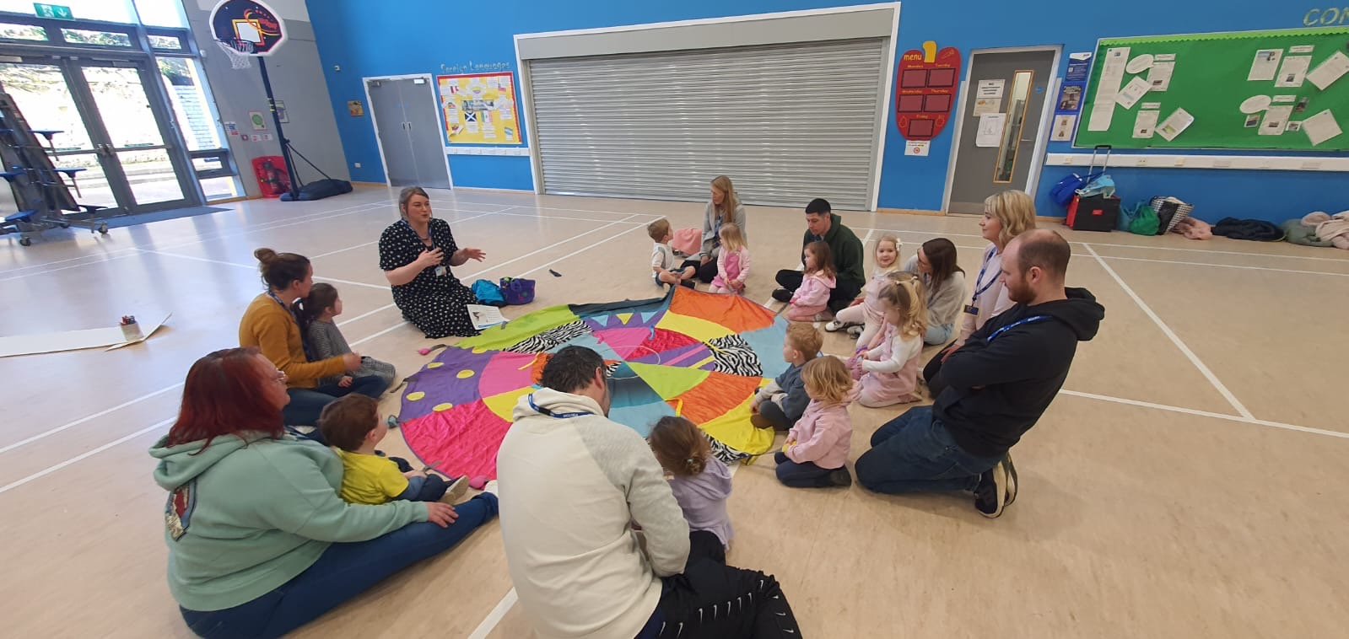
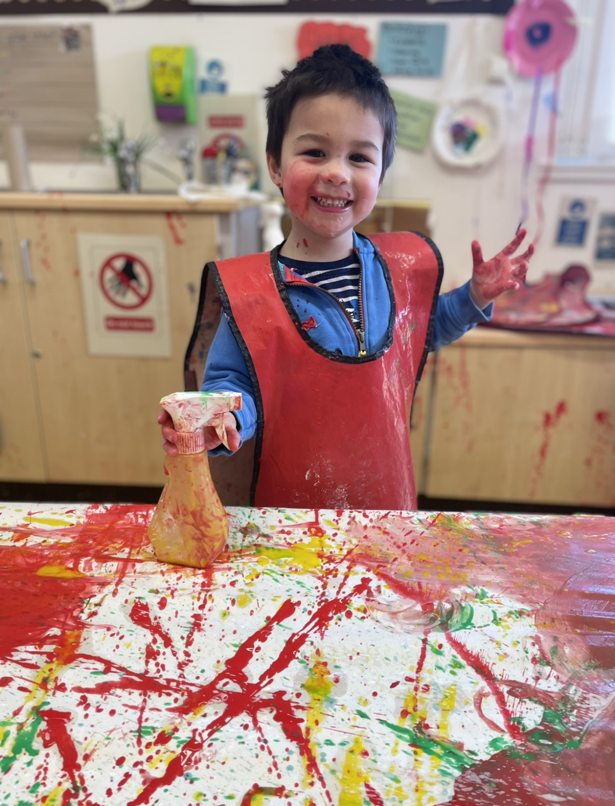
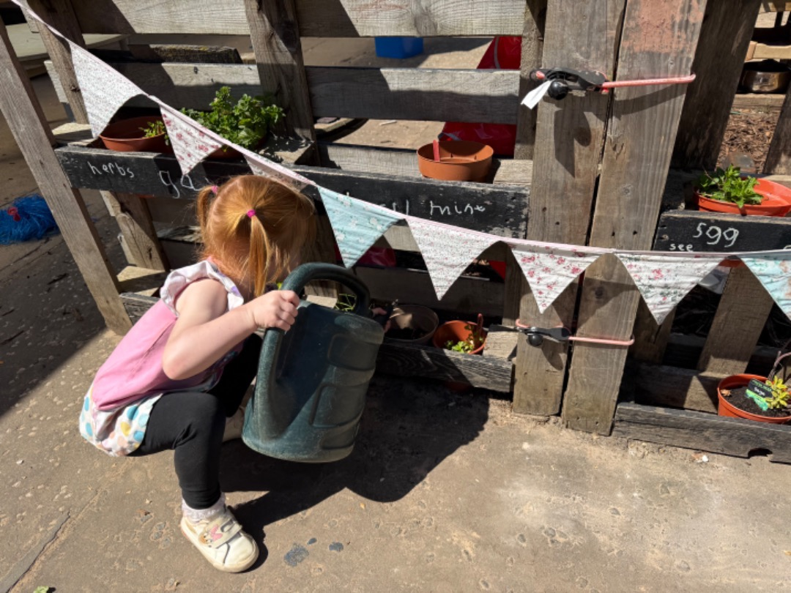
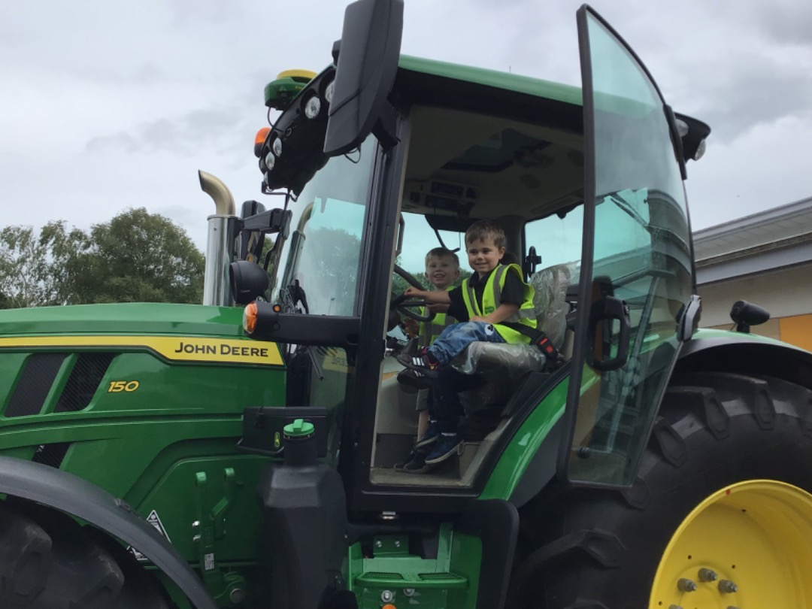
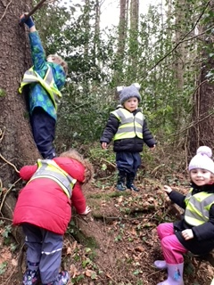
We have fun!

Slide 8



Early Years Staff – next session
Head Teacher – Mrs Fiona Meney
Depute Head Teacher – Mrs Lauren Miller
Depute Manager – Miss Kirsty McCallum
Senior EYP – TBC
Early Years Practitioners:
  Mrs Julie Lorimer
  Mrs Anne Ahmed
  Mr Ryan McGill
  Mrs Libby Pollock
  Mrs Victoria Cuff
  Mrs Haley Fraser
  Miss Caoilin Gibson
  Miss Kayleigh Adgie

Slide 9
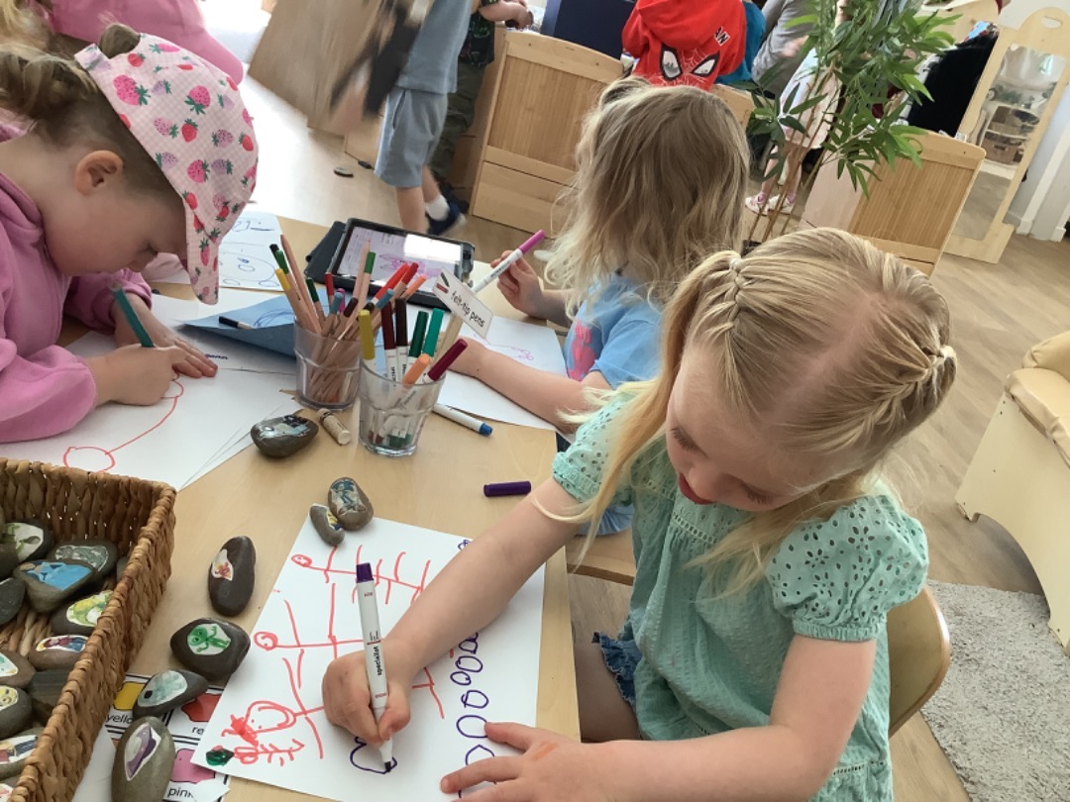
Early Years Centre Groups
There will be 8 groups with up to 8 children in each group. The groups will be a mix of ages.
Each group has a key worker(s).
Parents must sign their child in and out at their table in the lunch area.
Once signed in, children will be encouraged to free play, enjoying a range of experiences set up in preparation for the children arriving.
Picture please

Slide 10
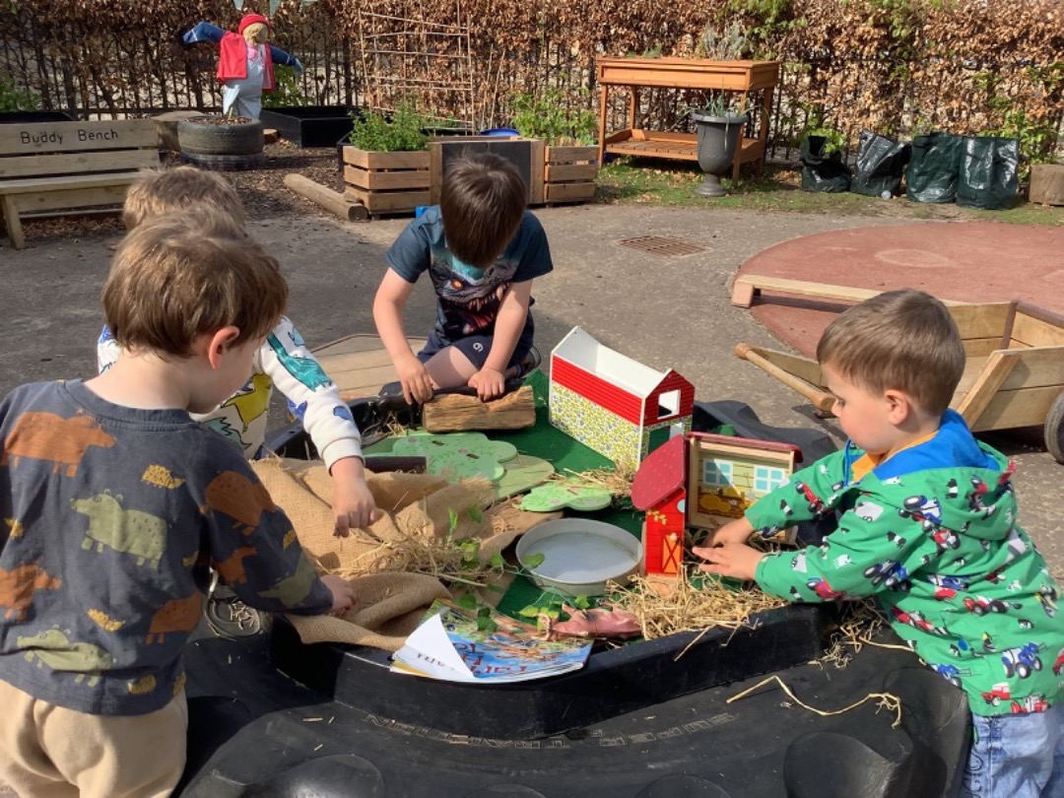
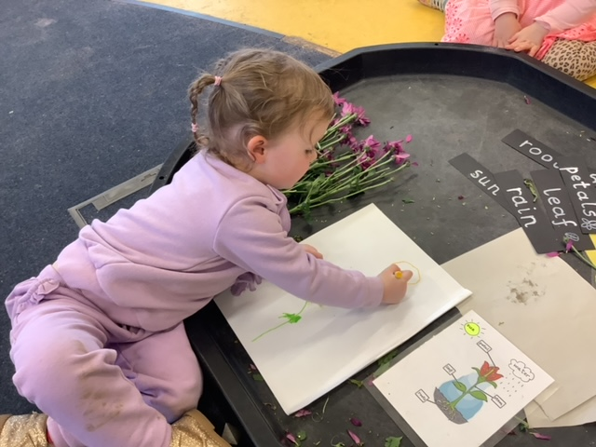
Early Years Centre – children’s routine
Sign in by adult and child at group area in lunch room.
Health and Wellbeing Check-In is encouraged to allow children to indicate how they are feeling. Staff follow up on this throughout the day.
Free play - Staff plan rich and responsive learning experiences which children can choose to visit.
Group times happen throughout the week.
Home time - children signed out and collected from group area in playroom.

Slide 11
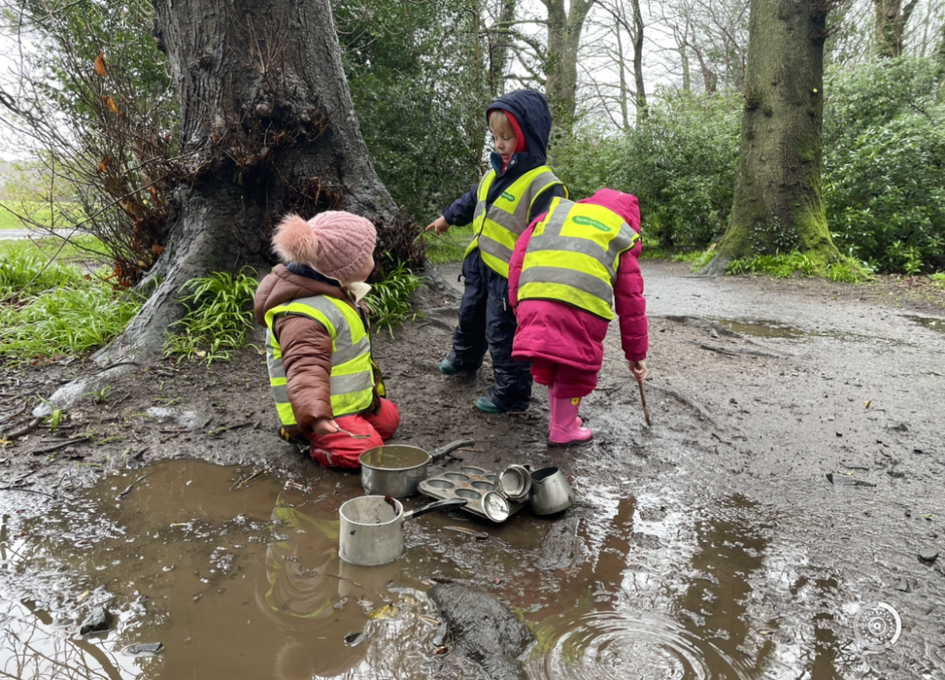
What Do I Bring?
There is no nursery uniform, children wear their own play clothes.
Parents should leave a change of clothes in a bag on their nursery peg.
Please supply outdoor clothes that can be kept in the EYC. Children have the opportunity to access the outdoors everyday, regardless of the weather.
NAMES ON EVERYTHING PLEASE!
Picture please

Slide 12
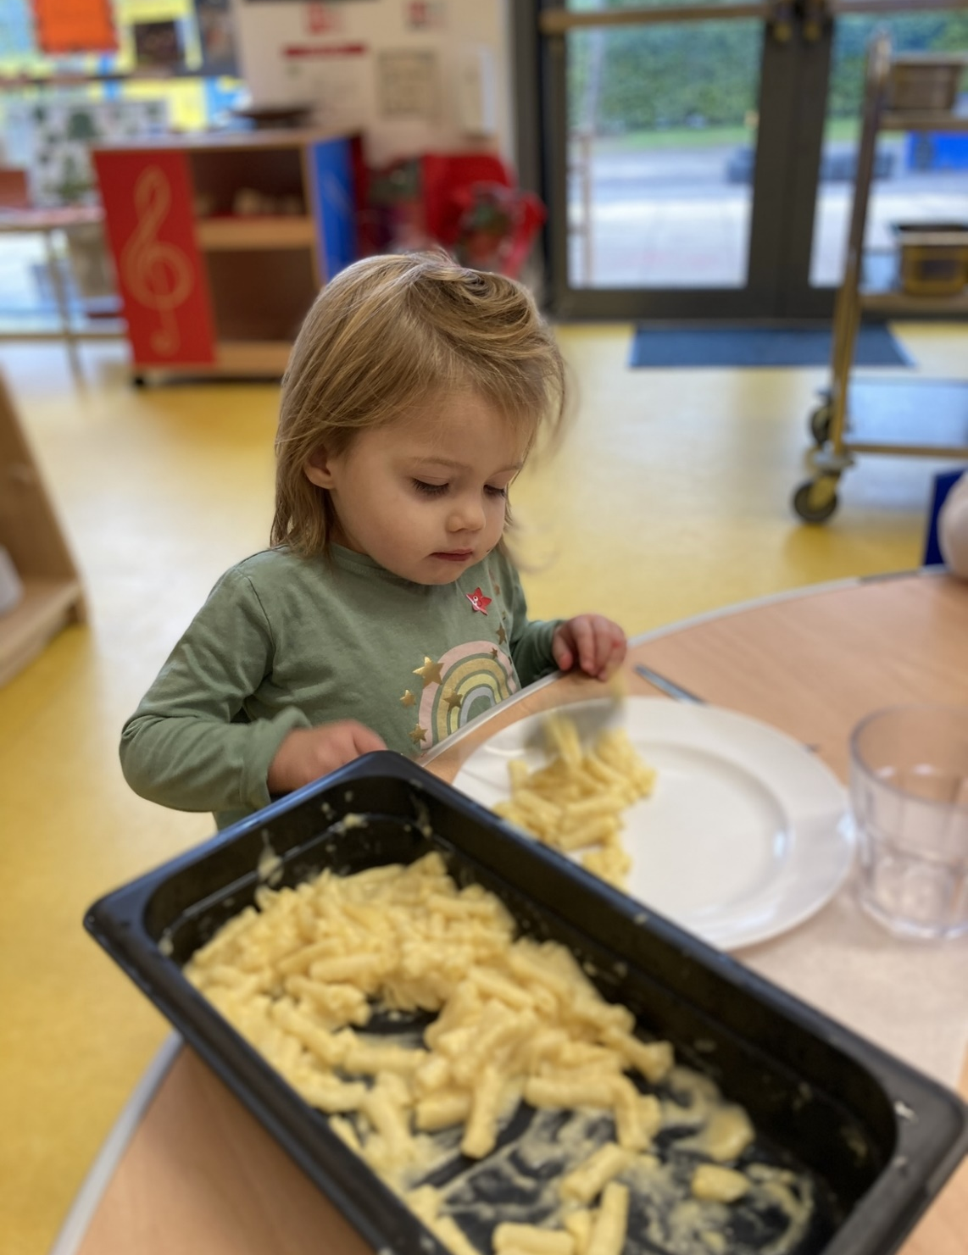
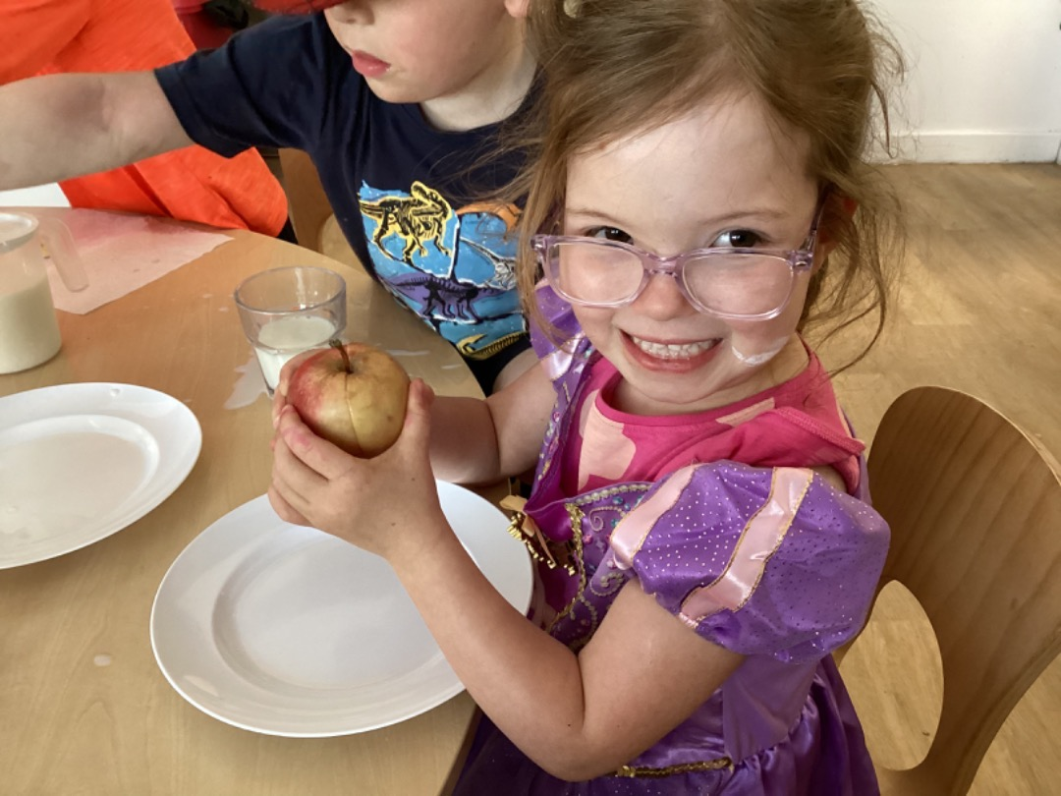
Early Years Centre Lunch
Children are provided with a free school hot lunch.
Staff have worked hard to develop a homely environment in which children and staff sit together for lunchtime.
This year, we have implemented a rolling lunch approach which was highly praised during our recent inspection. Children choose when they wish to have lunch, allowing play to be uninterrupted.
Staff model good table manners.
Children are encouraged to try new foods.
The lunch menu is shared with parents in advance.
Parents can provide a small healthy packed lunch if they think their child will not eat the school lunch. This should be placed in a disposable bag and named.
Please do not send in a packed lunch box/bag.

Slide 13
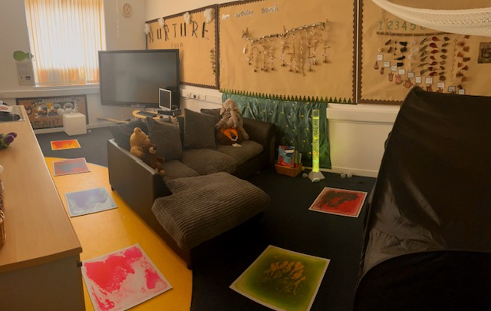
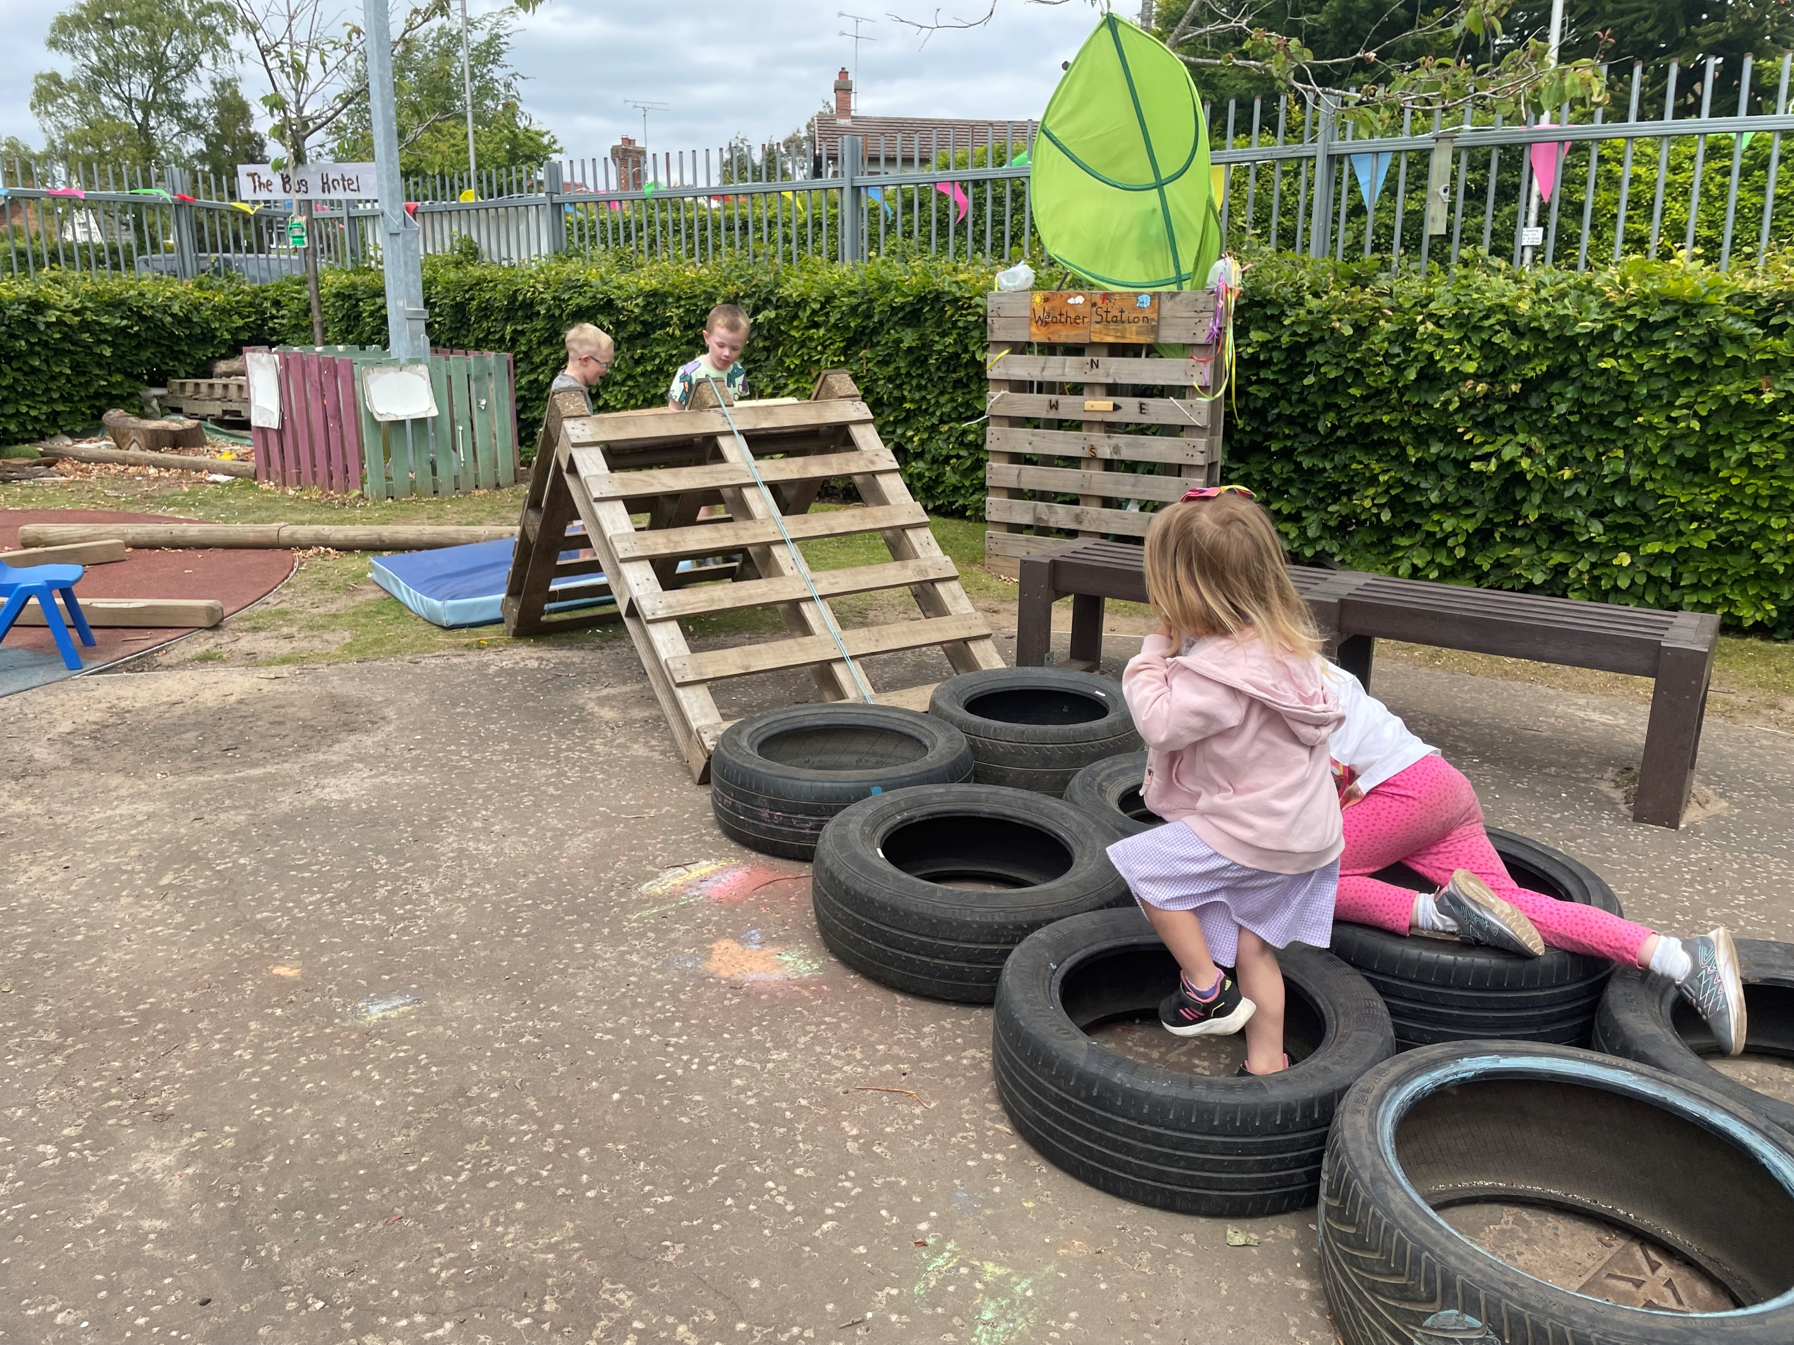
Early Years Centre areas
Playroom – free play with natural and real life resources and toys.
Quiet Room – a range of sensory resources. Provides opportunity for rest and relaxation.
Outdoor space – encourages physical play, curiosity, problem solving, literacy and numeracy.
School facilities – gym hall, ICT Suite, outdoor classroom, school playing field and public library.
Outdoor learning in School Eco-Garden and local area.
Pictures please

Slide 14
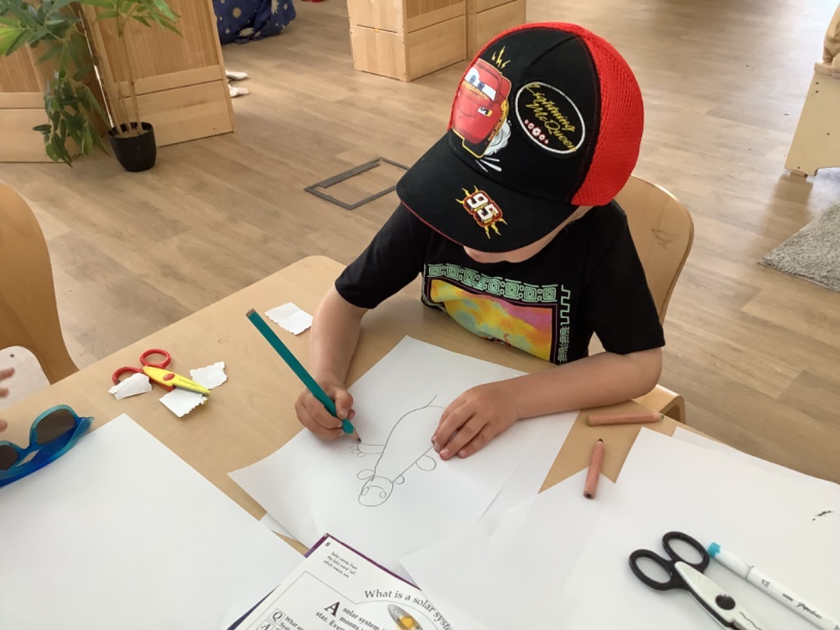
Each child is an individual
Key worker develops a strong relationship with parent and child.
Personal profile – Learning Journals.
Staff track individual progress.
Open door policy for good communication with parents.
Informal opportunities to discuss progress.
Stay and Play opportunities throughout the year.
3 termly written care plan meetings with staff.
Written annual report for pre-schoolers.
Picture please

Slide 15
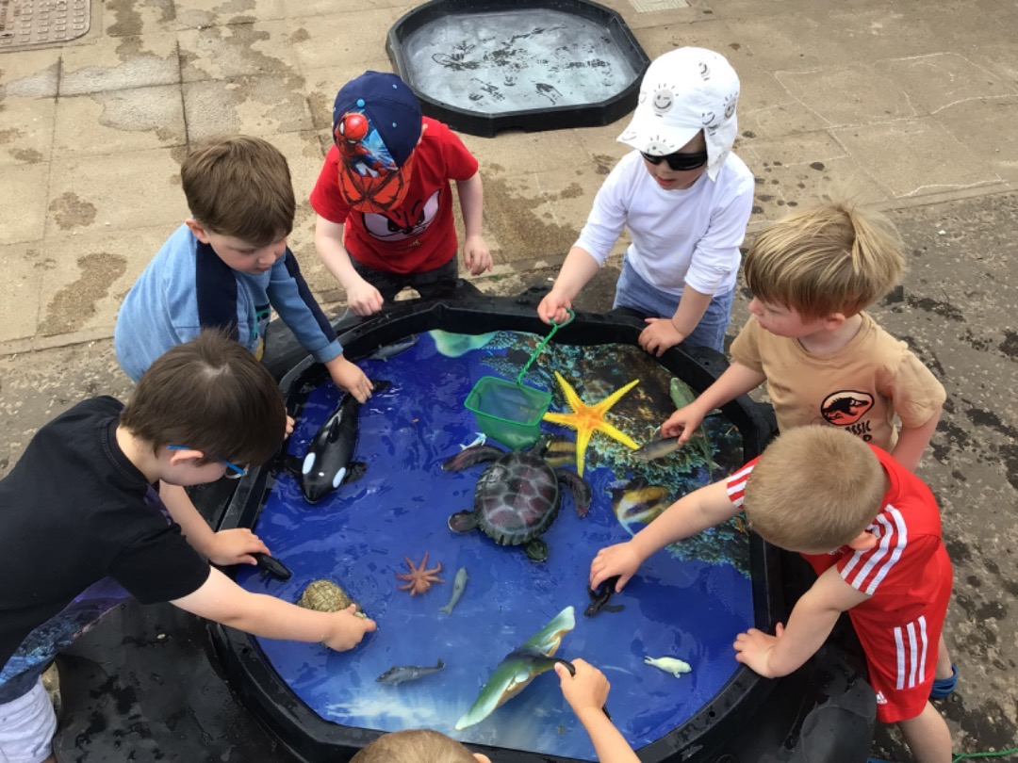
Play Pedagogy
Play is one of the most important ways in which young children gain essential knowledge and understanding.
Play helps children develop many skills, including:
Self-confidence and self-regulation
Creativity
Problem-solving skills
Communication and social skills
A love of learning
Flexible thinking
Engaging in purposeful play experiences enhances children’s mastery of academic concepts and builds interest and motivation to learn.
Pictures please

Slide 16
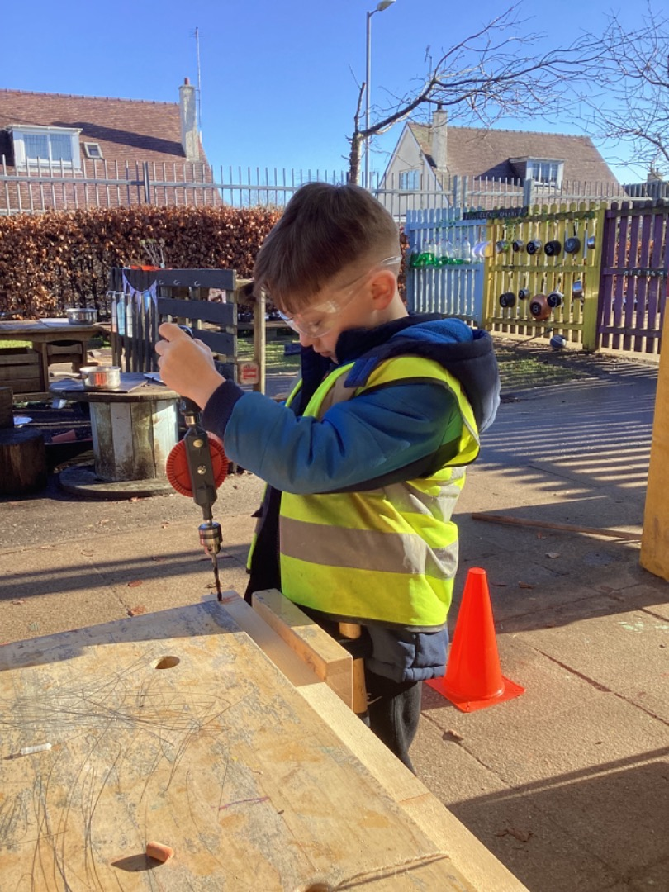
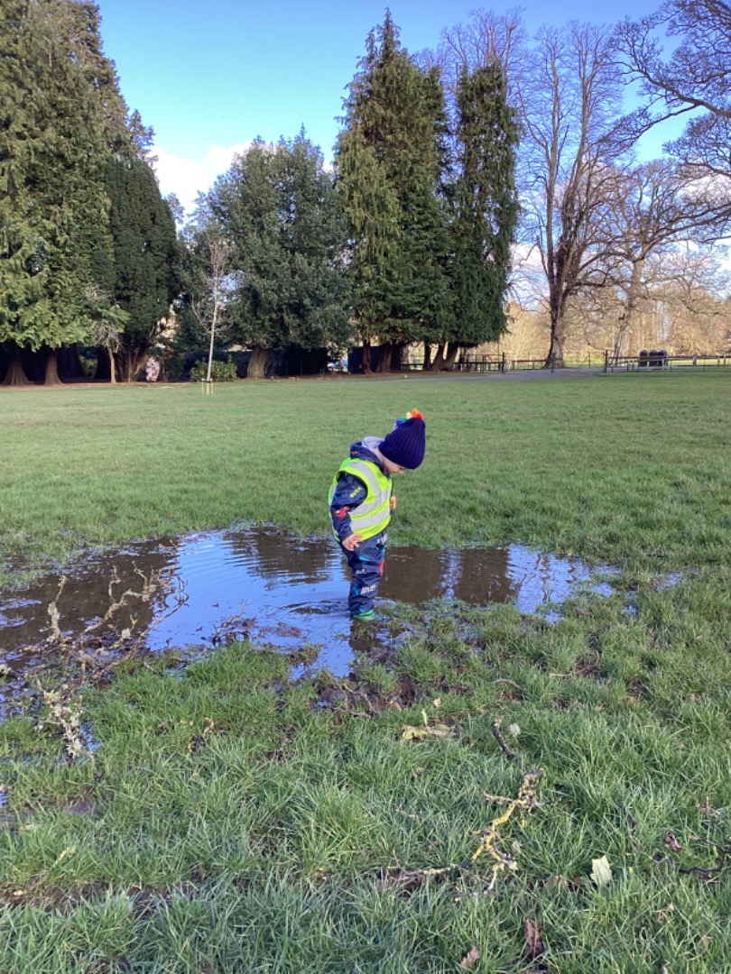
Outdoor Learning
Children benefit from learning outdoors.
Outdoor learning opportunities every day in nursery.
Outdoor learning in school grounds.
Outdoor learning visits planned to local area.
Forest Schools
Appropriate clothing to be sent in and left in the EYC at all times – puddle suit, wellies, hat, scarf, gloves, sunhat etc.
We will cancel on the day if we feel the weather is inclement and dangerous.

Slide 17
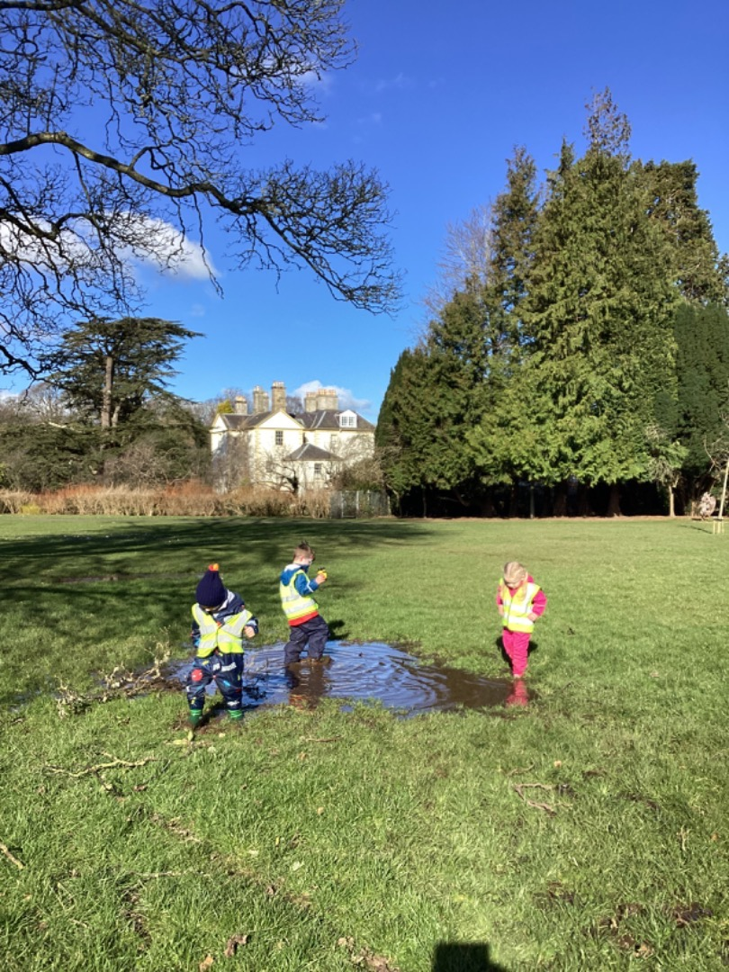
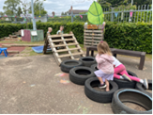
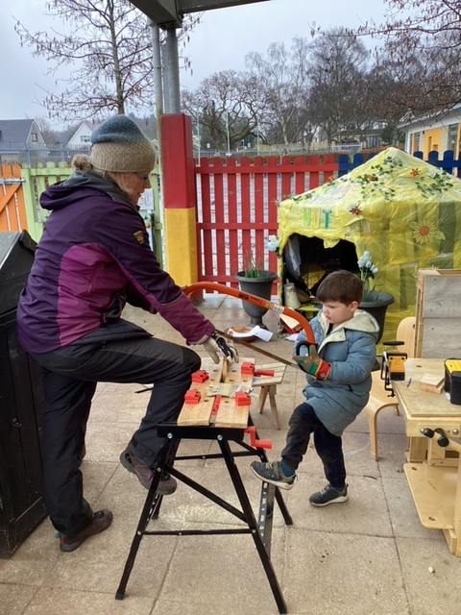
Realising the Ambition
Realising the Ambition is a national practice guidance document.
It is designed to guide and support all those who work with babies and children in the early learning and childcare sector and beyond into the early years of primary school in Scotland.
What I need to grow and develop?
Interactions
Experiences
Spaces

Slide 18
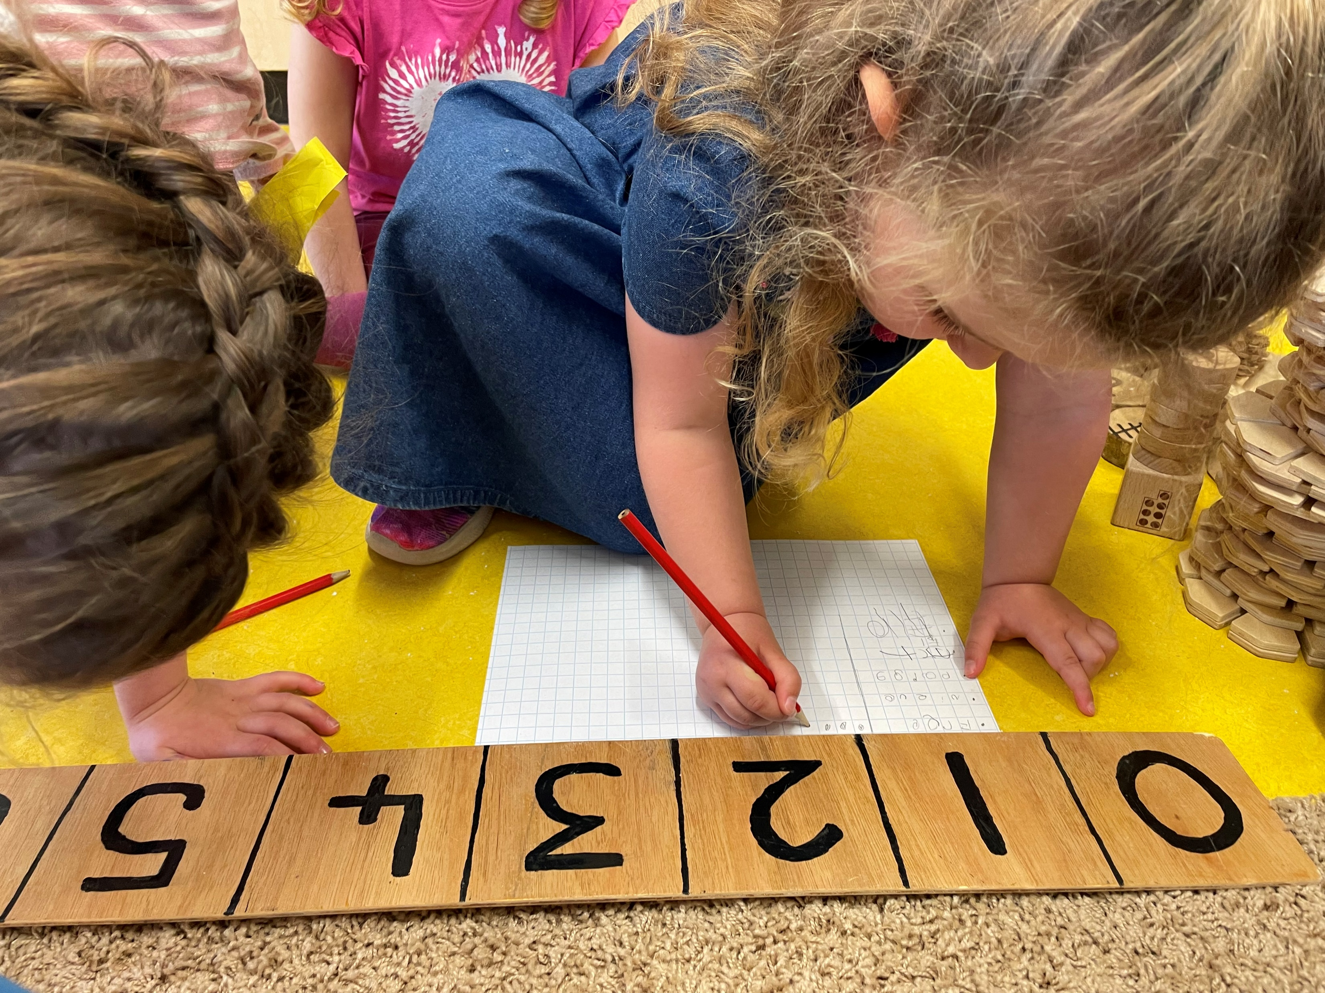
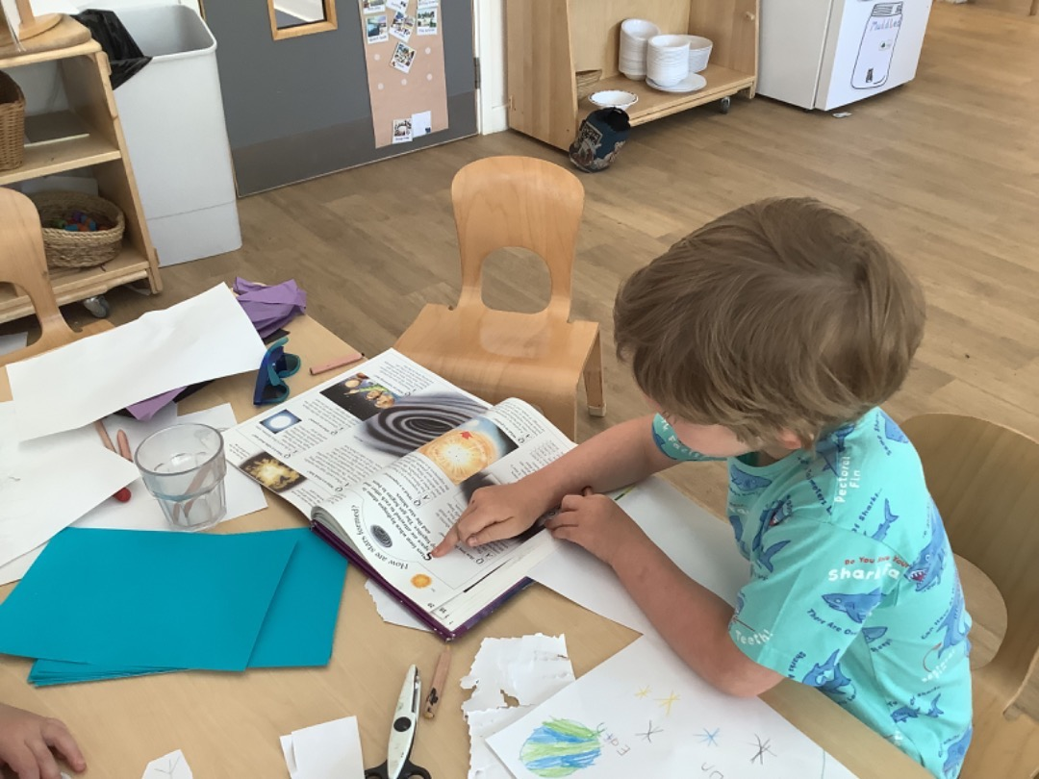

Curriculum for Excellence
Early Level
Curricular areas – Literacy, Numeracy, Health and Wellbeing, Science, Expressive Arts, Technologies, Social Subjects and Religious and Moral Education
Breadth and depth of experience of Early level outcomes.
South Ayrshire Developmental Milestones are tracked for pre-school children.

Slide 19
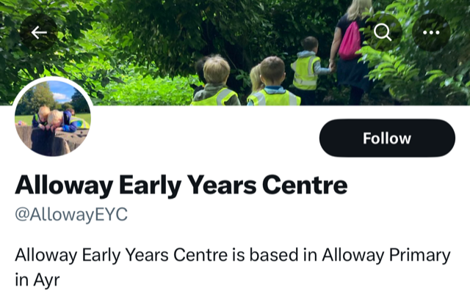

Parental Communication
Learning Journals
Twitter @Alloway EYC
GroupCall Xpressions App
Termly newsletters
Weekly flyers
Parental surveys and questionnaires
Communication board in welcome corridor

Slide 20

Learning Journals
We use Learning Journals as a communication app and to share information and photos about your child with you.
Learning Journals contracts will be issued and we ask parents to stick to this.
This year we will continue using Learning Journals online profiles with parents. This will give you regular updates about your child and their progress.

Slide 21
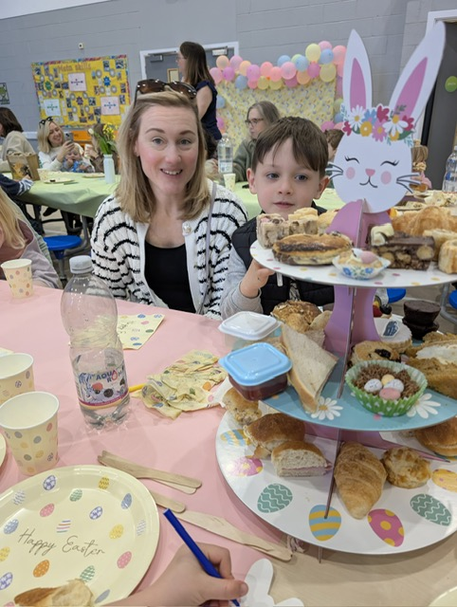
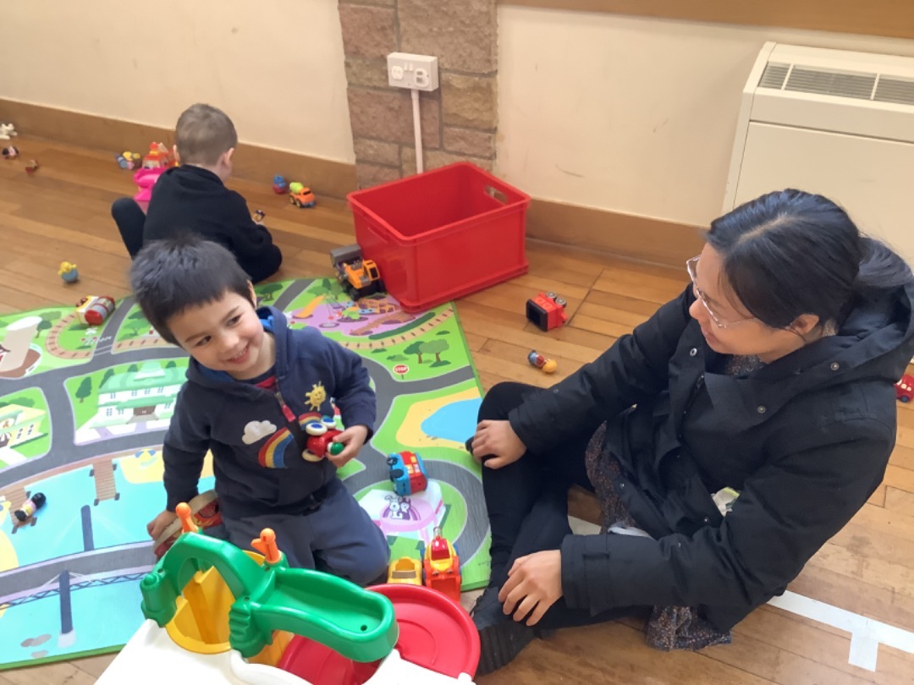
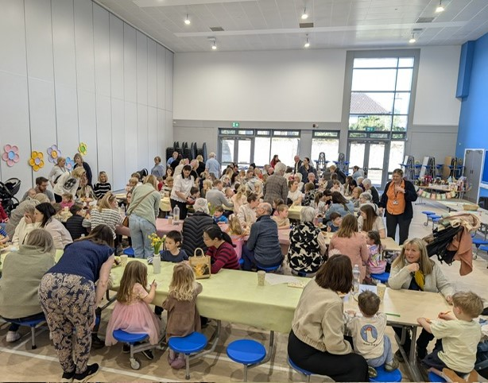
Parental Engagement Activities
Coffee and Chat
Stay and Play sessions (including evening sessions)
Church Stay and Play sessions
Parental workshops
Concerts
Parent helpers
Outings
PEEP/Bookbug groups

Slide 22
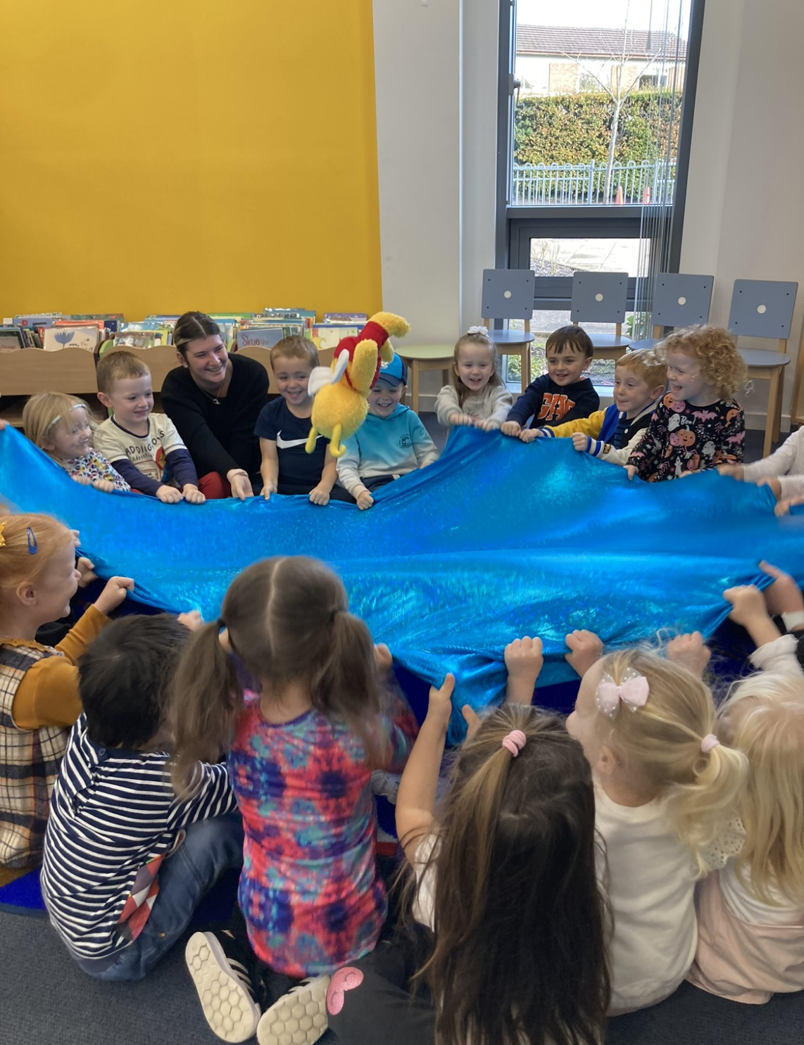
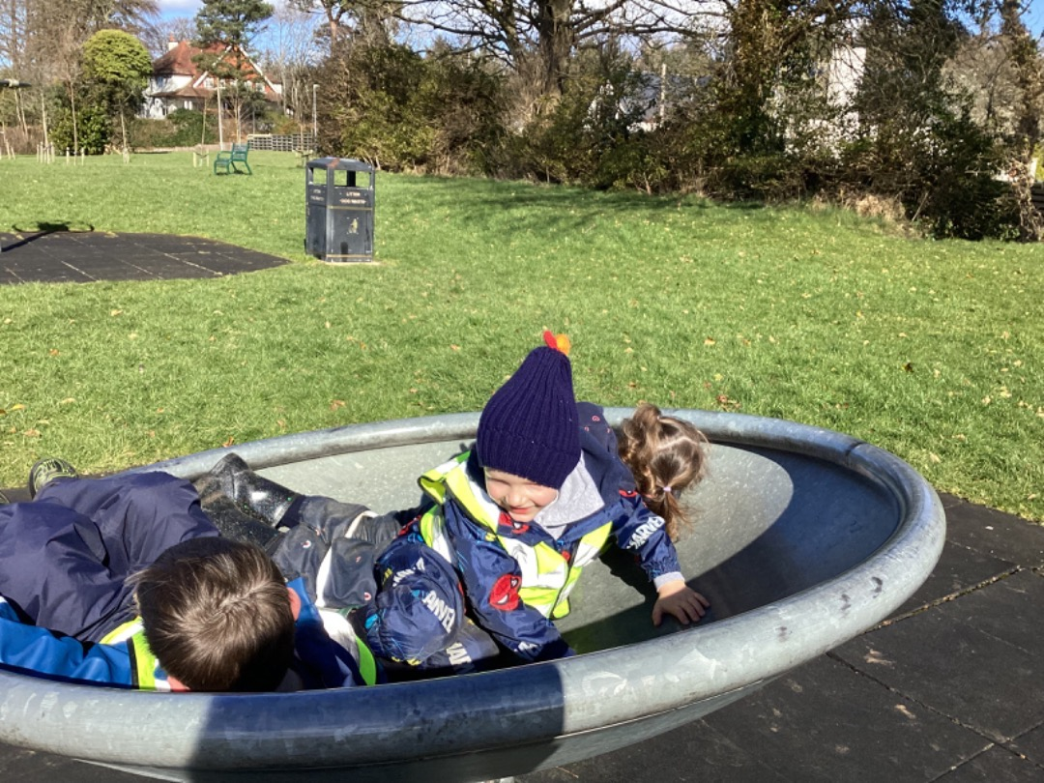
Community Links
Robert Burns Birthplace Museum
Village walks
Local post-office
Belleisle / Rozelle visits (Forest Kindergarten)
Coffee and chat stay and play in church halls
Pictures please

Slide 23
Parent Helpers
Children benefit from the help parents can give nursery.
Parents help in a variety of ways.
Parent helpers for outdoor learning and trips.
We ask our parents to be confidential about what they see and hear in nursery.
Picture please

Slide 24
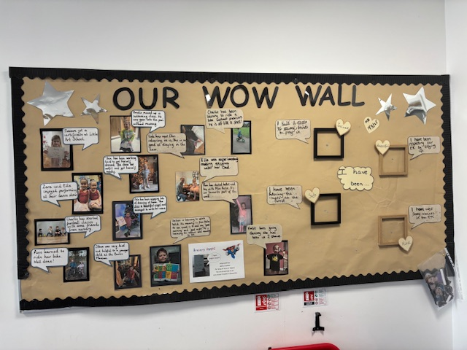
Wider Achievements
We are always keen to hear about your child’s achievements out with the EYC.
Please share any achievements with us via Learning Journals, and we will add these to our WOW wall.
We also love to hear about things your child gets up to out with the EYC, and will send surveys out to gather this information. This helps us get to know your child as an individual.
Picture please

Slide 25


More Information
Parentzone Scotland | Parent Zone (education.gov.scot)

Slide 26

A reminder –
EYC children starting the nursery in August 2025 are invited for visits. Information has been sent out.
Parents must remain with their child for these visits.
Children will be issued with an All About Me Booklet during these visits. We ask that you complete this with your child ready to return when they start.
The EYC reopens on Wednesday 20th August 2024 at 9.00am with full day provision.
Children starting the EYC throughout the year will be invited for a visit a week prior to their 3rd birthday. They will then receive their start date which will be the Monday after their 3rd birthday.

Slide 27

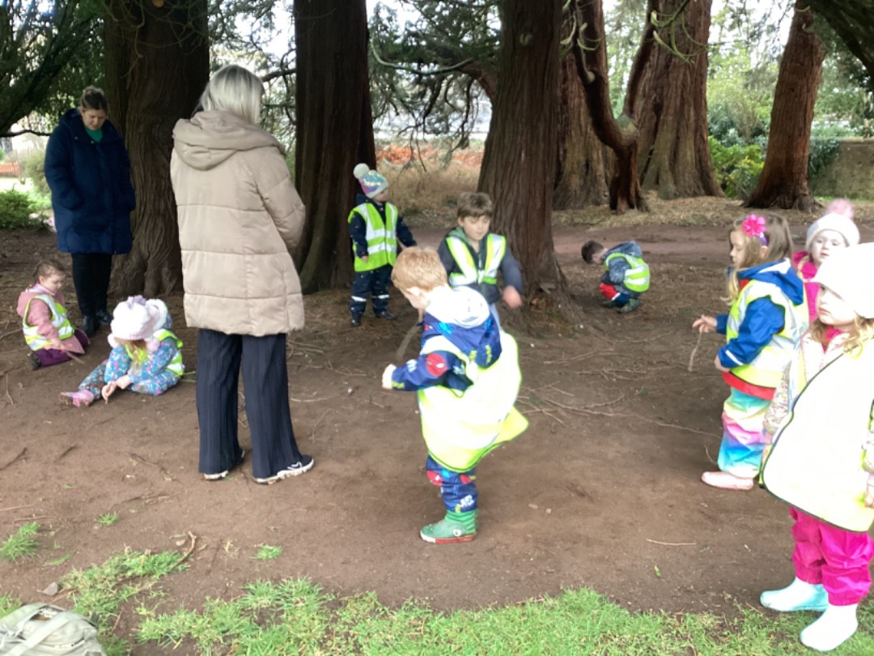
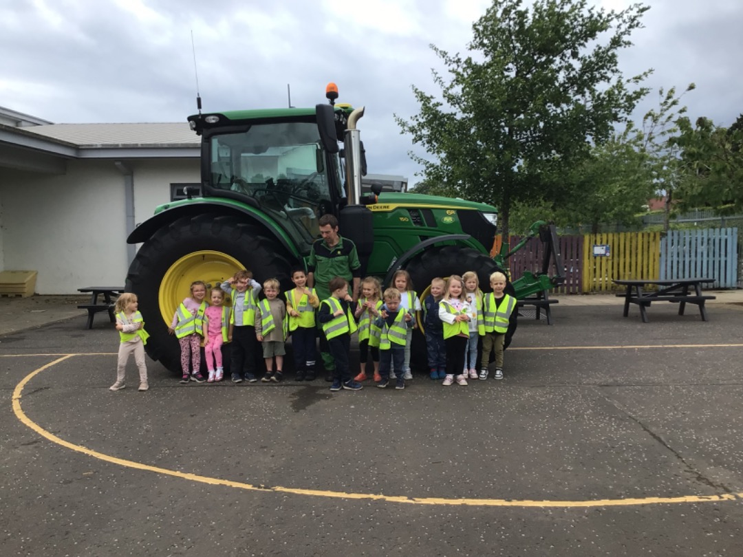
Picture please
We are looking forward to welcoming your child
and family into
Alloway EYC!
Picture please

