Slide 1
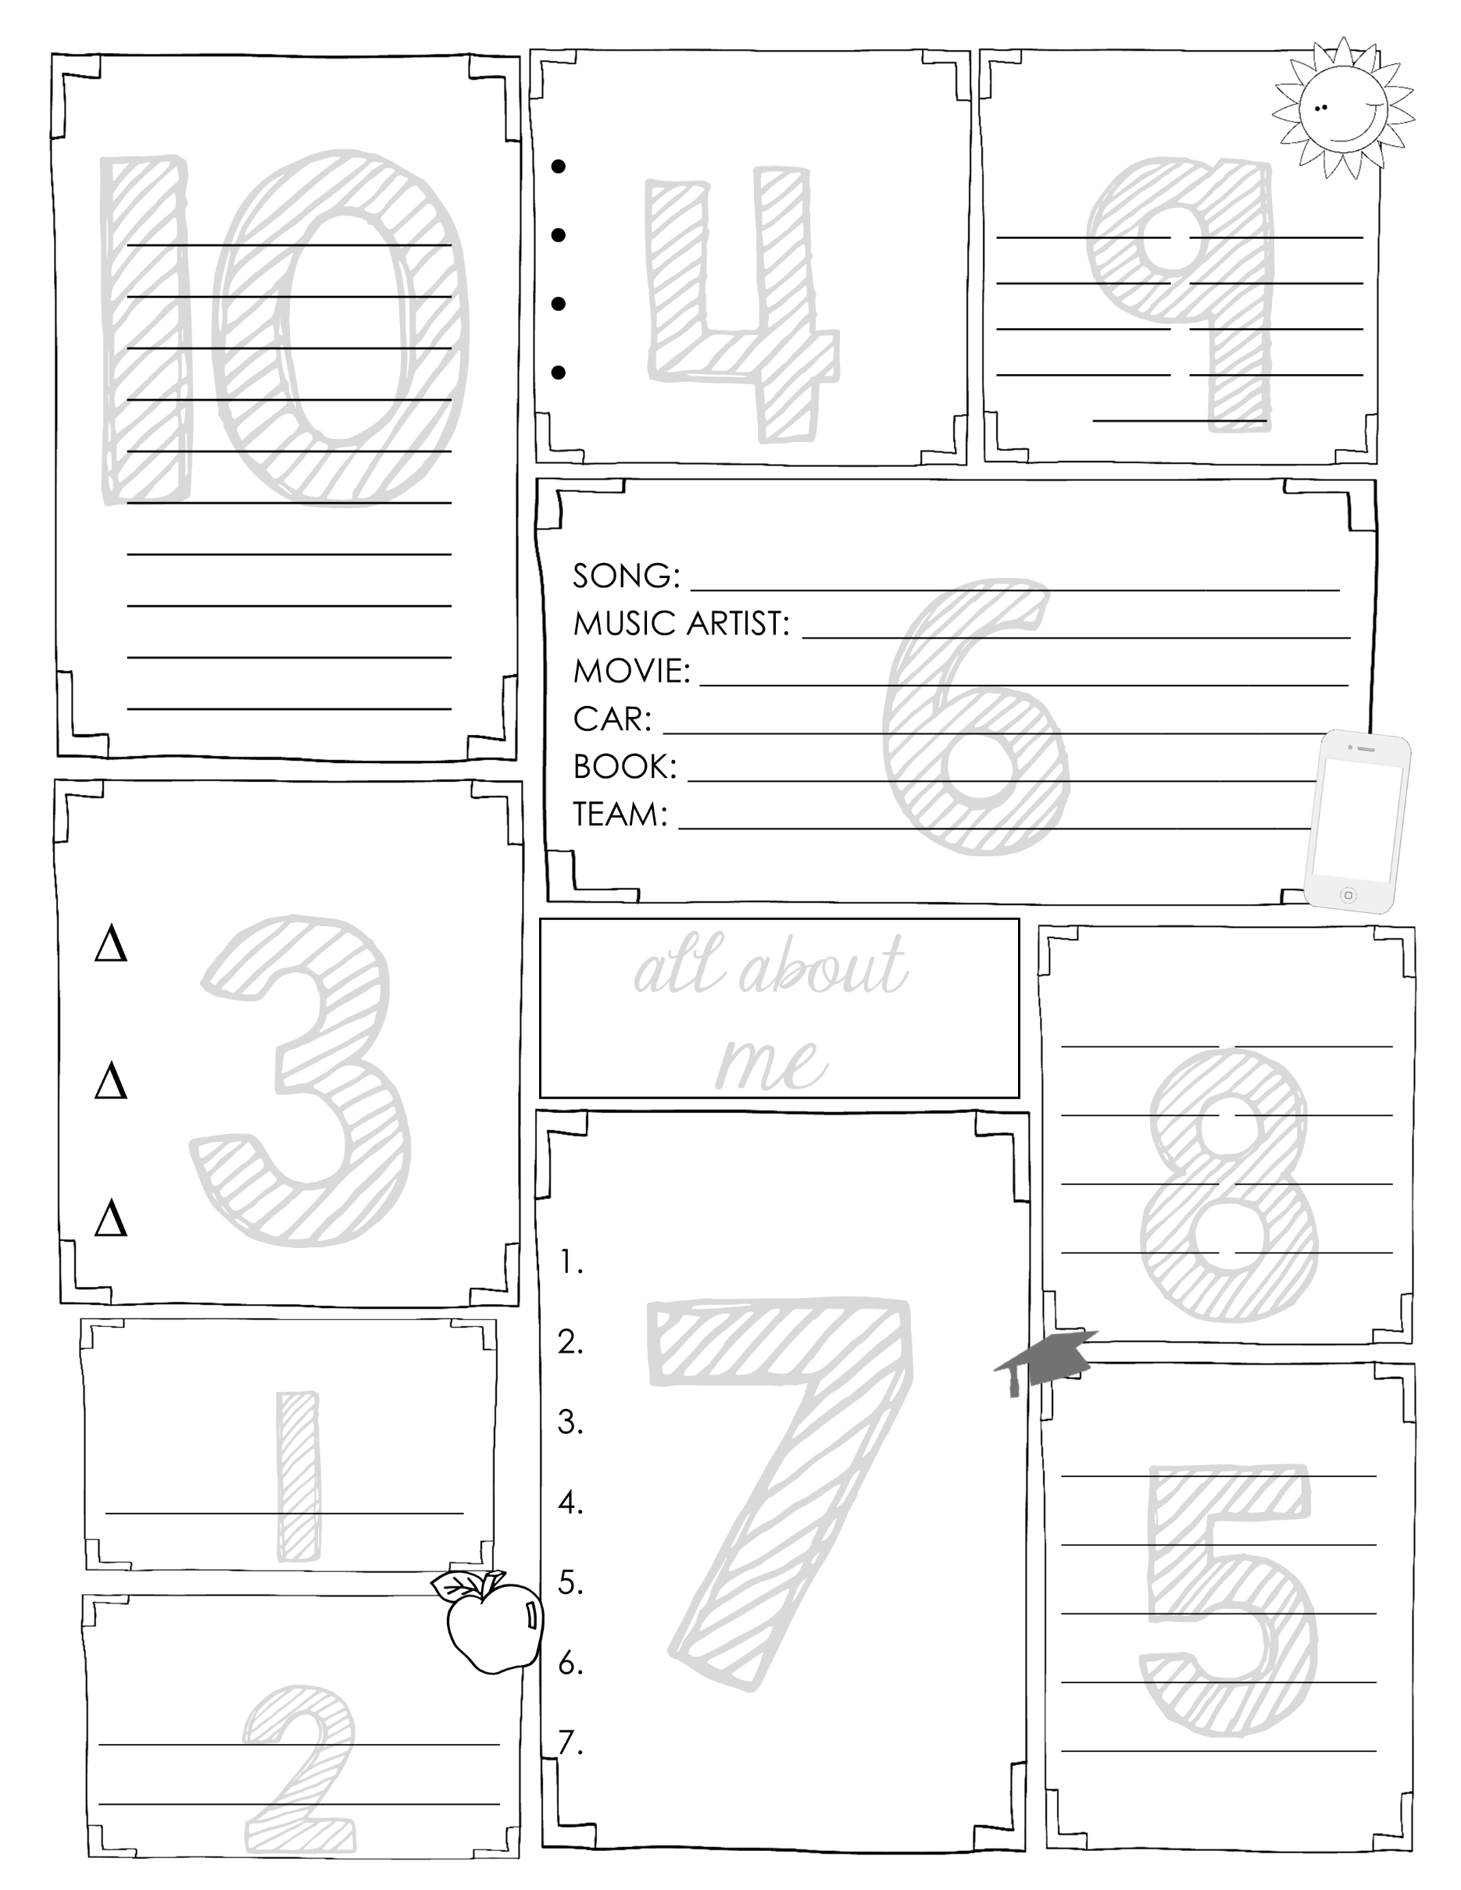
WORDS TO
DESCRIBE ME
THINGS I LIKE ABOUT SCHOOL
THINGS I LIKE TO
DO IN SUMMER
FAVOURITES
SCHOOL TARGETS FOR 2020 – 2021 SCHOOL YEAR
PEOPLE THAT MEAN
A LOT TO ME
THINGS I LEARNED
DURING LOCKDOWN
BEST FRIEND
LIFE GOALS
QUESTIONS FOR
TEACHER

