Slide 1
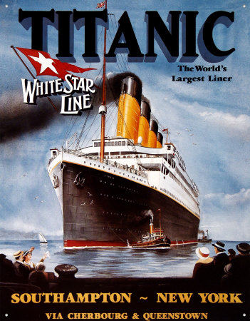
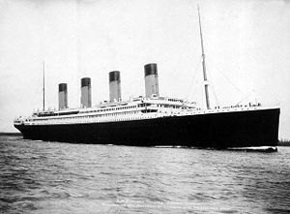
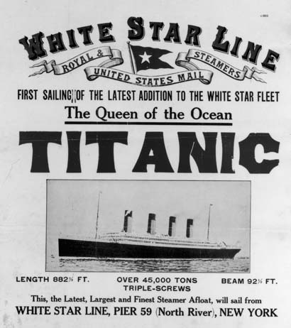
TITANIC
Learning Intention
To write an informative newspaper article following newspaper conventions.

Slide 2
Newspaper Article Conventions
How is the article laid out?
(what does it look like on the page?)
What are the language features of the newspaper article?
(tense, vocabulary choices etc.)
How is the article structured?
(what information is included and where?)

Slide 3
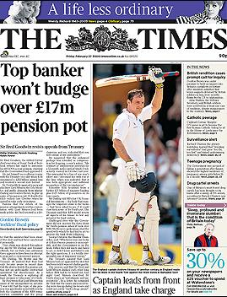
Newspaper Layout Conventions
Name of newspaper
Headline
Picture
Sub-heading
Picture caption
Main article in columns

Slide 4
Newspaper Language Conventions
Written in the third person
Range of tenses used
Use of connectives
Language will be formal
Sentences can be long and complex with use of commas to separate elements
Paragraphs – two or three sentences long
Use of emotive or eye-catching words in headlines
Captions use straight-forward language
Reporter often gives personal opinion
Use of direct quotation and reported speech

Slide 5
Newspaper Structure Conventions
Headline:
All stories have a headline, which gives the reader an idea of what the article is about. Tabloid headlines often use puns or other techniques, such as alliteration, to captivate their audience.
Introduction:
As the first paragraph in an article, the introduction is very important. Its contents tell the reader in more detail what the article is about. Research into how people reader newspapers shows that most people read the headline first, followed by the first paragraph of the story. If the introduction is not interesting then most people will to continue reading the article. The first paragraph is often known as a stand-first, printed in a bold font.
Elaboration:
The next few paragraphs tell the reader more about the story that is outlined in the introduction. They inform readers about the following key words: what, when, where, who, why, how.
Quotes:
Almost all news stories have comments from those involved or from voyeurs (onlookers). Their function is to make the article more objective by keeping a balanced viewpoint. Alternatively, they can make the article more subjective by sensationalising the reaction of the public and can indicate bias.
Projection:
Many stories tell the reader what might happen next in relation to the event or people in the report. This might include a comment from a police officer, an MP, a family member or a general prediction of consequences or outcomes.

Slide 6
Titanic Newspaper Headlines
Look at the following newspapers from 1912.
Imagine the public reaction to Titanic sinking – it was supposed to be ‘unsinkable’.
How are these newspapers different to newspapers you might see now?

Slide 7
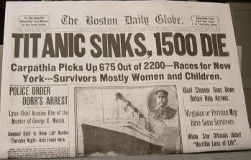

Slide 8
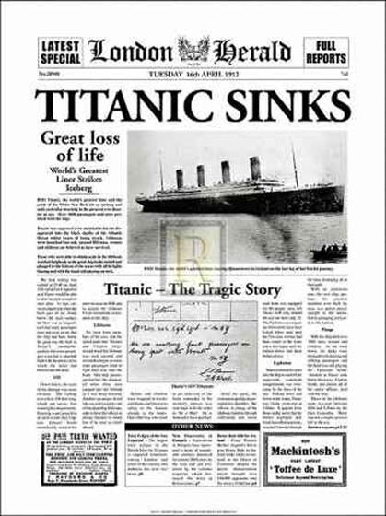

Slide 9
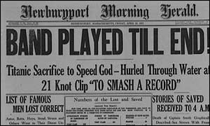

Slide 10
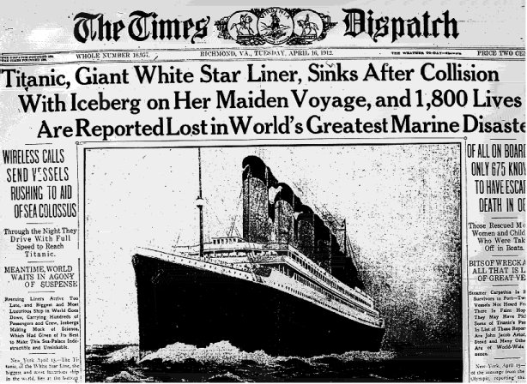

Slide 11
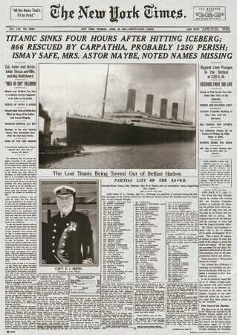

Slide 12
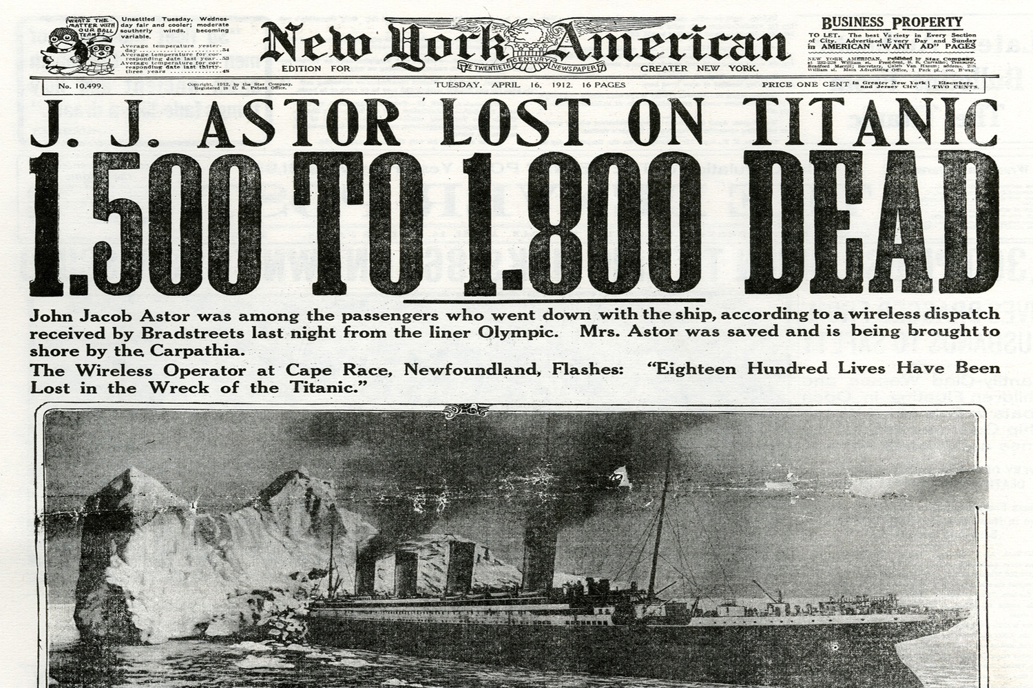

Slide 13
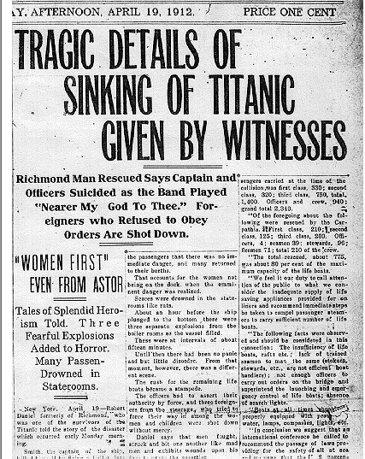

Slide 14
Newspaper Task
Your task is to write a newspaper article as if the Titanic has just sunk. Remember to follow the language, structure and layout conventions of newspaper articles.
Before you start read the following ‘real-life’ witness accounts of the Titanic sinking – you could use them as eyewitness quotes in your newspaper article...

Slide 15
First Class Passenger Account
‘At 10pm, my wife and I went out for a stroll along the promenade deck and it was ice
cold. We went to bed at around 11 and were awakened in the night by a bang
which seemed as though the ship had been hit on the side.
‘I went onto the deck to see what had happened and saw men in evening clothes chatting. I asked an officer what had happened and he told me that something was
wrong with the propeller, but that it was nothing serious.
I went back to my room and was just telling my wife not to bother getting dressed
to go outside, when a member of the crew knocked on my door. He whispered for us to get our life jackets and head outside, as the captain had asked for first class passengers to board the lifeboats.
‘No one wanted to get in the lifeboats because they felt they were safer on the “unsinkable” ship, and for that reason the boats went out half full to start with. As I helped my wife to board her boat I saw third class passengers armed with knives and clubs, fighting to get on the lifeboats. Unfortunately the officers had to shoot some of them to stop the lifeboats being swamped and drowned with people.
‘I will never forget their screams as I sat with my wife in the lifeboat, and how we wanted to go back for them as our boat had spaces, but could not risk them dragging us under with their weight. It is a decision that will haunt me forever.’

Slide 16
Newspaper Planning
Your task is to write a newspaper article as if the Titanic has just sunk. Remember to follow the language, structure and layout conventions of newspaper articles.
1. WHAT happened?
2. WHO was involved?
3. WHERE did it happen?
4. WHY did it happen?
5. HOW did it happen?
Don’t forget to plan your article first!
Use the questions here to help you!
an eyewitness account?
an expert opinion?
a brief summary of events?
historical background?
reaction from public figures?

Slide 17
Newspaper Writing
Your task is to write a newspaper article as if the Titanic has just sunk. Remember to follow the language, structure and layout conventions of newspaper articles.
Now you’ve planned your newspaper article you can start writing it!
Let’s start with the headline and subheading.
All stories have a headline, which gives the reader an idea of what the article is about. Tabloid headlines often use puns or other techniques, such as alliteration, to captivate their audience.
How could I improve this headline?
Ship Sinks!
Alliteration

Slide 18
Proof Read
Before you hand in your newspaper article remember to proof read your work!
Is it your best effort?
Does it follow newspaper conventions?
Have you checked the spelling and punctuation?
Did you remember paragraphs?
Have you missed out or misused a word?

