Slide 1
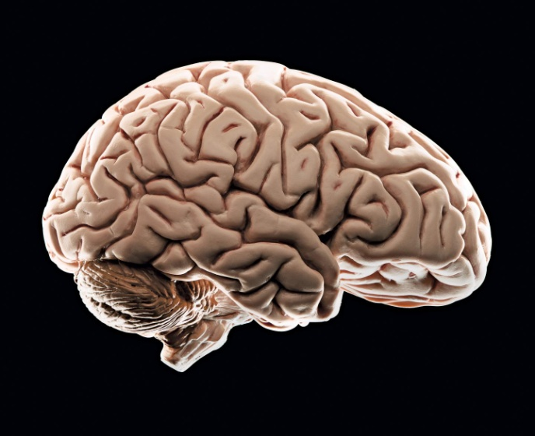
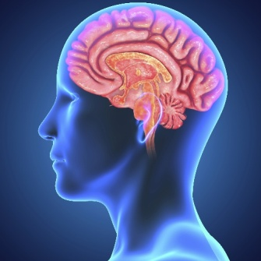
THE HUMAN BRAIN
L.I. To learn about the functions and parts of the brain.
I can listen to new information about the brain.
I can list the various activities the brain allows me to do.
I can create an information poster detailing facts on the parts and function of the human brain.

Slide 2
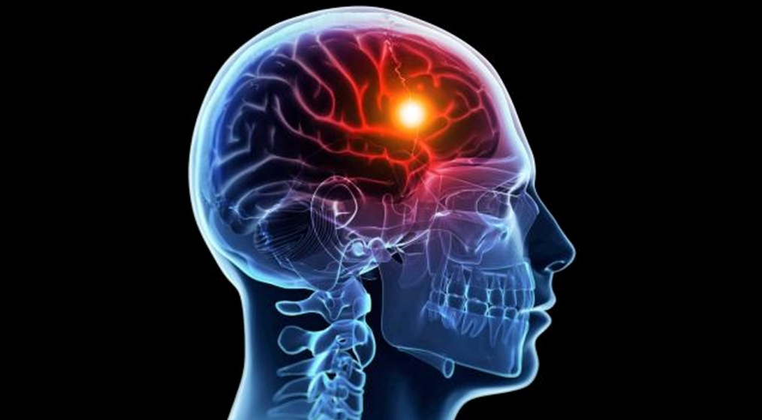
My brain lets me…
.
Think
Dream
Reason
Experience emotion
Speak
Problem-solve
Have memories
Learn

Slide 3
My brain controls…
My physical movement (when walking, talking, standing, balancing or sitting)
Information I receive from the world around me through my senses (seeing, hearing, smelling, tasting and touching)
My body temperature, blood pressure, heart rate and breathing

Slide 4
https://www.youtube.com/watch?v=Qw8E9WnZTQk https://www.youtube.com/watch?v=bLHutEdVEH4

Slide 5
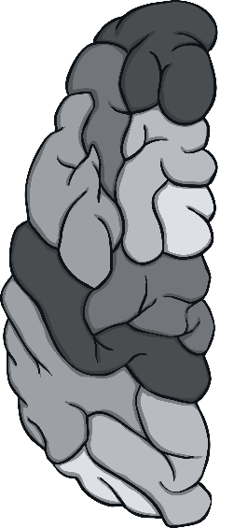
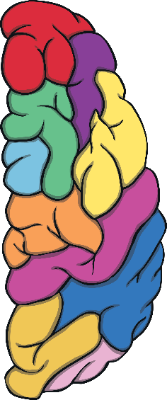
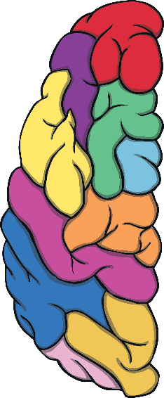
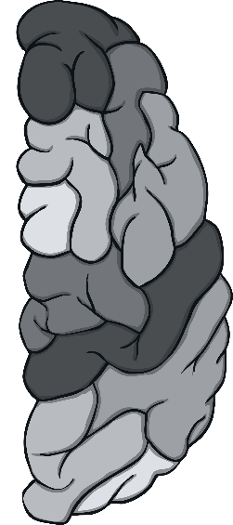
The Hemispheres
The left side of the brain
controls the right side of
the body.
The right side of the brain controls the left side of the body.
The left side of the brain
is also used for maths,
language, science and
problem-solving.
The right side of the brain is also responsible for creativity, the arts, music and imagination.

Slide 6
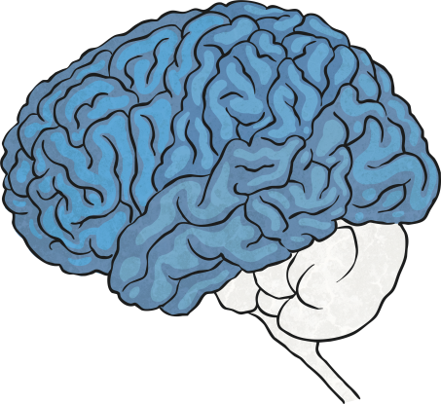
Three Main Areas
The cerebrum (the large front part of the brain) is responsible for the senses, thinking and memory.
The smaller and back part of the brain is called the cerebellum and is responsible for your movements and balance.
The brain stem is linked, by the spinal cord,
to the rest of the body. It is responsible for all
the unconscious activities, such as breathing.

Slide 7
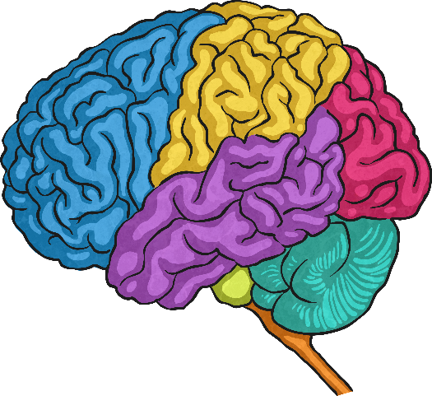
The Cerebrum Lobes
The cerebrum is split into different areas called ‘lobes’.
communication, memory and attention
helps to understand language
processes emotions
helps understand what our eyes see
Each of the different lobes perform
different functions.

Slide 8

The Language and Reading Area
There are a few different lobes that are involved in language and reading..
Language and reading
This is because there are so many different skills involved in both these things. Think how long it took you to learn to read and write!

Slide 9
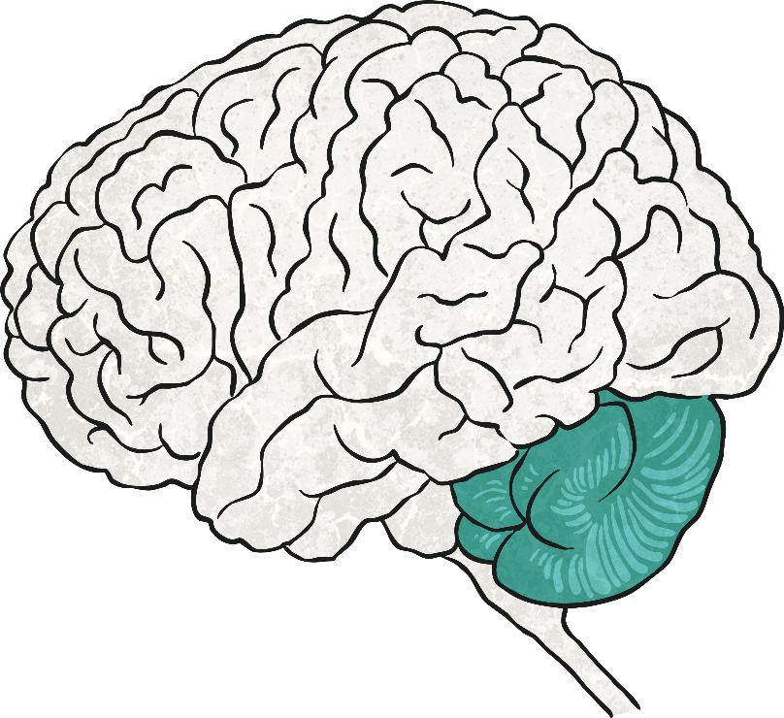
The Cerebellum
The cerebellum is the Latin word meaning ‘little brain’.
This part of the brain helps your motor skills (some movements) by controlling coordination, balance and timing.

Slide 10
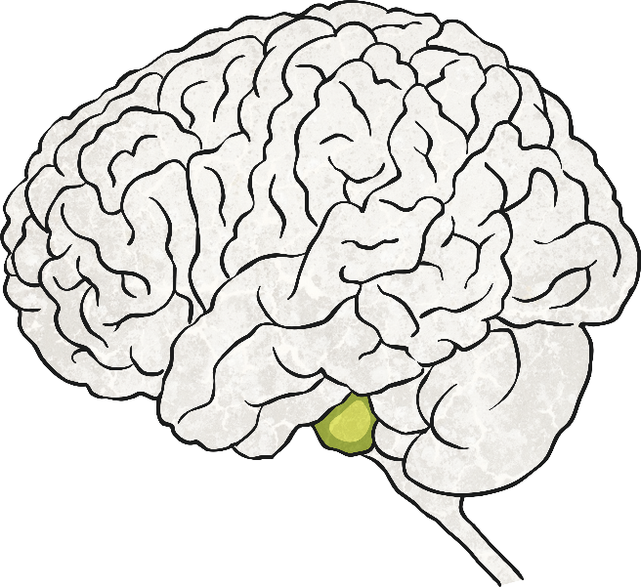
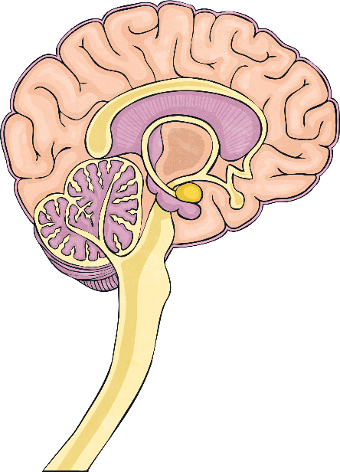
The Brain Stem
The brain stem is the central part of the brain (like the apple core) and goes to form the spinal cord.
It’s in charge of all the things you are not doing on purpose, such as breathing, your sleep cycle and circulating blood.
Click here to look inside

Slide 11
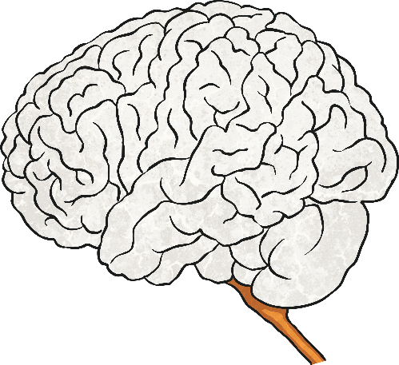
The Spinal Cord
The spinal cord is the information
superhighway of the nerves, connecting the brain to
the rest of the body.
It runs from the brain to the bottom of your spine
and is protected by the spinal column.
The brain and the spinal cord together form the central
nervous system.
The central nervous system receives all information from your skin and body on what is happening then produces the body’s responses.

Slide 12
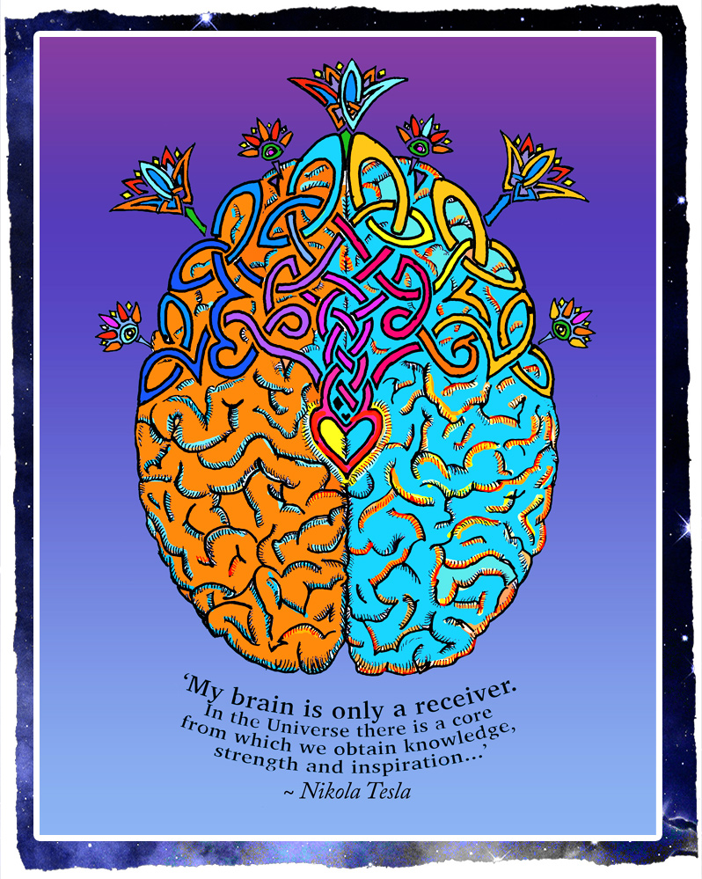
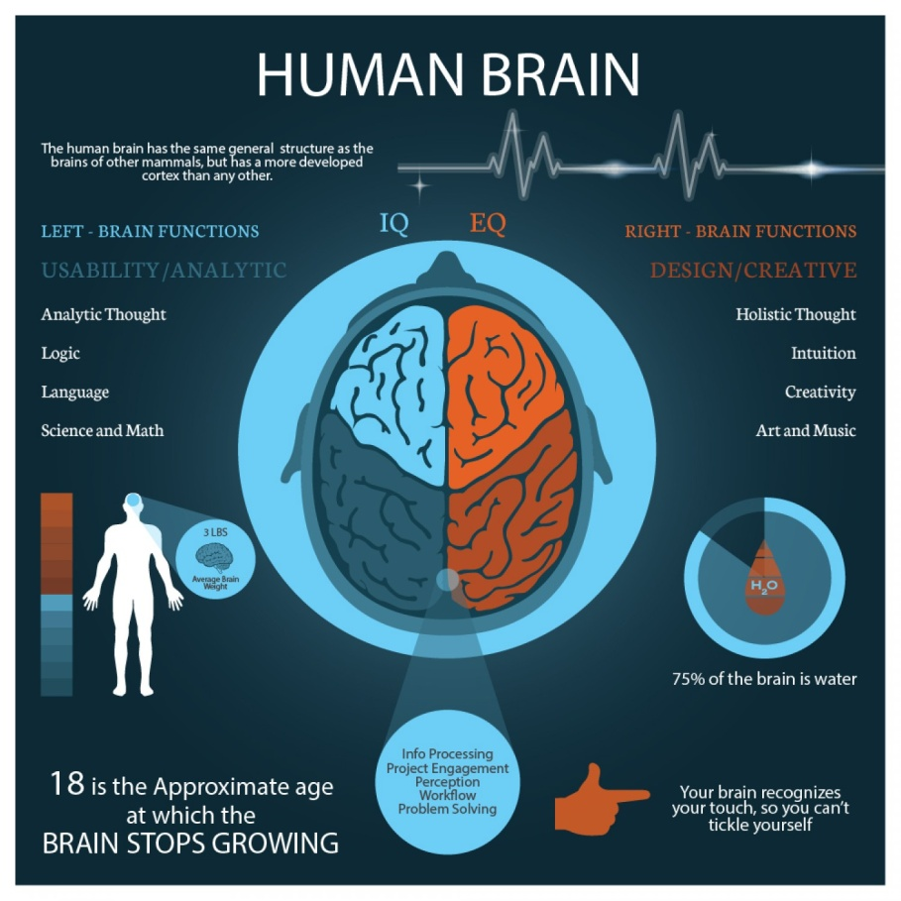
Information posters

