Slide 2
Aim
I can use a formula to calculate volume.
Success Criteria
I can use a formula to calculate the volume of cubes and cuboids.
I can identify whether or not I can use a formula to calculate the volume of a shape.

Slide 3




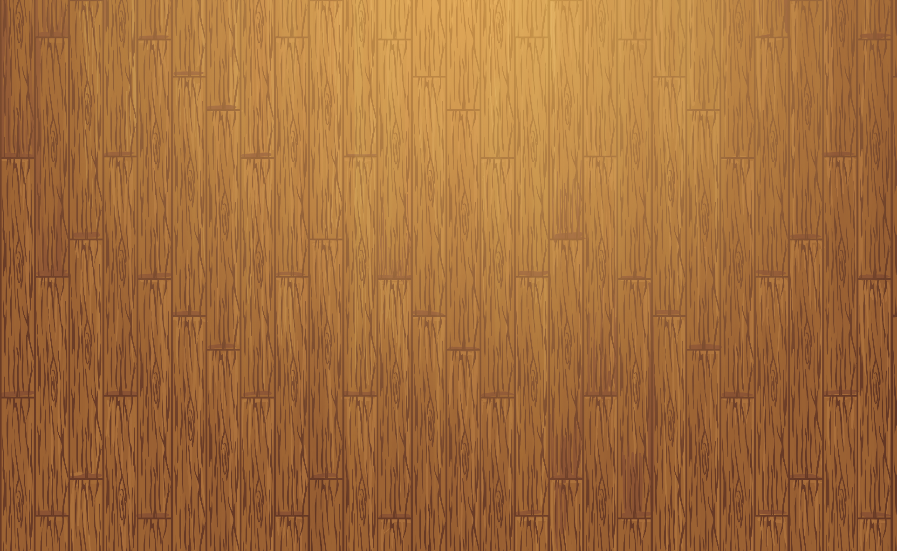

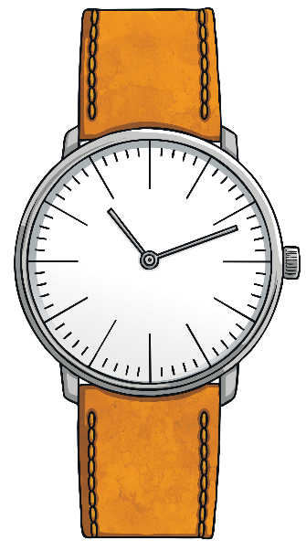

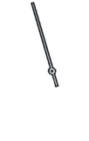
Quick Fire Multiplication
You will have 1 minute to complete as many multiplication facts as you can.
2 × 5 × 3 =
4 × 4 × 2 =
6 × 3 × 5 =
6 × 7 × 3 =
8 × 2 × 7 =
8 × 5 × 3 =
10 × 8 × 2 =
9 × 3 × 6 =
8 × 4 × 3 =
8 × 5 × 2 =
11 × 3 × 4 =
2 × 8 =
3 × 9 =
4 × 8 =
7 × 6 =
9 × 5 =
12 × 7 =
11 × 8 =
8 × 8 =
6 × 8 =
10 × 9 =
3 × 7 =
2 × 5 × 3 = 30
4 × 4 × 2 = 32
6 × 3 × 5 = 90
6 × 7 × 3 = 126
8 × 2 × 7 = 112
8 × 5 × 3 = 120
10 × 8 × 2 = 160
9 × 3 × 6 = 162
8 × 4 × 3 = 96
8 × 5 × 2 = 80
11 × 3 × 4 = 132
2 × 8 = 16
3 × 9 = 27
4 × 8 = 32
7 × 6 = 42
9 × 5 = 45
12 × 7 = 84
11 × 8 = 88
8 × 8 = 64
6 × 8 = 48
10 × 9 = 90
3 × 7 = 21
Go!

Slide 4



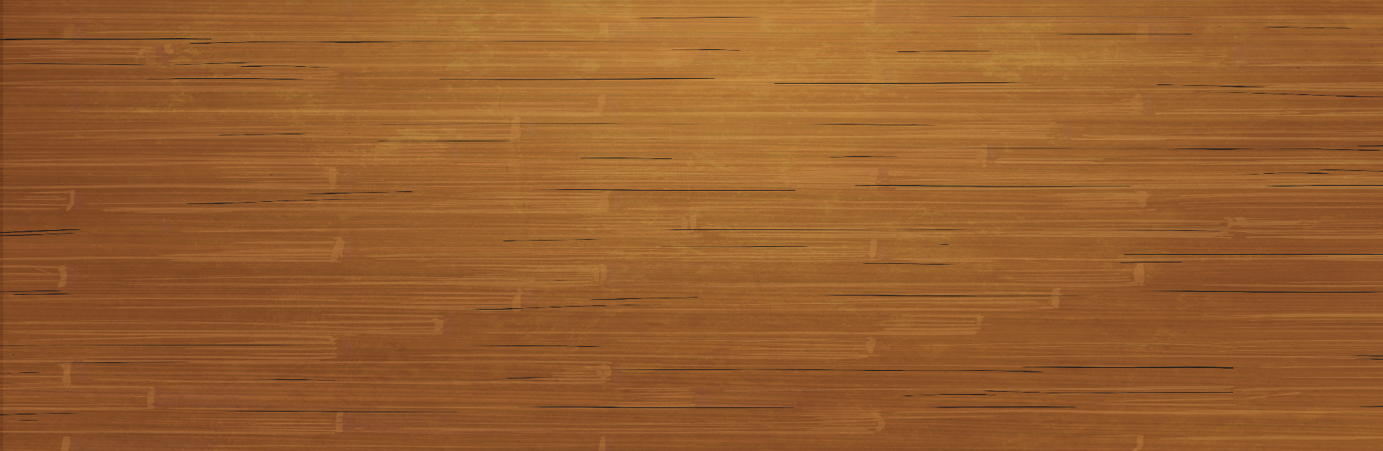

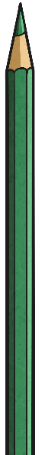
Volume of Cubes and Cuboids
To calculate the volume of a cube or cuboid, you could count the cubes in each layer.
Another way to look at this would be to multiply the length × breadth × height.
6
cubes
6 + 6 + 6 + 6 = 24 cubes
3 × 2 × 4 = 24 cubes
If each cube was 1cm³, the volume of this shape would be 24cm³.
If each cube was 1m³, the volume of this shape would be 24m³.

Slide 5
Volume of Cubes and Cuboids
To calculate the volume of a cube or cuboid, you could count the cubes in each layer.
In this cuboid:
l = 3
b = 2
h = 4
How could you write an algebraic statement to show how to calculate the volume of a cube or a cuboid?
Another way to look at this would be to multiply the length × breadth × height.
lbh
3 × 2 × 4 = 24 cubes
volume = 24cm³
If each cube was 1cm³, the volume of this shape would be 24cm³.
If each cube was 1m³, the volume of this shape would be 24m³.
volume = length × breadth × height
We do not use the multiplication symbol, so the formula would be written as:
v = lbh

Slide 6
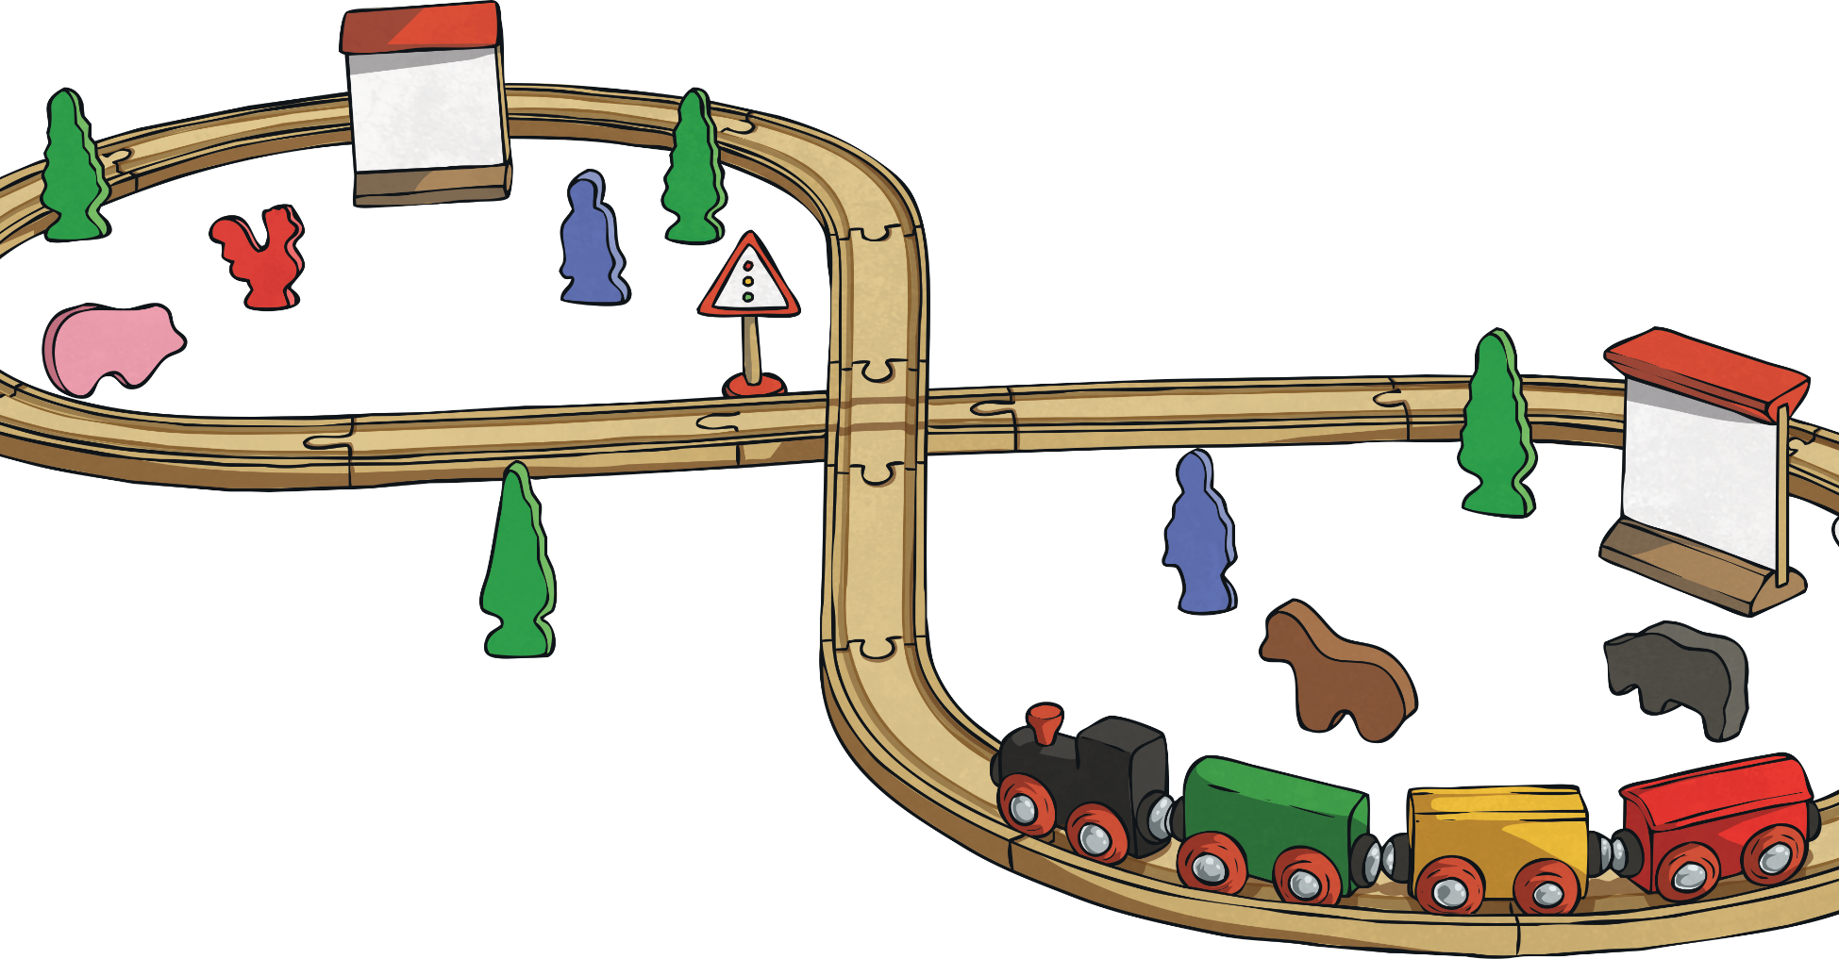
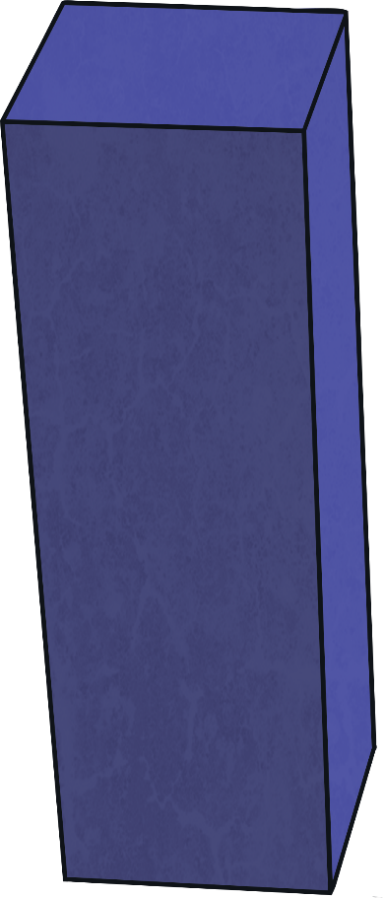
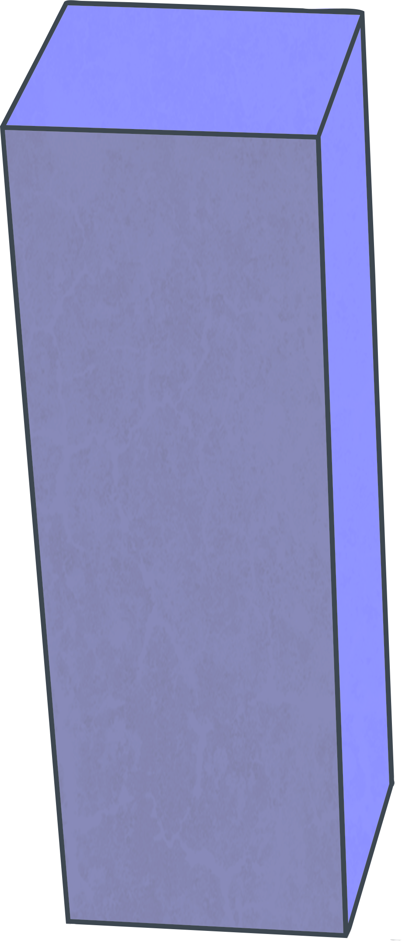
Volume of Cubes and Cuboids
v = lbh
Calculate the volume of these shapes. Use cm³ or m³ in your answer .
5m
5m
4m
5m
120m³
3cm
8m
3cm
200m³
6m
6cm
54cm³

Slide 7
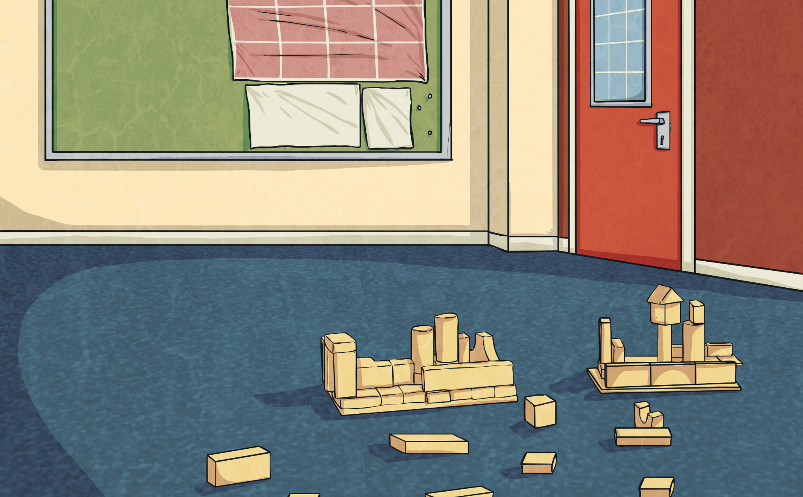
Volume of Cubes and Cuboids
Do these shapes have enough information for you to be able to use a formula to calculate the volume? If yes, use the information given and calculate the volume of the shapes.
Yes. Although only 2 dimensions are given, you can still work out the volume.
2m
2.5m
Area of face = 12.5m²
We know the breadth multiplied by the height is 12.5m² (bh), so we can multiply this by the length to find the volume.
12.5m × 2m = 25m³
Yes. The shape is a cube, so all
of the dimensions are the same.
8cm × 8cm × 8cm = 512cm³
v = lbh
8cm
No. This shape only has 2 measurements. To calculate the volume, you need the measurement of 3 dimensions.
9m
3m

Slide 8

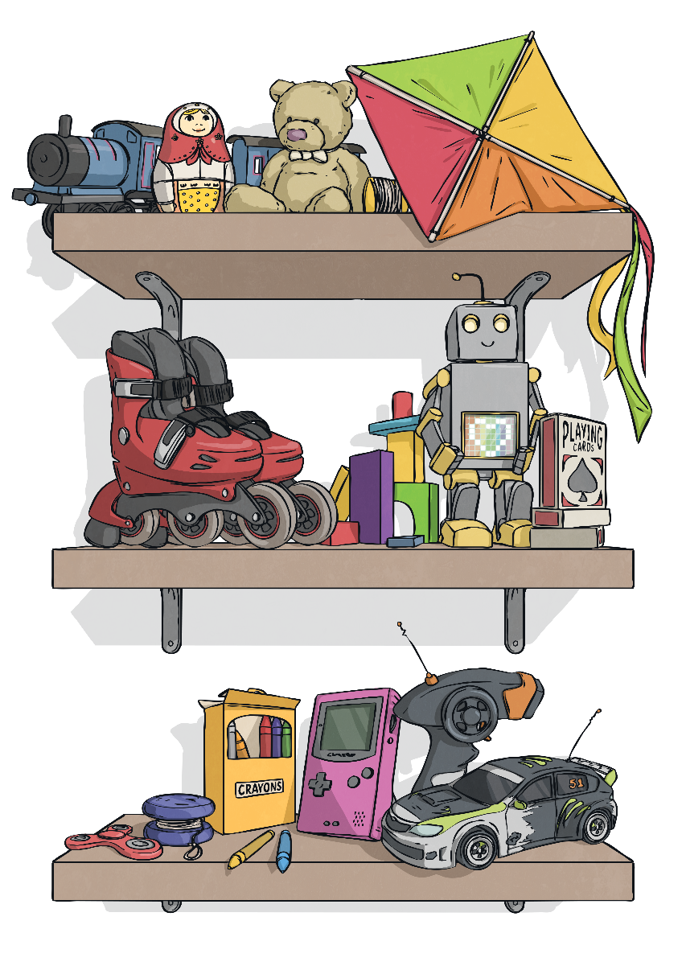
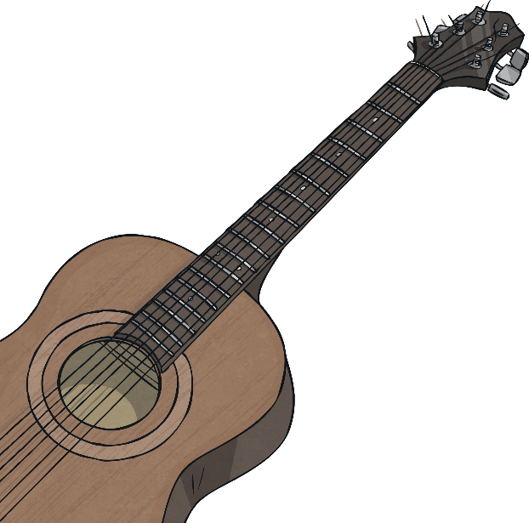
Volume of More Complex Shapes
4cm
How can you calculate the volume of this shape? One cube is equal to 1m³.
v = lbh
Calculate the volumes of these shapes:
The shape can be split into 2 separate shapes.
7cm
2
2
360cm³
2cm
The cuboid on the left has the dimensions
4m × 2m × 2m = 16m³.
9cm
10cm
4
The cube on the right has the dimensions
2m × 2m × 2m = 8m³.
6cm
7cm
99cm³
2cm
Add together the 2 volumes.
16m³ + 8m³ = 24m³
4
9cm
3cm

