Slide 2



Diving into Mastery Guidance for Educators
Each activity sheet is split into three sections, diving, deeper and deepest, which are represented by the following icons:
These carefully designed activities take your children through a learning journey, initially ensuring they are fluent with the key concept being taught; then applying this to a range of reasoning and problem-solving activities.
These sheets might not necessarily be used in a linear way. Some children might begin at the ‘Deeper’ section and in fact, others may ‘dive straight in’ to the ‘Deepest’ section if they have already mastered the skill and are applying this to show their depth of understanding.
Diving
Deeper
Deepest

Slide 3
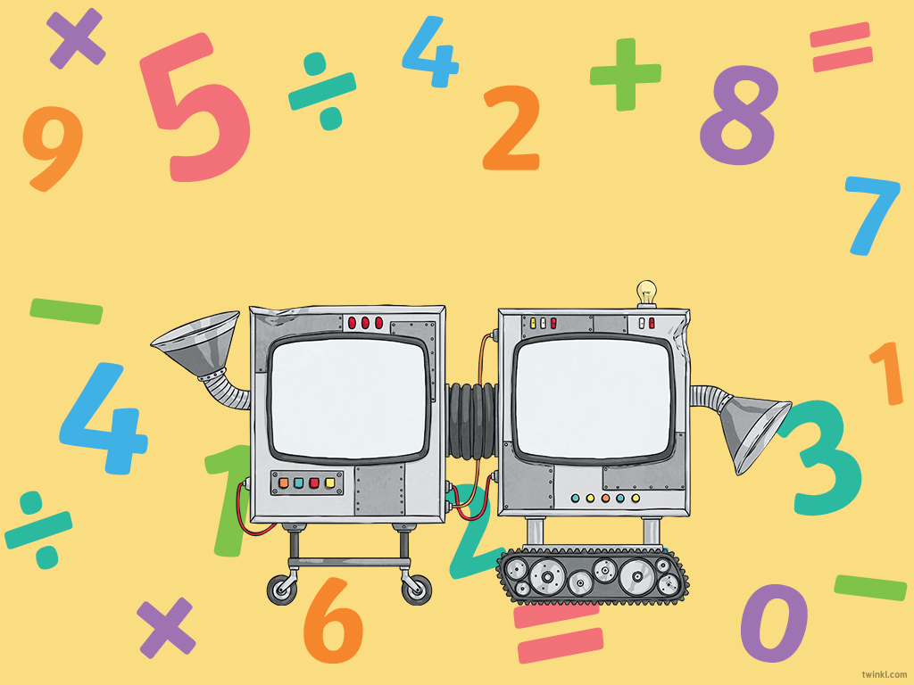
Aim
Use simple formulae.

Slide 4


Find a Rule – Two Step
Diving
This function machines has two steps.
Give the missing inputs and outputs for the machine.
Input
Function
Function
Output
5
9
80
700
12
50
2¼
14
30
314
2794
42
194
3
×4
−6

Slide 5




Find a Rule – Two Step
Deeper
Function
Function
Emily and Jamal are thinking how they could change this two-step function machine into a one step-function machine.
Input
×5
×2
Output
Do you agree or disagree with each child’s statement? Explain why.
Emily: I think that this function machine could be changed to a one-step machine if we add the ×5 and ×2 together to make one function of ×7. The output would still be the same.
Emily is incorrect, as when we multiply a number by 5, then multiply it by 2, this is not the same as multiplying by 7. For example, if the input was two, then 2 × 5 × 2 = 20, whereas 2 × 7 = 14.
Jamal: I think that this function machine could be changed to a one-step machine by having the function of ×10. It would then give the same answer as the two-step function machine.
Jamal is correct, as when we multiply by a number by 5, then multiply it by 2, this is the same as when we multiply by 10. For example, if the input was five, then 5 × 5 × 2 = 50 and 5 × 10 = 50.

Slide 6


Find a Rule – Two Step
Deepest
Give an input number, two functions and an output that follow the rules set by the function machine.
Input
Function
Function
Output
Any whole number up to 100
Make each number in three different ways.
× any multiple of 4
− any multiple of 6
6
18
30
For example:
3 × 4 – 6 = 6
3 × 12 – 30 = 6
3 × 18 – 48 = 6
3 × 12 – 18 = 18
18 × 4 – 54 = 18
6 × 12 – 54 = 18
9 × 4 – 6 = 30
18 × 4 – 42 = 30
6 × 12 – 42 = 30

Slide 7
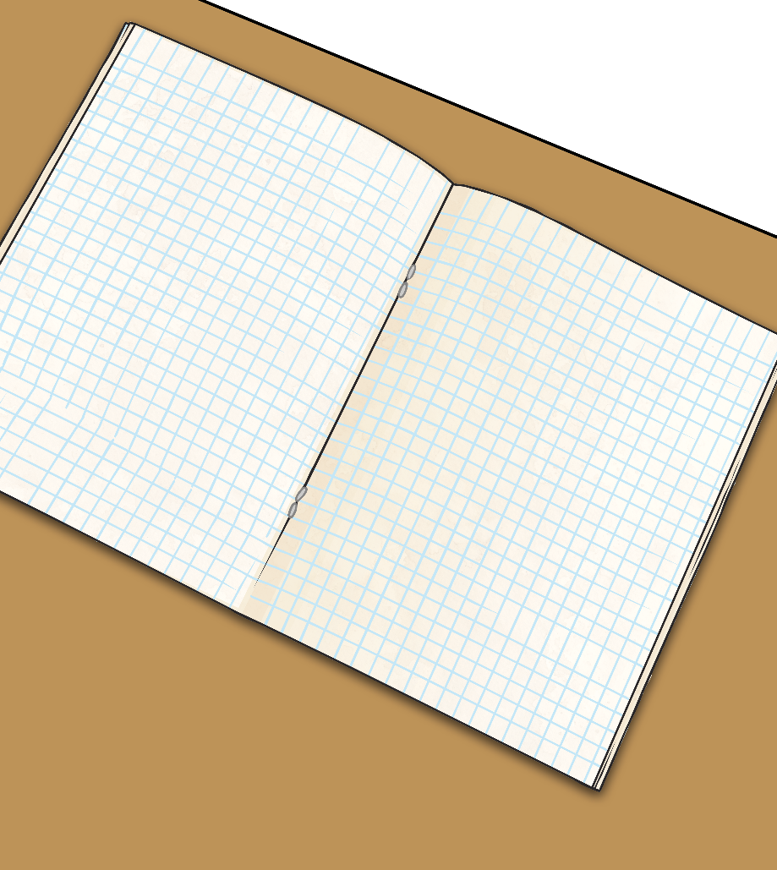

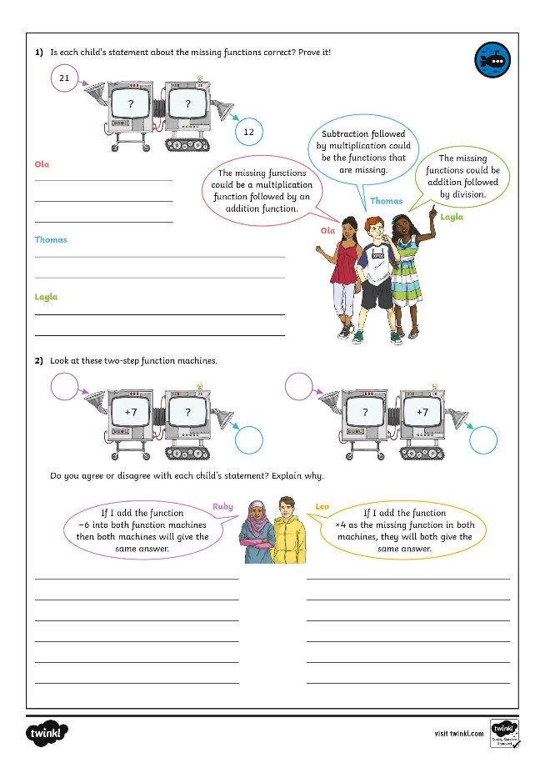
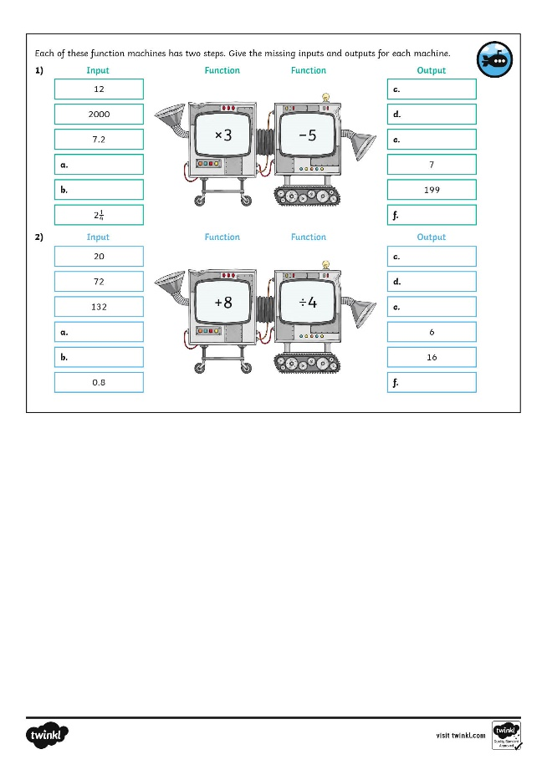
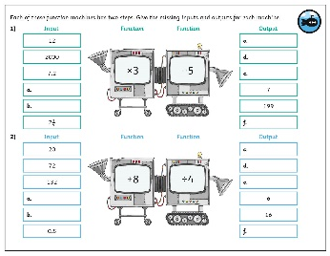
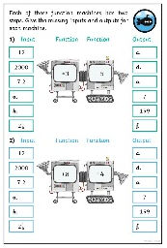
Find a Rule – Two Step
Dive in by completing your own activity!

Slide 8
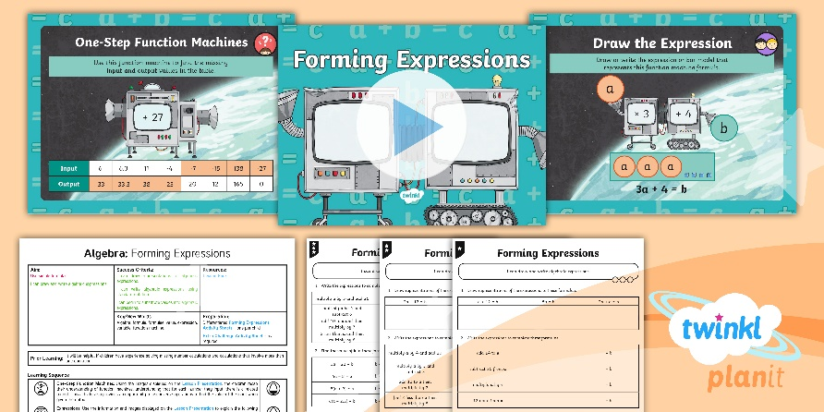
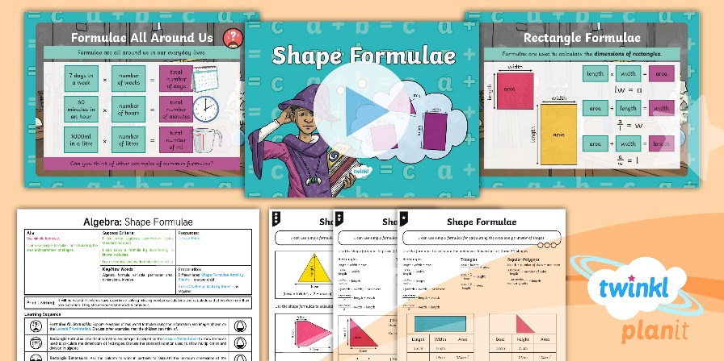

Need Planning to Complement this Resource?
National Curriculum Aim
Use simple formulae.
For more planning resources to support this aim, click here.
Twinkl PlanIt is our award-winning scheme of work with over 4000 resources.

