Slide 2
Formal Letter Elements
  Your address - Put your name and address in the top right corner.
  Date - Put today’s date under your address. Be sure to write out the month’s name, followed by the date, followed with a comma and the four-digit year.
  Recipient’s address - On the left side under the date, put the recipient’s name (with a formal title of Dr., Mr., Mrs., or Ms.) and the recipient’s address.
  Greeting - You may use “Dear”, or “To Whom It May Concern:” followed by the recipient’s name.
  Main body of letter - This is the actual letter with your words.
  Closing - You may close with “Sincerely,” “Yours sincerely,” or “Thankfully” followed with a comma. Then on the next line put your name.

Slide 3


Beginning Your Letter
If you don’t know who to address your letter to, then begin the letter with:
If you know the name of the person you are writing to, then begin the letter with Mr., Mrs., or Ms. along with their
last name:
Dear Sir or Madam,
Dear Mr. Smith

Slide 4
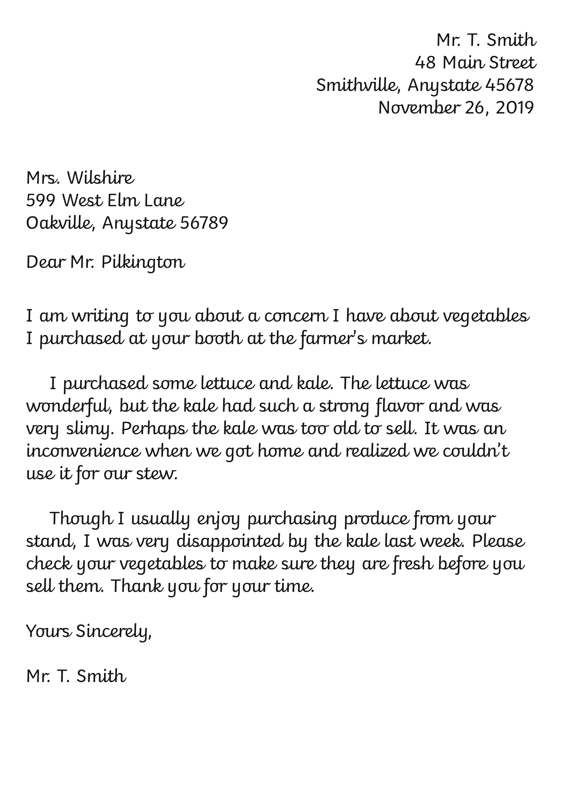

Layout
1
Your address
Click on the coloured numbers to learn more about the layout of a formal letter.
Date
2
Recipient's address
3
Greeting
4
Main body
5
Closing
6

