Slide 1
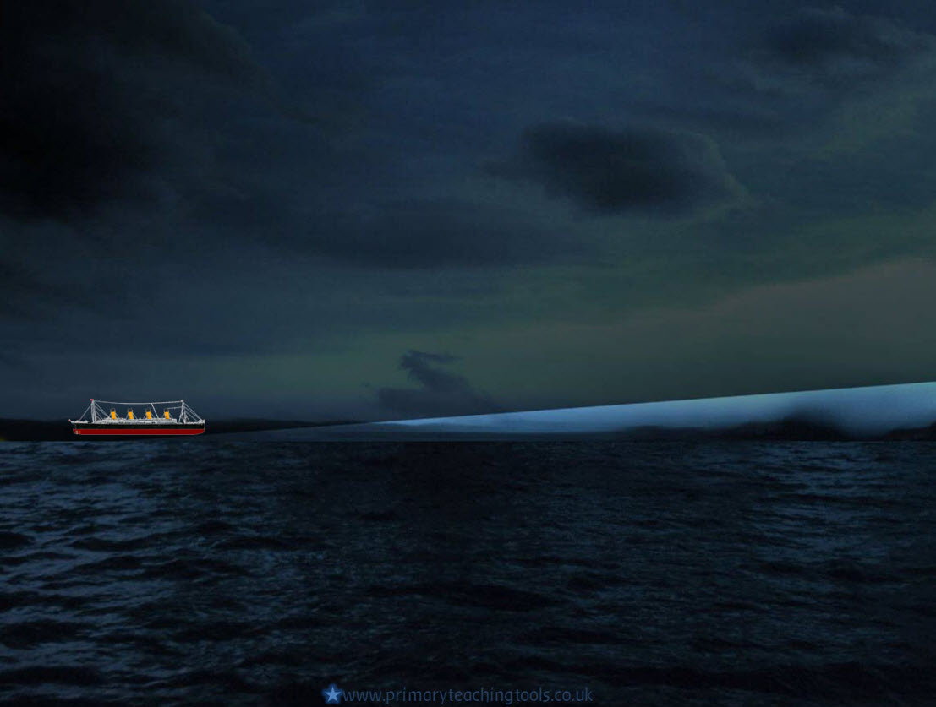
Timeline of the voyage

Slide 2
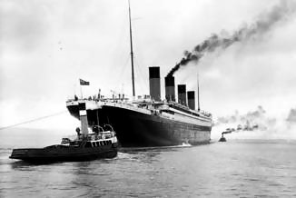
Setting sail
10th APRIL 1912 9:30am
Passengers arrive in Southampton and start boarding the Titanic.
10th APRIL 1912 Noon
The Titanic leaves Southampton, and begins her maiden voyage.
10th APRIL 1912 6:30pm
More passengers are picked up from Cherbourg in France
11th APRIL 1912 11:30am
More passengers are picked up from Queenstown, Ireland

Slide 3
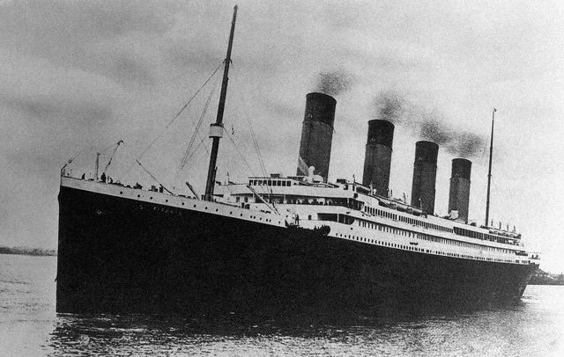
Crossing the Atlantic
12th – 13th APRIL 1912
Titanic sails through calm waters. Experienced travellers comment on how smooth the Titanic was, and how much more comfortable it was than any other boat they had been on.
Sunday 14th APRIL 1912
The Titanic receives several messages from other ships about icebergs in the area.
Captain Edward Smith changes Titanic’s course to try to avoid the ice.

Slide 4
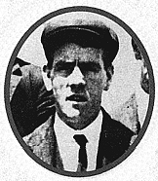
Sunday 14th April
11:40
The lookout, Fred Fleet notices an iceberg in Titanic’s path. He sounds the warning bell and telephones the bridge saying: “Iceberg right ahead!” The iceberg is 18 metres high above the sea. First Officer William Murdoch orders the engine room to stop the engines, and calls “Hard-a-starboard” to the helmsman.
The Lookout - Fred Fleet

Slide 5
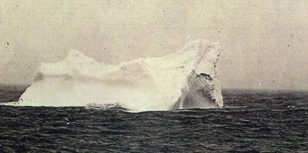
Sunday 14th April
11:41
The warning comes too late. The iceberg was only 600 metres away, and it is too late for Titanic to turn and avoid it. She hits the iceberg. Some people feel and hear the impact.
A photograph of the iceberg that the Titanic probably hit.
11:50
Five watertight compartments begin to fill with water. Titanic was built to survive only four compartments full of water. Captain Smith, who was off duty, wakes up with the impact of the iceberg.
He should have ordered a full evacuation of the Titanic, but didn’t.

Slide 6
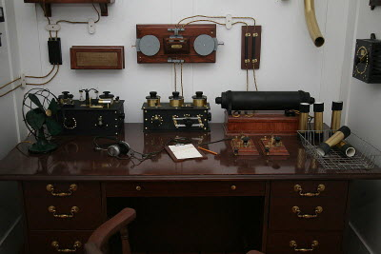
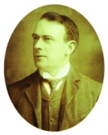
Monday 15th April
12:00
Harold Bride and Jack Phillips worked in a room like this on the Titanic. Their job was to send and receive messages by Morse code.
Titanic sends out distress calls to other ships in the area.
Picture by Cliff1066, flickr, Creative Commons licence
12:05
Thomas Andrews, the ship’s designer advises Captain Smith that the ship can only stay afloat for two hours.
Orders are given to uncover the lifeboats and get the passengers and crew ready on deck.
12:15
Many ships receive the Titanic’s distress signals and prepare to come to help her.
Thomas Andrews

Slide 7
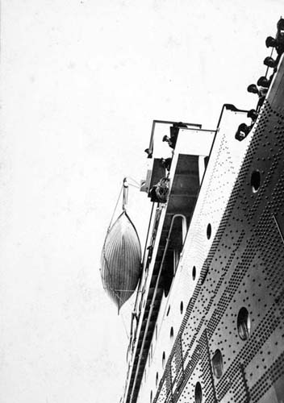
Monday 15th April
12:25
The lifeboats start to be filled, with women and children first.
12:45
The first lifeboat is lowered into the sea. It leaves with only 28 people, and 37 empty seats. This may have been because the crew thought there were ships in the area coming to rescue them, so that the boats could return and pick up more passengers.

Slide 8
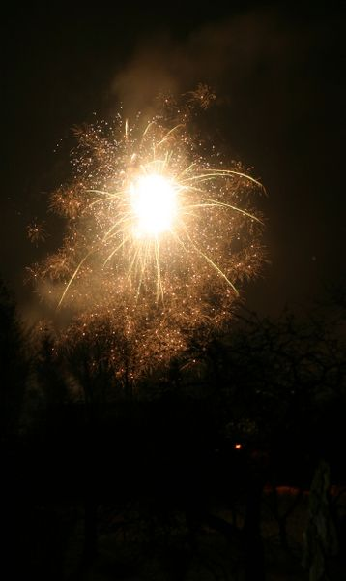
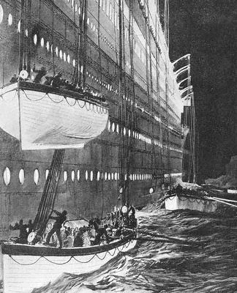
Monday 15th April
12:00
Rockets are fired to alert other ships to the danger the Titanic was in.
1:15
Water reaches the Titanic’s name on the bow. The ship is starting to sink. The passengers, who had earlier been calm, are starting to panic. No rescue ship has yet appeared.
2:05
The last of the lifeboats is lowered into the sea. There are 1,500 people left on board the sinking ship. The Titanic’s decks are tilting. The lifeboats frantically row away from the Titanic, thinking that she might take them down with her.

Slide 9
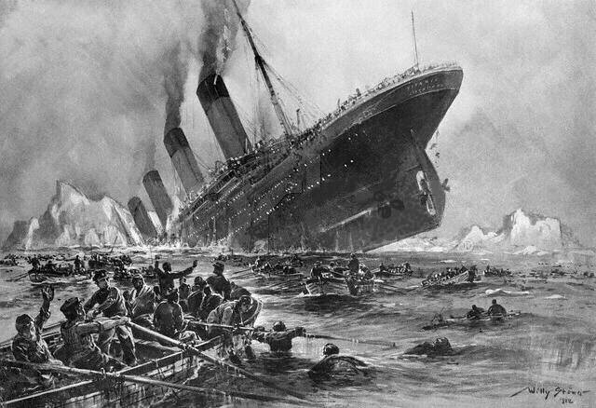
Monday 15th April
2:18
Crashing noises are heard coming from the Titanic.
The lights on the ship blink, and then go out.
The ship breaks into two, and the bow sinks
2:20
The stern settles back in the water, and becomes level for a moment, until it fills with water and sinks. All the people on board are thrust into the icy Atlantic ocean.
Screams can be heard by the people in the lifeboats. Slowly it becomes quiet, as the people in the icy water freeze to death. The lifeboats dare not row over to the people in the water in case they are swamped by the people in the sea, causing the lifeboats to sink.

Slide 10
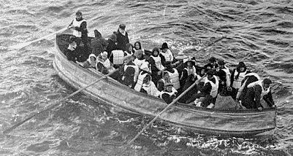
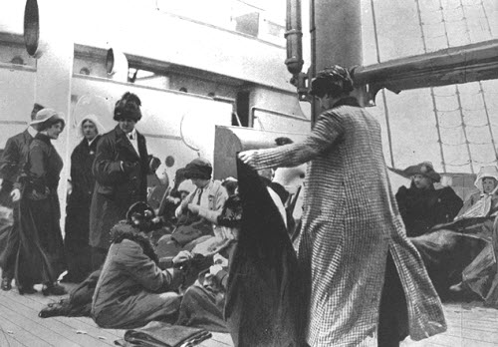
Monday 15th April
2:20 – 4:00
The people in the lifeboats wait to be rescued. It is very cold and very dark.
4:05
The rescue ship, the Carpathia arrives. She picks up all the survivors.

Slide 11
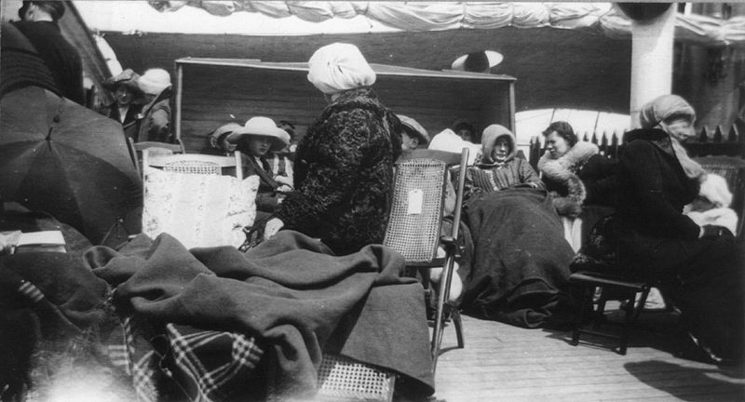
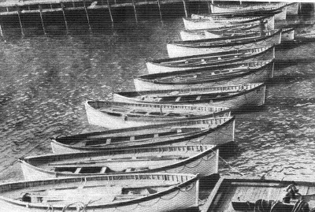
Monday 15th April
8:50
The Carpathia leaves, taking 705 survivors to New York.
All that remains of the Titanic are its lifeboats.

Slide 12
Online links
BBC – Survivors of the Titanic tell their stories
All acknowledged images used published under a Creative Commons Licence
All other images in the Public Domain

