Slide 1
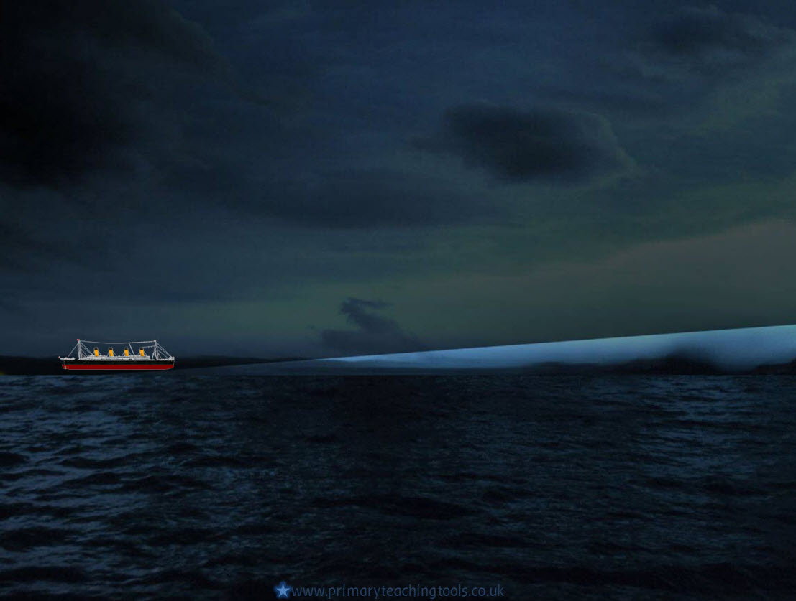
Timeline of the voyage

Slide 2
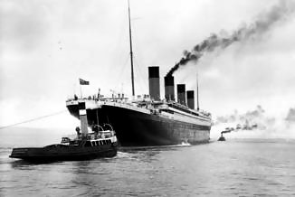
Setting sail
10th APRIL 1912 9:30am
Passengers arrive in Southampton and start boarding the Titanic.
10th APRIL 1912 Noon
The Titanic leaves Southampton, and begins her maiden voyage.
10th APRIL 1912 6:30pm
More passengers are picked up from Cherbourg in France
11th APRIL 1912 11:30am
More passengers are picked up from Queenstown, Ireland

Slide 3
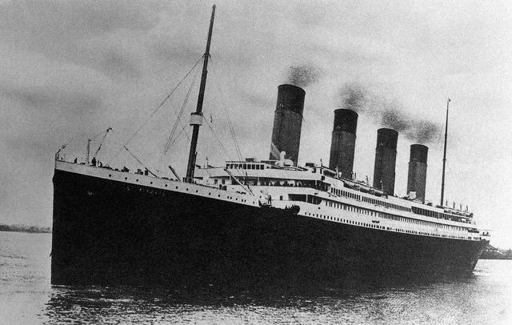
Crossing the Atlantic
12th – 13th APRIL 1912
Titanic sails through calm waters. Experienced travellers comment on how smooth the Titanic was, and how much more comfortable it was than any other boat they had been on.
Sunday 14th APRIL 1912
The Titanic receives several messages from other ships about icebergs in the area.
Captain Edward Smith changes Titanic’s course to try to avoid the ice.

Slide 4
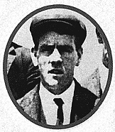
Sunday 14th April
11:40
The lookout, Fred Fleet notices an iceberg in Titanic’s path. He sounds the warning bell and telephones the bridge saying: “Iceberg right ahead!” The iceberg is 18 metres high above the sea. First Officer William Murdoch orders the engine room to stop the engines, and calls “Hard-a-starboard” to the helmsman.
The Lookout - Fred Fleet

Slide 5
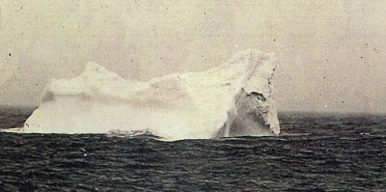
Sunday 14th April
11:41
The warning comes too late. The iceberg was only 600 metres away, and it is too late for Titanic to turn and avoid it. She hits the iceberg. Some people feel and hear the impact.
A photograph of the iceberg that the Titanic probably hit.
11:50
Five watertight compartments begin to fill with water. Titanic was built to survive only four compartments full of water. Captain Smith, who was off duty, wakes up with the impact of the iceberg.
He should have ordered a full evacuation of the Titanic, but didn’t.

