Slide 1
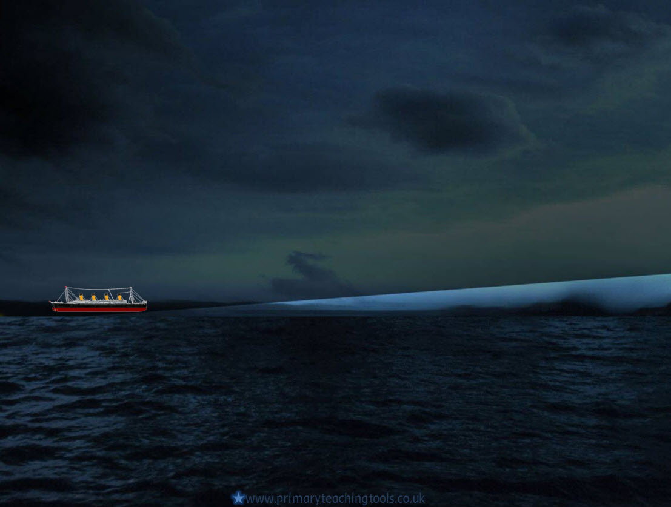
On board the Titanic

Slide 2
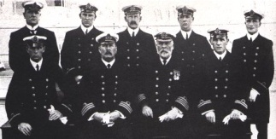
The Officers
BACK ROW left to right:
Chief purser Herbert McElroy, 2nd Officer Charles Lightoller, 3rd Officer Herbert Pitman, 4th Officer Joseph Boxhall, 5th Officer Harold Lowe
FRONT ROW left to right:
6th Officer James Moody, Chief Officer Henry Wilde, Captain Edward Smith, 1st Officer William Murdoch

Slide 3
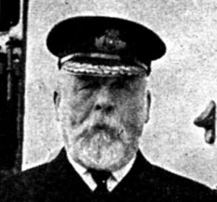
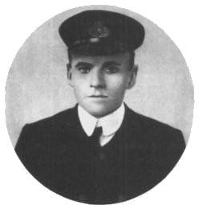
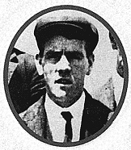
Captain Edward John Smith - the Titanic’s maiden voyage was to be Captain Smith’s last trip before he retired. He went down with his ship.
Second Officer Lightoller.
Lookout Fred Fleet.
The crew consisted of stewards, cooks, cleaners, waiters, etc.; 320 engineers, and 65 engaged in navigation – altogether there were 913 crew members.

Slide 4
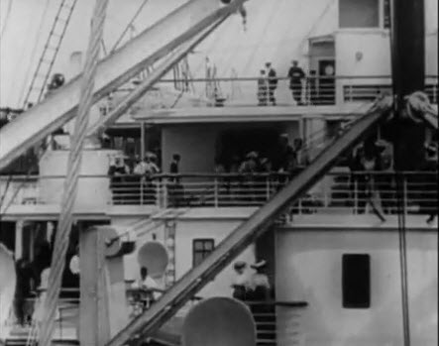
Passengers
The Titanic could carry more than three thousand people on board, but for its maiden voyage, 2,229 people were on the ship.
First Class: 325
Second Class : 285
Third Class : 706
Crew : 913
(* These numbers may not be exact, as there are conflicting reports of numbers of survivors and passenger numbers)
The different classes did not mix on the ship – the First Class passengers were on the top decks; the Second Class on the middle decks; the Third Class further down.

Slide 5
Passengers
White Star realised that they could make a lot of money from Third Class passengers. (Third Class was also known as ‘Steerage’.)
Other ships at the time did not provide comfortable living quarters for Third Class passengers, but by providing comfortable accommodation on the Titanic, White Star believed that it would be recommended to friends and family who would join those who had already emigrated.

Slide 6
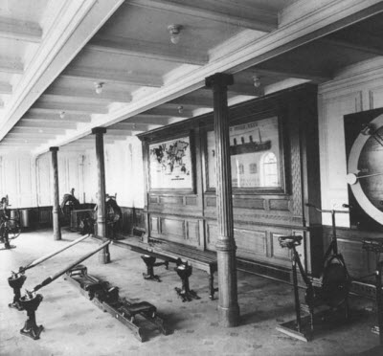
First Class
First Class passengers could swim in the pool, work out in the gymnasium, play squash, have a Turkish bath, or tan themselves on sunbeds.
Rooms for First Class passengers were decorated with wood panelling and expensive furniture.
There were also libraries, French cafés, hairdressers and barbers.
First Class luxury came at a high cost – the top price of a First Class ticket for a parlour suite was £875, which would be more like £64,000 today! A smaller First Class berth cost £30 - £2,200 today.
There were 325 First Class passengers on the Titanic – 200 of them survived.

Slide 7
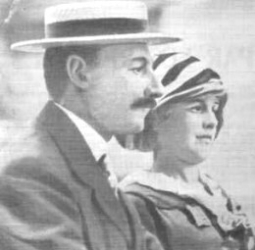
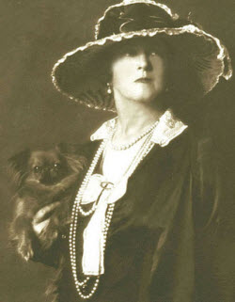
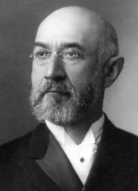
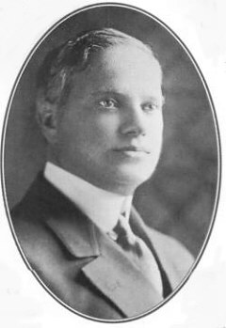
First Class Passengers
Some important people of the time were travelling in First Class.
John Jacob Astor IV and his wife.
Astor was an American millionaire businessman. They were travelling back home to America with their dog Kitty, and maid Rosalie Bidois.
Lady Duff Gordon was a famous fashion designer, and designed clothes for the royal family.
Isidor Straus was the owner of Macy’s; a well-known department store in America.
Benjamin Guggenheim was an American businessman who was travelling back to America with several servants.

Slide 8
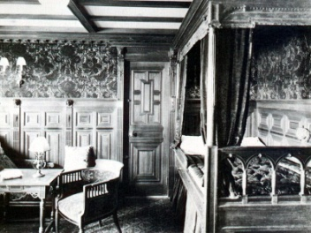
First Class Stateroom
First Class cabins were very luxurious. First Class passengers could choose from a cabin, a suite, or a stateroom.

Slide 9
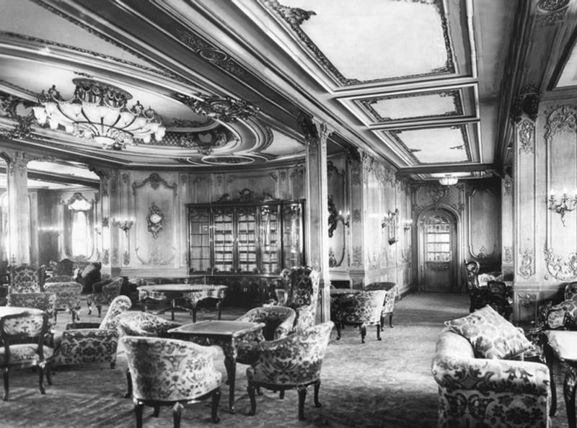
First Class Lounge
Afternoon tea was served in the First Class Lounge, and passengers could relax in front of the marble fireplace, or sit by the bay windows, looking out at the sea view.

Slide 10
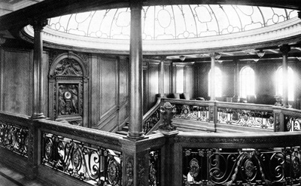
The Grand Staircase
This is a picture of the Grand Staircase, with a crystal dome and clock. The staircase ran from the Boat Deck, to the spa complex on F Deck.
Behind the staircase were the First Class lifts, with lift attendants and sofas.

Slide 11
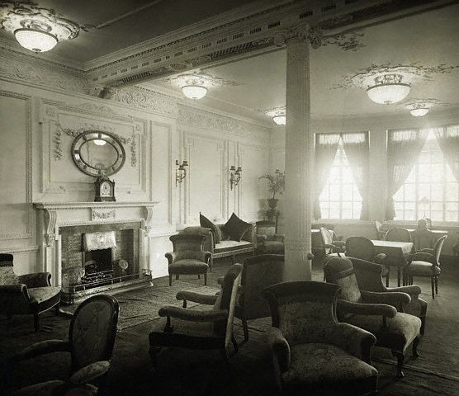
The Reading and Writing room
The Reading and Writing room was for the Titanic’s rich female passengers. They would spend time writing letters home, or reading.

Slide 12
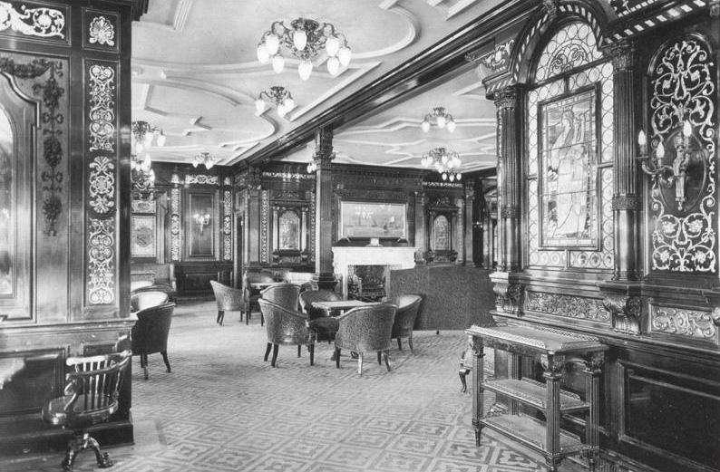
The Smoking Room
The Smoking room had stained glass windows and mahogany walls. It was a room for gentlemen only, and here they would play cards, drink brandy, and talk about politics or business affairs.

Slide 13
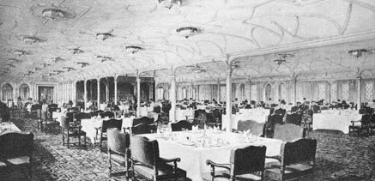
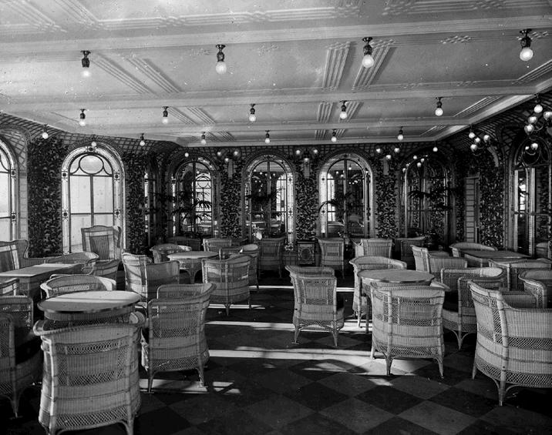
First Class Dining
Dinner was served each evening at 7:00pm. The First Class passengers were served ten course meals.
First Class passengers could also eat at the Veranda Café, where they could order whatever they wanted from the menu.

Slide 14
First Class Menu
First Class - April 14, 1912
Hors Doeuvre
Varies
Oysters
Consommé Olga
Cream of Barley
Salmon, Mousseline Sauce, Cucumber
Filet Mignons Lili
Sauté of Chicken, Lyonnais
Vegetable Marrow Farcie
Lamb, Mint Sauce
Roast Duckling, Apple Sauce
Sirloin of Beef, Chateau Potatoes
Green Peas - - Creamed Carrots
Boiled Rice
Parmentier & Boiled New Potatoes
Punch Romaine
Roast Squab & Cress
Cold Asparagus Vinaigrette
Pate De Foie Gras
Celery
Waldorf Pudding
Peaches in Chartreuse Jelly
Chocolate & Vanilla Éclairs
French Ice Cream

Slide 15
The Gymnasium
Inside the gymnasium was a gym instructor, who helped the First Class passengers to exercise.

Slide 16
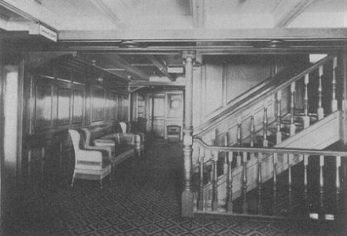
Second Class
Second Class passengers on the Titanic would be as comfortable as First Class passengers on any other ship.
There was room for 564 Second Class passengers on board.
There was a library and bars and an open deck so the Second Class passengers could walk around and look at the Atlantic ocean.
Second Class fares were much cheaper than First Class – a ticket would cost around £13, which would be around £950 today.
There were 285 Second Class passengers on board the Titanic; 118 of them survived.

Slide 17
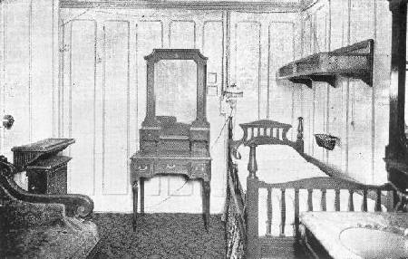
Second Class
Second Class cabins were not as luxurious as the First Class rooms – they were very similar to Third Class cabins. They would contain bunk beds, unless it was a single room such as the one above, and sinks and mirrors.

Slide 18
Second Class staircase
Although the Second Class staircase on the Titanic was not as grand as the Grand Staircase, it was still well made from mahogany. There was also a lift for the Second Class passengers.

Slide 19
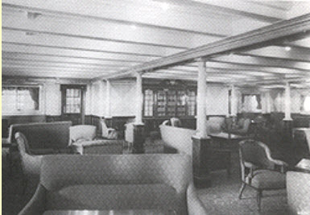
Second Class Library
The Second Class library was for both men and women. Tea or coffee would be served here to passengers in the afternoons.

Slide 20
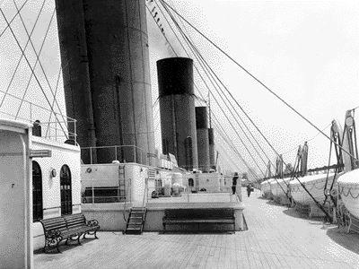
Second Class
The Second Class boat deck, where passengers could walk around, or sit and relax.

Slide 21
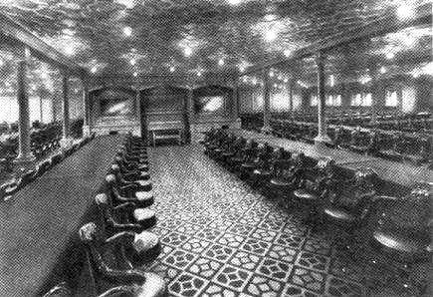
Second Class dining
The Second Class dining room consisted of long tables, fastened to the floor in case of stormy weather. The chairs were mahogany swivel chairs, and passengers would each be given a specific seat at the start of the voyage, which they would keep for the whole journey.

Slide 22
Second Class Menu
Second Class April 14 1912
Dinner
Consommé
Tapioca
Baked haddock
Sharp sauce
Curried chicken and rice
Spring lamb, mint sauce
Roast turkey, cranberry sauce
Boiled rice
Boiled and roast potatoes
Plum pudding
Wine Jelly
Coconut sandwich
American ice cream
Nuts assorted
Fresh Fruit
Cheese and biscuits
Coffee

Slide 23
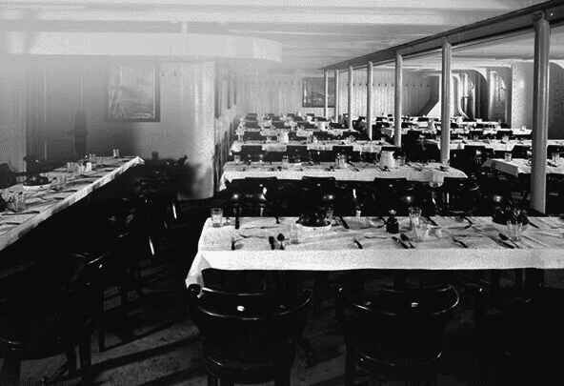
Third Class
Most of the people travelling in the Third Class were emigrants from Ireland and Scandinavia. Many cities in Europe were overpopulated at the time, and it was mainly the working classes who wanted to go and live in America, in search of a better life.
There was room on the Titanic for 1,134 Third Class passengers.
Life on the lower decks was not as comfortable as above, but it was as good as Second Class on any other ship.
Third Class fares cost between £3 and £8 – that’s between £220 and £580 today.
There were 706 Third Class passengers on the Titanic, but only 174 survived.

Slide 24
Third Class
Third Class passengers had a separate dining room. The passengers were impressed with the tablecloths, and the fact that their food was brought to them by waiters and waitresses.

Slide 25
Third Class Menu
Third Class April 14 1912
Breakfast
Oatmeal porridge and milk
Smoked herrings
Jacket potatoes
Ham and eggs
Bread and Butter
Marmalade
Tea or coffee
Dinner
Rice Soup
Fresh Bread
Cabin biscuits
Roast beef
Brown gravy
Sweet corn
Boiled potatoes
Plum pudding
Sweet sauce
Fruit
Tea
Cold meat
Cheese
Pickles
Fresh bread and butter
Stewed figs and rice
Tea
Supper
Gruel
Cabin biscuits
Cheese

Slide 26
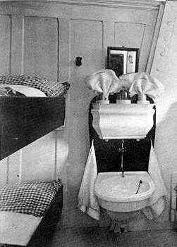
Third Class
Third Class cabins would be for between 4 to 6 people, with bunk beds and a sink. There would be a shared bathroom, with showers and toilets.

Slide 27
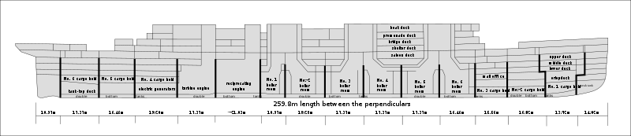
Decks
The Titanic consisted of ten decks. The lower three were for the crew, and the top seven for the passengers.
Image by Dfoerster, Creative Common Licence, Wikimedia Commons
Click to view an online ‘cutaway’ of the Titanic

Slide 28
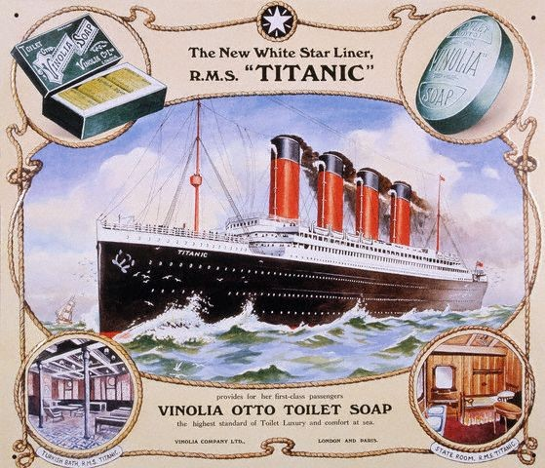

Slide 29
Online links
A plan of the Titanic
Titanic passenger list
Titanic’s deck plans
All acknowledged images used published under a Creative Commons Licence
All other images in the Public Domain

