Slide 1
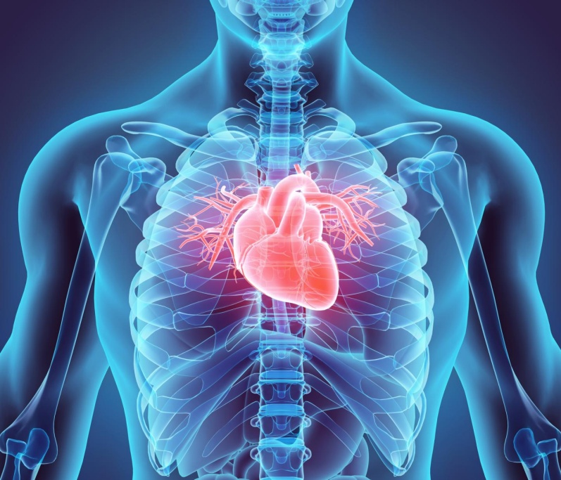
The Heart
L.I. To learn the function and parts of the human heart.

Slide 2
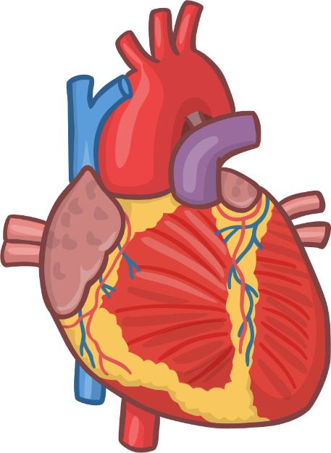
The Heart- Function
The heart is like a pump, but it is a muscle. It is located a little to the left of the middle of the chest and it is about the size of your fist.
The heart sends blood around the body.
The blood provides the body with the oxygen and nutrients it needs.

Slide 3
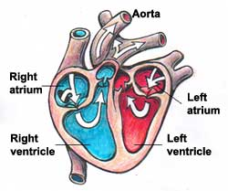
The Heart-Parts
Arteries- carry blood AWAY from the heart.
Veins carry blood TO the heart.
Aorta-largest artery in the body.

Slide 4
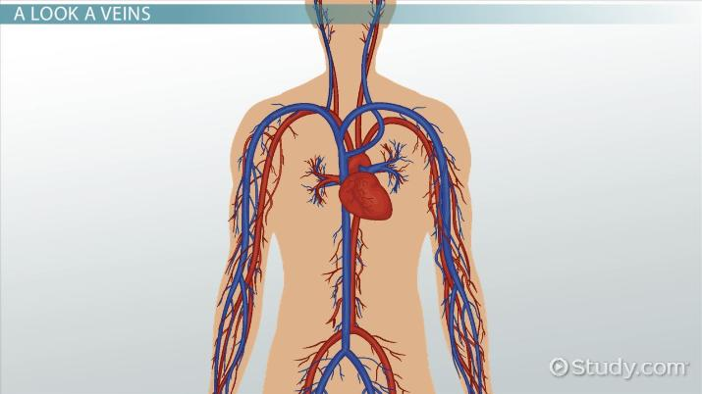
Arteries and veins

Slide 5
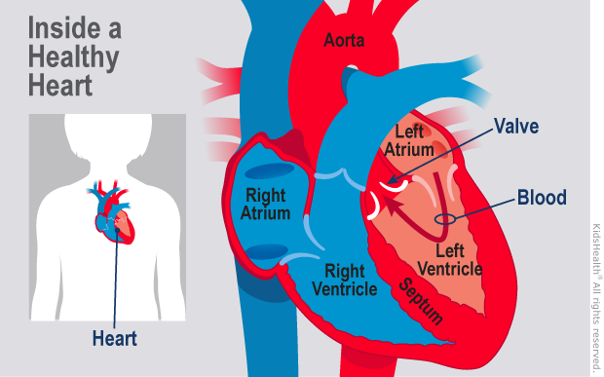
Valves

Slide 6
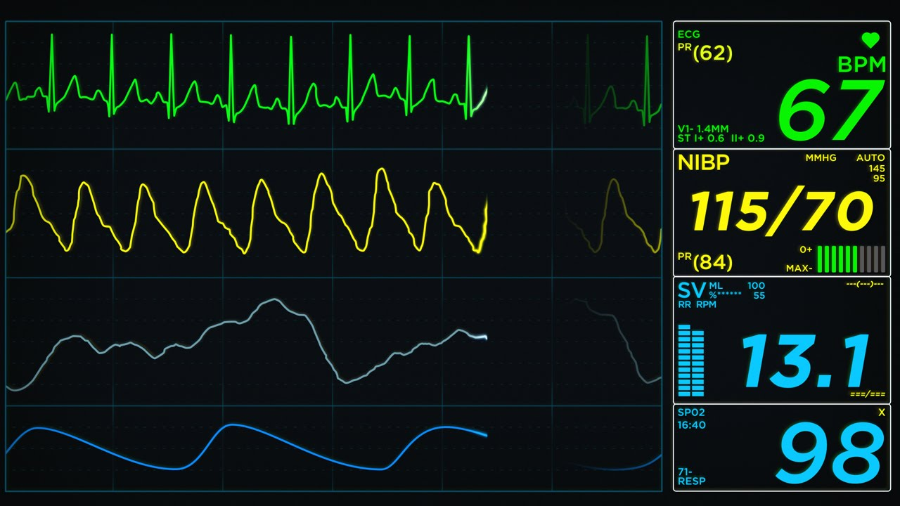
ECG-measures heart rhythm

Slide 7
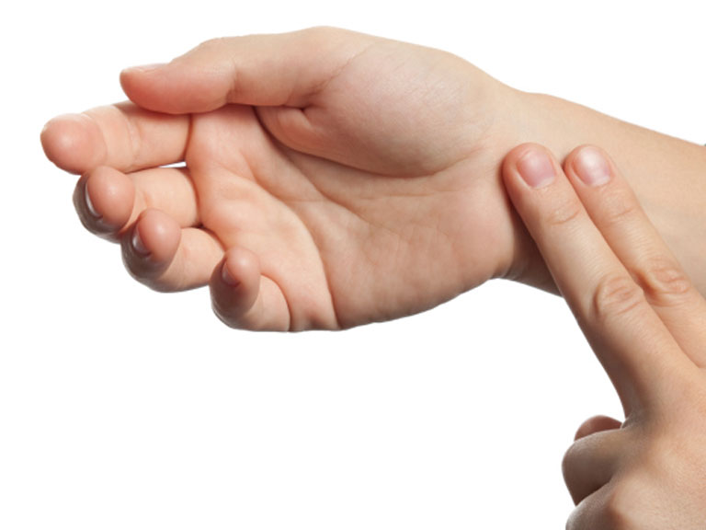
Pulse is equal to heart beat
Heart beat- the number of times your heart beats in one minute
Pulse-when the heart beat contracts, it increases pressure in the arteries, so you feel a pulse.

Slide 8
Pulse
Children aged 7-9:
A healthy pulse is 70 to 110 beats per minute.
Children aged 10 and older, and adults:
60-100 beats per minute.

Slide 9
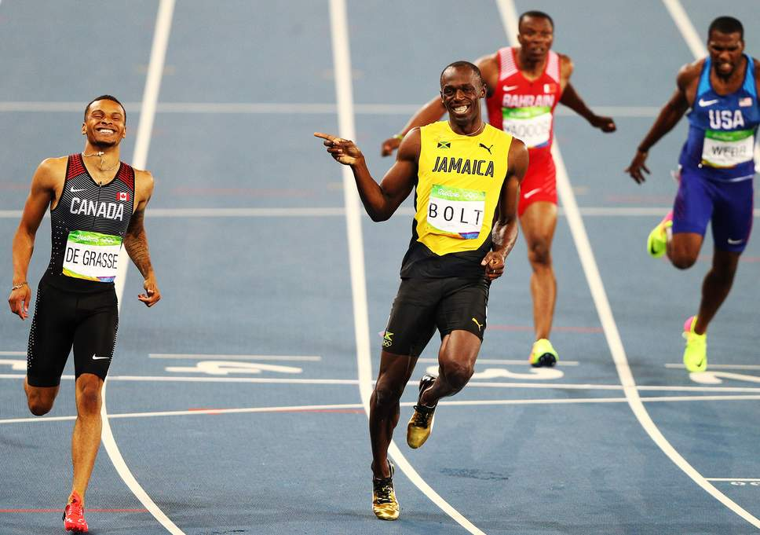
Athletes
Exercise makes your pulse quicker as more blood is needed to carry oxygen to your muscles.
Athletes resting heart rate is 40-60bpm as their hearts are stronger, so their hearts beat more blood each time.

Slide 10
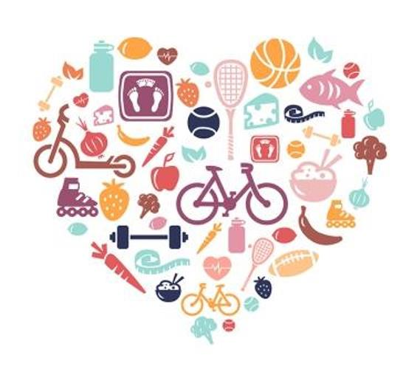
What do you do which keeps your heart healthy?
Eat fruit and vegetables
Make sure you exercise
Don’t eat too much sugar

Slide 11
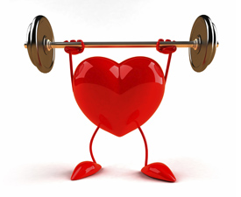
True or False
There are 6 chambers in the heart
The heart is a muscle that sends blood around the body
Athletes have a stronger heart than non-athletes
We must eat sugar and watch TV all day to have a healthy heart

