Slide 1

On board the Titanic

Slide 2
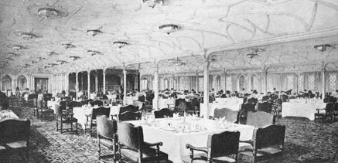
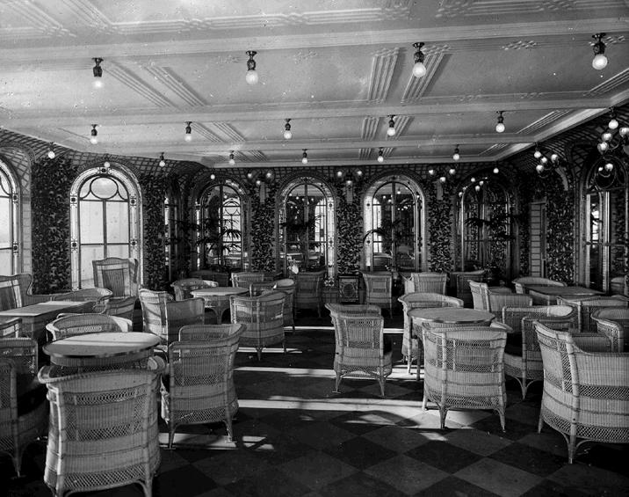
First Class Dining
Dinner was served each evening at 7:00pm. The First Class passengers were served ten course meals.
First Class passengers could also eat at the Veranda Café, where they could order whatever they wanted from the menu.

Slide 3
First Class Menu
First Class - April 14, 1912
Hors Doeuvre
Varies
Oysters
Consommé Olga
Cream of Barley
Salmon, Mousseline Sauce, Cucumber
Filet Mignons Lili
Sauté of Chicken, Lyonnais
Vegetable Marrow Farcie
Lamb, Mint Sauce
Roast Duckling, Apple Sauce
Sirloin of Beef, Chateau Potatoes
Green Peas - - Creamed Carrots
Boiled Rice
Parmentier & Boiled New Potatoes
Punch Romaine
Roast Squab & Cress
Cold Asparagus Vinaigrette
Pate De Foie Gras
Celery
Waldorf Pudding
Peaches in Chartreuse Jelly
Chocolate & Vanilla Éclairs
French Ice Cream

Slide 4
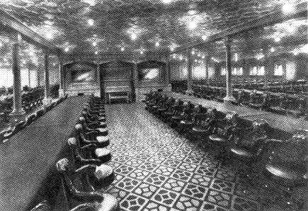
Second Class dining
The Second Class dining room consisted of long tables, fastened to the floor in case of stormy weather. The chairs were mahogany swivel chairs, and passengers would each be given a specific seat at the start of the voyage, which they would keep for the whole journey.

Slide 5
Second Class Menu
Second Class April 14 1912
Dinner
Consommé
Tapioca
Baked haddock
Sharp sauce
Curried chicken and rice
Spring lamb, mint sauce
Roast turkey, cranberry sauce
Boiled rice
Boiled and roast potatoes
Plum pudding
Wine Jelly
Coconut sandwich
American ice cream
Nuts assorted
Fresh Fruit
Cheese and biscuits
Coffee

Slide 6
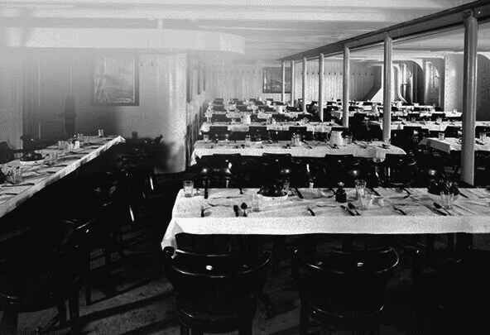
Third Class
Third Class passengers had a separate dining room. The passengers were impressed with the tablecloths, and the fact that their food was brought to them by waiters and waitresses.

Slide 7
Third Class Menu
Third Class April 14 1912
Breakfast
Oatmeal porridge and milk
Smoked herrings
Jacket potatoes
Ham and eggs
Bread and Butter
Marmalade
Tea or coffee
Dinner
Rice Soup
Fresh Bread
Cabin biscuits
Roast beef
Brown gravy
Sweet corn
Boiled potatoes
Plum pudding
Sweet sauce
Fruit
Tea
Cold meat
Cheese
Pickles
Fresh bread and butter
Stewed figs and rice
Tea
Supper
Gruel
Cabin biscuits
Cheese

Slide 8
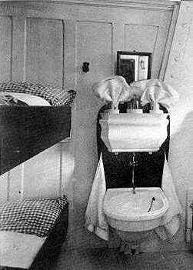
Third Class
Third Class cabins would be for between 4 to 6 people, with bunk beds and a sink. There would be a shared bathroom, with showers and toilets.

Slide 9
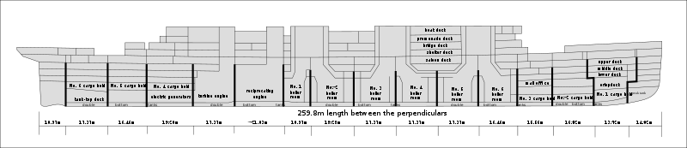
Decks
The Titanic consisted of ten decks. The lower three were for the crew, and the top seven for the passengers.
Image by Dfoerster, Creative Common Licence, Wikimedia Commons
Click to view an online ‘cutaway’ of the Titanic

Slide 10
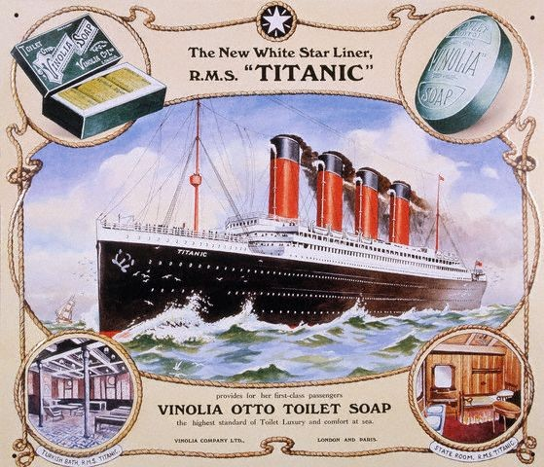

Slide 11
Online links
A plan of the Titanic
Titanic passenger list
Titanic’s deck plans
All acknowledged images used published under a Creative Commons Licence
All other images in the Public Domain

