Slide 1
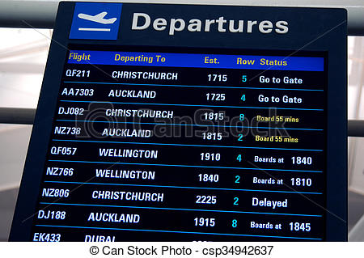
24 Hour Clock

Slide 2
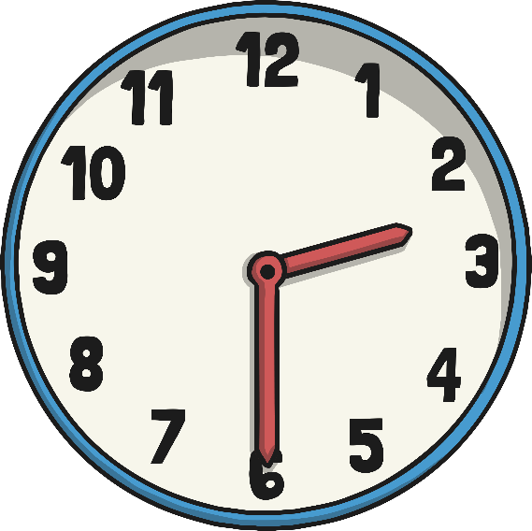
The 24 Hour Day
A day has 24 hours. A clock has 12 hours.
This means each time will happen twice every day.
half past 2 in the morning
half past 2 in the afternoon

Slide 3
a.m. and p.m.
We have to use a way to write these times differently. One way is to use a.m. and p.m.
a.m. (ante meridiem – before noon)
p.m. (post meridiem – after noon)
2:30 a.m.
2:30 p.m.

Slide 4
The 24 Hour Clock
Another way is to use a 24 hour clock.
This means the hours after 12 noon are converted to 13:00 to 23:00.
2:30
14:30
A 4 digit format is used. 2 digits for the hour, a colon (:) and 2 for the minutes.

Slide 5
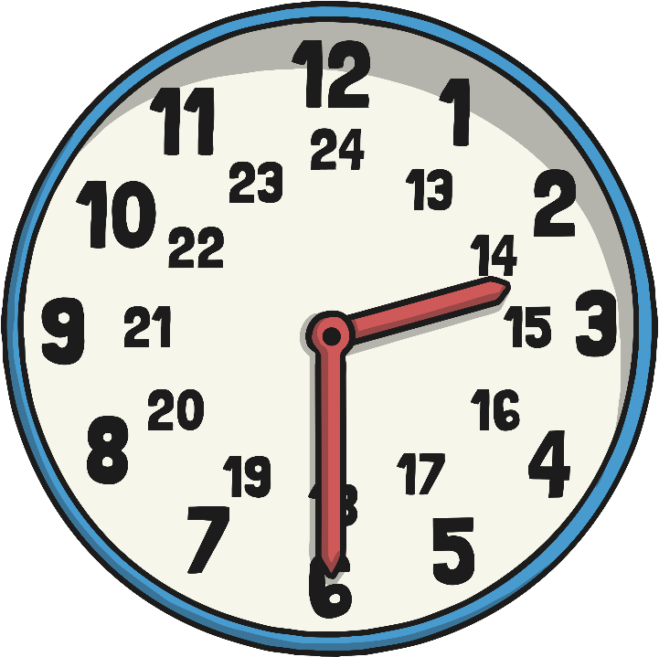
24 Hour Hours
This clock and table show the corresponding hours on a 24 hour clock.
00:00 = 12:00 AM | 12:00 = 12:00 PM
01:00 = 1:00 AM | 13:00 = 1:00 PM
02:00 = 2:00 AM | 14:00 = 2:00 PM
03:00 = 3:00 AM | 15:00 = 3:00 PM
04:00 = 4:00 AM | 16:00 = 4:00 PM
05:00 = 5:00 AM | 17:00 = 5:00 PM
06:00 = 6:00 AM | 18:00 = 6:00 PM
07:00 = 7:00 AM | 19:00 = 7:00 PM
08:00 = 8:00 AM | 20:00 = 8:00 PM
09:00 = 9:00 AM | 21:00 = 9:00 PM
10:00 = 10:00 AM | 22:00 = 10:00 PM
11:00 = 11:00 AM | 23:00 = 11:00 PM
12:00 = 12:00 AM | 24:00 = 12:00 PM
Midnight is referred to as both 00:00 and 24:00

Slide 6
24 Hour Time in the Morning
To convert between 12 and 24 hour time in the morning change the format.
6:00 a.m.
06:00
becomes
10:30
10:30 a.m.
becomes
The hours stay the same.

Slide 7

24 Hour Time in the Afternoon
To convert between 12 and 24 hour time in the afternoon add or subtract 12 hours and change the format.
6:00 p.m. becomes 18:00
22:30 becomes 10:30 p.m.

Slide 8
Convert 12 to 24 hour
Convert these times to 24 hour time
12 hour time
24 hour time
2:45 a.m.
02:45
10:20 a.m.
10:20
1:55 p.m.
13:55
3:05 p.m.
15:05
5:35 p.m.
17:35
8:40 p.m.
20:40
11:25 p.m.
23:25

Slide 9
Convert 24 to 12 hour
Convert these times to 12 hour time
24 hour time
12 hour time
03:15
3:15 a.m.
11:15
11:15 a.m.
14:45
2:45 p.m.
16:20
4:20 p.m.
18:55
6:55 p.m.
21:05
9:05 p.m.
22:35
10:35 p.m.

Slide 10
12 and 24 hour clock times
 | midnight | a.m. | noon | p.m.
12 hour | 12:00 a.m. | e.g. 5:15 a.m. | 12:00 p.m. | e.g. 4:15 p.m.
24 hour | 00:00 | e.g. 5:15 | 12:00 | e.g. 16:15

