Slide 1
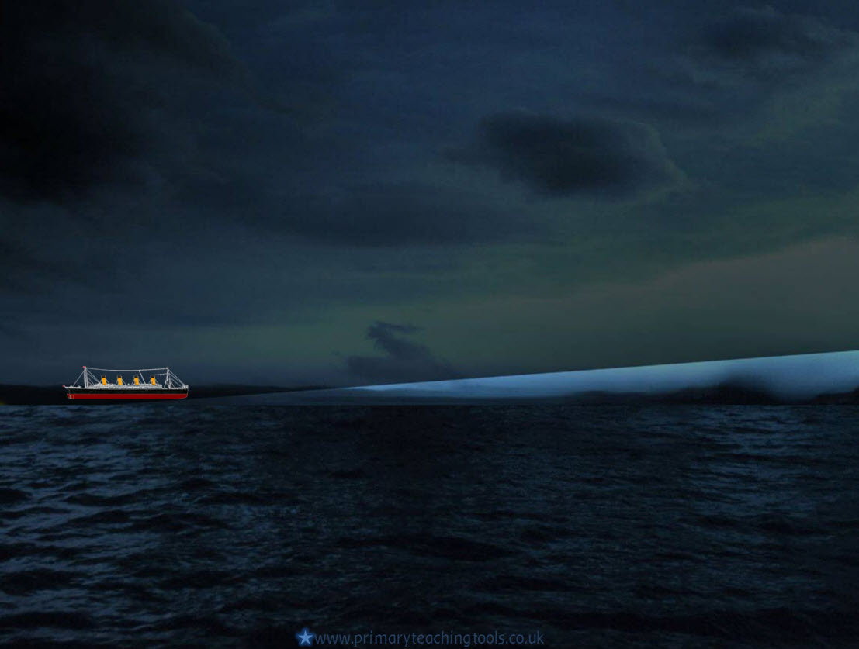
TITANIC

Slide 2
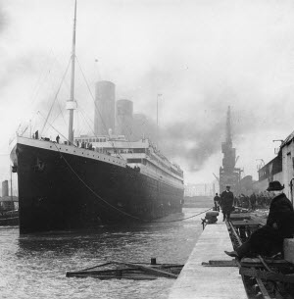
Titanic
The Titanic was a famous ship that was built around a hundred years ago.
It was known at the time as the largest, most luxurious passenger liner in the world.
The ship had three different sections: First Class, Second Class, and Third Class.
What do you think these were for?

Slide 3
The 1900’s
The 1900s were a time when many things were being invented . People trusted the new technology.
Many people wanted to travel to America, either to work there, or go to visit friends and relatives.
The only way to do this was to cross the Atlantic Ocean in a ship.
This journey would take 5 or 6 days.
How long would it take today by plane?

Slide 4
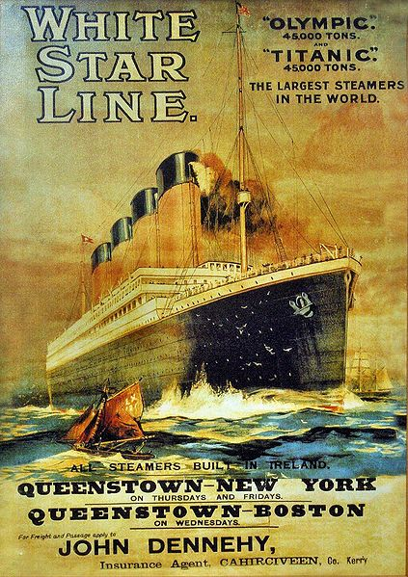
Titanic’s maiden voyage
In the early 1900’s, there were many shipping companies in competition with each other.
The White Star Line, a shipping company in Belfast designed the Titanic to beat the competition, and advertised the ship as ‘unsinkable’.
The Titanic set off from Southampton on the 10th April 1912.
Her final destination was New York city, but she never arrived.
Do you know why?

Slide 5
Online links
Building the Titanic – BBC LZB
The day I saw the Titanic – BBC LZB
All acknowledged images used published under a Creative Commons Licence
All other images in the Public Domain

