Slide 1

Question
Should School
Meals Go Vegan?

Slide 2
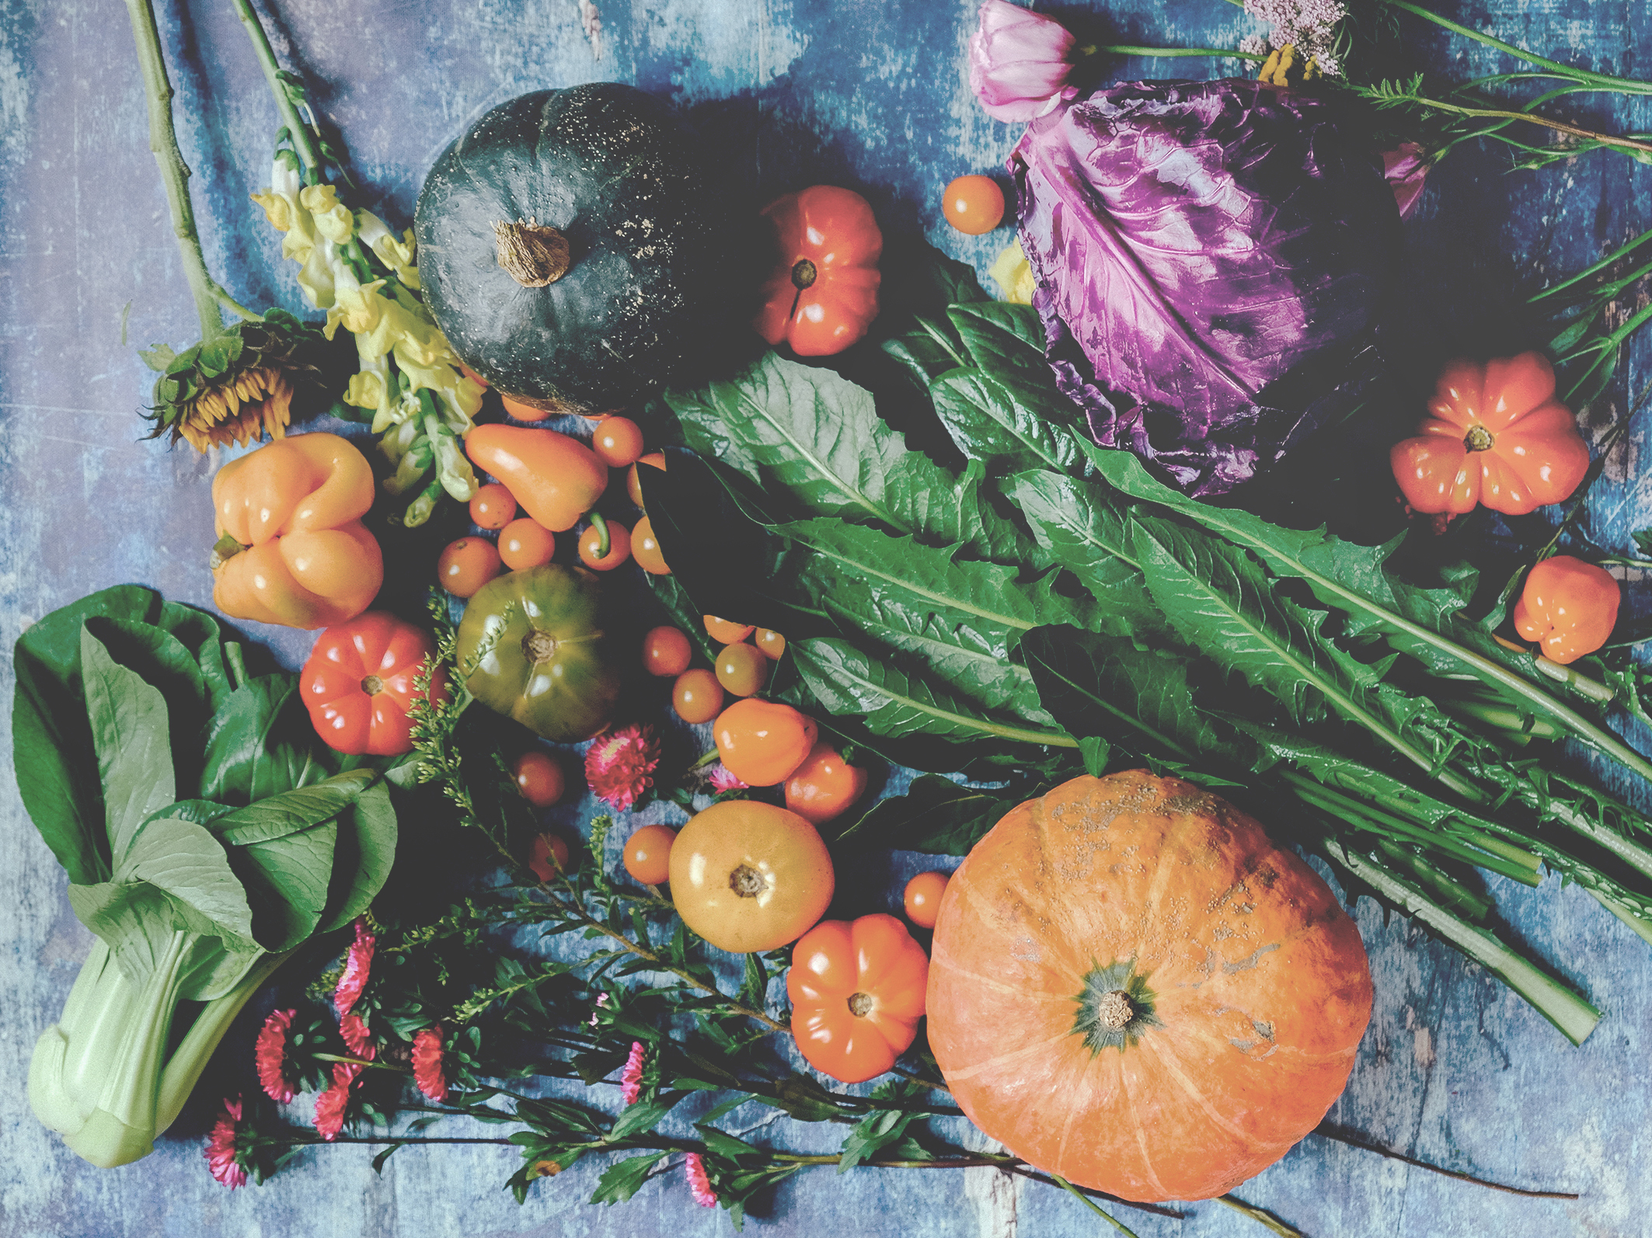
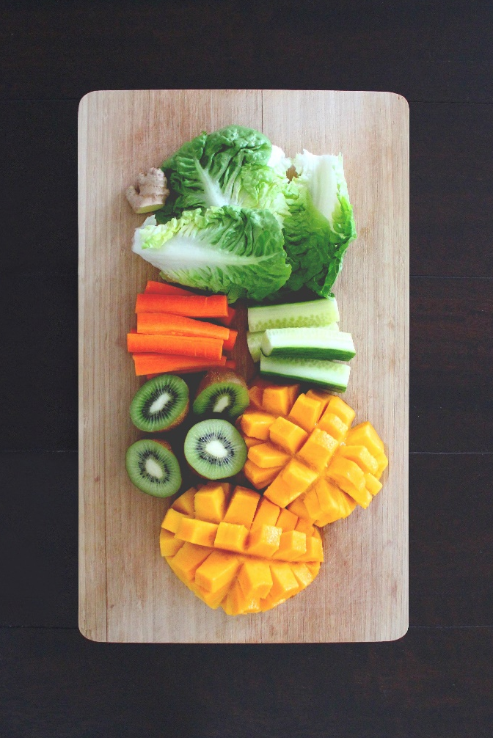
Vegan School Meals: The Context
Veganism is a way of living that aims to completely avoid using animal products in a person’s daily life – this includes food, cosmetics and clothing where possible. In 2018, it was reported that 600,000 people identified as vegan in the UK – a rise from 150,000 in 2006.
Many people choose to go vegan as a result of animal welfare, environmental and health concerns. As more and more people are ’going vegan’ or trying to eat more vegan meals as a result of awareness months such as ‘Veganuary’, vegan options in restaurants and stores are on the rise.
Schools cater to many different dietary requirements for medical and religious reasons, but there isn’t a requirement for schools to cater to individuals who have chosen to go vegan.
What do you think? Should school meals go vegan?

Slide 3

“Schools should cater to every type of diet where possible, not just individuals with religious or health considerations. Veganism is a growing dietary choice and people do it for a range of reasons. It would be great to see schools making healthier, environmentally-friendly conscious choices in the future.”
“Schools already offer vegetarian meals for the most-part and vegan cooking can be expensive. Many schools struggle to find funding for the basics, so catering to vegan diets is a long way off. It’s also worth noting that some people simply don’t want to eat
vegan meals”
What Do You Think?
Who do you agree
with? Why?
What Do You Think?
Who do you agree with? Why?

Slide 4
Research Activity
Veganism is growing in popularity in countries such as the UK and the USA, but has been incredibly popular around the world for a number of years. Using the Internet of your mobile phone, research the following:
Which 5 countries have the most vegans? What percentage of the population is this?
How many people signed up to take part in Veganuary in 2020? How does this compare to 2019?
Find three restaurants or fast food chains that now offer vegan alternatives – list what they offer and how popular these choices have been.

Slide 5
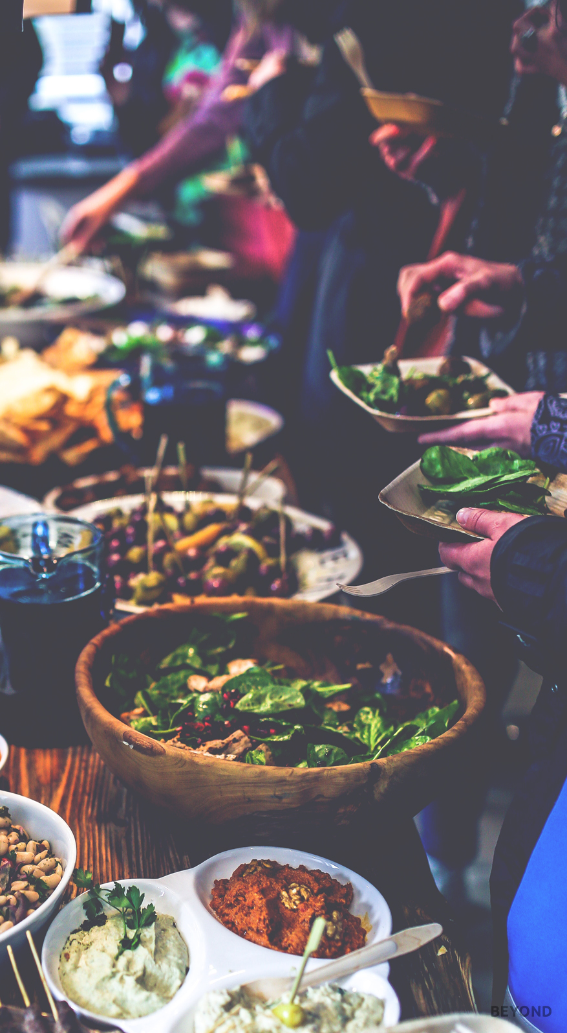
Personal Response
Do you think your school could do more to encourage vegan eating? Do you believe that schools should offer vegan alternatives to meat-based dishes? Do you feel as if vegans should provide meals from home instead?
Write down your thoughts and feelings on the matter.

Slide 6
The Big Question:
Should School Meals Go Vegan?
Working with your group, prepare a speech or presentation to tackle the question above. Consider the pros and cons and come to a conclusion that you can present to the rest of your class.

Slide 7


