Slide 1
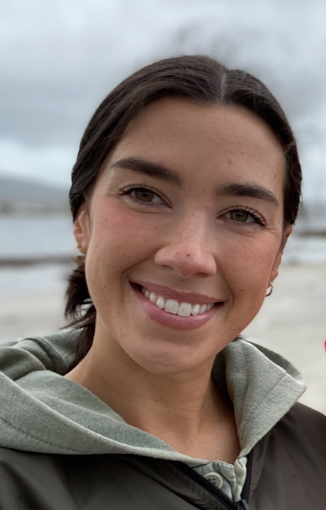



Hi everyone, welcome to primary 7B!
I am so happy to be teaching the class for 3.5 days of the week. The times I am not in class will be covered by Mr. MacKay on a Thursday afternoon and by Mrs. Fitzsimmons every Friday!
This is my 1st year teaching at Woodlands Primary as a newly qualified teacher and I’m excited for the year ahead!
Welcome to P7B!
Our school is committed to upholding the values of being limitless, kind, fair, respectful, creative and brave. We will always try our best to
1. Listen attentively
2. Keep hands, feet and objects to ourselves
3. Use only school appropriate language
Our class novel this term is Holes by Louis Sachar. It will take us on a learning journey exploring different styles of writing as well as linked topics such as natural disasters, human rights, friendship and much more!
P.E days will be on a Monday and a Friday! Remember to bring a change of clothes and shoes to take part!

Slide 2




Our focus for numeracy will be number processes, fractions, decimals & percentages, measurement, properties of shape and data analysis, among other exciting areas!
The pupils of Woodlands Primary school will always be listened to. I have a message box in my classroom where pupils can leave me a note if they have any concerns. Place2Talk is also in place for pupils who feel they would like to speak to a trusted adult.
We will be exploring relationships this year in P7b Every pupil will receive a letter home explaining this closer to the time but if you need any more information, please contact the school.
This year, P7’s have a great opportunity to become house captains. Those chosen to be house captains will be hard working and engaged pupils who reflect the school values to the best of their abilities!

