Slide 1
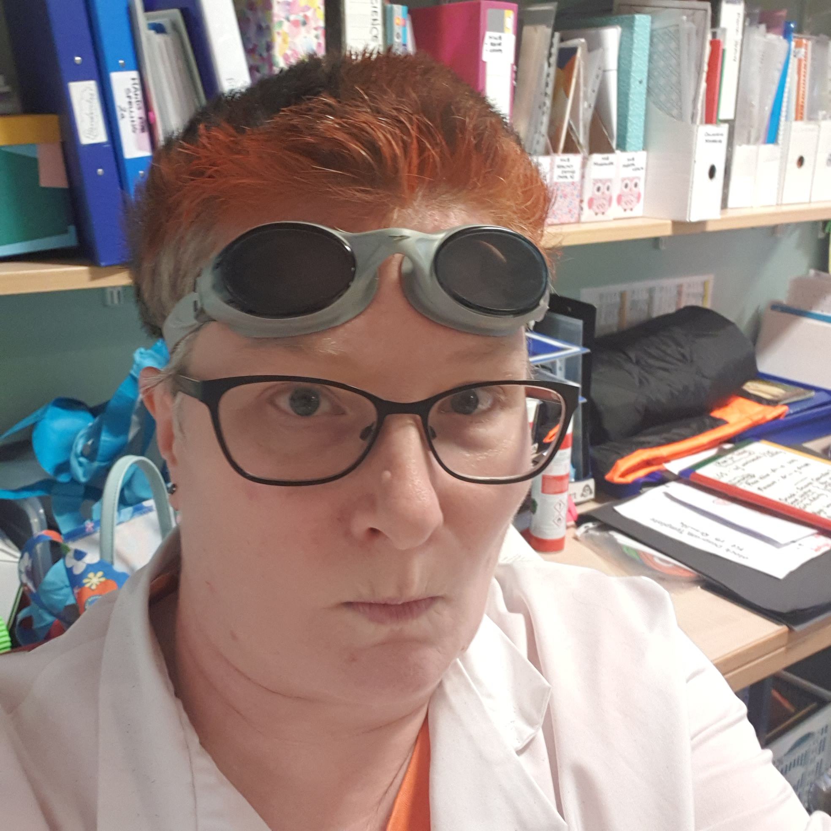
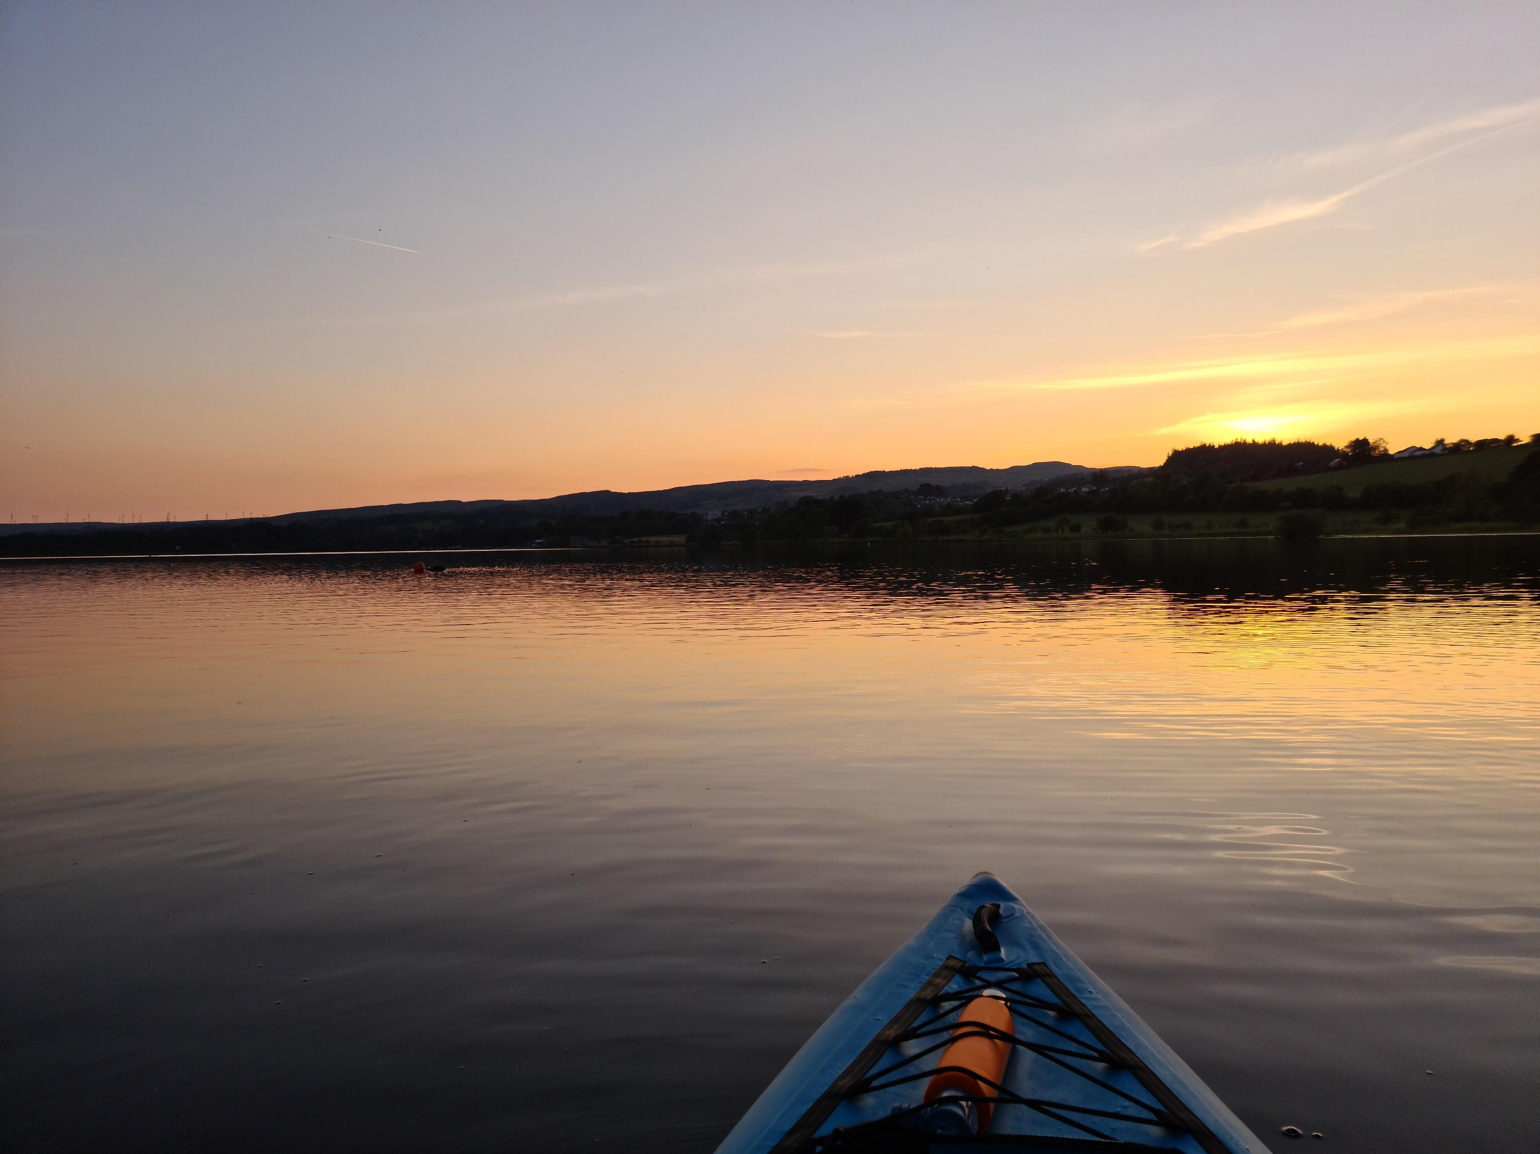
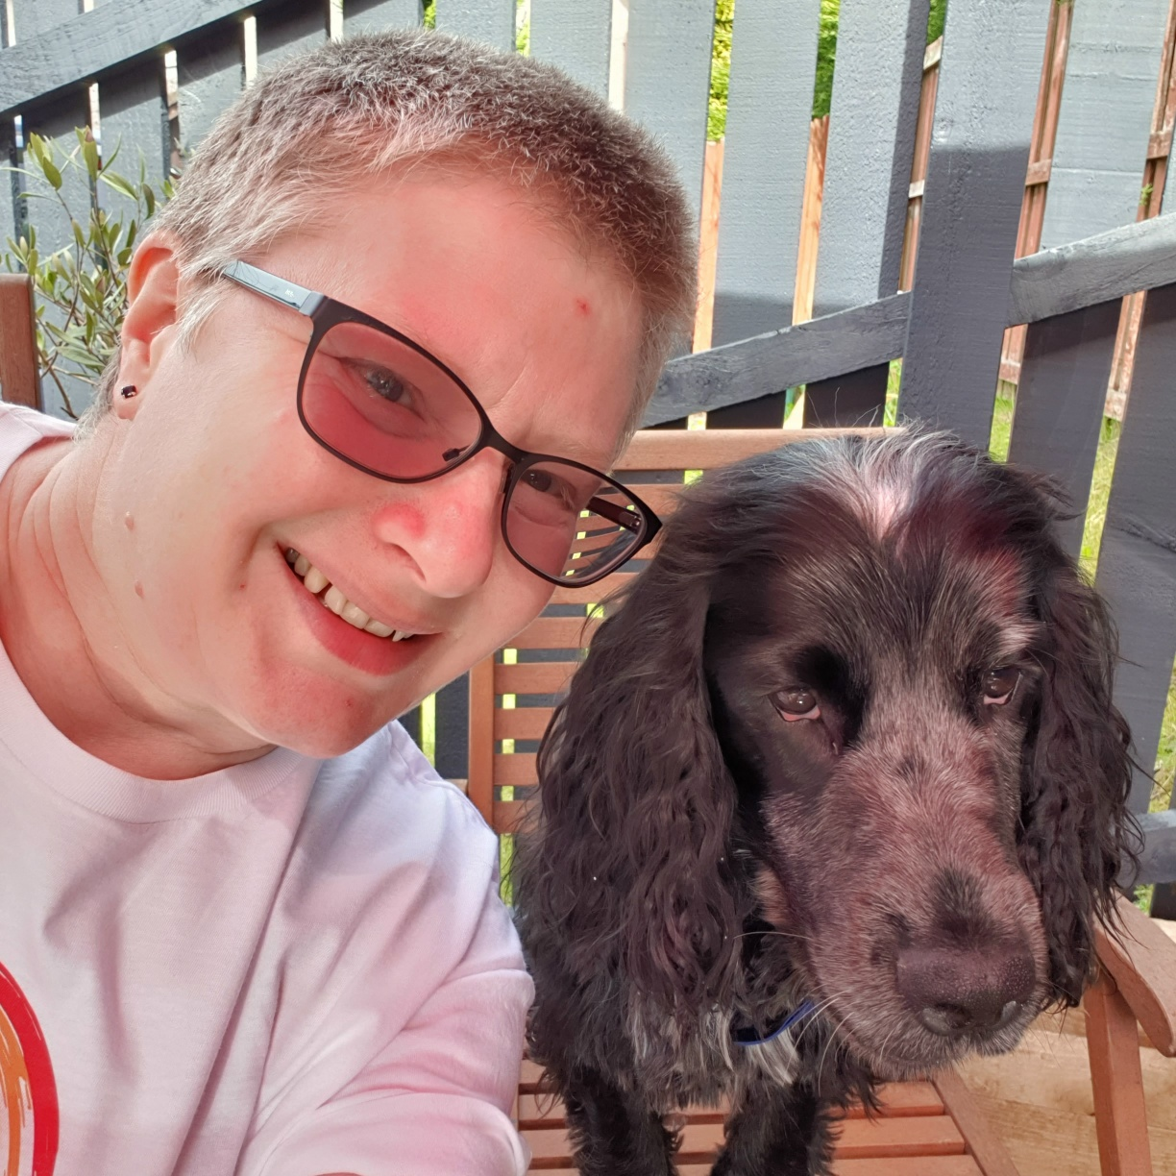
Hi there, Mrs Fitzsimmons here!
I have been teaching at Woodlands now for 10+ years having previously been a research scientist at the Beatson in Glasgow. I love bringing Science into the classroom and inspiring children to get out into the great outdoors by sharing my experiences through their learning.
These are a few of my favourite things….♪♪♪
Kayaking
My family
Food!
Laughing
This year I am working in P7B on a Friday. During this time, I will be covering some Outdoor Learning (see the monthly focuses on the website), Science and Health and Wellbeing, especially PE (fitness) and mental health. I am looking forward to this new challenge and hope to be able to share the good work we do in class.
Sunsets
Working with children
Meeting friends
Camping
Walking Otis

