Slide 1
Paisley Grammar School
Information for our new S1 Pupils
May 2020

Slide 2
Introduction
Welcome to our essential guide to starting S1. We are eagerly awaiting your arrival and are excited to see all of you again soon.
In this Power Point you will find lots of information about our school. You might already know some of the information from your visits, however given our current situation it won’t do any harm to remind you.
On the following slide you will our school values and these are at the heart of everything we do at Paisley Grammar School.

Slide 3
Our School Values

Slide 4
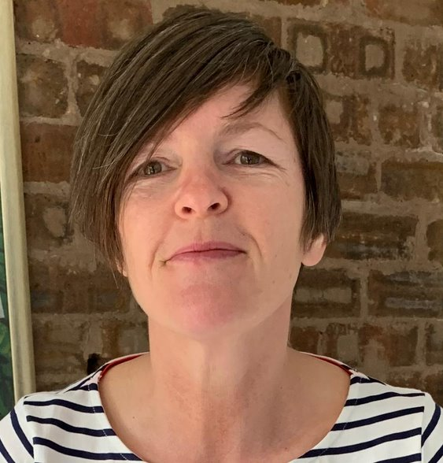
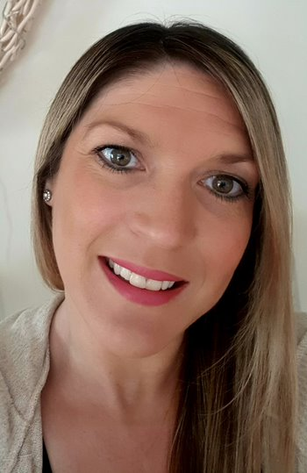
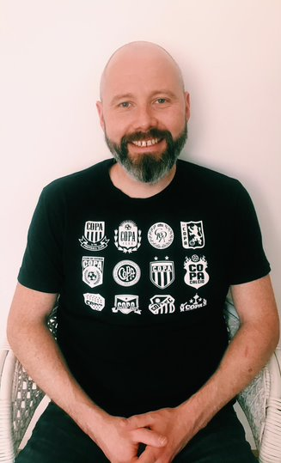
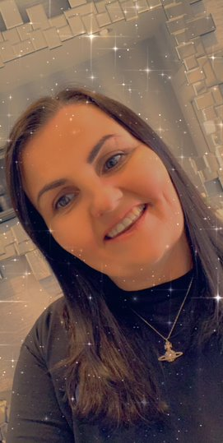
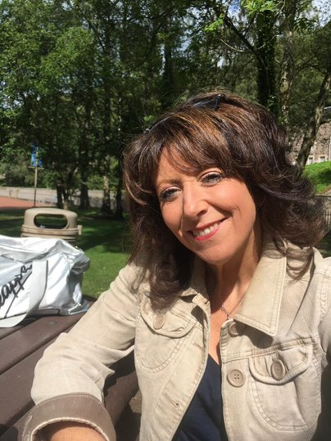
Senior Leadership Team
Head Teacher
Ms Levens
Mrs Hood
DHT
Mrs McCrory
DHT
Mr Crawford
DHT
Mrs McDiarmid
DHT

Slide 5
PGS Island Teams
We have 3 Island Teams in Paisley Grammar School;
Iona, Mull and Skye
Classes are split into these Island Teams.
If you have a sibling in Paisley Grammar then we aim to keep you in the same Island Team.
Each Island has their own Island Head, Principal Teacher of Pupil Support and 2 Leaders Of Learning.
All the staff within each of the island teams are there to support you with you learning, attendance, timekeeping and al aspects of your wellbeing. On the next slide you will see the staff who will be supporting you.

Slide 6
PGS Island Teams
Mull
Iona
Skye
DHT Mrs Hood
PT PS Mrs Hewitt
LOL Mr Singh &
Miss Cassidy
DHT Mrs McCrory
PTPS Mrs Kerr
LOL Miss Kennedy &
Miss Fitzgerald
DHT Mr Crawford
PTPS Ms Stockan
LOL Miss Gallacher & Miss Pearson
Mrs Shand - Transitions Teacher

Slide 7
The School App
Paisley Grammar has a school app with all the latest news and information about the school. You can download the app from these links:
Android
https://play.google.com/store/apps/details?id=com.jigsawschoolapps.android.paisleygs&hl=en_GB
Apple
https://itunes.apple.com/gb/app/paisley-grammar-school/id1065257681?mt=8

Slide 8
The School Day/Week
Paisley Grammar is timetabled on a 33 period a week structure.
This means that over the course of the week pupils will have three ‘late’ days and two ‘short’ days.
The timings and days are indicated here
Period | 1 | 2 | Interval | 3 | 4 | 5 | Lunch | 6 | 7
Time | 8.50 – 9.40 | 9.40 – 10.30 | 10.30 – 10.45 | 10.45 – 11.35 | 11.35 – 12.25 | 12.25 – 13.15 | 13.15 – 14.00 | 14.00 – 14.50 | 14.50 – 15.40
Mon
Tue
Thu
Period | 1 | 2 | Interval | 3 | 4 | Lunch | 5 | 6
Time | 8.50 – 9.40 | 9.40 – 10.30 | 10.30 – 10.45 | 10.45 – 11.35 | 11.35 – 12.25 | 12.25 – 13.15 | 13.15 – 14.00 | 14.00 – 14.50
Wed
Fri

Slide 9
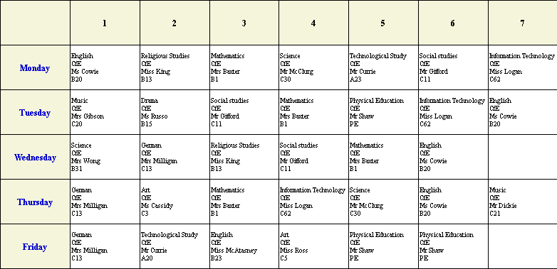
Typical S1 Timetable

Slide 10
Some information about the subjects you will study………
English: In the English Department, you are given the opportunity to explore a variety of poems, plays, novels and films. During the ‘Childhood Unit’ you will be encouraged to reflect upon and write about your own experiences. The English Department also does an S1 project on Health Inequalities in Scotland. This is an Interdisciplinary Learning Project, meaning that you will do related work in other departments.
RME: The Religious and Moral Education Department will encourage you to reflect upon the beliefs, values and practices of religious people across the globe. In S1 you will learn about two of the world’s religions: Christianity and Hinduism. You will learn about the philosopher Aristotle and you will ponder some of the Ultimate Questions. ‘What makes humans different from other animals?’ for example.

Slide 11
ModernLanguages:
In the Modern Languages Department you will have the opportunity to develop language skills in French, German and Spanish. Working in thirteen week blocks, you will develop the ability to speak, read, write and listen in each language. The department will also teach you about the countries and cultures where these languages are spoken.
ICT: The ICT department will help you to develop a wide range of computer skills that will be useful throughout the school and in everyday life. You will attend twice per week and learn everything from word-processing and presentation software to Photoshop and webpage creation. You will also be introduced to basic coding, creating your own simple game using the Scratch Program.
Maths:
In the maths department you will learn about whole numbers, fractions, decimals, percentages, time, probability, negative numbers, data-handling, angles, symmetry, area and volume – huge range of interesting and useful topics. You will also use the Numeracy Ninjas and Sumdog programs to improve your abilities by playing games and completing tasks.

Slide 12
Technical:
The Technical Department will introduce you to both Graphic Communication and Design and Manufacture. In Graphic Communication you will learn hand-drawing and rendering techniques as a well as computer-aided design and desktop publishing. Through a series of Design and manufacturing projects you will learn how to safely use workshop tools to make objects out of wood, plastic and metal.
Art:
The Art and Design Department will introduce you to a wide variety of drawing and painting techniques and teach you how to develop design ideas. In your first year you will learn how to create decorative patterns based on the famous Paisley pattern. You will also be introduced to portraiture, learning how to draw a face and render it with tone and colour. Your painting skills will improve when you paint a forest scene inspired by the artist Henri Rousseau.
Science:
In first year you will learn about the three main areas of science: biology, physics and chemistry. These three subjects will be taught in one classroom by the same teacher. You will learn about volcanoes, the cells that make up your body, optics (the study of light), reproduction and the environment.

Slide 13
Music:
The Music Department will introduce you to a wide variety of instruments in S1: tuned percussion, keyboard, guitar, drum kit, bass guitar and uckele. You will also learn about music notation, rhythm and performing techniques. Your music teacher will teach how to listen to music, how to identify instruments of the orchestra and explain how instruments are used to tell a story. The department also offers free tuition, subject to availability.
Drama:
In S1, the drama department will give you the opportunity to explore drama through movement, voice. Language and characterisation. You will be provided with interesting scenarios to explore, such as the story of Thesus and the Minotaur. To encourage your dramatic creativity, you will take part in a murder mystery story. In the drama department you will be encouraged to reflect upon and evaluate your own work and the work of others.
Social Subjects:
The Social Subjects Department will introduce you to a wide variety of topics, ranging across history, geography and politics. In S1 you will learn about Scottish history, climates across the globe, children’s rights and voting in the UK. In collaboration with the English and Science departments, Social Subjects will teach you about health in Scotland.

Slide 14
Health and Food Technology:
The Health and Food Technology Department will teach you a range of topics related to health, wellbeing and nutrition. In S1 you will learn about kitchen safety and hygiene and develop your practical cookery skills by following a range of recipes.
Physical Education
In S1 you will have the opportunity to learn and develop a range of skills and movements throughout a number of individual and team sporting activities. You will be taught about varying aspects of fitness and how these are transferable across all activities. You will also be given the opportunity to develop your creativity skills both during class time and during our wide range of extra curricular sporting clubs.

Slide 15
PGS School Library
At your school library you can borrow books, do your schoolwork and participate in events and clubs.
Clubs at the Library
Book Club / Comic Club / Dungeons and Dragons
Library Hours
Tuesday, Thursday: 8:30am – 4:15pm
Wednesday: 8:30am – 4:00pm
Open during break and the last 20 minutes of lunch.
To search the library catalogue go to renfrewshirelibraries.co.uk and select ‘Paisley Grammar’ under ‘School Pages’.
Follow the library on Twitter at: @pgs_library

Slide 16
School Uniform
At Paisley Grammar school all pupils wear school uniform.
School Uniform consists of:
White Shirt
School Tie
Black Trousers/Skirt
Black Shoes
Paisley Grammar Blazer
The following items of clothing are unsuitable for school wear:
Denim jeans or jacket
Track suits
Baseball caps
Football colours
Extremes of fashion

Slide 17
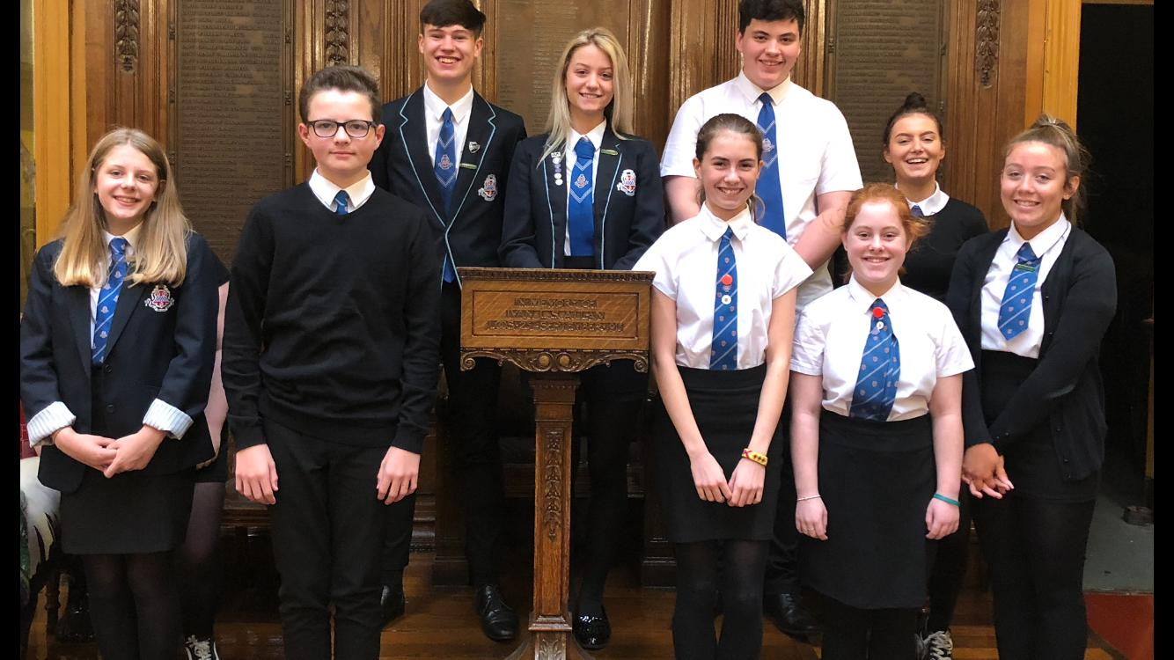
School Uniform

Slide 18
School Uniform
At Paisley Grammar School we actively encourage pupils to wear our agreed uniform, including a blazer
Academy Uniforms will be in contact with the school in due course regarding the ordering of school blazers. This information will be shared with you as soon as we receive further information. Academy Uniforms can be contacted directly via their website;
https://www.academyuniformsltd.co.uk
Please note however, that blazers can be purchased from other suppliers.

Slide 19
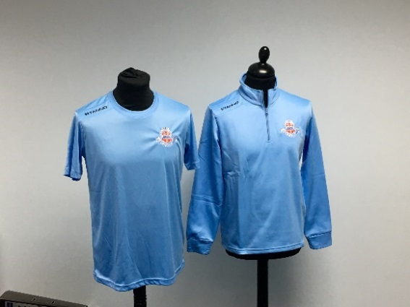
PE Uniform and School Tie
All pupils expected to wear our PGS PE T-Shirt
PE Tops can be purchased online from School Wear Made Easy:
Ties are £7 and can be purchased from our school office when the schools reopen.
www.schoolwearmadeeasy.com

Slide 20
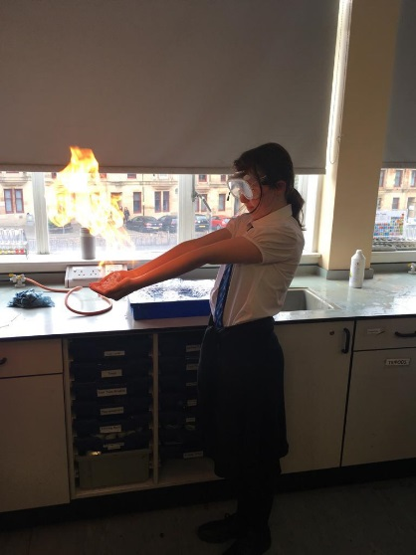
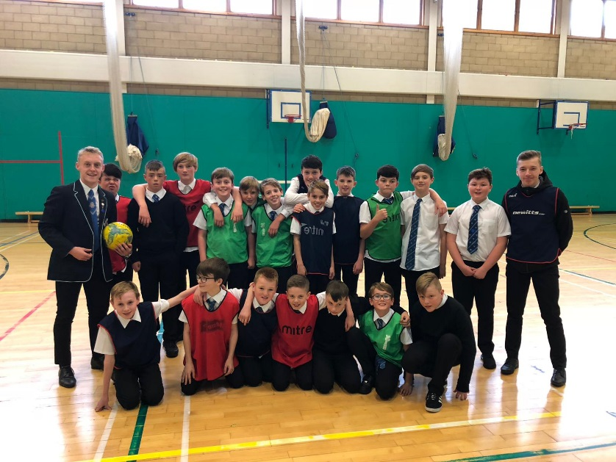
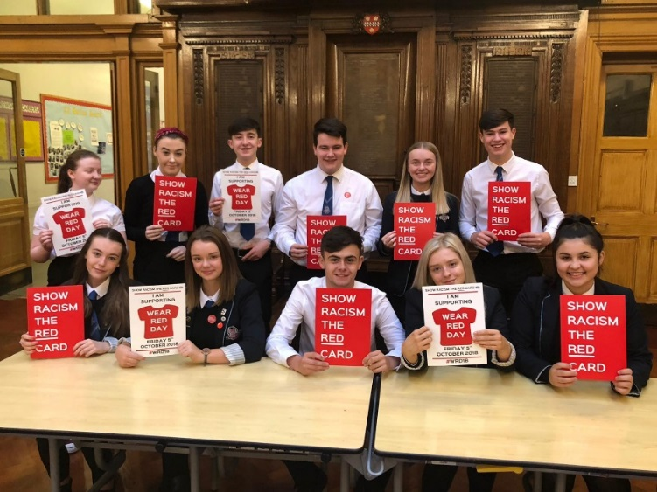
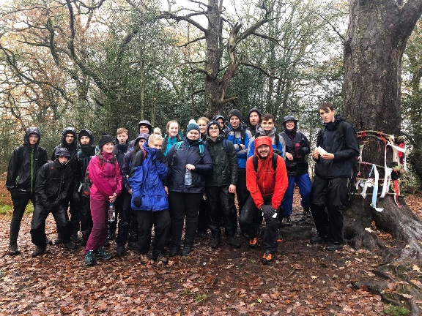
Extra Curricular
In Paisley Grammar there are a lots of clubs and extra curricular activities, such as:
Drama Club
Drop in Club
Choir
Basketball
Football
Science Club
Guitar Club
School Show
School of Rugby
Fair-trade
Eco Council
Rights Respecting School
School Trips

Slide 21
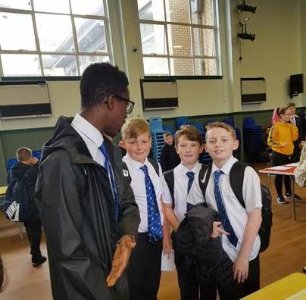
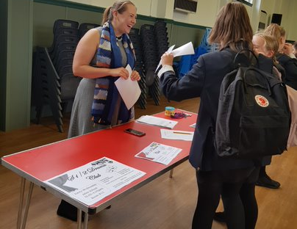
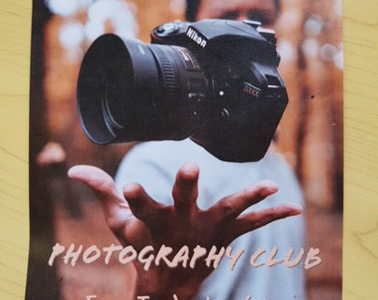
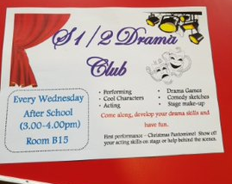
Extra Curricular Clubs
Our ‘Extra Curricular Roadshow’ is an opportunity for our S1 pupils to find out more information about all the lunch time and afterschool clubs running in the school and a chance to sign up for those you are interested in. You will told more about this when you come to PGS.

Slide 22
FME
You may be aware of Pupil Equity Fund.
Schools receive funding relative to the number of pupils who are registered for Free School Meals.
It is important for your child that they are receiving their entitlements and the additional funding allows us to further support young people in school.
More Information regarding FME and School Clothing Grants can be found on the Renfrewshire Council Website – www.renfrewshire.gov.uk

Slide 23
Parent Council
Meets the first Monday of every month, new members always welcome.

Slide 24
We look forward to seeing you!
All parents/carers will receive a letter with more information around the arrangements for pupils starting S1 when we have clearer information on this. All information will also be uploaded to our school app.
If you have any immediate concerns regarding transitions then please email our Schools Enquiries - Paisley Grammar
paisleygrammarenquiries@renfrewshire.gov.uk
We hope you have found this information useful.
Stay safe and looking forward to seeing you soon.

