Slide 1
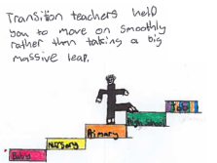
Preparing for High School- Learning

Slide 2
This pack is designed to help families think
about their learning transition from P7 to S1.
The underlying message is that learning in high
school is moving on from primary school;
learning is linked.
The information is designed to reassure and to build children’s confidence with
what they already know from primary which can support
them in high school, as well as the kind of things they can continue to
consolidate before transition.
The information in this power point has also been created in ‘flipbook’ format which is often easier for families to access on their mobile phones. You can send these directly to families via online classroom forums, email or via the school website. If you would like to create your own bespoke flipbooks see the ‘Guidance on using transition flipbooks’ document.
Links to flipbooks (view on slide show mode to click on links)
Curriculum flipbook
Maths flipbook
Literacy flipbook

Slide 3
Preparing for High School
Moving to High School is continuing your learning. It isn’t a new start.
It is important to know that a lot of the knowledge and skills you already have will help you in High School.
In this presentation and booklets you can look at subjects you might study, what you already know and complete some activities to get you thinking about learning at High School.

Slide 4
Preparing for High School
In High School your day will be split up into periods. Each period you will have a different subject.
Here are some of the subjects you might have;
English Maths Social Subjects (Geography, History and Modern Studies )
Health and Food Technology Technological studies
ICT Science (Biology, Chemistry and Physics)
PSE (Tutorial) P.E Religious Studies
Music Art Modern Languages

Slide 5
What do you already know?
The work that you do in High School is just the next step in your learning. You will have experience and knowledge of each subject from Primary School. Under each subject is a list of activities you might have covered in Primary.
English
Novel Studies
Writing VCOP
Talking and Listening
Maths
Add, subtract, multiply, divide
Use fractions, decimals and percentages
Name shapes and angles and so much more!
Social Subjects
( Geography, History and Modern Studies)
You will have learned about these subjects during all your brilliant topic work.
WW2
Natural Disasters
Studies of different countries

Slide 6
What do you already know?
The work that you do in High School is just the next step in your learning. You will have experience and knowledge of each subject from Primary School.
RE ( Religious Education)
You will have learned about different religions and key figures.
Music
You will know about different musical instruments and music is all around you
Art
You will have used different materials to create lots of art work.

Slide 7
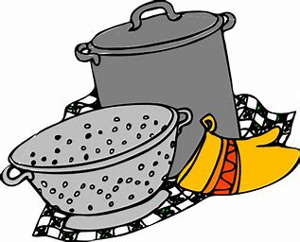
What do you already know?
The work that you do in High School is just the next step in your learning. You will have experience and knowledge of each subject from Primary School.
Health and Food Technology
In school and at home, you might have had some experience of cooking. You will be aware of how to prepare food safely.
Technological Studies
In Tech you will get the chance to make items in workshops. This links in with STEM.
ICT
In school you will have used ICT in a number of ways.
Research
Presentations
Also while being at home you might have uploaded your work.

Slide 8
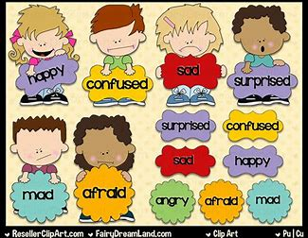
What do you already know?
The work that you do in High School is just the next step in your learning. You will have experience and knowledge of each subject from Primary School.
Science
You will have taken part in Science experiments in school. You will have looked to see if there has been any changes and noted the results.
PSE ( tutorial)
In school you might have used PATHS , Bounceback, or learned about Health.
P.E
Basket ball Gymnastics
Hockey Football
Fitness
Are just a few of the areas of P.E you have covered and will meet again in High School.

Slide 9
What do you already know?
The work that you do in High School is just the next step in your learning. You will have experience and knowledge of each subject from Primary School.
Modern Languages

Slide 10
Can you guess which subject you could make a dessert in ?
Music
Social Subjects
Health and Food Technology

Slide 11
Can you guess which subject you could write a Critical Essay in?
English
Science
Maths

Slide 12
RME
Modern Languages
Social Subjects
Can you guess which subject you could learn about the Paisley Witch Trials in?

Slide 13
Can you guess which subject you could learn how to use a Spreadsheet in?
Art
ICT
English

Slide 14
Websites
There are a few websites, which can provide some more information about moving to High School and the curriculum.
https://education.gov.scot/parentzone/my-child/transitions/
https://education.gov.scot/parentzone/my-child/transitions/changing-school/
https://education.gov.scot/parentzone/learning-in-scotland/broad-general-education/
https://education.gov.scot/parentzone/learning-in-scotland/about-the-3-18-curriculum/
https://learn.sssc.uk.com/observing/downloads/cfetransitions.pdf

Slide 15
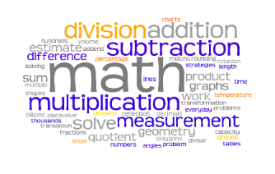
Preparing for High School: Learning – Maths
A Guide for Families to Help Build on Prior Learning in Numeracy

Slide 16
Preparing for High School: Learning – Maths
Promoting Positive Attitudes towards Maths-
Some General Tips and Advice
Be positive about maths. Try to avoid saying things like "I can’t do maths" or "I hated maths at school"; your child might start to think like that themselves.
Point out the maths in everyday life. Include your child in activities involving maths such as using money and cooking when you can.
Praise your child for effort rather than talent - this shows them that by working hard they can improve their maths skills.

Slide 17
Preparing for High School: Learning – Maths
Further Tips and Advice
There are right and wrong answers in maths, but, we should try to focus on how pupils got to the answer, and value our children’s inventive ways of working out problems.
Making mistakes is good! Mistakes are essential for learning and result in brain growth. If a child finds an activity challenging, encourage them that it is an opportunity to learn.

Slide 18
Preparing for High School: Learning – Maths Addition- Recommended Strategies Remember, it’s important to remind pupils that there is not only ‘one way’ to solve problems in maths. It’s great to encourage creativity with numbers.

Slide 19
Preparing for High School: Learning – Maths

Slide 20
Preparing for High School: Learning – Maths

Slide 21
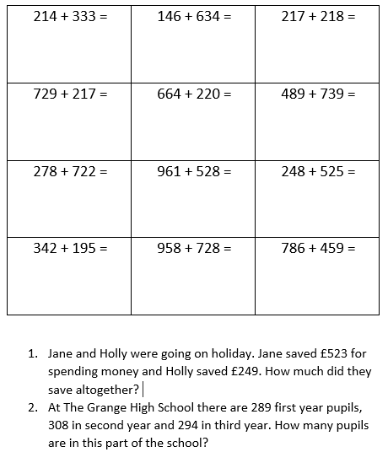
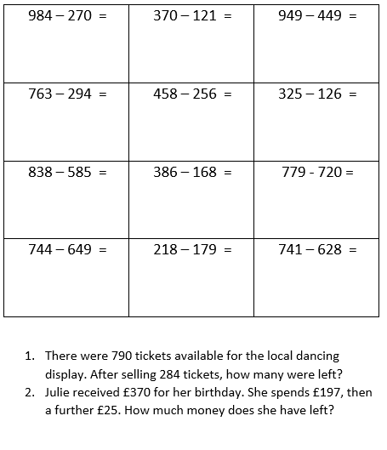
Preparing for High School: Learning – Maths Here are some addition and subtraction questions to try

Slide 22
Preparing for High School: Learning – Maths Multiplication– Some Useful Strategies

Slide 23
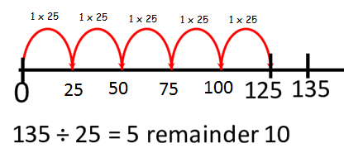
Preparing for High School: Learning – Maths Division- Some Recommended Strategies

Slide 24
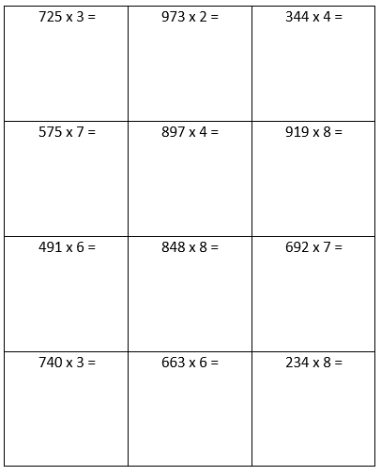
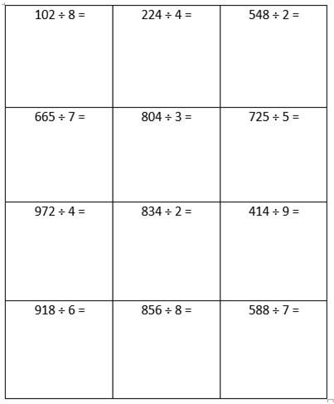
Preparing for High School: Learning – Maths

Slide 25
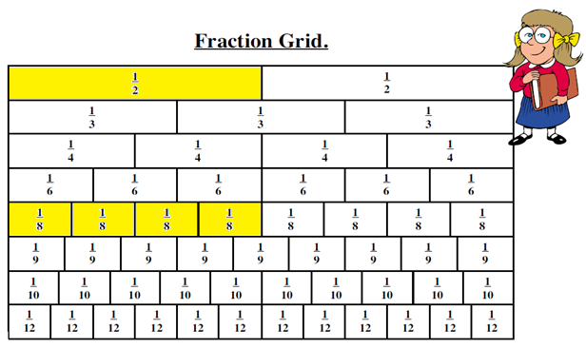
Preparing for High School: Learning – Maths
Fractions
A fraction Grid or Wall is a great tool for helping y you with fractions.

Slide 26
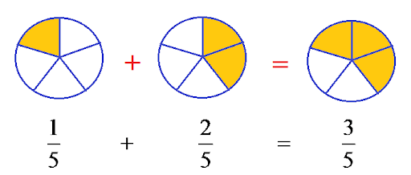
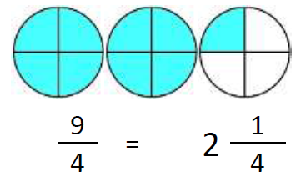
Preparing for High School: Learning – Maths
Some extra Fraction activities
Simplifying Fractions:
https://www.bbc.co.uk/bitesize/topics/zghnb9q/articles/zm2v382
Adding and subtracting fractions:
https://www.bbc.co.uk/bitesize/topics/zghnb9q/articles/zh7yvk7
Improper and mixed number fractions:
https://www.bbc.co.uk/bitesize/topics/zghnb9q/articles/zdkthbk

Slide 27
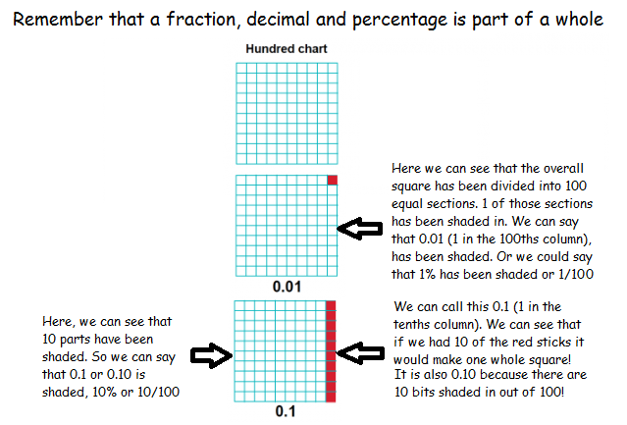
Preparing for High School: Learning – Maths Linking Fractions, Decimals and Percentages

Slide 28
Preparing for High School: Learning – Maths
Recommended Websites
https://mathsbot.com/manipulatives/blocks
https://mathsbot.com/manipulatives/fractionWall
https://www.ictgames.com/mobilePage/arrowCards/
https://www.bbc.co.uk/bitesize/subjects/znwqtfr
https://www.topmarks.co.uk/

Slide 29
Preparing for High School- Learning Literacy

Slide 30
Preparing for High School- Learning Literacy
Here is a list of skills you have used in Literacy in Primary School.
Critical thinking skills
Evaluating Analysing
Collaboration Creating
Creativity Identifying
Communication Understanding
In High School, you will use all of these skills in your English class.
Here are some of the activities you will be doing in English.
Reading
Writing
Comprehension
Talking
Spelling
Listening

Slide 31
Preparing for High School- Learning Literacy Let us see what you Know!
Onomatopoeia- a sound associated with what is named
Alliteration- the occurrence of the same letter or sound
Personification- Giving human characteristics to something nonhuman
Metaphors- Metaphor is a type of analogy, which is a class of rhetorical figures of speech that creates comparisons between different objects.
Similes- Making comparisons, saying something is like something
Can you make up some sentences or a paragraph using these techniques?

Slide 32
Preparing for High School- Learning Improving Sentences
Think about different ways to improve a sentence.
use powerful verbs
use adjectives (but not too many!) to describe the noun
add adverbs to tell the reader about the verb
extend your sentence by using connectives
add a super sentences starter – time, place and character
add extra information – don’t forget the commas!
These sentences are boring and need to be made more interesting. Use the list opposite to help you.
The band played.
The police searched the park.
The witch climbed onto her broom.
The footballer kicked the ball.
The man walked up the hill.
The cat walked along the wall.

Slide 33
Preparing for High School- Learning Literacy
DESCRIBE A PICTURE
A picture is worth a thousand words, right? Well, here’s a chance for you to write as many words as you can about a picture.
Write as many sentences as you can to describe the picture. Think about what we would see, hear, taste, smell, and touch if we were in the image.
This Photo by Unknown Author is licensed under CC BY-SA

Slide 34
Preparing for High School- Learning Literacy
Websites
https://www.bbc.co.uk/bitesize/topics/zpccwmn
https://www.bbc.co.uk/teach/school-radio/english-ks2-michael-rosen-talking-poetry/zn37rj6
https://uk.ixl.com/inspiration/family-learning

