Slide 1
Preparing for
High School – Wellbeing

Slide 2
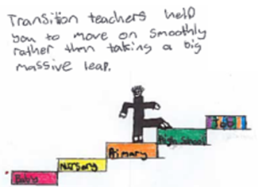
This pack is designed to help families think
about their wellbeing transition from P7 to S1
There are 3 parts to the pack:
1 Friendships
2 Pupil Wellbeing
3 Top Tips for Making High School a Success
The information in this power point has also been created in ‘flipbook’ format which is often easier for families to access on their mobile phones. You can send these directly to families via online classroom forums, email or via the school website. If you would like to create your own bespoke flipbooks see the ‘Guidance on using transition flipbooks’ document.
Friendship flipbook (view in slide show mode to click on links)
Pupil Wellbeing flipbook
Top Tips flipbook

Slide 3
Friendships

Slide 4
Friendships
Most young people are thinking about friendships when starting high school.
The following videos show young people giving handy tips on keeping old friends and making new friends in high school. Click on the weblinks on each page.

Slide 5
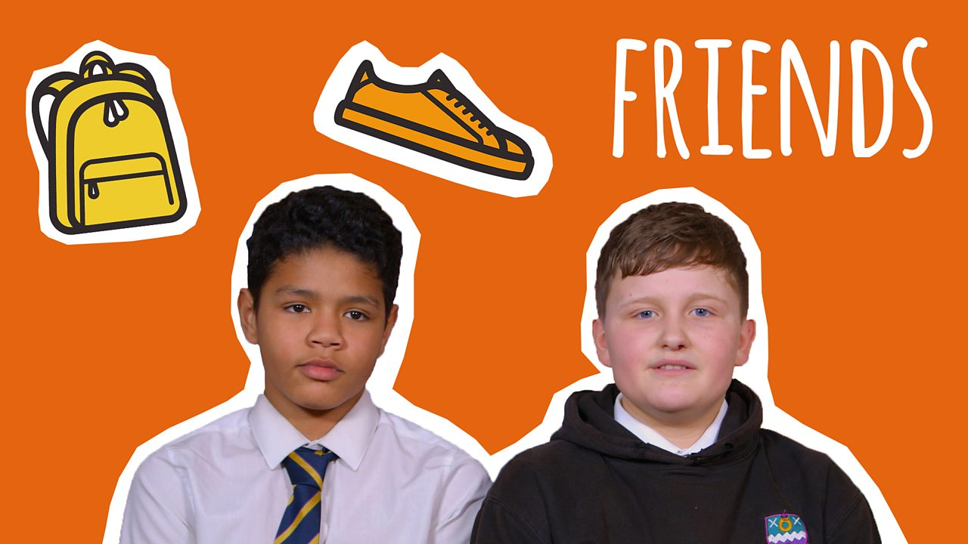
How to make lasting friendships at your new school
Tips:
Join a club or after school activity to meet new people.
Be yourself and you will make friends with people with similar interests to you.
Smile and be approachable.
Make an effort to speak to people even if it takes you out of your comfort zone.
Don’t rush this: the most genuine friendships develop gradually as you get to know each other.
You will be seated with different people in different subjects and will have to work together. This is a good opportunity to get to know your classmates and form new friendships.
https://www.bbc.co.uk/bitesize/articles/znhf7nb

Slide 6
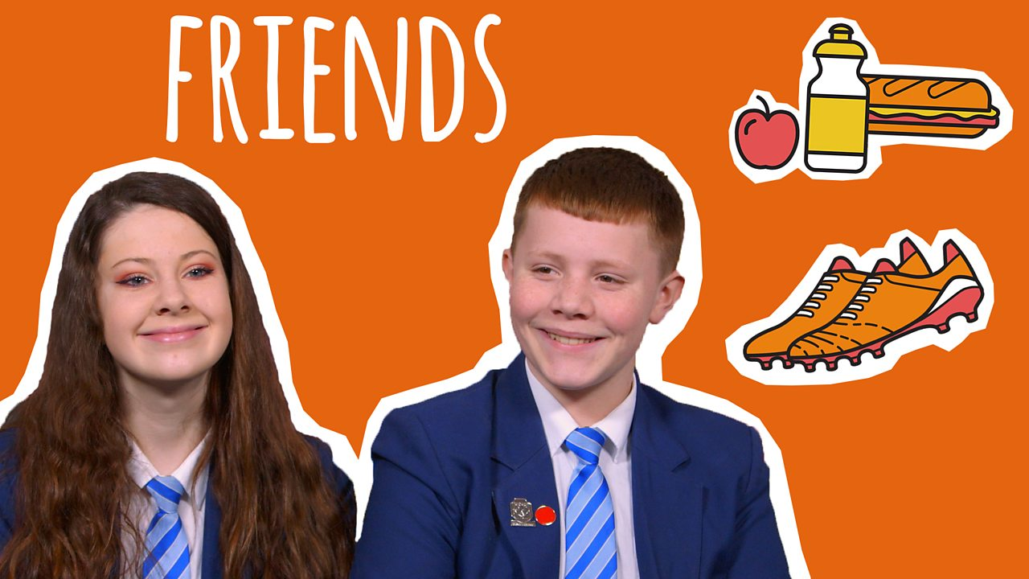
Keeping my old friends
Tips:
Keep in touch and make sure you see each other outside of class time.
Don’t let other commitments or new friends get in the way of making time for your old friends.
Introduce your new friends to your old friends.
Don’t worry about not being as close or seeing them as regularly, a good friendship can pick up at any time.
Send an occasional encouraging text or give them a call for a chat, your old friends are probably worried about losing you as a friend too.
After a couple of weeks, organise an activity with a few of your old friends to compare notes on new classes or schools and just catch up.
https://www.bbc.co.uk/bitesize/articles/z7yrhbk

Slide 7
Developing new friendships
Starting high school brings lots of opportunities to make new friends. The animations in the next 2 pages are set in the fictional Phoenix Academy for superhumans. Four super-powered students look at how to develop new friendships.

Slide 8
Developing new friendships
Tips on how to start a conversation:
Make your goal just to say, “Hello”.
Ask questions.
Start with something easy – like classes you share, movies, music, or sports.
Compliments are great too, even simple ones like, “I like your bag”.
https://www.bbc.co.uk/bitesize/articles/z6mj47h

Slide 9
Quick Friends / Slow Friends
The group look back to their first week of school and how their old friends from primary school did not make the transition with them. Sanj talks about how it felt daunting at first, which made him rush to try and make new friends, rather than take his time.
Tips:
Be patient and persistent.
Stay open to new friendships.
Share your interests and hobbies.
It’s okay to spend time with new people – it doesn’t mean you like your friends any less!
https://www.bbc.co.uk/bitesize/articles/z6mj47h

Slide 10
Activities that you can do with your family to help
you practise making
new friends…

Slide 11
Discuss the ways you think will help you make new friends with your family.
being kind | asking questions | avoiding eye contact | giving compliments
keeping yourself to yourself | offering to help people | sharing | trying out new clubs
shouting | keeping quiet | gossiping | listening to others
staring at the ground | finding things in common | smiling | frowning
staying all the time with the people you already know | introducing yourself | sharing | saying hello and introducing yourself

Slide 12
Think of 3 questions that you could ask a new friend:
1.
2.
3.

Slide 13
Think of 3 interesting things you could tell a new friend about yourself:
1.
2.
3.

Slide 14
Preparing for high school Wellbeing pupil Wellbeing during school closure

Slide 15
Introduction
School closures and lockdown is something none of us have ever experienced and hopefully never will again. We are living out the curriculum of the future! Coronavirus will be taught in schools in the future and you’ll have first hand experience!
This is a strange time and everyone is feeling a little bizarre and out of sorts. You might be missing your friends, clubs, routine and after school classes or even…SCHOOL! Everyone is missing something just now and that can leave us feeling a bit worried, upset or annoyed and that is understandable.
This booklet is designed to try and support you, to help you to feel a bit more relaxed if you ever start to feel any uncomfortable emotions during school closure and lockdown. There are lots of ideas and tips here to help you.

Slide 16
What are the facts?
There is so much information flying around and rumours start easily. Here are a couple of videos with some Coronavirus facts to help keep you informed.
https://www.bbc.co.uk/bitesize/articles/zb23382
When you have watched the videos and read the article, take the quiz here… https://www.bbc.co.uk/bitesize/articles/zjswwty
Remember you cannot believe everything that you read or hear so try not to get carried away with all of the rumours that are flying around. No one knows when life will return to normal, so follow government guidelines, keep safe and keep your brain active!

Slide 17
It is normal to experience uncomfortable emotions
At a time like this it is absolutely normal to have good days and bad days. It is also normal to love being in lockdown! Everybody feels differently and all feelings and emotions are valid. This BBC Bitesize clip gives some advice on what to do if you are not feeling yourself.
Click me
Discuss these strategies with an adult and have a think about how you are managing your emotions. It is important that you talk to someone if you’re feeling upset. Remember that your school is still there, you might not be able to see them but they will be there to talk if you need them.

Slide 18
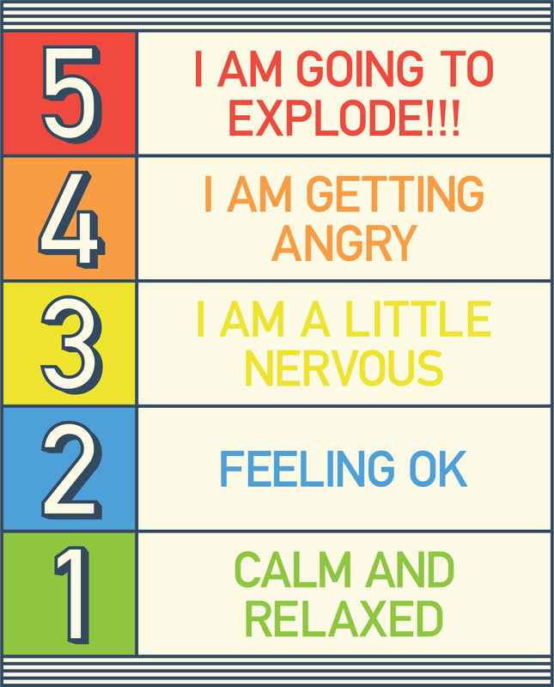
This scale is handy to have around to help identify how you are feeling. This can help you explain to adults how you are feeling and help you identify if you need to try some of the activities and strategies in this booklet to help you feel better.

Slide 19
What can I do?
There are lots of things you can do to keep busy and positive during lockdown. Your teacher will be providing school work already but here is a list of other things you might want to try that will help support your wellbeing. These are all tried and tested ways that help children and teenagers to feel calm, relaxed and positive in times of upset
Stay active – physical activity
Reading – or being read to
Art – drawing, colouring, painting, collage…the list is endless
Meditation and mindfulness
Yoga
Breathing activities
Listening to music
The following pages have a range of activities for you to work through! Enjoy!

Slide 20
Cardio
These links are great for getting you up and active without having to leave the house! Prepare to release those happiness inducing endorphins!
GBX workout Lots of cardio and Cardio to Level up
whole body workouts.

Slide 21
Be artistic
Art of all forms can be very relaxing. Here are some ideas to get you started and see where it leads you!
Take your pencil for Shading lesson Relaxing art session
a walk

Slide 22
Yoga
When children learn techniques for self-health and relaxation, they can navigate life's challenges with a little more ease. Yoga encourages self-esteem and body awareness with a physical activity that's non competitive. Yoga has multiple benefits for children. Physically, it enhances your flexibility, strength, coordination, and body awareness. In addition, it develops concentration and sense of calmness and relaxation.
Beginners yoga with Adrienne 30 min teen yoga
A series of short beginners
lessons.

Slide 23
Meditation, breathing and mindfulness
These strategies are proven to support brain development in kids and adolescents. All methods support self regulation, relaxations and decision making. They are commonly known to support children to calm down and reduce stress levels.
15 min guided imagery for kids Headspace meditation Calming breathing

Slide 24
Reading and being read to
‘You can find magic wherever you look…just sit back and relax all you need is a book!’ Dr Seuss
Audible is currently free for a month. It is so relaxing to be read to and there are so many free books and genres to choose from. If you prefer to read, your local library has a free app.
Link to Audible Link to Renfrewshire libraries app

Slide 25
Mindful colouring
Research suggests that mindful colouring, as with meditation and other kinds of art, can provide numerous benefits for all ages. Along with providing a much-needed break and the chance to relax and refocus, it can: help lift your mood, decrease upset and stress.
Set up a free Twinkl Link to free printables
account

Slide 26
Some ideas for you to try….
Pointilism
Research Pointillism and answer this question: What is pointillism and where did it originate? You can use this website or find your own. https://www.ducksters.com/history/art/pointillism.php
Watch this clip of the techniques used in pointillism https://www.youtube.com/watch?v=1dyapH_yAPQ
Create your own pointillism art. You can copy the design of A Sunday Afternoon on the Island of La Grande Jatte or
The Eiffel Tower by Georges Seurat or you can create your own piece using pointillism.
There are a variety of levels you can use and this can be as easy or as difficult as you like.
When you have mastered the skills, if you want to try a breathing technique with it try the technique mentioned at the bottom of this link http://kidsrelaxation.com/educator-resources/the-point-is-relaxation-pointillism-to-relax/
Positivity quotes
Google positivity quotes, there are so many out there! Use them to inspire you to write your own. You can then design your own positivity poster to display at home or in your window! Positive vibe, positive life! (There are some ideas on the next page for inspiration!)

Slide 27
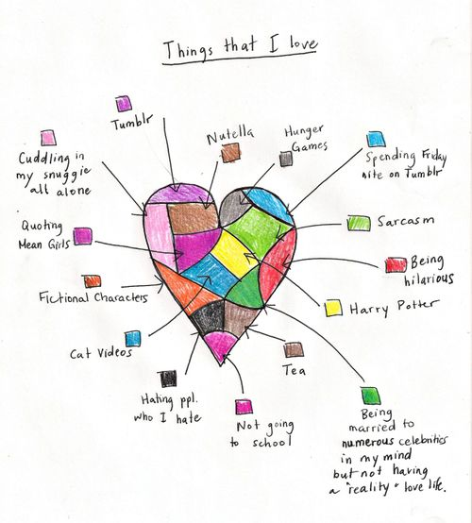
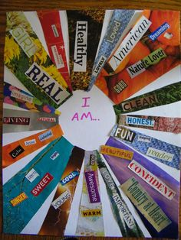
Heart maps
Design your own heart map. Think about all of the things in life that are important to you. What you love, people, places, hobbies and interests. Create a heart map that is as individual as you are.
I am me!
Think of all of the things that make you, you. What is your personality like? What are
your personality traits? What are your likes and dislikes? What are your talents? Use
a range of newspapers, magazines, types of paper that you have, pens and pencils and
create a piece of art all about you.

Slide 28
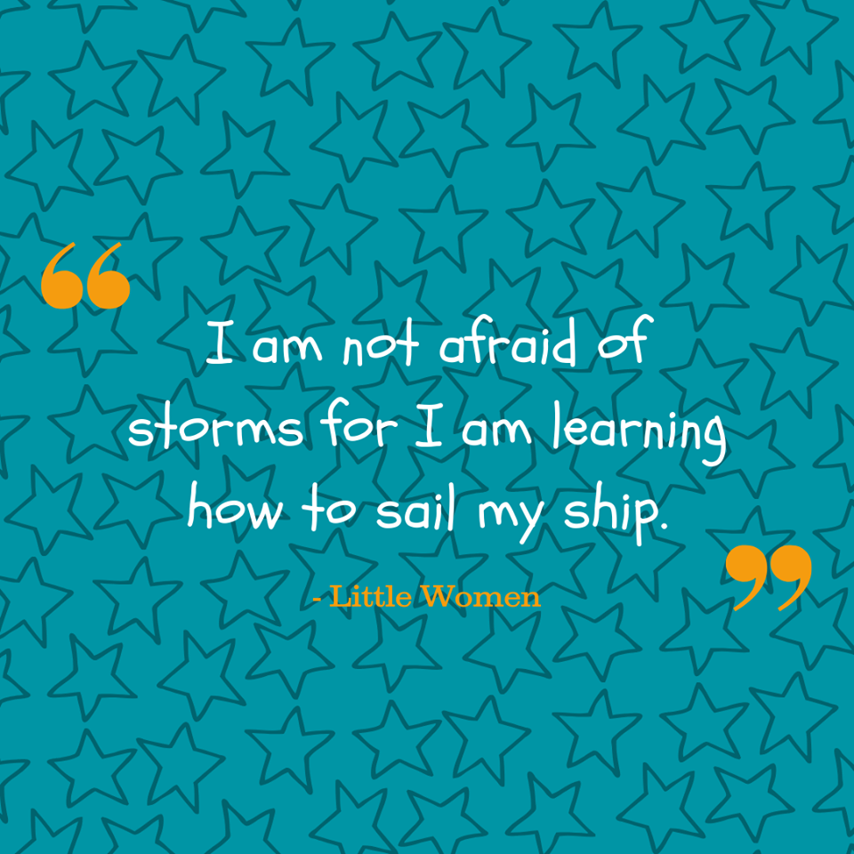

Slide 29
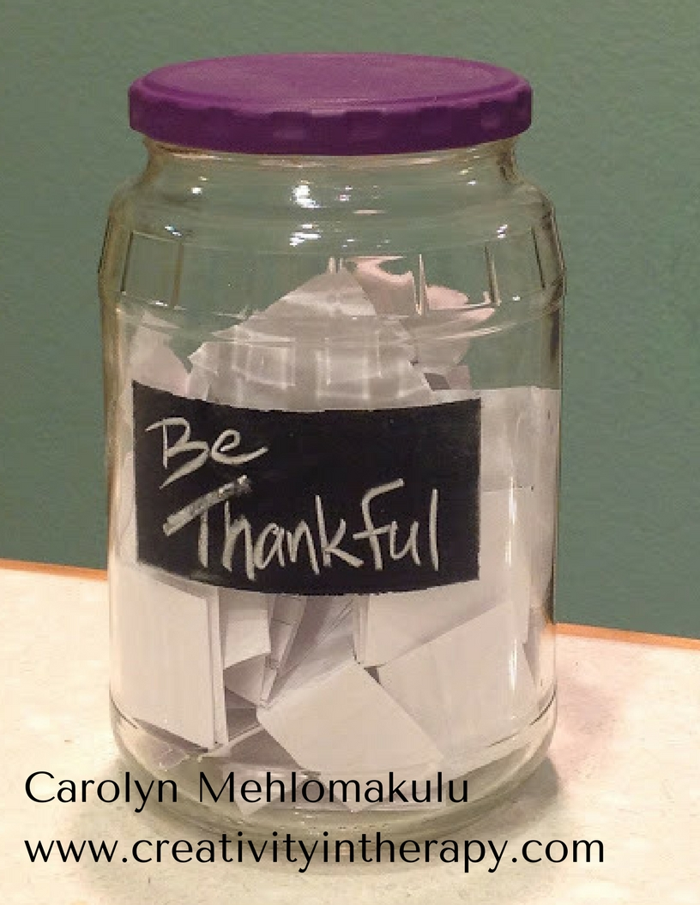
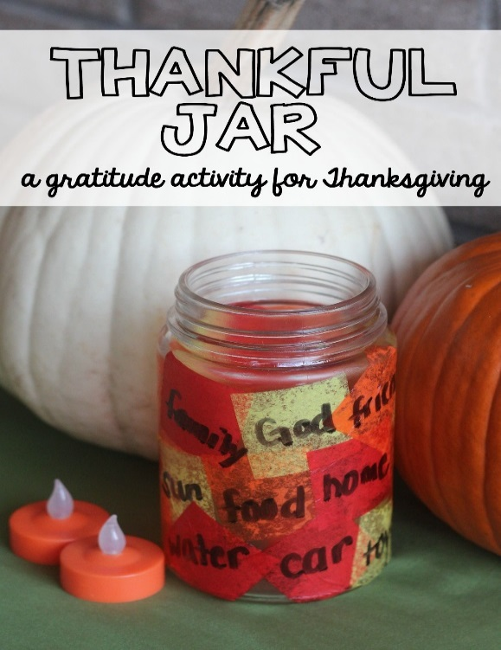
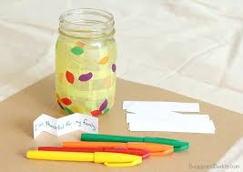
Thankful jars
Make your own thankful jar. It can be made from any box, jar or tub. Find a way to decorate it, make it special and individual to you. Put it somewhere safe, that you will see it and remember to use it. Every day add pieces of paper with notes about what you have been thankful for, what has made you happy that day, positives for the day. Then when you have time, you can read over your notes either alone or with an adult in your house. Perhaps an adult can join in. I have made my jar and my favourite note was from my wee boy who wrote ‘you gave me a hug when I was sad and it made me feel so much better.’ There are lots of small positives to take from these strange days, sometimes you just have to look and think a bit harder about them.

Slide 30
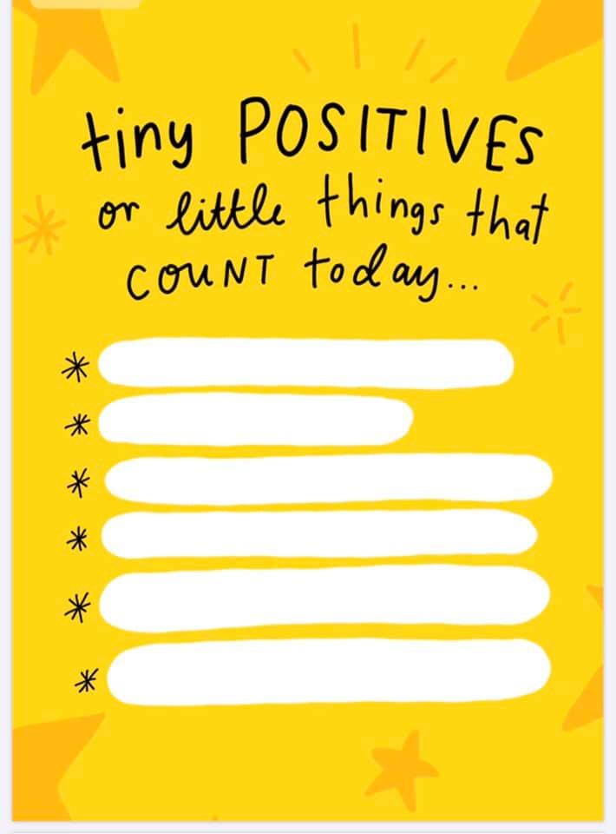
Things that count today!
With an adult sit and think of all of the little positive things that have things that happened today. You’ll be surprised at how many you will find and how good it will make you feel.
The sun is shining We laughed at jokes
We had a lovely walk
I liked hearing the birds singing We played
I phoned my friends FaceTime

Slide 31
Thank you, Primary 7!
Thank you all for taking the time to work through this booklet.
Remember: don’t try to calm the storm, that wont work! Calm yourself and the storm will pass in its own time. School will be there for you as soon as we are allowed to open. The transition team, your primary and your high school are working hard to make sure everything is in place for your move to high school. Don’t worry, everything will be fine! We all miss you and can’t wait to see you!
https://www.childline.org.uk/toolbox/calm-zone/

Slide 32
Preparing for High School – Wellbeing
Top Tips for Making High School
a Success

Slide 33
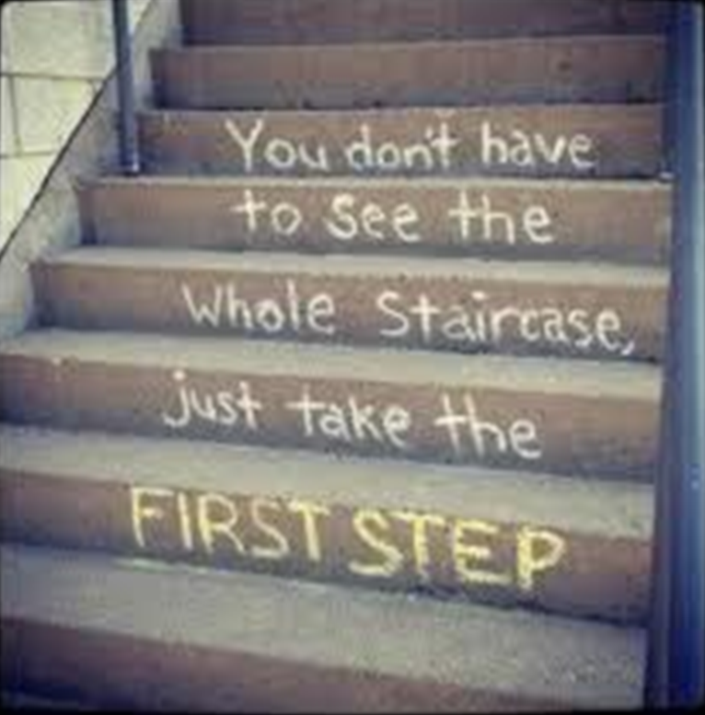
Each step you have already taken, has helped and prepared you for your next one – moving to high school.
With change comes all sorts of emotions, thoughts and questions. The following pages will show you ways to manage the change and answer your questions.

Slide 34
Remember that you are not alone and that everyone wants this step to be as easy as it can be for you.
There are people to help you each step of the way – your parents/carers, your teachers, other staff in your new school and your friends.

Slide 35
But first, let’s begin with you. It’s important to recognise and celebrate who you are and what you have achieved.
Discuss the following with your family:
What kind of person/friend are you?
What do people like about you?
What do you enjoy?
What are you good at?
What have you achieved already? Think about in school and out of school.

Slide 36
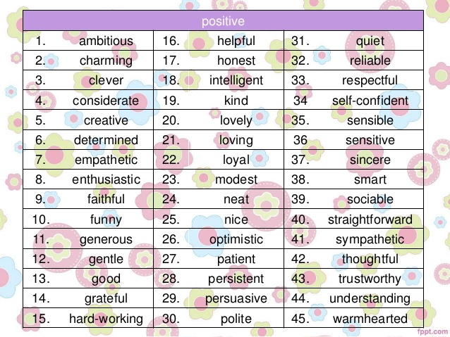
Ask your family members and your
friends to describe you.
What positive things do they say about you?

Slide 37
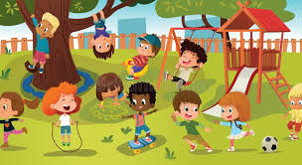
Remembering Together 1
Talk to a member of your family about your memories of primary school. Here are some questions you might want to start with:
Which events, trips, plays, shows, assemblies, sports and music activities do you remember?
What jobs or roles of responsibility have you had in primary school?
What lessons have you enjoyed the most?
Who have you been good friends with at primary?
Can you remember any funny incidents?

Slide 38
Remembering Together 2
Talk to a family member about their memories of starting high school. Here are
some questions you could ask:
Can you remember how you felt when you were leaving primary or starting high school?
Can you think of something that you are proud of when you were in high school?
What were your favourite subjects and why?
Is there anything you would do differently?
Did you know what you wanted to do when you left high school?
Did you do that or something else?
Are there any helpful hints or tips you could give me for starting high school, to help me make the most of it?

Slide 39
Your new high school may be further away from where you live so it’s important
to plan and, if possible, to practise your new journey to school.
As a family, decide which of these you will need to think and talk about.
Where am I going?
How am I getting there?
How long will it take?
What is the quickest way?
What time do I have to leave?
Where is the bus stop?
Is there a school bus?
Do I get a pass?
Who will drive me there?
Will I go with a friend?
How much does the bus/train cost?
How will I get home?

Slide 40
Now let’s look at some of the questions and thoughts you may have.
But before we do, it’s important to say that your primary school, your transition teacher and your new high school are all working together to support you and your family.
We care about you and are here to help so if you have any questions, remember that there are people who know the answers to them and want to do all we can for you. No question is too small or too silly and they have actually been asked by each new S1 pupil for generations!
A great source of information is your new school’s website. On the next page you will find a link to all the high schools in Renfrewshire.
Have a look at your high school to see what you can discover and don’t forget their Twitter account too.

Slide 41
Links to School Websites
https://www.castleheadhigh.renfrewshire.sch.uk/
http://www.glenifferhigh.renfrewshire.sch.uk/
https://www.gryffehigh.com/
https://www.johnstonehigh.co.uk/
http://www.paisleygrammar.com/
http://www.linwoodhigh.renfrewshire.sch.uk/
http://parkmains.com/
https://www.renfrewhighschool.com/
http://www.standrewspaisley.com/
https://trinityhighrenfrew.co.uk/
https://www.oraetlabora.co.uk/ (St. Benedict’s)
https://blogs.glowscotland.org.uk/re/maryrussell/

Slide 42
There are many questions and thoughts that you may have that every pupil going into S1 has. Let’s look at some of these and their solutions.
* I’m nervous/scared.
It’s absolutely ok to feel like that. Many others will be
feeling the same way too.
Take deep breaths and share your worries with someone you trust.
* Is the work really hard?
Remember when you were starting a new class in primary school and you had the same thought about the work – and you managed it!
Learning is a step that you are taking, building on what you already know.
There are times when we all may feel that things are hard but it’s good for our brain to be stretched by new learning.
We can all temporarily forget things and need to seek help.
If you need help at anytime, please ask.
* Who do I go to if I have a
problem or need help with
something?
You will each have a pastoral or
guidance teacher who will be
there for you for big things that concern you. S/he will also be the one that your family will speak to if they need to.
For class things, or anything that you are unsure of speak to your class teacher who will help you or point you in the right direction of someone else who can help you.

Slide 43
* What if I get lost?
You very well may get lost so try not to worry about it and
just accept it as part of getting used to a new place. New teachers in the school get lost too!
Just say to a pupil or adult, “Excuse me, I’m looking for (e.g) the Science department. Can you tell me how to find it please?”
Remember that everyone understands that it takes a while to get used to a new, larger building and they felt the same as you.
* My primary teacher knows all about me and the things that I need help with, what will happen in high school when there are so many teachers?
Primary schools and high schools
talk to each other and they pass on important information so that the staff know about you and can help you in the same way. Make sure you say to your teacher if there is something that you find difficult and they can help with e.g. you can’t see the board.
* What about homework?
Because you will have so many subjects, you will find that you get homework from different classes. Like primary, you’ll be told what and when it’s due in. It’s important to be organised so that you don’t end up with a lot to do in one night. Spread your work throughout the week and if you forget to do something or find it difficult just let your teacher know so they can help you.

Slide 44
* I’ve heard some scary stories about high school and
about teachers.
These stories have been going around since schools began.
Sometimes people like to tease new S1s by telling them
scary things as the situation is so new to them.
It is important for you to know that the staff will be doing all they can to make you feel safe and happy in your new school.
If at any time you are worried about anything, then share it with your pastoral/guidance teacher or a member of staff.
It is natural to be unsure about new teachers until you get to know them. You may have had the same thoughts and feelings in primary school. Take people as you find them, not as you what others say about them.
Remember to share any worries you have early on so that you can be helped. As well as the school staff, your parents/carers and friends are there for you.
* What about all the questions I have about lunch, school rules and other things that I don’t know about?
Don’t worry as some of these questions will be answered when you get to high school. Look at the school handbook too as you will find a lot of information there.

Slide 45
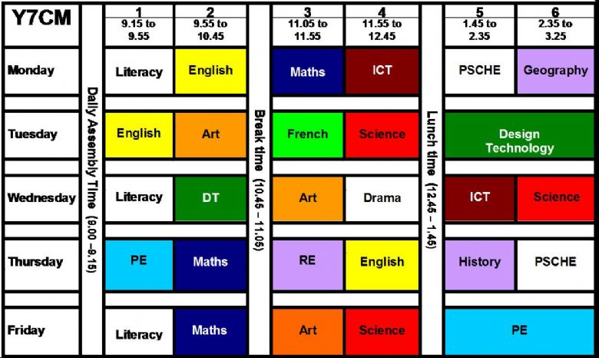
* Will I have a lot of things to
take with me to school every day?
Because you move about from
classroom to classroom (many pupils
say that they really like that) you will have to put all that you need for that day in your bag. Being organised will help you here.
Some pupils like to colour code their timetable and their jotters for the different subjects. They put a dot or a sticker of the matching colour on their jotter and they can quickly see which jotters they need to bring with them for each day. If you have a phone you can take a photo of your timetable.
Remember stationery like pencils, pens etc. If you don’t have any, your teacher will help.
When you have PE, you will need to have your PE uniform with you for these days. Make sure you can tie your tie as you may be going into another class afterwards and you need to change into your school uniform for that.
You could be asked to bring a box to HFT (Health and Food Technology) so you can take the delicious things you have made with you.
If you forget anything, just say to your teacher at the beginning of the class.

Slide 46
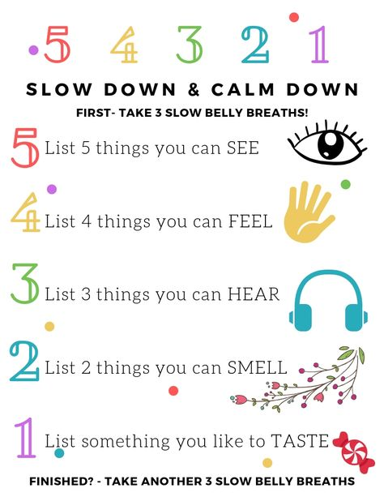
Remember:
* You are not alone, other people
feel the same way too.
* High school is your next step. You will, amongst other things: make new friends, learn new things, use new equipment, meet new people and become more independent.
* There are people there to help you
* If at any time you feel yourself getting anxious, take some deep breaths and do the 5, 4, 3, 2, 1 exercise in the poster.

Slide 47
Useful Websites
Here are some websites for you to look at for some more information:
http://renfrewshire.gov.uk/Freeschoolmealsandclothinggrants
http://www.renfrewshire.gov.uk/article/10122/Mental-health-and-wellbeing-advice
https://education.gov.scot/parentzone/my-child/transitions/changing-school/
https://www.bbc.co.uk/bitesize/tags/zh4wy9q/starting-secondary-school/1
https://youngminds.org.uk/resources/school-resources/find-your-feet-transitioning-to-secondary-school/
https://www.nhs.uk/oneyou/every-mind-matters/
https://young.scot/get-informed/national/how-to-look-after-your-mental-wellbeing
https://clearyourhead.scot/

