Slide 1
Under 3’s -
Learning Statements and photographs
West Johnstone ELCC

Slide 2
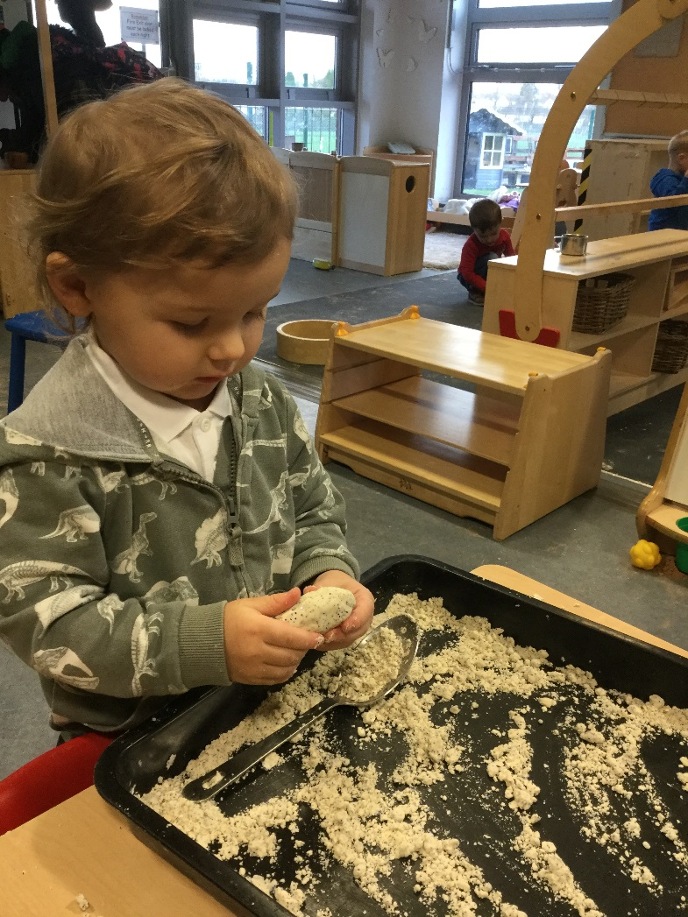
“By exploring malleable play using my senses, I am developing concepts about textures”.
“I am developing gross and fine motor skills using malleable resources by twisting, rolling, squeezing and stretching them”.

Slide 3
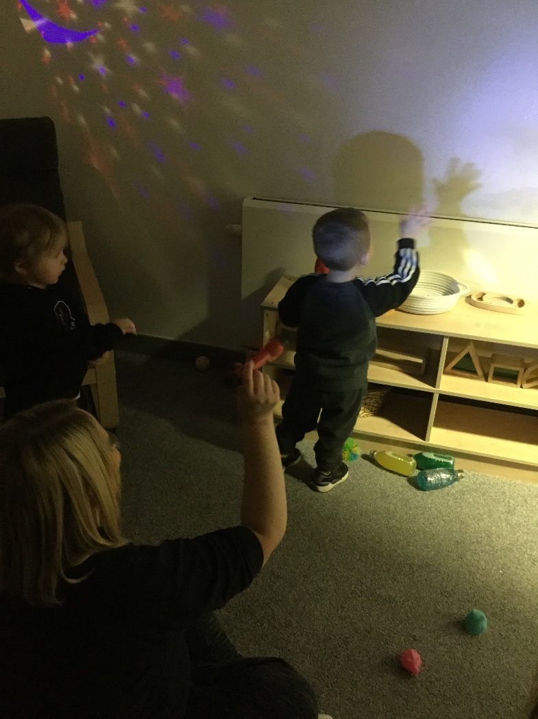
“I am learning about shadows and how they are made”.
“I’m exploring ideas of dark and light which helps me to make sense of the world”.

Slide 4
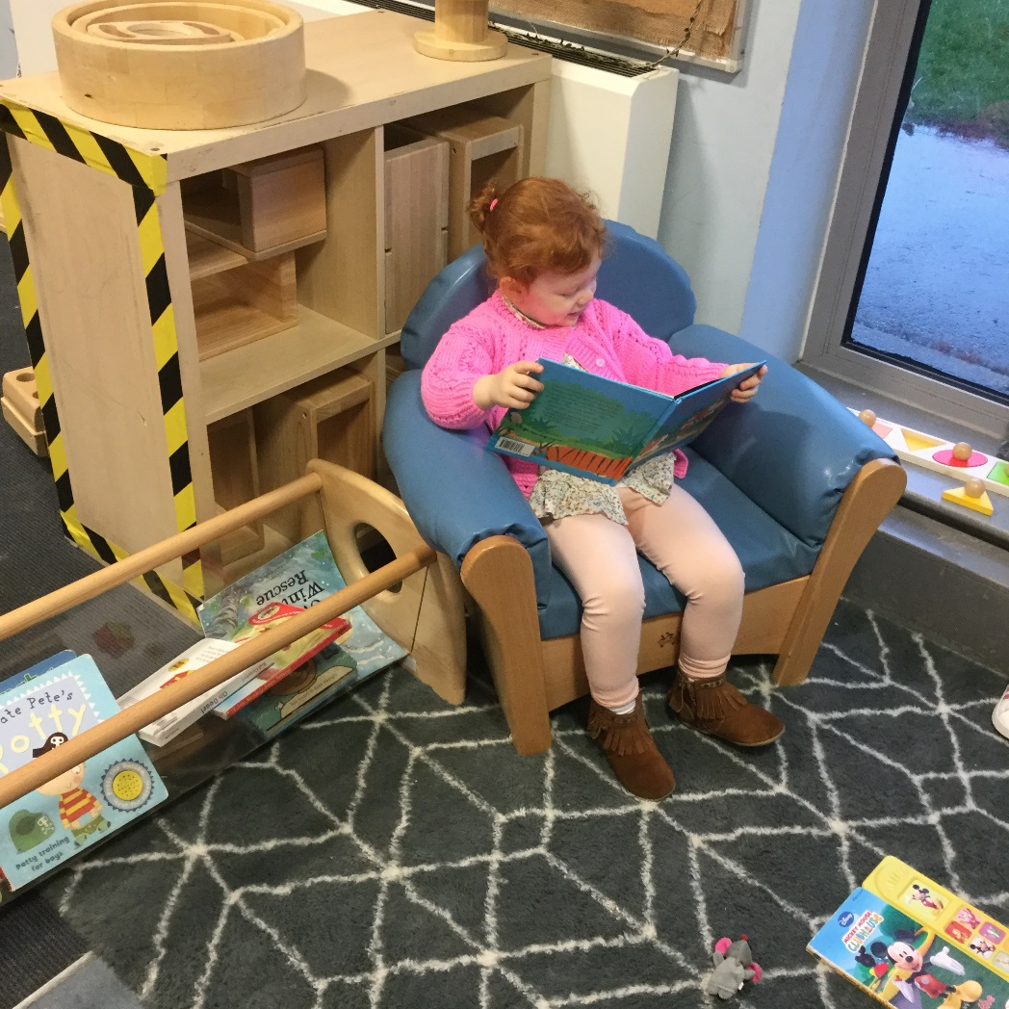
“Looking and enjoying a book on my own offers me some quiet time throughout my busy day”.
“I am developing and awareness of print in a book and although I can’t read it yet…I know it has meaning”.

Slide 5
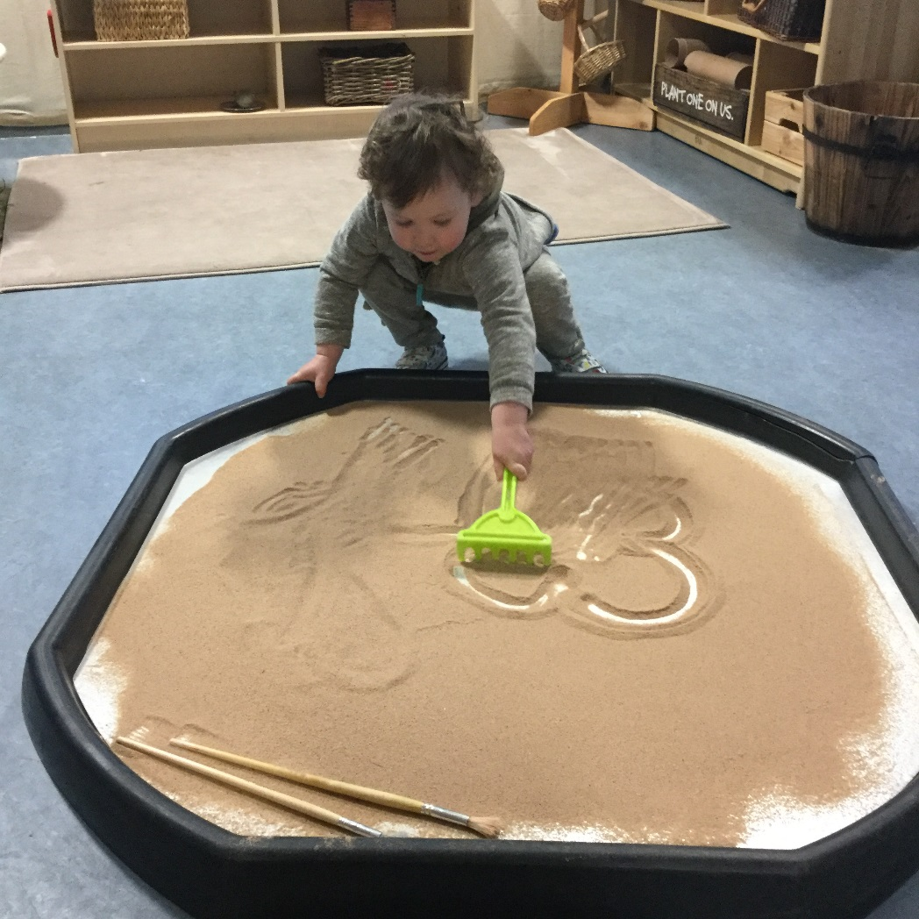
“I am exploring early mark making in the sand…later I will apply these skills when I learn to write”.

Slide 6
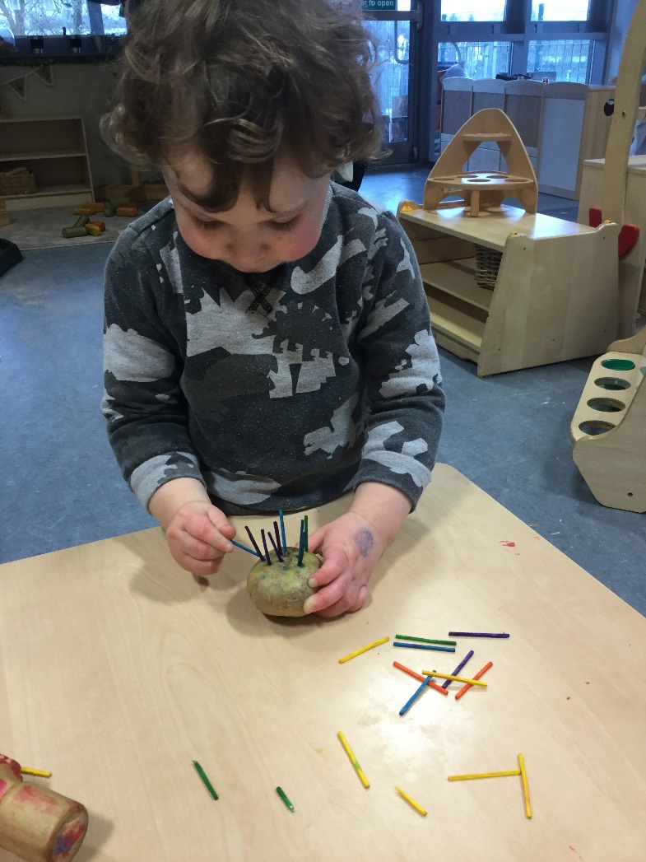
“I am developing my fine motor skills and my pincer grip…these skills will help me develop the hand and finger muscles I need for when I’m holding a pencil”.

Slide 7
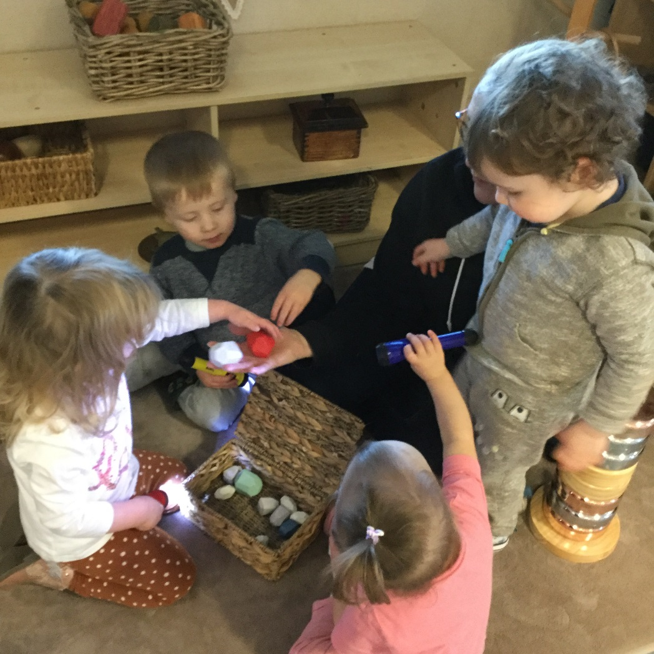
“We are explorers”…we are using torches to explore treasure we’ve found”.
“Learning alongside friends expands curiosity, creativeness and communication skills”.

Slide 8
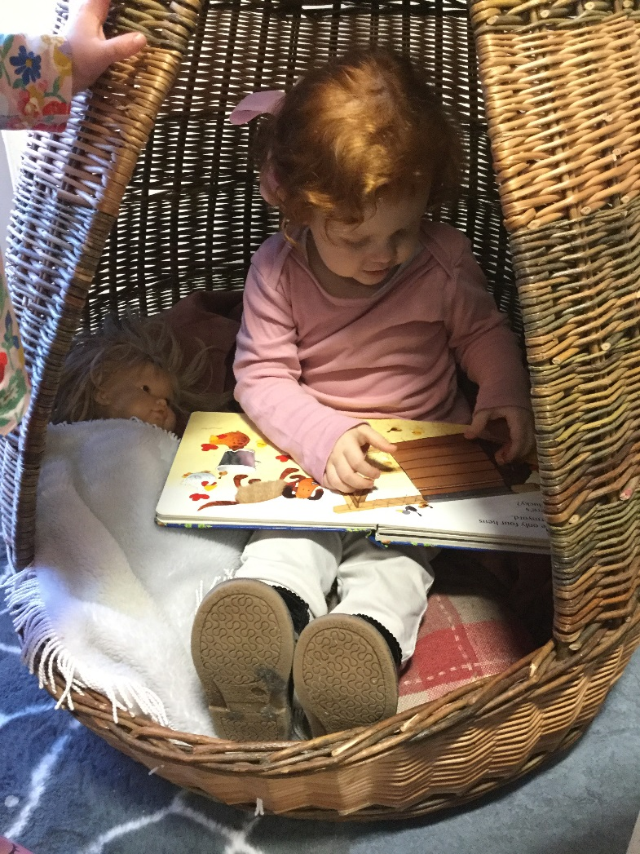
“Quiet spaces allow time out from my busy day”.
“I can tell a story by interpreting what's happening in the pictures”.

Slide 9
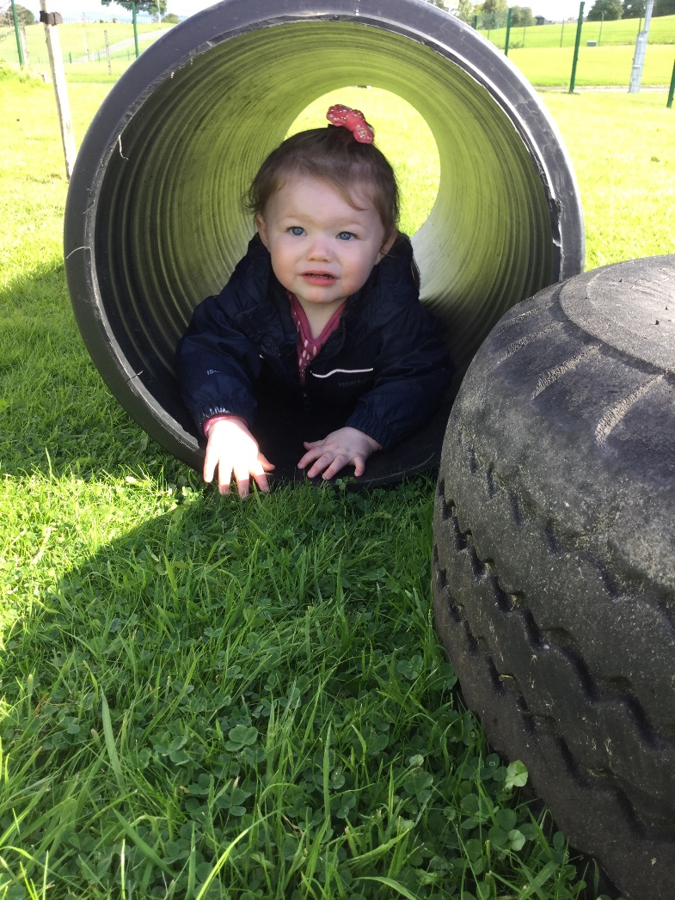
“I am developing independence in exploring a variety of equipment indoors and outdoors”.
“I can develop my physical skills using a variety of movements”.

Slide 10
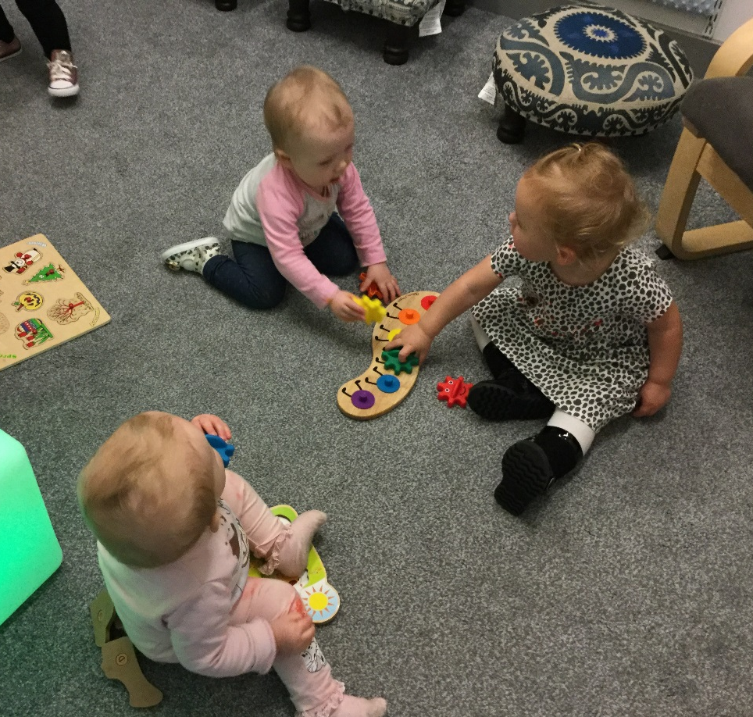
“I am becoming aware and interested in the play of others”.
“I am learning to play alongside my peers”.

Slide 11
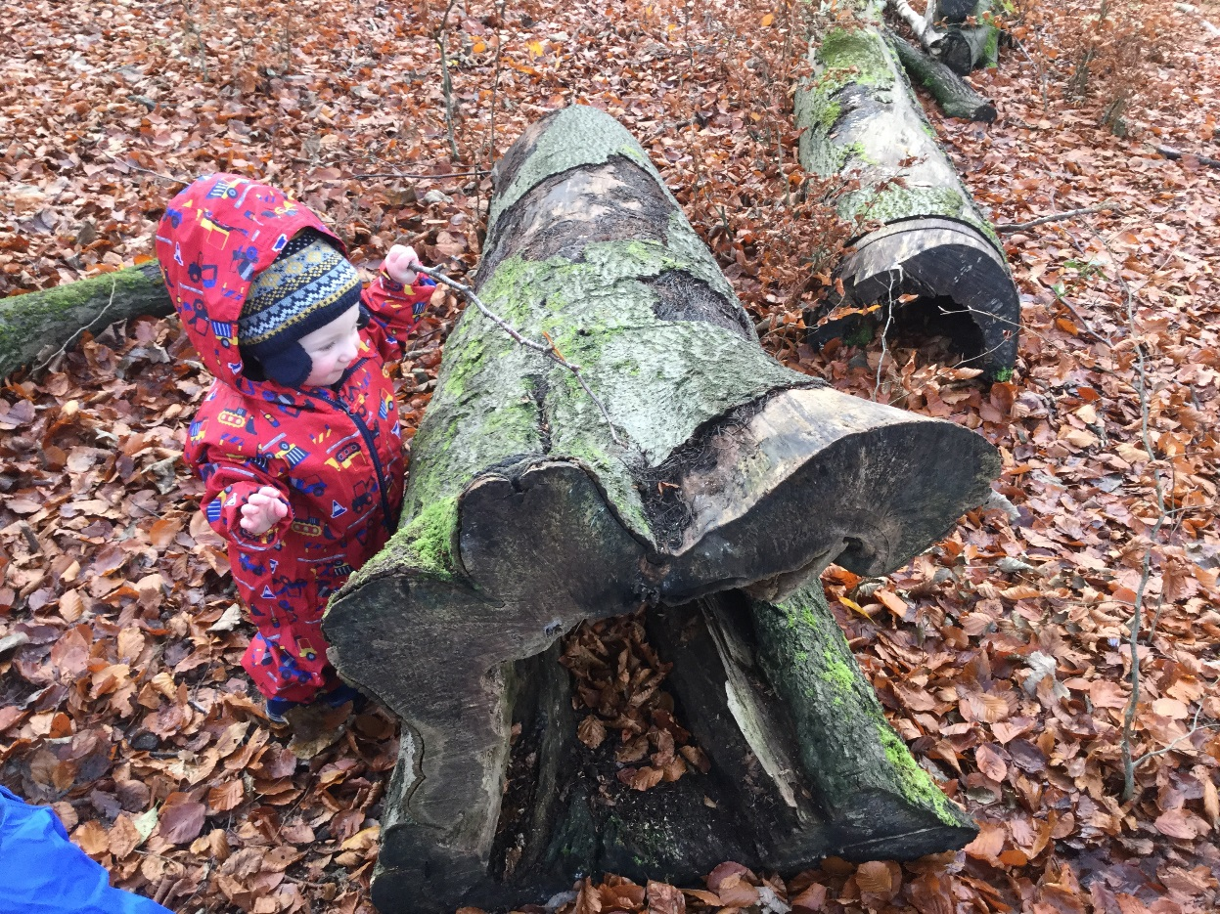
“I am an explorer…I’m out in the forest exploring and following my curiosity”.
“I am developing a sense of wonder about nature by exploring outdoors, stones and natural objects in the local community”.

Slide 12
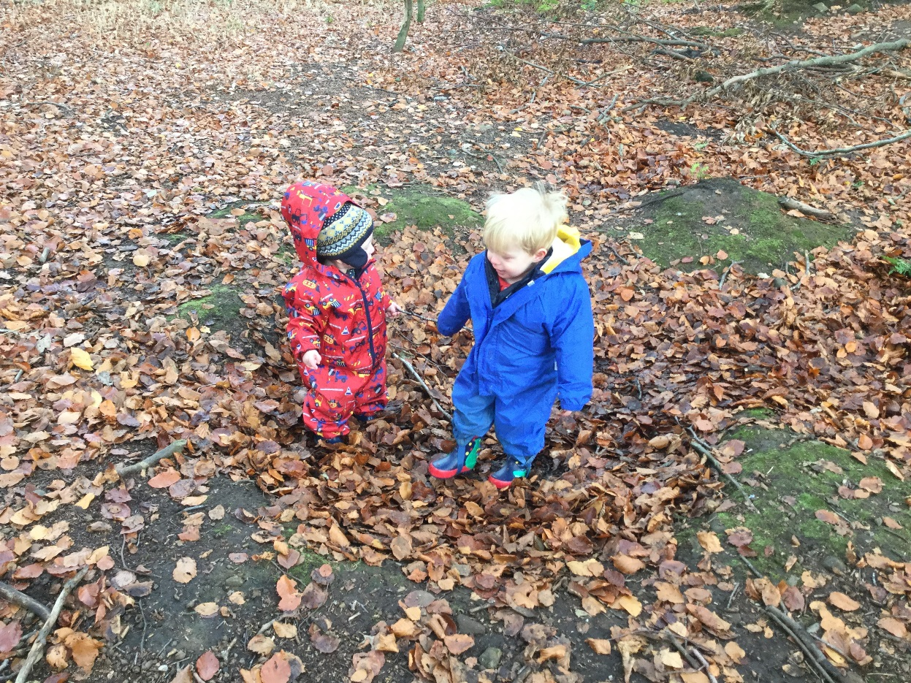
“I am developing a sense of wonder about nature by exploring outdoors, stones and natural objects in the local community”.
“I am learning to play alongside my peers”.

Slide 13
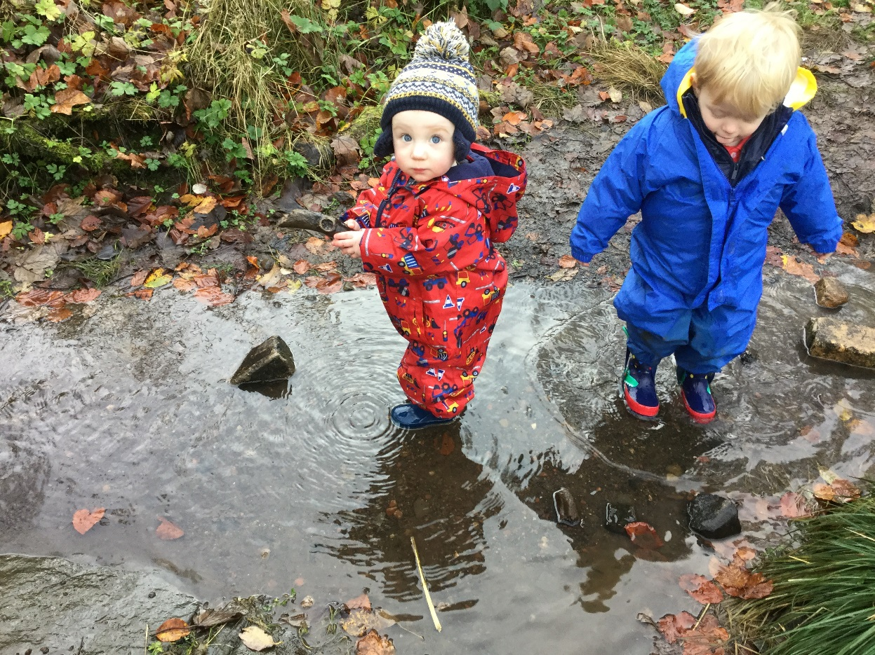
“Oh the potential of a puddle”!
“I am learning through sensory play the patterns that can be made when the water moves”.
“I am a scientist I can test how deep or shallow the puddle goes, using my feet”.

Slide 14
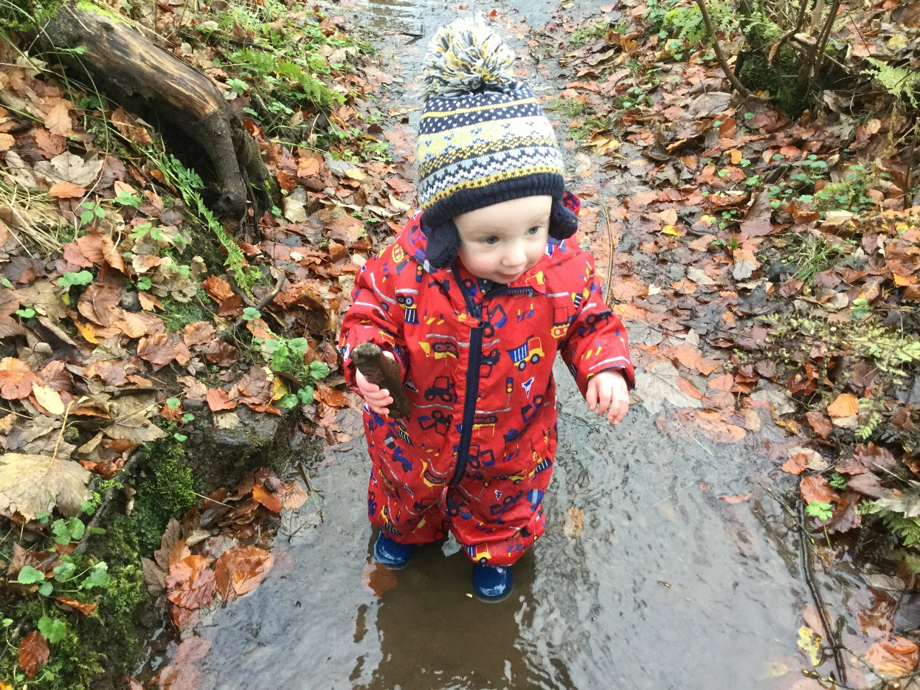
“I am learning to make sense of the world and learn new skills through Schematic play”.
“Dropping sticks into the water lets me explore aspects of the Trajectory schema”.

