Slide 1

Welcome to
West Early Learning and Childcare Class
Honesty
Respect
Trust

Slide 2
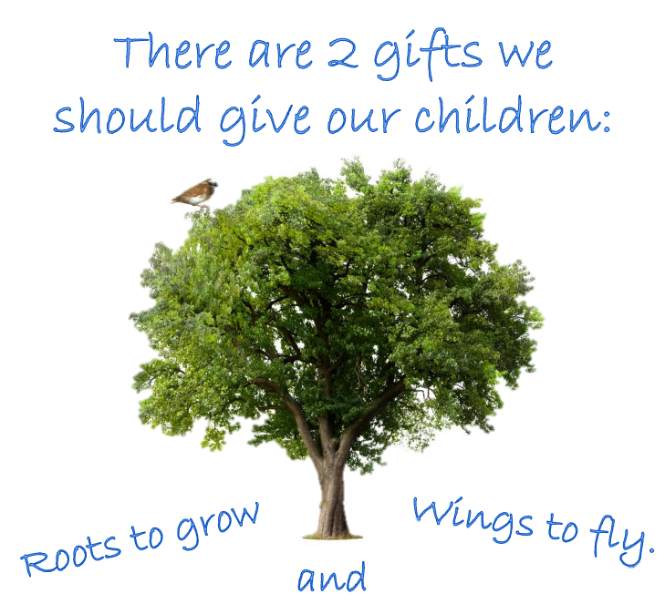
Meet the
West ELCC
Staff Team

Slide 3
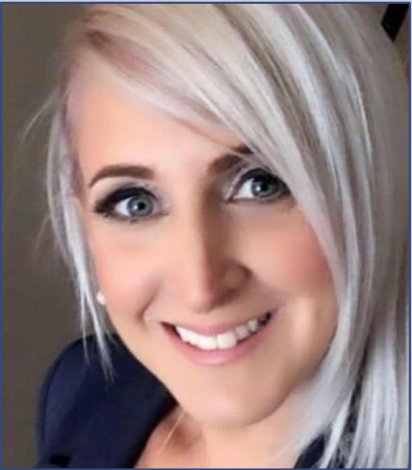
Mrs Wiszniewski
Deputy Head Teacher
My favourite colour is
Purple.
Something I love is..
Musicals. I would love to be in one.
My favourite food is..
Breaded chicken.
An interesting fact about me is…
I have met King Charles when he was Prince.

Slide 4
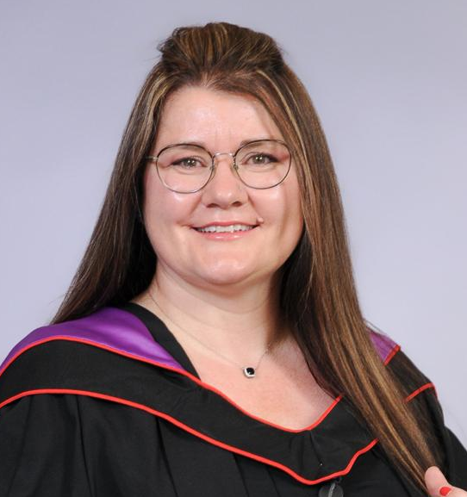
Ms Russell
Acting Senior Early Learning and Childcare Officer
I am the Keyworker for the Yellow Group.
My favourite colour is
Red.
My favourite food/drink is..
Lady Grey tea.
Something I love is..
My animals.
An interesting fact about me is…
I am a mum to 5 children.

Slide 5
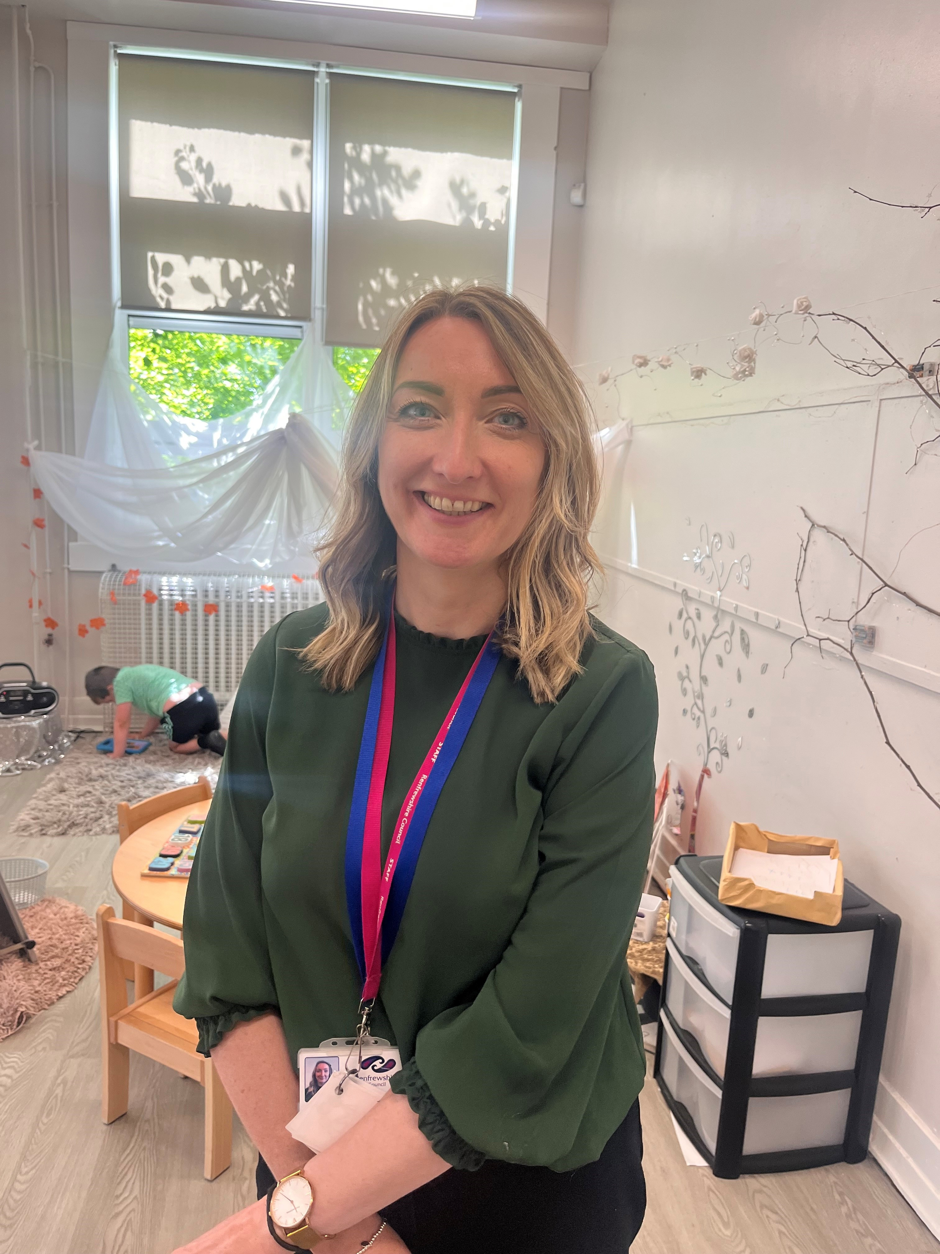
Mrs Harding
Early Years Graduate
My favourite colour is
Green
I am the Keyworker for the Rainbow Group (I look after all the groups.)
Something I love is..
To sing loudly in my car.
My favourite food is..
Indian or Italian
An interesting fact about me is…
I once broke my finger going down a slide at soft play and had to learn to change a nappy with one hand.

Slide 6
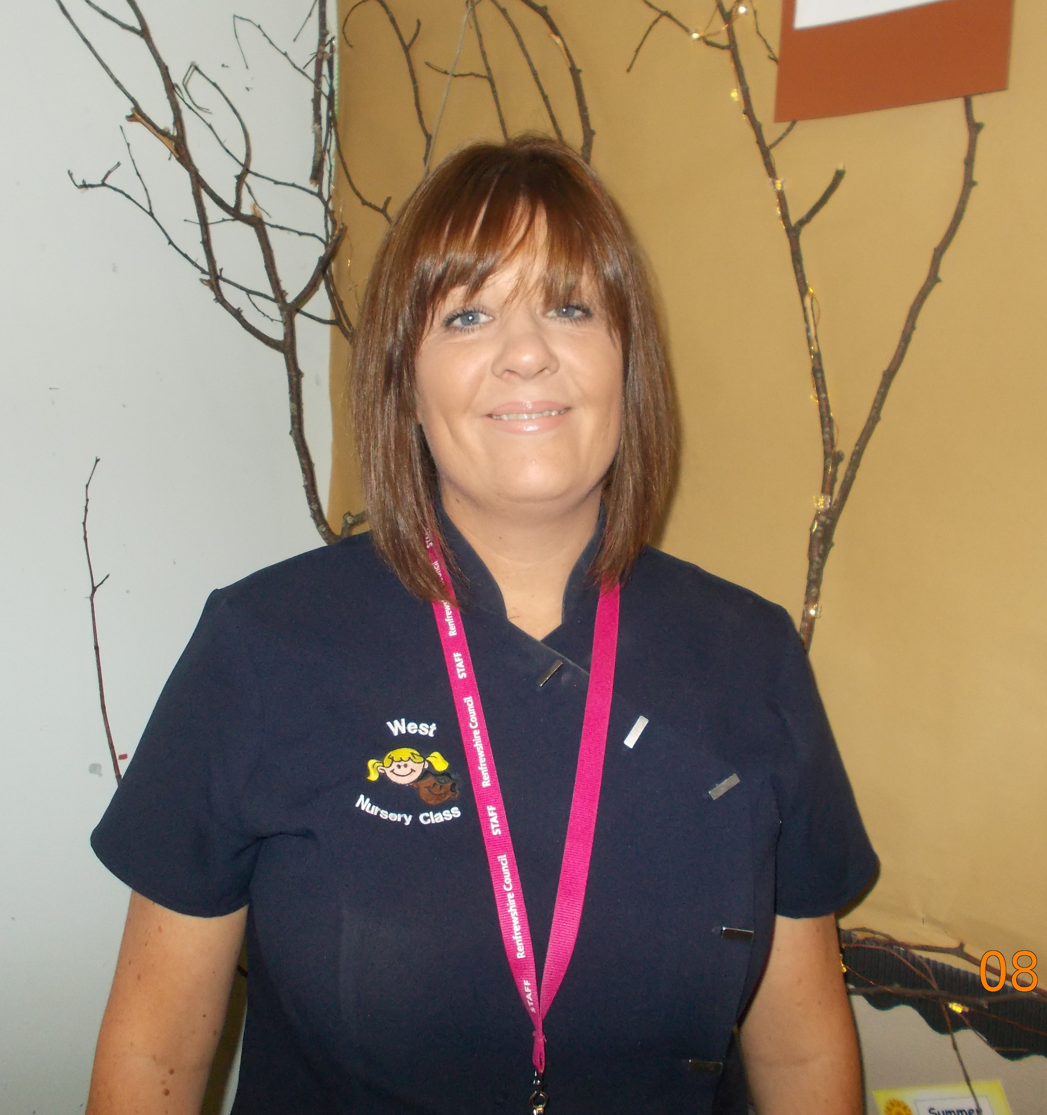
Mrs Simpson
Early Learning and Childcare Officer
My favourite colour is
Red.
I am the Keyworker for the Red Group.
My favourite food is..
Sunday Roast.
Something I love is..
I am a twin.
An interesting fact about me is…
I have twin girls.

Slide 7
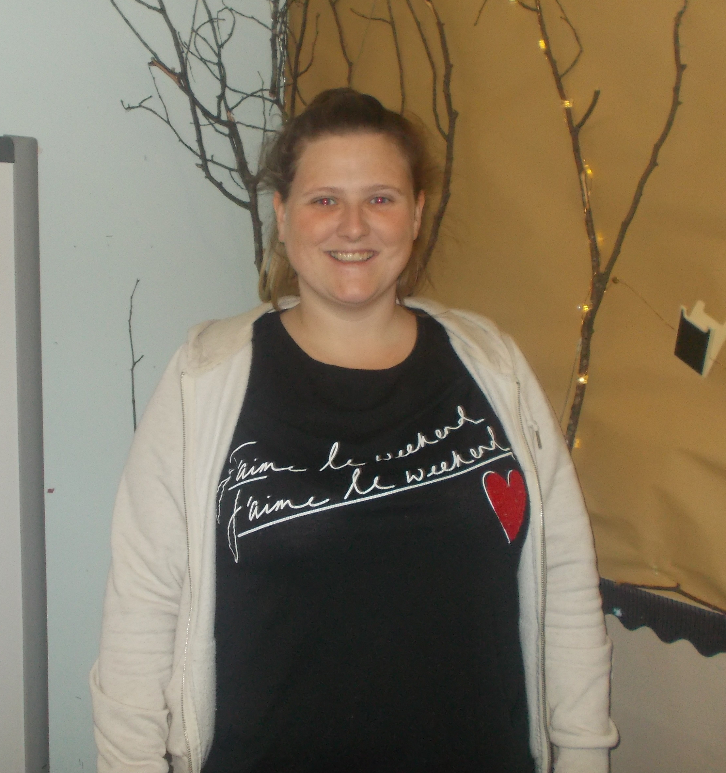
Mrs Haggerty
Early Learning and Childcare Officer
My favourite colour is
Pink.
I am the Keyworker for the Green Group.
Something I love is..
I am 1 of 4 girls.
My favourite food is..
My Granny’s mince & totties.
An interesting fact about me is…
I have the same birthday as Neil Armstrong.

Slide 8
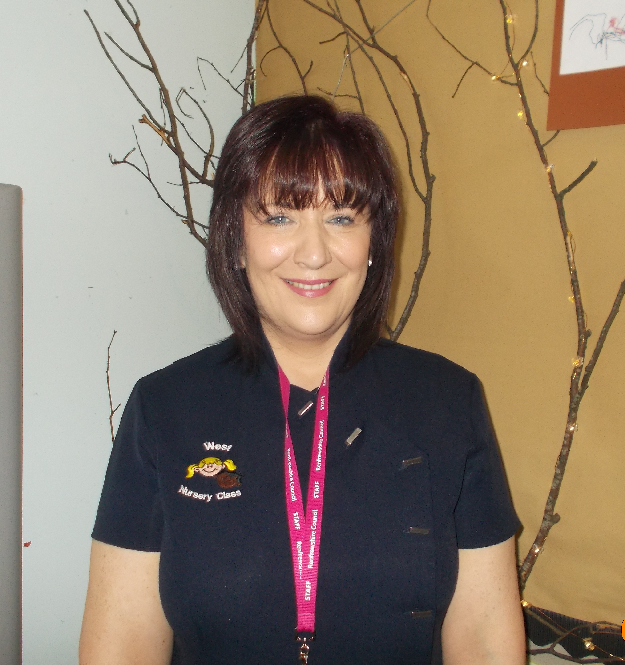
Mrs McIntosh
Early Learning and Childcare Officer
My favourite colour is
Blue.
I am the Keyworker for the Blue Group.
My favourite food is..
Italian food.
Something I love is..
taking Bookbug Sessions.
An interesting fact about me is…
I am a mum of 2 boys.

Slide 9
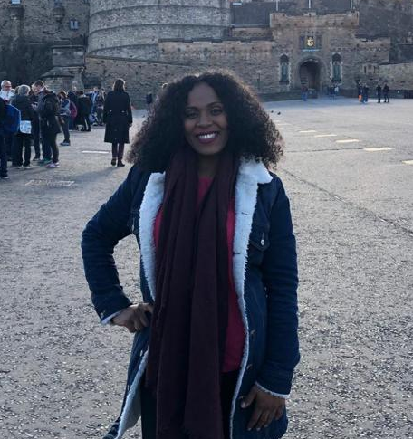
Miss Jones
Early Learning and Childcare Officer
My favourite colour is
Black.
I am the Keyworker for the Yellow Group.
My favourite food is..
Chinese food.
Something I love is..
My puppy Kingsley.
An interesting fact about me is…
I can speak another language.

Slide 10

West Primary & ELCC
Our Vision & Values
See you soon Little Westie!

