Slide 1
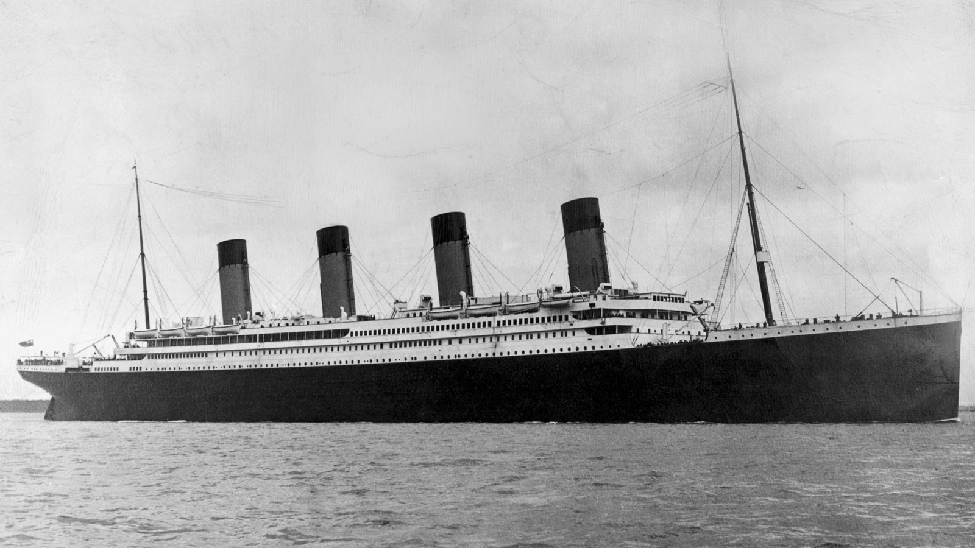
Titanic Lola Max cerys
The titanic fire below the titanic fire went on for 10 days the fire start in 1 of the engine engine5meiting the metal.

Slide 2
It is sad and it sank is sad for us and you
The Titanic was built between 1909 and 1911
Over 1500 people died because of the sinking
In the days of ships took weeks if not months to travl

Slide 3
the titanic sunk over 300,00 yers a go in the iesberg

