Slide 1
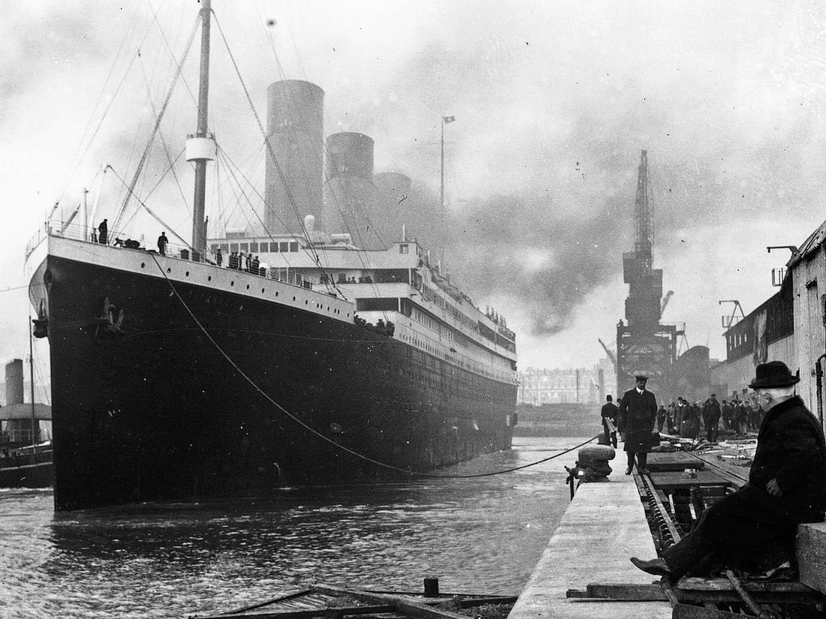
Ten reasons Titanic sank
Titanic sank because of these reasons.

Slide 2
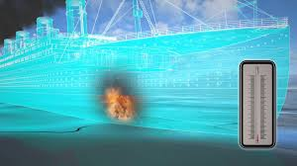
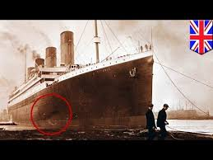
There was a FIRE in bunker room 5. The fire was burning for ten days. It was in between 500 to 1000 degrees.

Slide 3
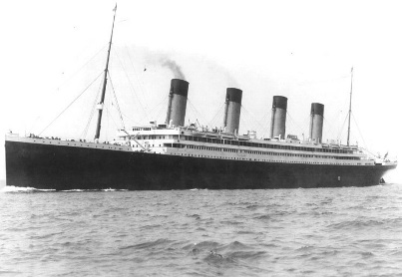
Olympic was racing a war ship the war ship rammed the Olympic and they had to fix it because it had bookings that made the titanic late.

Slide 4
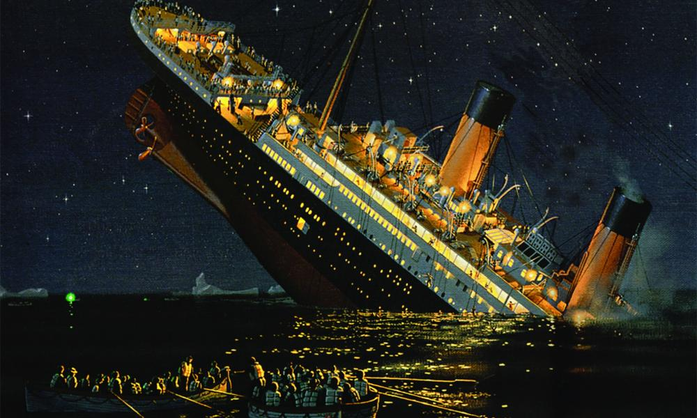
There was a man on the ship that had the keys to the binoculars. But he was kicked of the ship because there was a new officer from the Olympic.

Slide 5
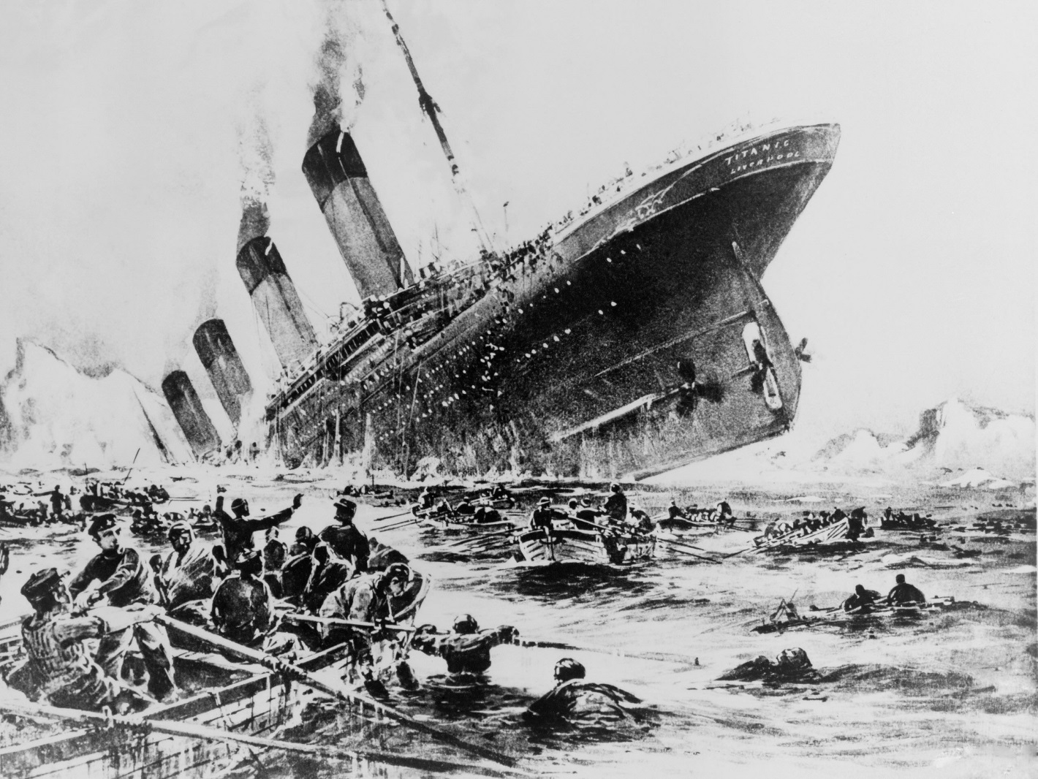
The passengers did not know that the Titanic had struck an iceberg. The Atlantic was very cold that night. Her hull was too cold.

Slide 6
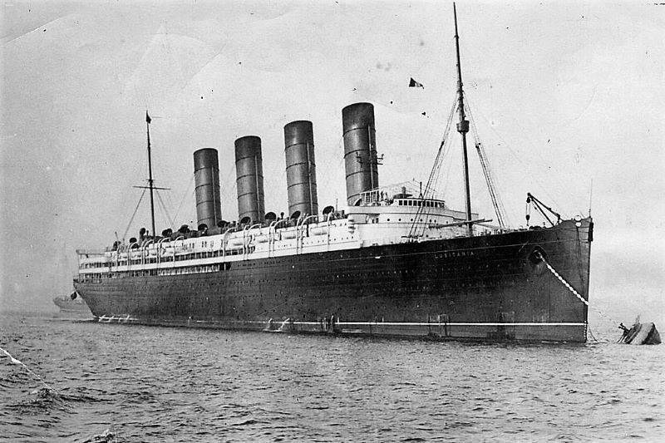
They used a machine to get in the steel rivets but their was a to tight a space so they used iron rivets and iron rivets and their weaker.

Slide 7
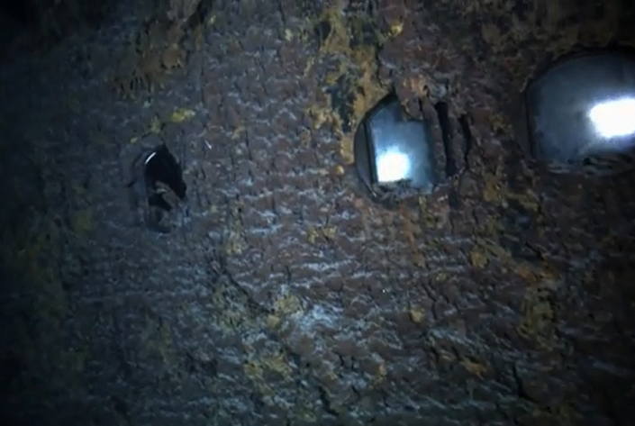
Passengers left their portholes open which caused more flooding.

Slide 8
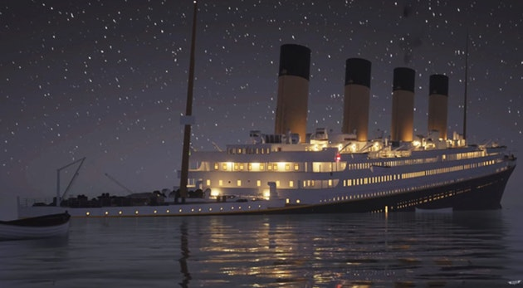
And the obvious resin it hit a iceberg.

Slide 9
About 1,500 people died Sign in All Videos Images Maps News More About 1,500 people died. Tools SafeSearch on Size Colour Usage Rights

Slide 10
It went over speed.

Slide 11
The capatin was asleep.

Slide 12
Any questions

