Slide 1
Titanic
And 10 reasons it sank

Slide 2
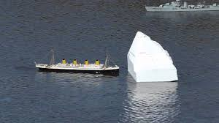
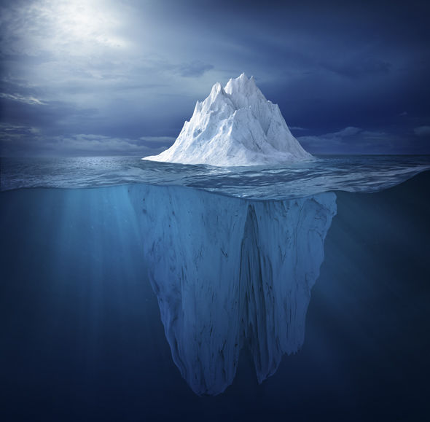
ICE BERG
The titanic hit an ice berg which all of you know!
It was ice berg season when the collision happened.

Slide 3
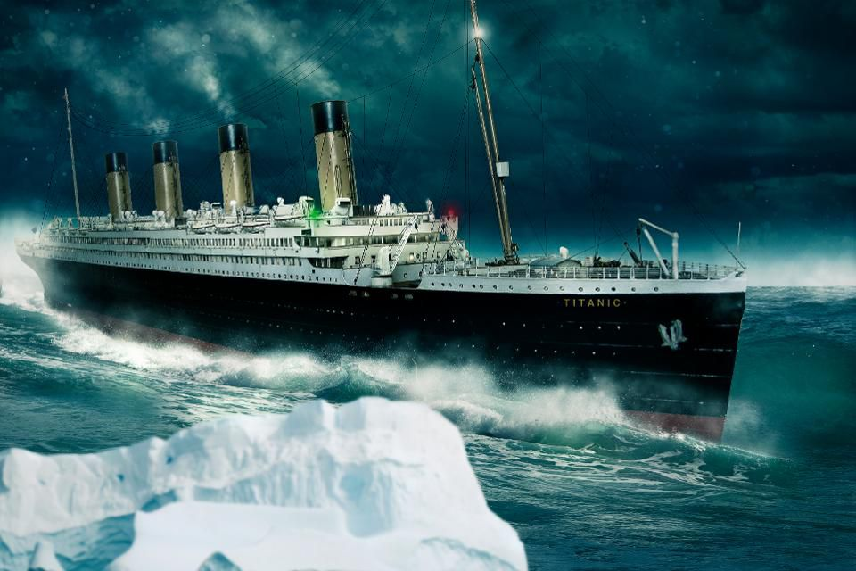

Slide 4
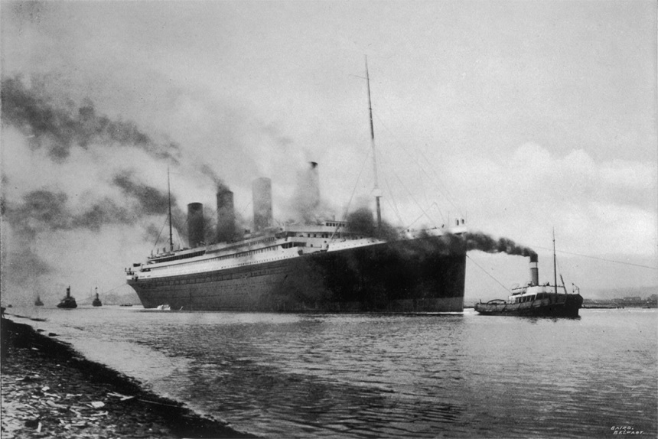
THE DELAY
THE Olympic was in a race with a war ship and she got hit on the side!
So all of the workers went to fix Olympic

Slide 5
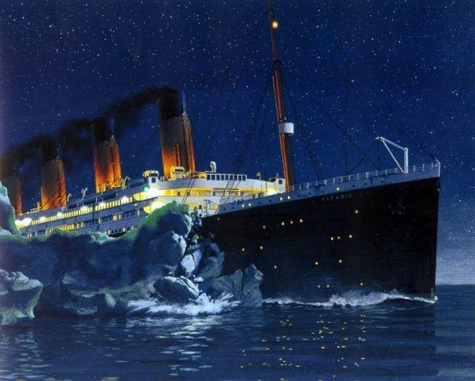
THE DODGE
The dodge of the Titanic may have been the worst choice of all
if they hit it straight on it might not of got damaged as it did

Slide 6
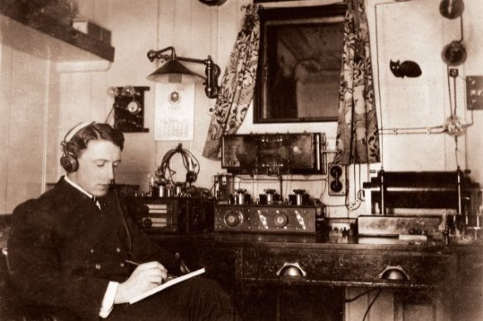
3 little letters MSG
The titanic were receiving messeges but with no MSG and they told them to go to bed so they did exactlly that.

Slide 7
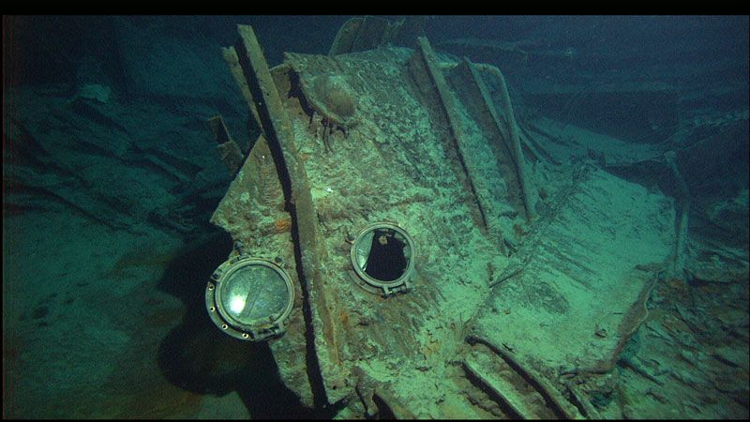
Open portholes
300 portholes were left open so 12 would of doubled the amount of damage of the ice berg.

Slide 8
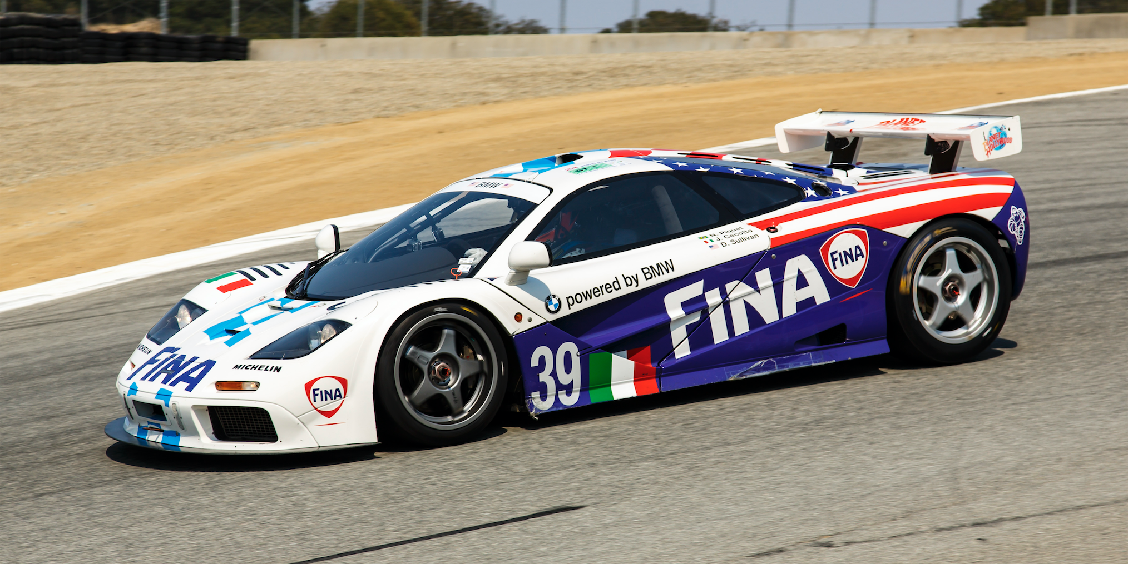
NEED FOR SPEED!
The captain of the Titanic captain smith had a need for speed
Captain Smith was driving the Titanic at 21 knots 3 more knots than neaded

Slide 9
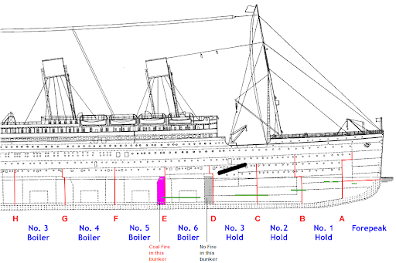
Fire down below
The fire was on for 10 days!
There was lots of fire men trying to help the titanic stay strong.

Slide 10
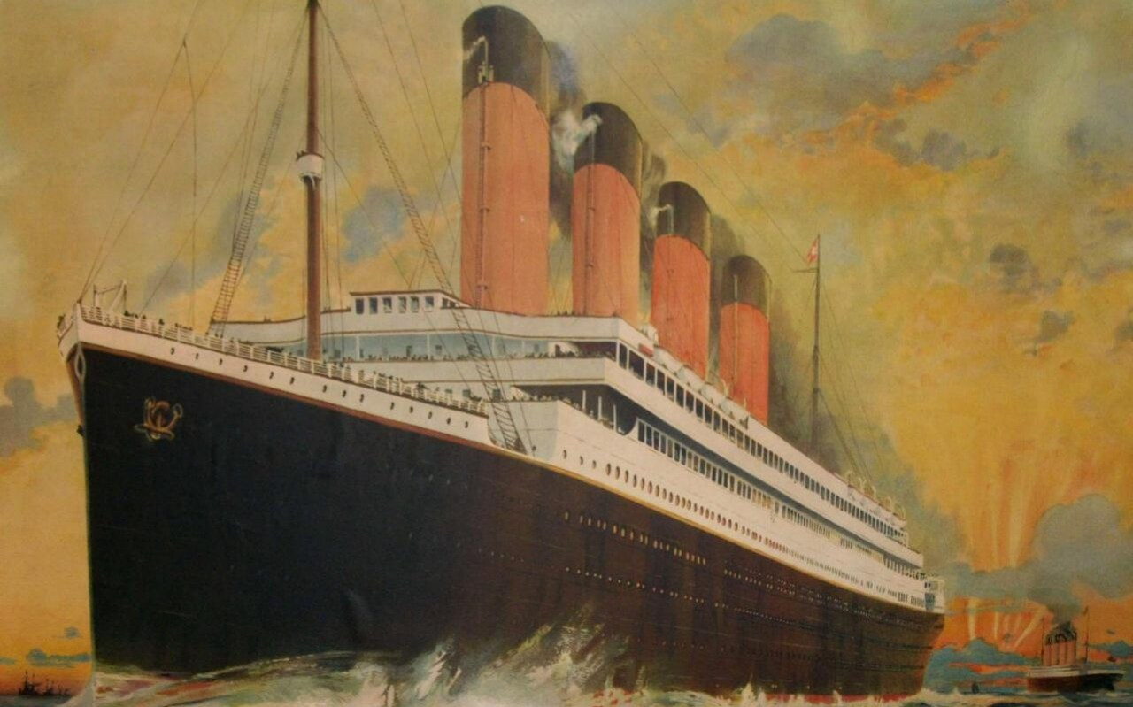
How many people died?
Around about 2,500 people died on the titanic

Slide 11
Thank you for listening
ANY QUESTIONS???????

