Slide 1
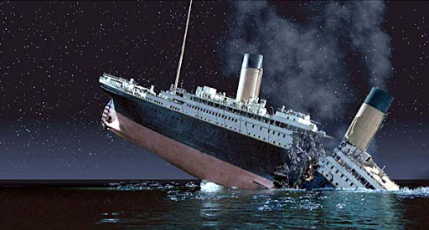
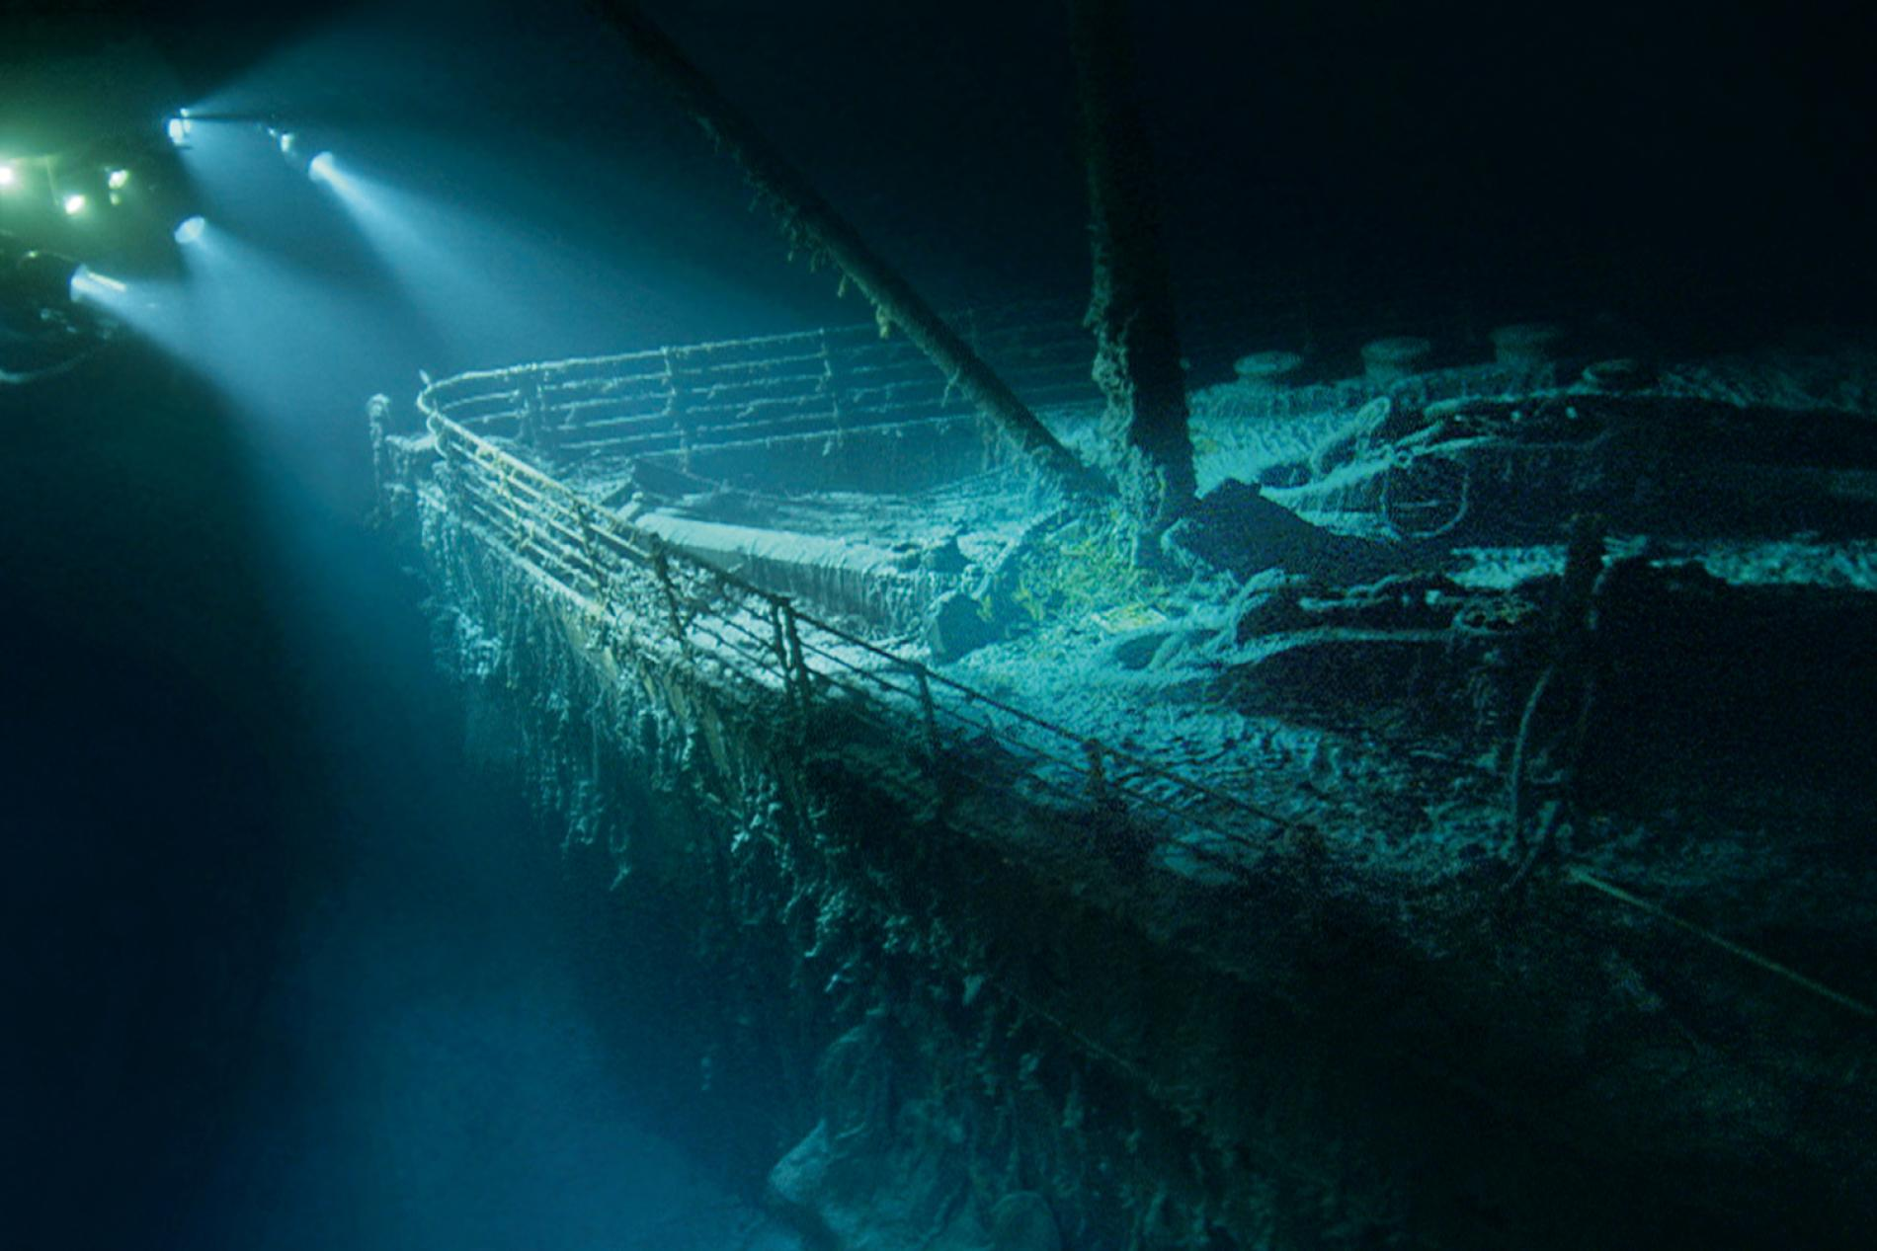
Titanic
And how it sank

Slide 2
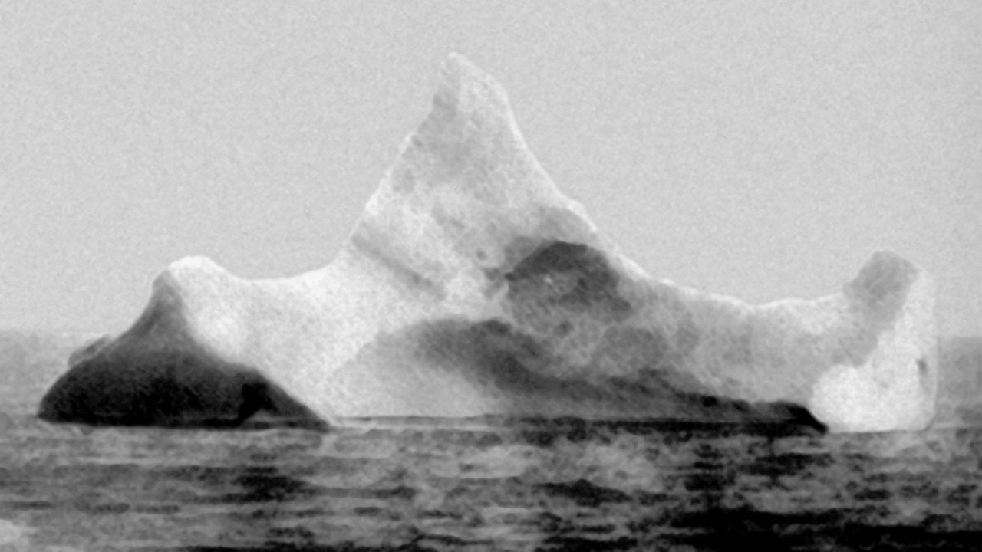
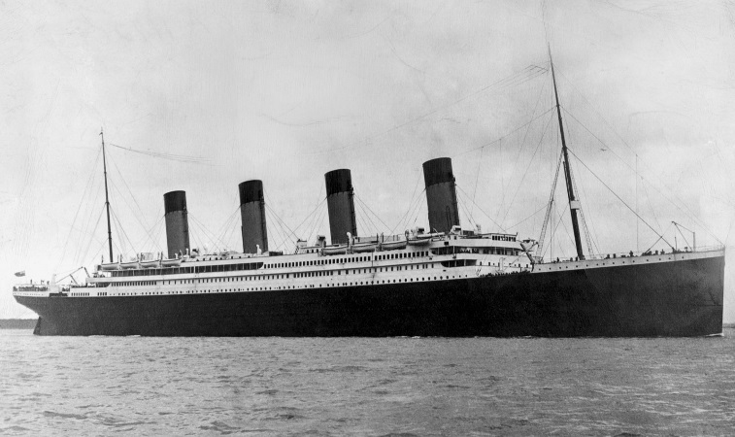
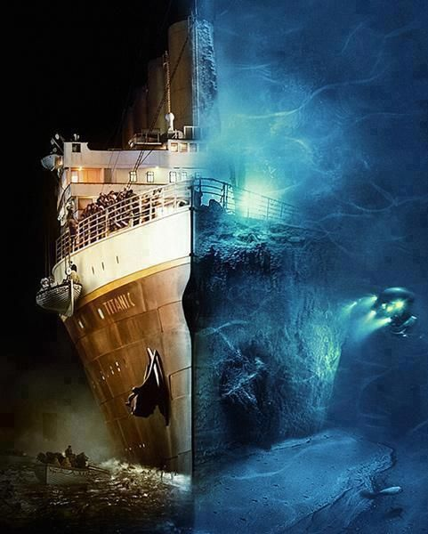
ICEBERG
The Titanic killed 1500 people.
If the Titanic went straight ahead it would not sink

Slide 3
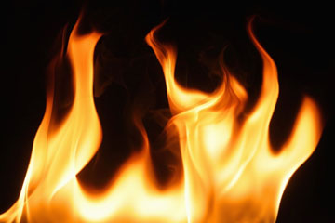
FIRE
Burning for 10 days
The fire started in Belfast
Metal was warping & weakening

Slide 4
3 LITTLE LETTERS
MSG is the letters

Slide 5
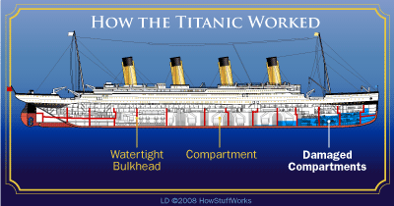
SHORT BULK HEADS
Water would go over the bulkhead that were to short .

